Slide 1
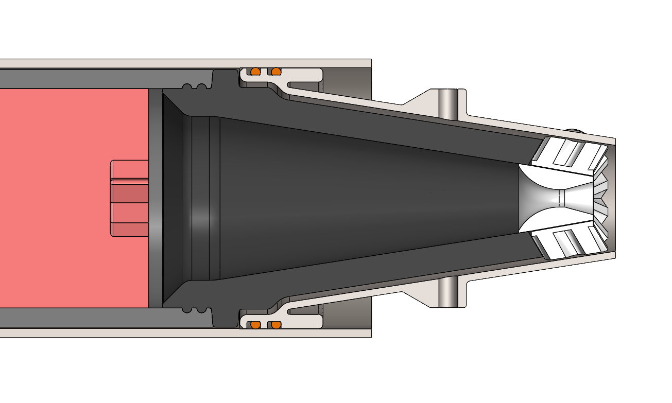
Motor case
Aft closure
Propellant
Aft closure insulator
Nozzle
Nozzle insulator
Instrument port

