Slide 1
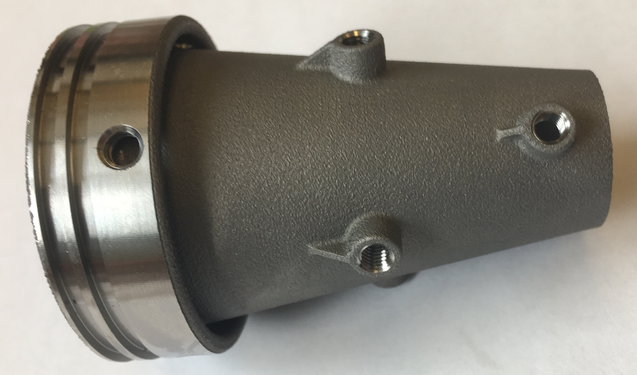
O-ring glands
Instrument ports
Motor case interface hole
~ 8 cm

