Slide 1
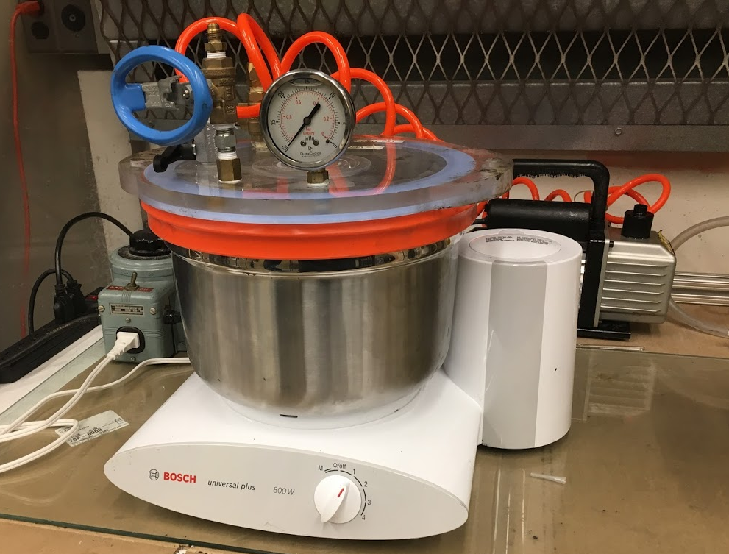
Vacuum lid
Vacuum pump
Mixing bowl
Mixer base

