Slide 1

Emma‘s Small Engines
Case Presentation 3
NEXT:
Agenda

Slide 2
Agenda
Sitemap
Storyboard
User Management
Reports
Sales & Order
Inventory
New Use Case
Repair
Closing
NEXT:
Sitemap

Slide 3
UML
Sitemap
By Kevin

Slide 4
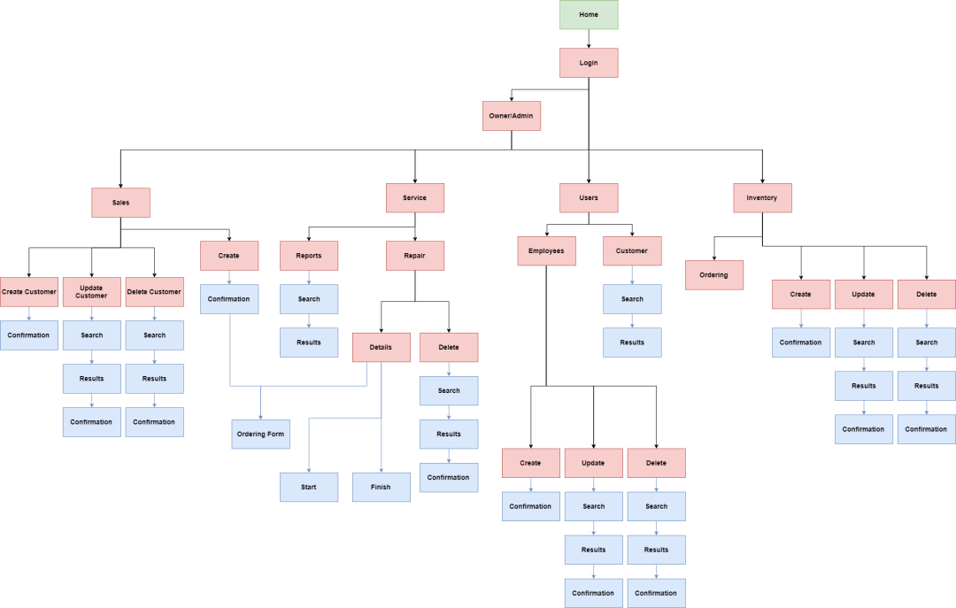
Sitemap
NEXT:
Admin

Slide 5
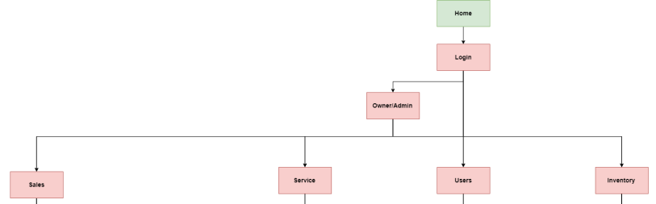
Sitemap 1-1

Slide 6
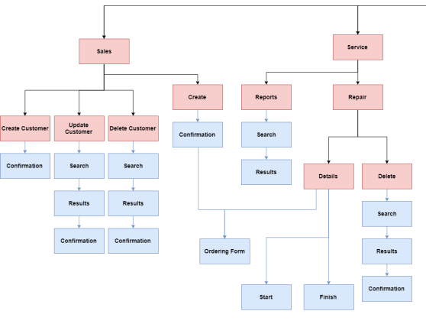
Sitemap 1-2

Slide 7
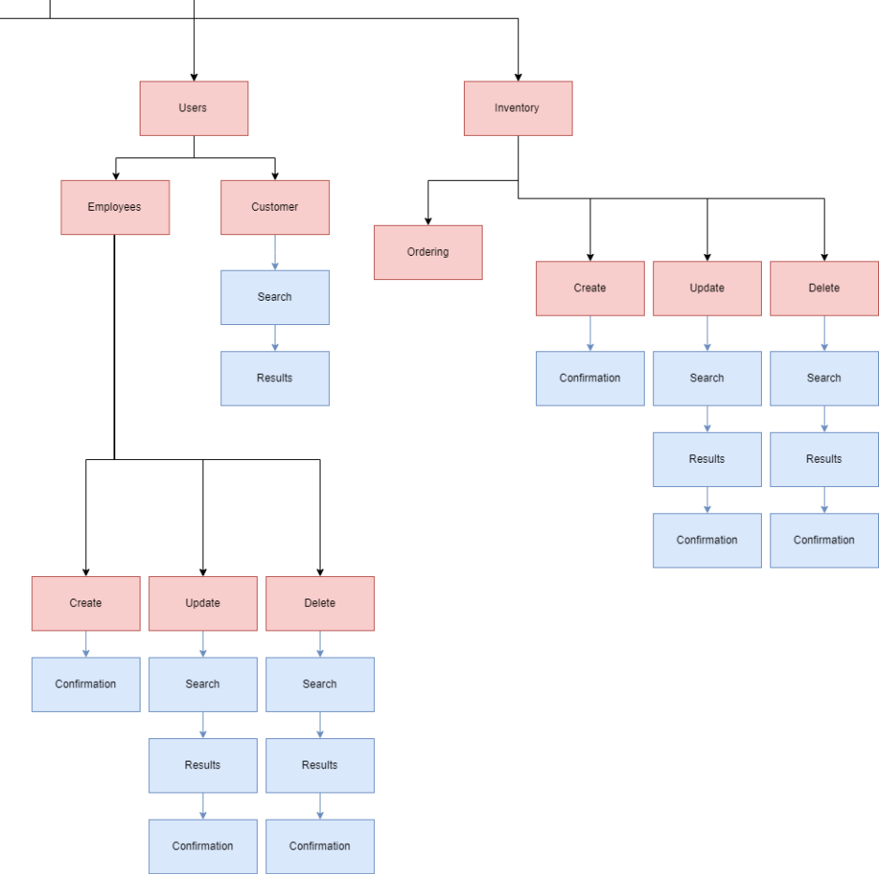
Sitemap 1-3

Slide 8
UML
Storyboard
- User Management
By Yorguin

Slide 9
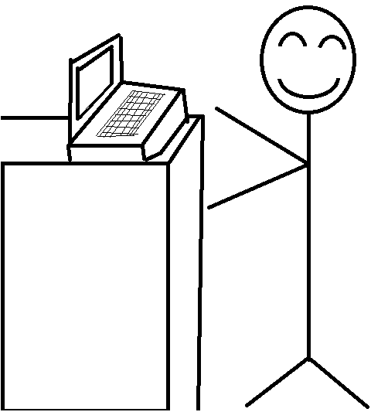

Slide 10
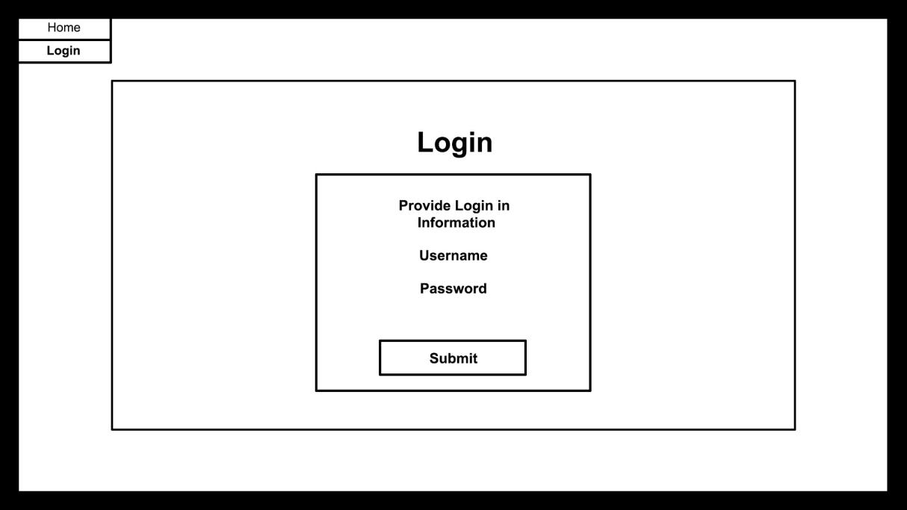
NEXT:
Reports

Slide 11
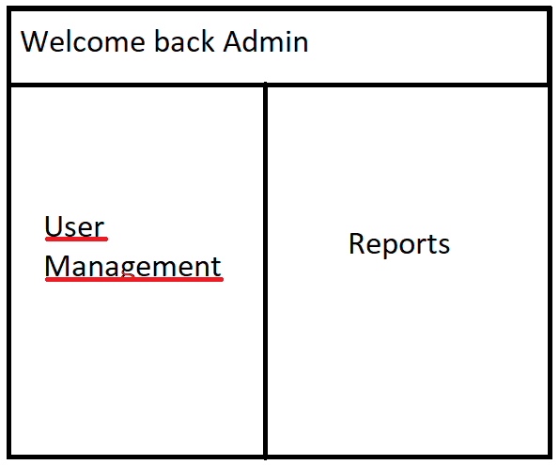

Slide 12
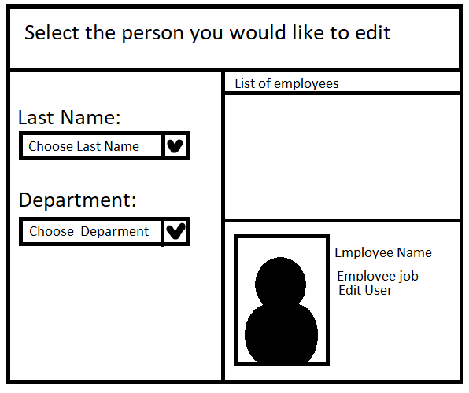

Slide 13
UML
Storyboard
- Reports
By Yorguin

Slide 14
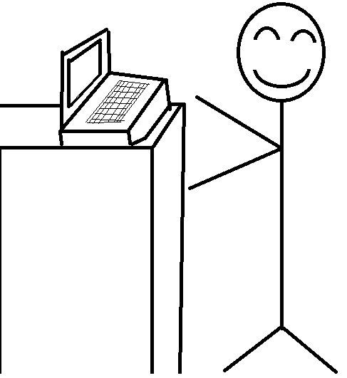

Slide 15
NEXT:
Sales

Slide 16
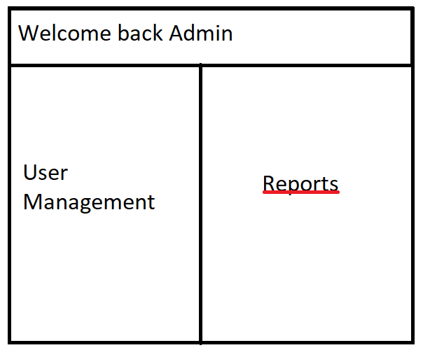

Slide 17
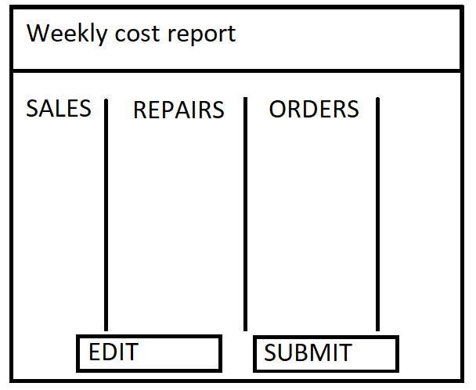

Slide 18
UML
Storyboard
- Sales
By Kanghyun

Slide 19
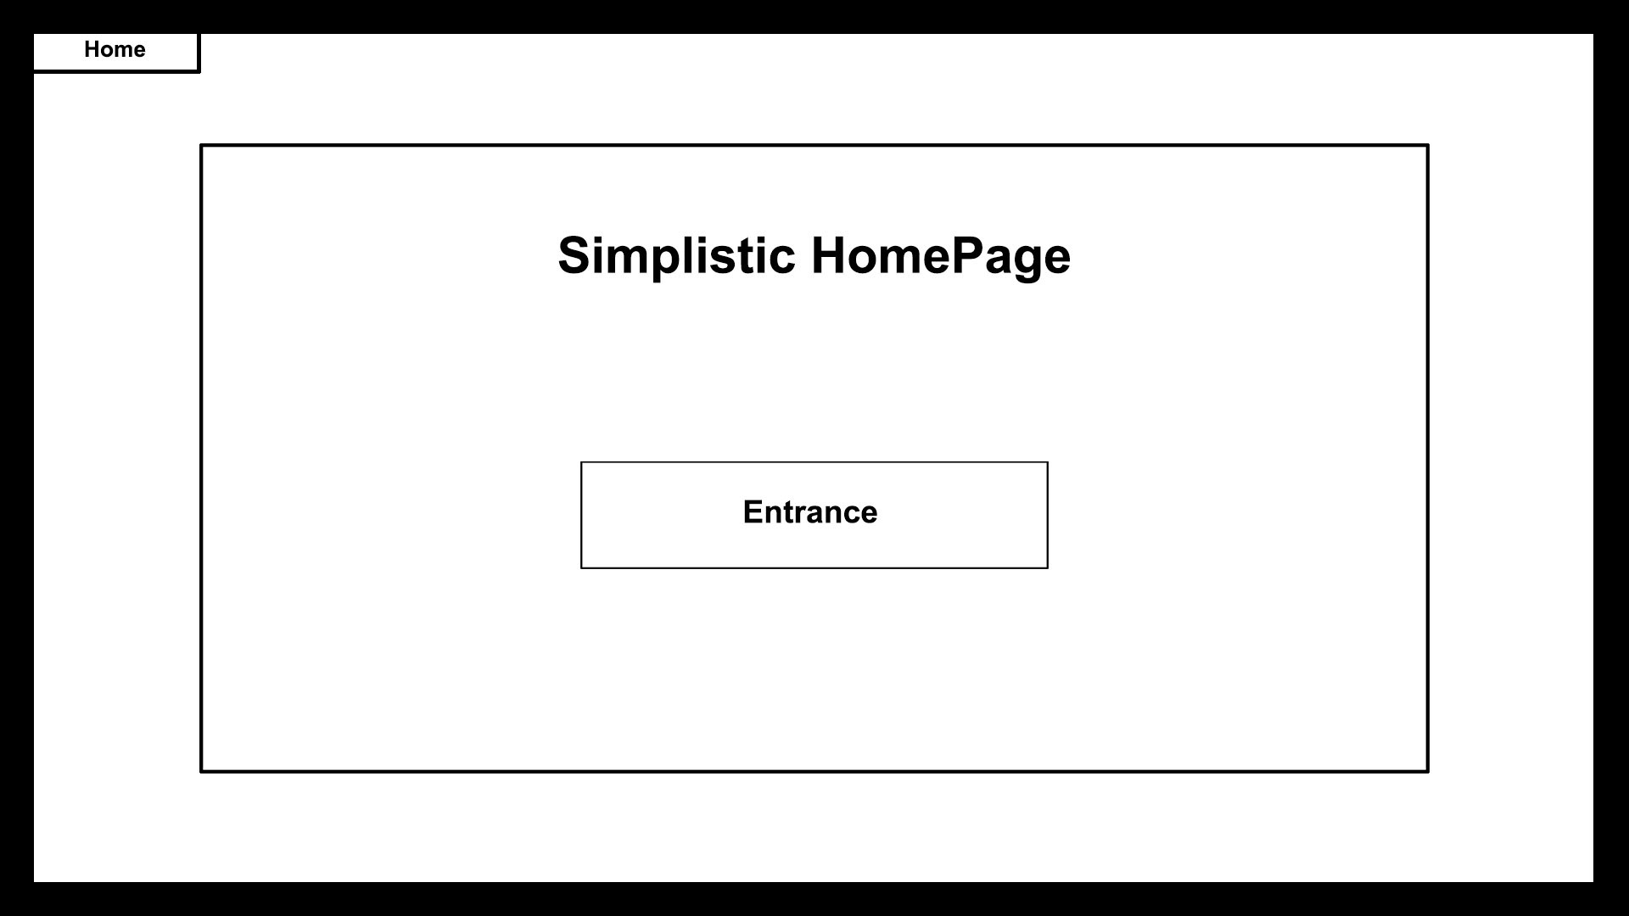
UML

Slide 20

UML

Slide 21
Will
Notes:
This is Will. He is waiting for a customer to come in at work.

Slide 22
How Can I help?
Battery, Please.
Will
Hurry
Notes:
Will is greeting the regular customer(Hurry) and determining customer needs.

Slide 23
Sure, let me check.
Hurry
Will
Notes:
When Hurry is here for purchase, Will checks whether the item is in inventory on the system.

Slide 24
Home
Login
Inventory
Inventory
Battery
In Stock
Battery : 9
Product #060-1758-8
Will
Notes:
Will checks inventory of the battery on the system.

Slide 25
Home
Login
Inventory
Inventory
Battery
In Stock
Battery : 8
Product #060-1758-8
Will
Notes:
Will updates quantity of the battery on the system.

Slide 26
Will
Notes:
Will go and pull the item from the shelf.

Slide 27

Home
Login
Update Customer Info
Sales
Customer
H
Harry
Harper
Hector
Hellen
Hill
Hunter
Hurry
Purchase
Service
Will
Notes:
Will calls up customers information on the system and updates.

Slide 28
Home
Login
Purchase
Sales
Customer
Hurry
Purchase History
Print receipt
Will

Slide 29
Here you are.
Thanks.
Will
Hurry
Notes:
Complete transaction.

Slide 30
EXIT
♪
♪
♪
♬
Hurry
NEXT:
Order
Notes:
Customer leaves happy.

Slide 31
UML
Storyboard
- Order
By Kanghyun

Slide 32
How Can I help?
Engine, Please.
Will
Hurry
Notes:
Will is greeting the regular customer(Hurry) and determine customer needs.

Slide 33
Will
Notes:
When Hurry is here for purchase, Will check whether the item is in inventory on the system.

Slide 34
Home
Login
Sales
Inventory
Engine
Low in Stock
Engine : 3
Item #060-6405-8
Will
Notes:
Will checks inventory of the engien on the system.

Slide 35
Home
Login
Update Customer Info
Sales
Customer
H
Harry
Harper
Hector
Hellen
Hill
Hunter
Hurry
Purchase
Service
Will
Notes:
Will calls up customer information on the system.

Slide 36
Will
Notes:
Will goes and pulls item from the shelf.

Slide 37
Home
Login
Purchase
Sales
Customer
Hurry
Purchase History
Print receipt
Will
Notes:
Will updates Customer infomation on the system.

Slide 38
Here you are.
Thanks.
Will
Hurry
Notes:
Complete transaction.

Slide 39
EXIT
♪
♪
♪
♬
Hurry
Notes:
Customer leaves happy.

Slide 40
Home
Login
Inventory
Inventory
Engine
Low in Stock
Engine : 2
Item #060-1758-8
Will
Notes:
Will updates inventory and gets a message saying it runs low in stock..

Slide 41
Home
Login
Inventory
Engine is low in Stock
Please order more
Inventory
Engine
Low in Stock
Engine : 2
Send Info
Order Later
Item #060-1758-8
Will
Notes:
Will updates inventory and gets a message saying it runs low in stock..

Slide 42
Home
Order Form
Login
Sales
Order Number:
Create
Engine
Order Info.
Low in Stock
Item Price:
Engine QTY : 5
Info.:
Product #060-1758-8
Info.:
Confirm
Cancel
Will
Notes:
Will completes the order form and complete the order.

Slide 43
Home
Login
Order Form
Sales
Order has been completed.
Create
Order Number:
Order Form
Engine
Order Info.
Low in Stock
Item Price:
Engine QTY : 5
Info.:
Product #060-1758-8
OK
Info.:
Confirm
Cancel
Will
NEXT:
Inventory
Notes:
Will checks inventory of battery on the system.

Slide 44
UML
Storyboard
- Inventory
By Kevin

Slide 45
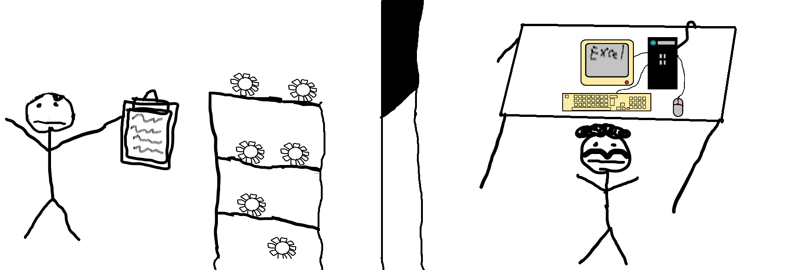
UML

Slide 46
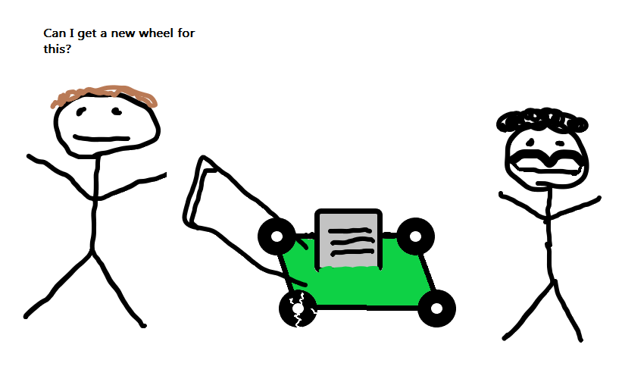
UML

Slide 47
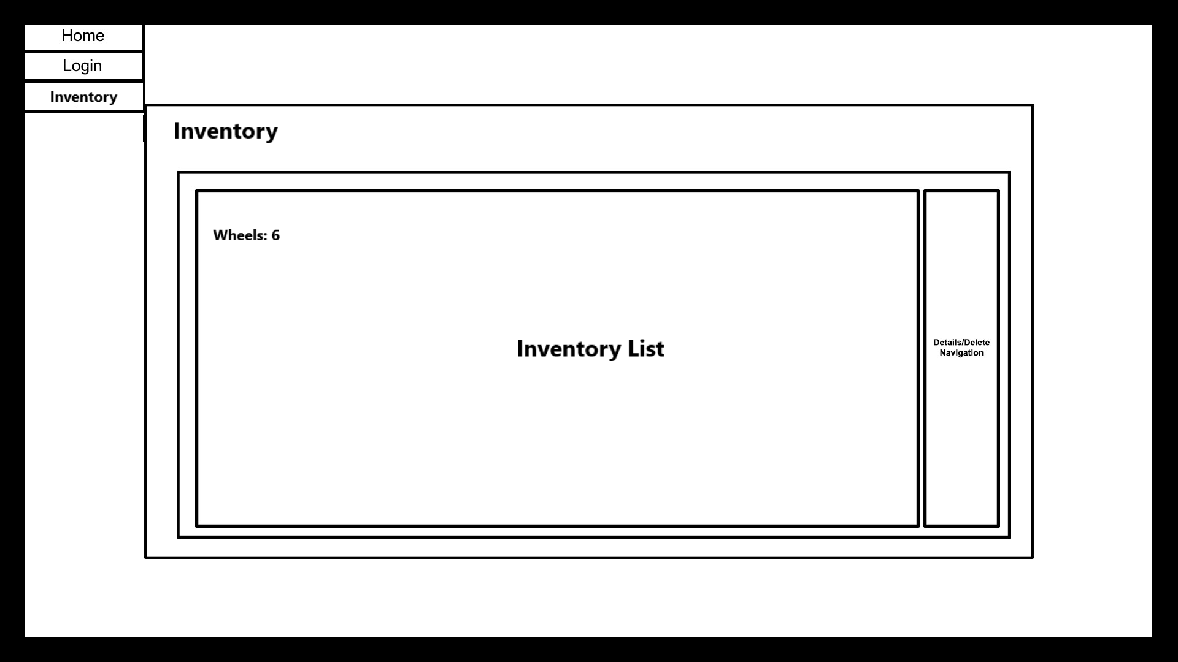
UML

Slide 48
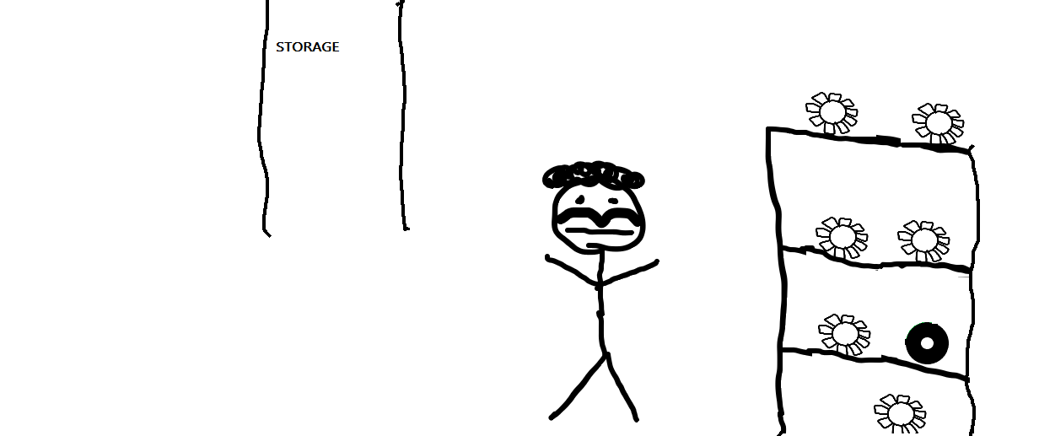
UML

Slide 49
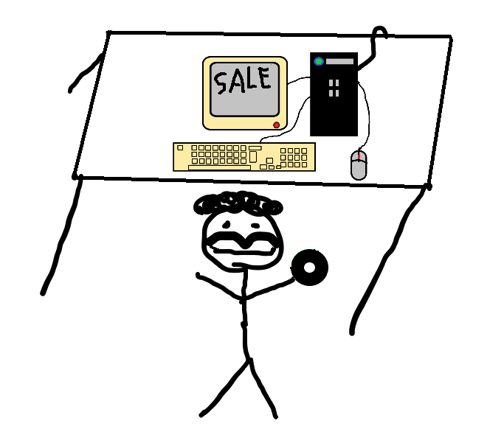
UML

Slide 50
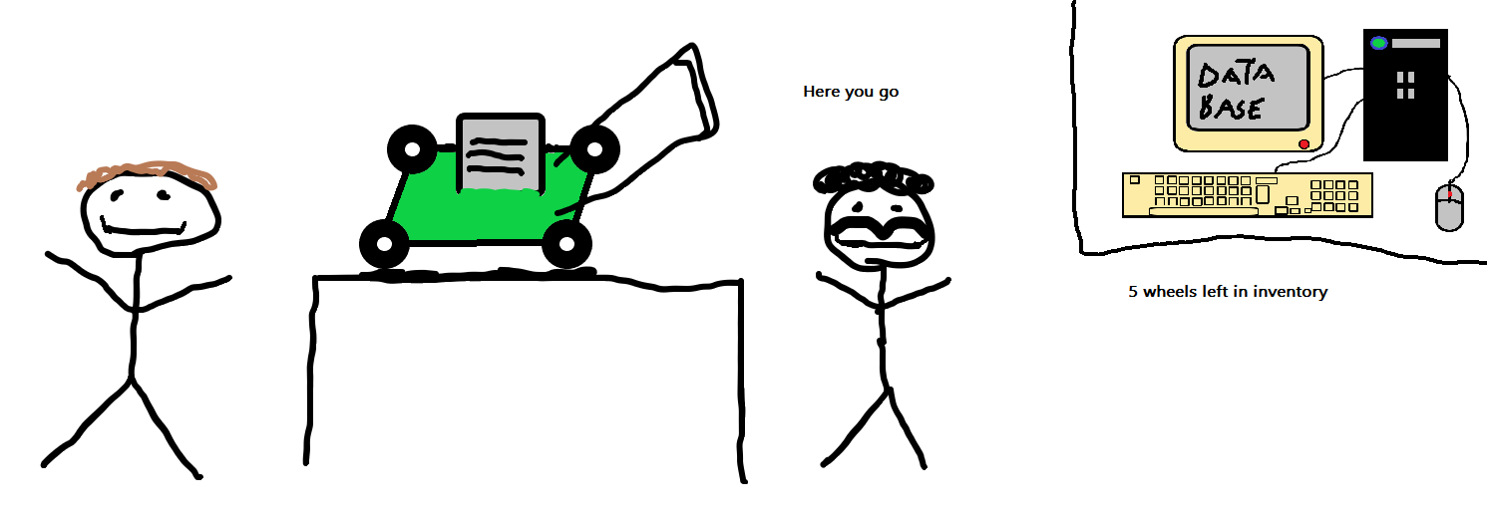
UML
NEXT:
Repair

Slide 51
UML
Storyboard
- Repair (In stock)
By Ryan

Slide 52
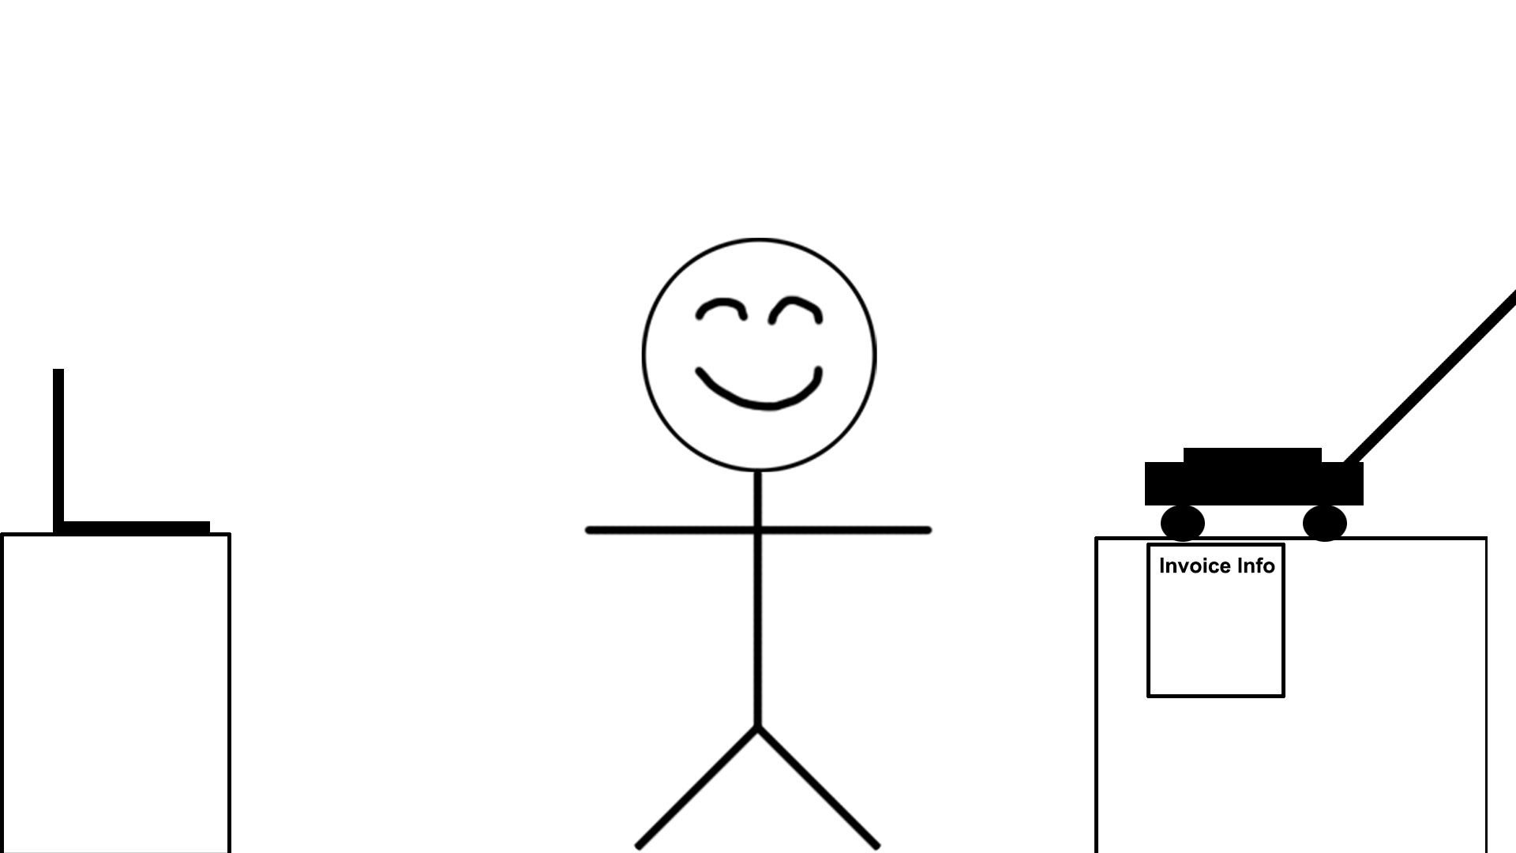
UML

Slide 53
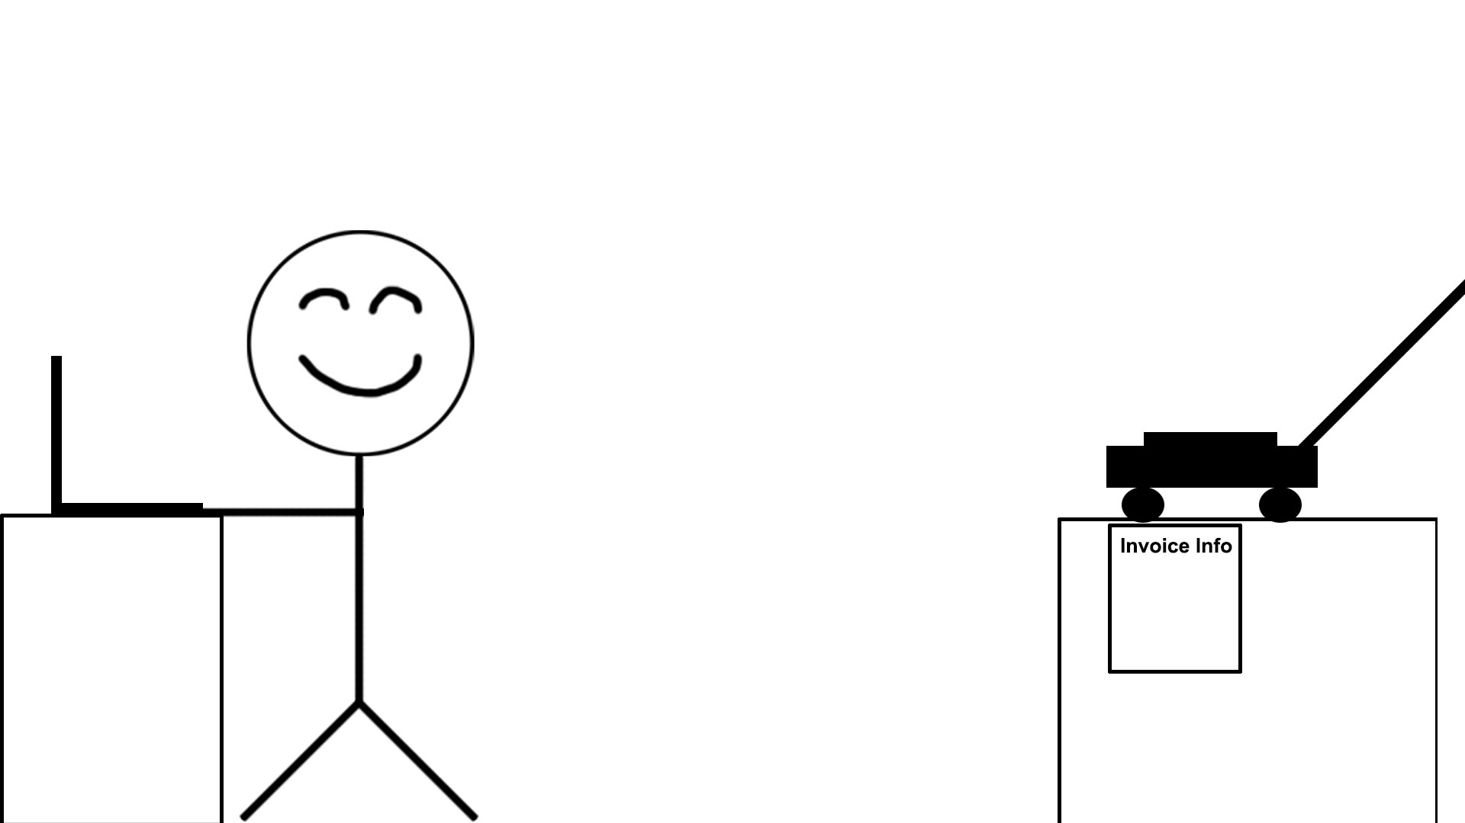
UML

Slide 54
UML

Slide 55
UML

Slide 56
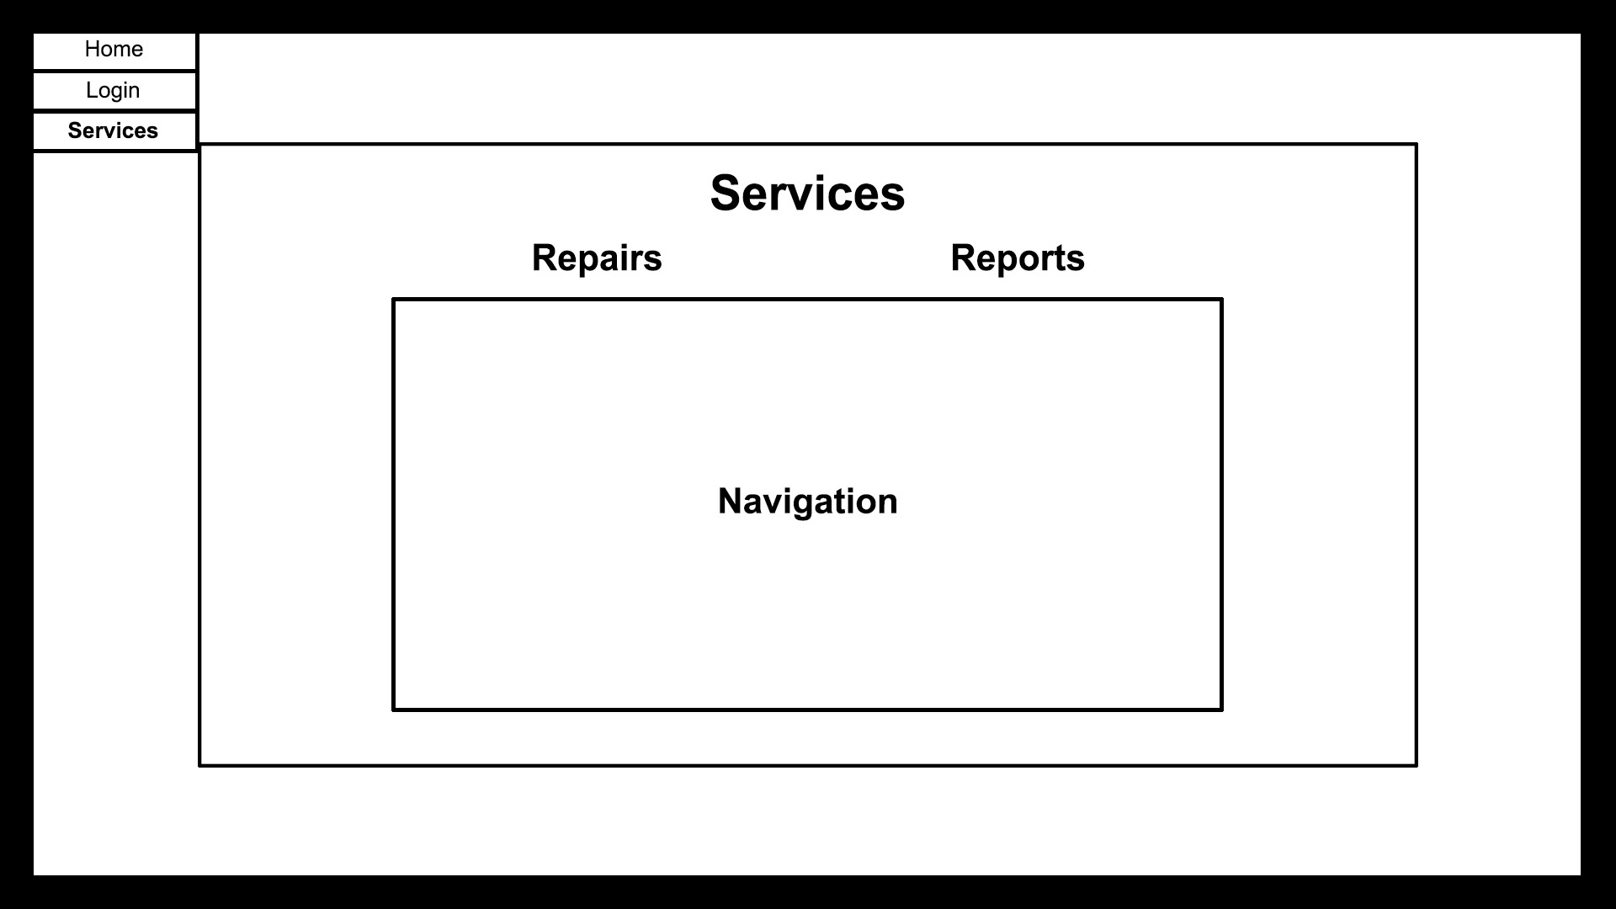
UML

Slide 57
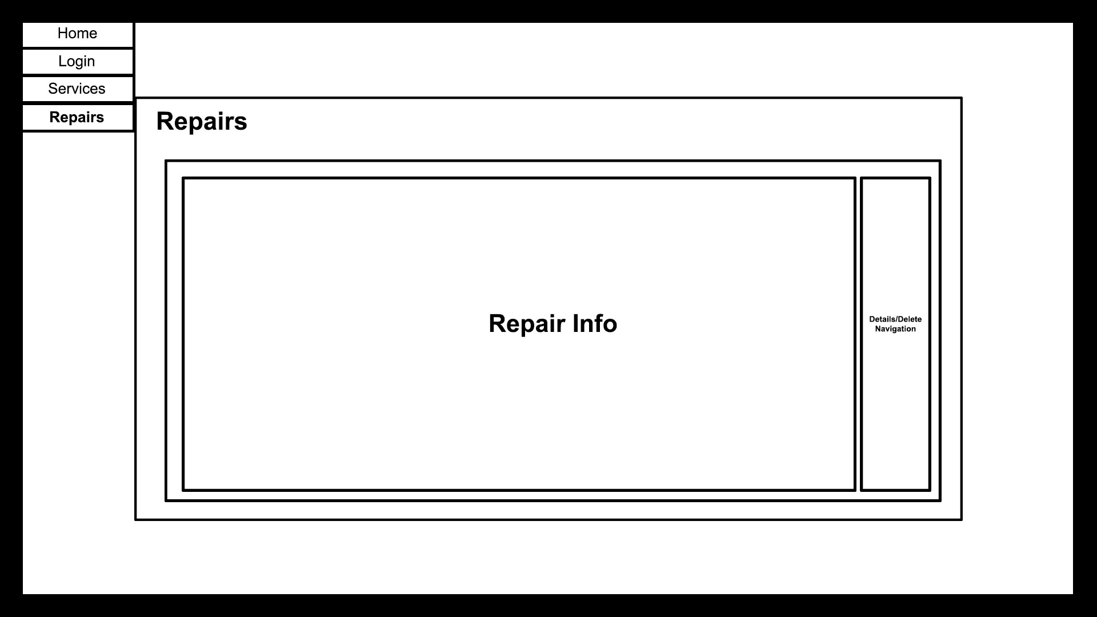
UML

Slide 58
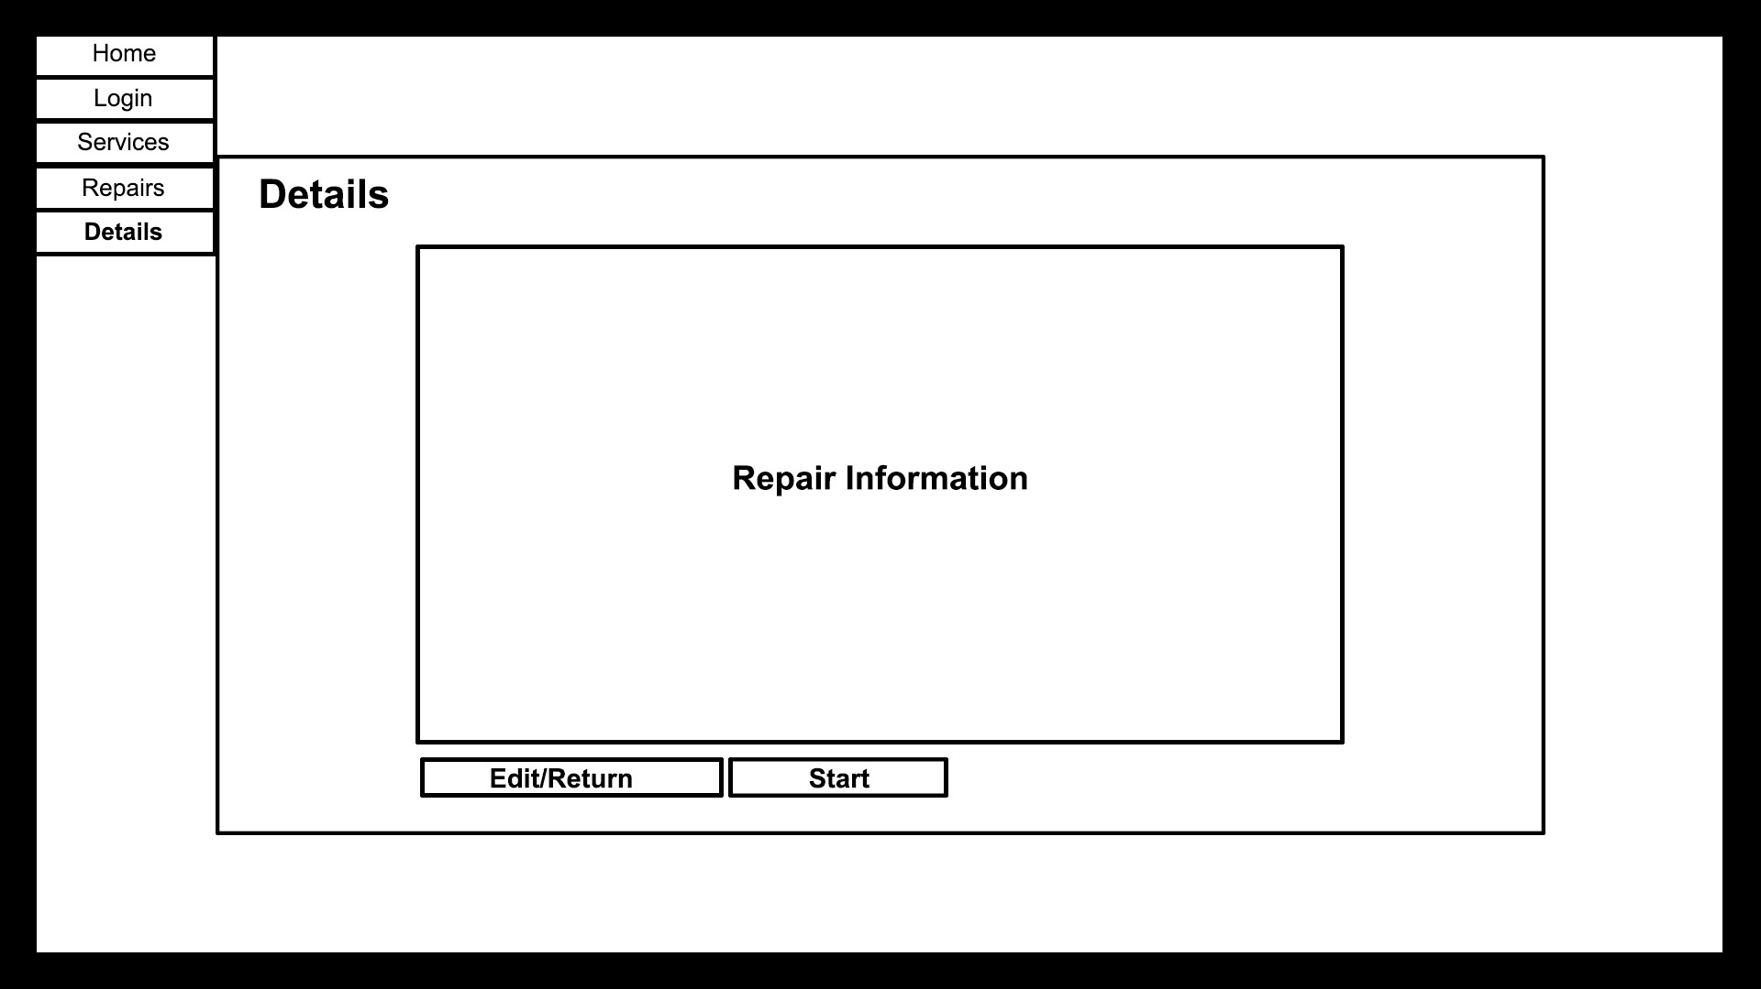
UML

Slide 59
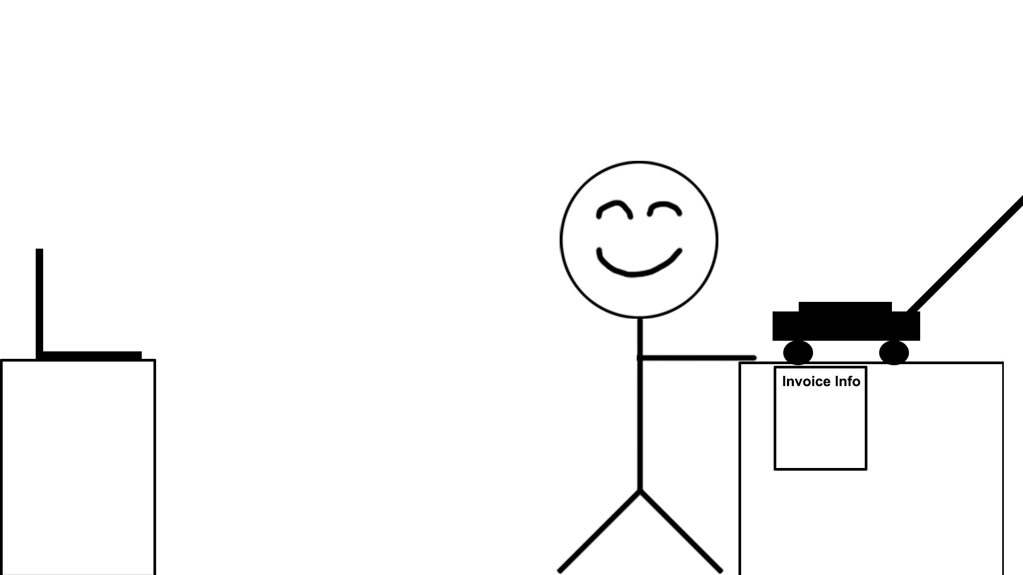
UML

Slide 60

UML

Slide 61

UML

Slide 62
UML
Storyboard
- Repair (Out of stock)
By Ryan

Slide 63
UML

Slide 64
UML

Slide 65
UML

Slide 66
UML

Slide 67
UML

Slide 68
UML

Slide 69

UML

Slide 70
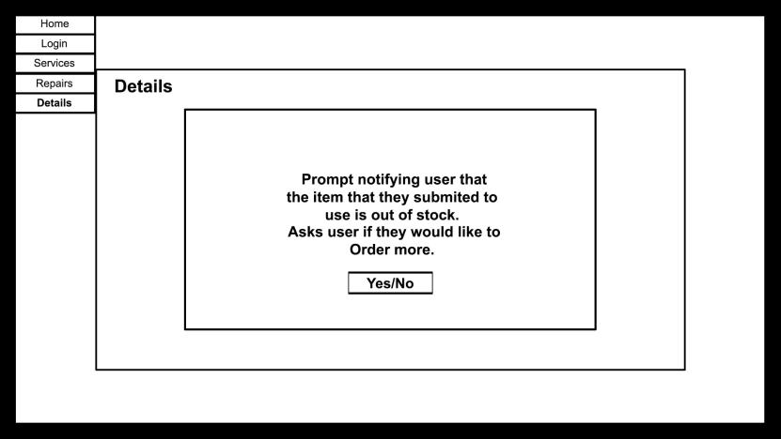
UML

Slide 71
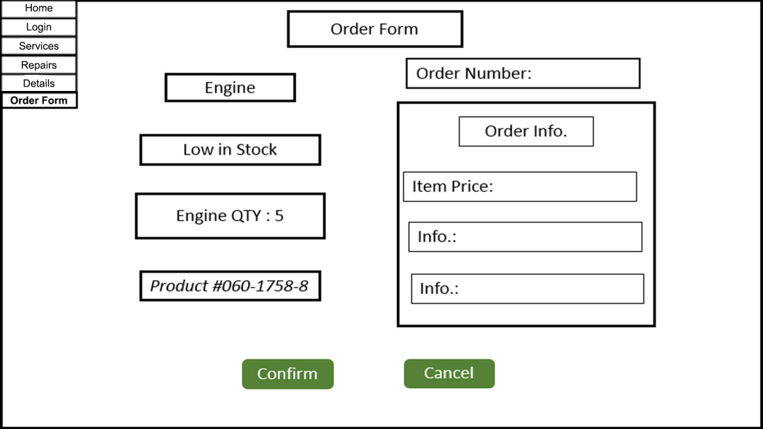
UML
NEXT:
Closing

Slide 72
UML
Order has been completed.
OK
NEXT:
Closing

Slide 73
Closing

