Slide 1


Slide 2
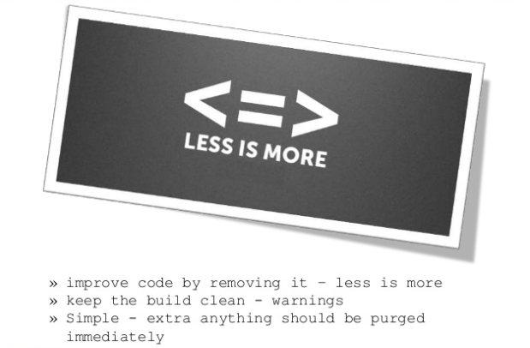
Mission Statement
“ Code harder until it gets simpler.”

Slide 3
Ryan Chrysler
Experience & Skills:
I am currently enrolled in the Computer Programming Analyst (CPA) Program at Niagara College and have been for the past year. During my time at Niagara College I have learned a variety of different skills and coding languages. These languages/skills include HTML, CSS, C#, Javascript ETC. The program has also given me plenty of experience creating SQL Databases and NoSQL databases as well as taught me how to apply those databases to a variety of different applications.
Strengths:
One of my strengths is design, I am always trying to make the interface of any program I work on as pleasant to use as possible, keeping the interface simplistic as well as user-friendly design. I often do my own graphics for icons or any images that I will use in any given project.
Out of the list of skills mentioned I have a mild preference towards programming in C# and SQL databases. With that being said I take more of an interest in those two parts of programming so I would say that I am better practiced in those areas and make more of a point to practice those areas. Overall I take a high interest in learning all aspects of programming and I am comfortable with all the skills mentioned above and continue to practice as well as study each with a high interest of improving my overall skill set in all areas of programming.
Given my strengths/interest in design and programming, as well as my experience and skills that I have acquired attending the Computer Programmer Analyst Program at Niagara College, I believe that I can be a useful asset to our team moving forward with future projects.

Slide 4
Sebastian van der Est
Skills:
-Programming in Python, C, C#
-Scripting in JavaScript, AppleScript and Tcl/Tk
-UI development in HTML/Css, ASP, Windows Forms, and Tcl/Tk
-Database development in SQL Server and MongoDB
Experience:
I have to major development projects under my belt. In the fall of 2015, I worked in a chemistry lab at Brock University to modernize a program called ESP, used to run experiments and analyze the results. This involved changing some of the back end optimizations, which were still set up as if the program were running on a 30 year old computer, and developing a graphical user interface for the program, which previously ran from the command line.
Since June of this year, I have been working for an organization called Youth Resources Niagara, who run a number of group homes for at risk youth in the criminal justice system. For YRN, I am developing a piece of custom database and case management software. This process is on going.

Slide 5
Kanghyun Jo
Strengths:
-Web Design
-Photoshop
-SQL Server
Experience:
-Craftsman Information Equipment Operation Certificate
-2 years in Signal department in Army
-I Have built several desktop PCs

Slide 6
Kevin McGrinder
Skills:
-Competent in Python, C#, JavaScript, Java and C++
-Knowledge in algorithms, data structures, object orientated design and artificial intelligence
-Great at independent work
-Uses .NET and SQL Server in many programs
Experience:
-Created Java applications with GUI for both my local library and family members
-Second year Niagara College Student
-Did one year at Brock

Slide 7
Yorguin Murillo
Skills:
-C#
-SQL
Experience:
I’ve been in the programming world since October 2017. I’ve been very interested in this and always trying to find a way to better at it. I have experienced the world as I’ve lived in different parts of the world. I like to see the things from different perspectives to decide which one will be better.

Slide 8
Roles
Main Designer: Ryan Chrysler
Team Lead: Sebastian van der Est
Database Designer: Kanghyun Jo
Main Coder: Kevin McGrinder
Documenter: Yorguin Murillo

Slide 9
Contract - Meetings
Meetings are scheduled every Wednesday right after class for 2 hours. If one of us cannot attend, we will need to discuss if we need reschedule the meeting or proceed with the meeting and let the other person know what we have discussed in the meeting.

Slide 10
Contract - Responsibilities
Each member of the group is accountable for their own part and will be accountable of everything accorded in each meeting. Failure to do this will be affected in the peer evaluation mark.
When deciding the work breakdown if someone disagrees with the team, this person will need to give their ideas and convince the whole group why this idea would be beneficial for the group.
The deadline to present the work to the group is Monday and the person assigned will take a look at all the material and decide if we need an “Emergency meeting on Tuesday”

Slide 11
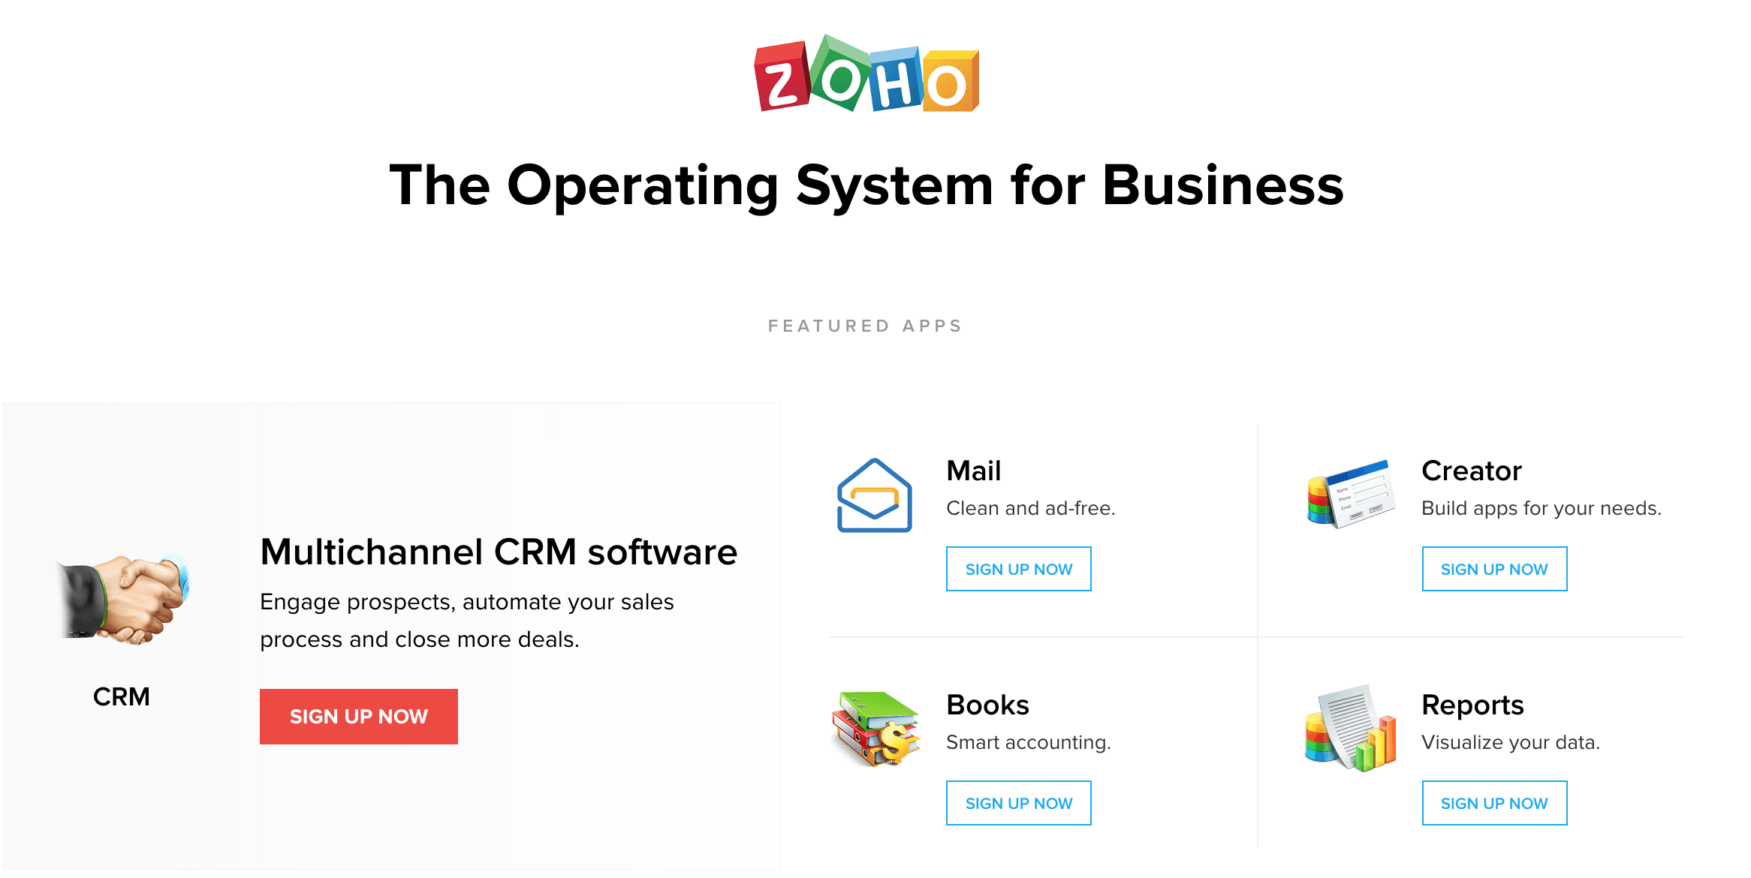
Existing Software

Slide 12
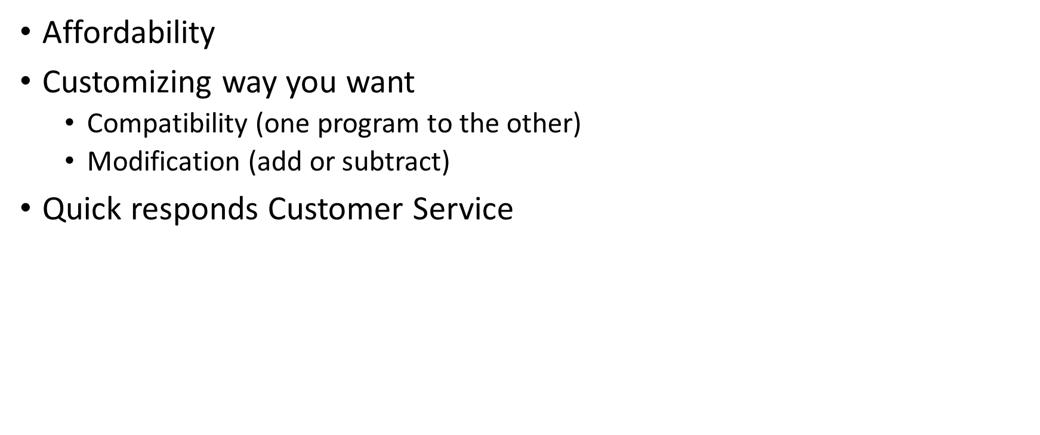
Why Choose Us?

Slide 13
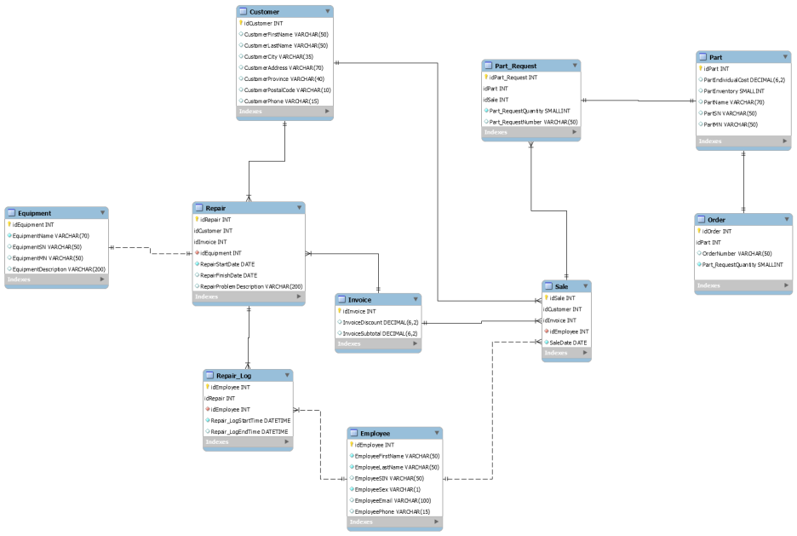
Data Model

Slide 14
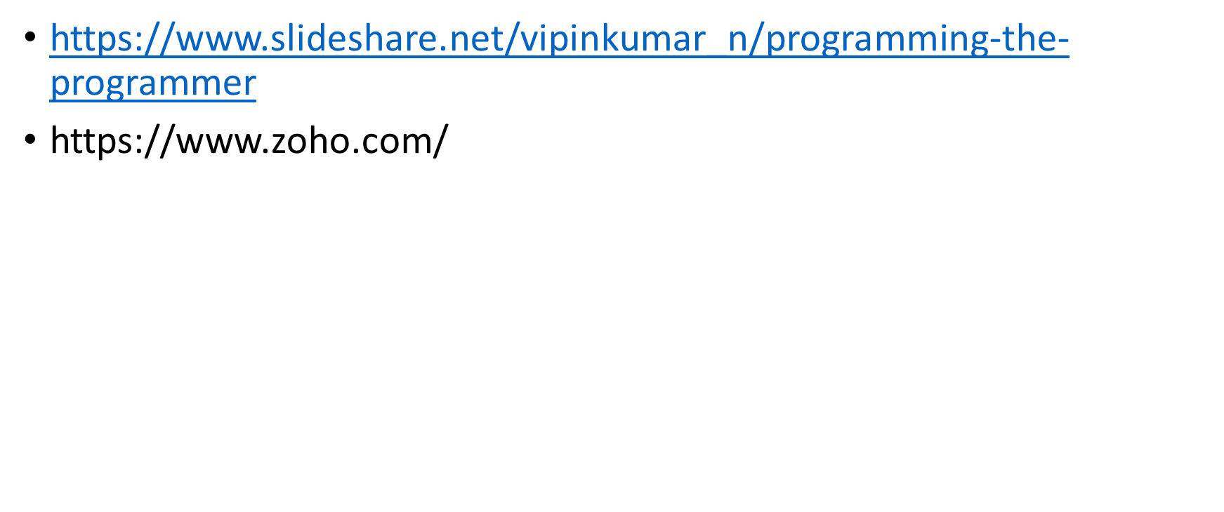
References

