Slide 1

Emma‘s Small Engines
Case Presentation 2
NEXT:
Agenda

Slide 2
Agenda
Goals
Business Rules
UML Diagrams
Database Diagram
Closing
UML Diagrams
Sales
Ordering
Admin
Technicians
Owner
NEXT:
Goals

Slide 3
Goals
Streamline the process
Eliminate errors
Reduce cost
Reduce stress
NEXT:
Business Rules

Slide 4
Business Rules
2% towards staff party
Ordering and Sales in the same system
Order number to find an order and complete delivery.
Web search with partners to find an item.
Start Stop button to record time and to look at previous times for specific jobs.

Slide 5
Business Rules Continued
Previous job information will be kept
Record customers personal information
Warranty reports
Total 2% of the week
Weekly costs ( total sales and repairs, shipping and receiving totals)
Items to be order
Warranty report for specific company
NEXT:
Sales

Slide 6
UML
Sales
By Kang

Slide 7
Goals for Sales (Wendy and William)
Save typing time
Drop Down List for type of repairs
Call up customers’ information
Store repeat customers’ personal / equipment info
Automated inventory system
Real-time numbers for inventory
Notification for low inventory

Slide 8

Sales – Case Diagram
Sales System
Remember type of repairs
Call up
Personal Info
Save
Sale Record
Call up
Equipment
Info
Load
Sale Record
Sales
Send
Sale Record
Track
Inventory
Notify
Low Inventory

Slide 9
Sales – Activity Diagram
Sales Representative
Parts and Order
Parts and Order
Greeting
Determine Needs
Save Info
Purchase
Repair
Check
Inventory
Complete
Two Repair Forms
Repair
yes
no
Order
Contact
Customer
Receive
Order
Give to
Customer
Complete
Sale

Slide 10



Inventory System
Current System
End of Week
Call out
Numbers
Record
Numbers
New
Stock
Modify
Numbers
Add 10% markup
Low/
None
Fill out
Request Sheet
Send
Request Sheet
To Parts and Ordering
Place
Items
New System
Any day of Week
Sell or Receive
Item
Modify Numbers
on System
One Click to
Send Info.

Slide 11
Sales - Hidden Potential
Automated Adding Markup System
Send Request Form / Sale Record through the System
(No more print out/ fill out documents)
Online Sign Up / Ordering System – Online shopping
NEXT:
Ordering

Slide 12
UML
Ordering
By Kevin

Slide 13
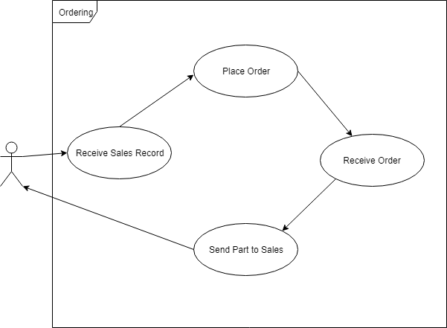
Ordering – Case Diagram

Slide 14
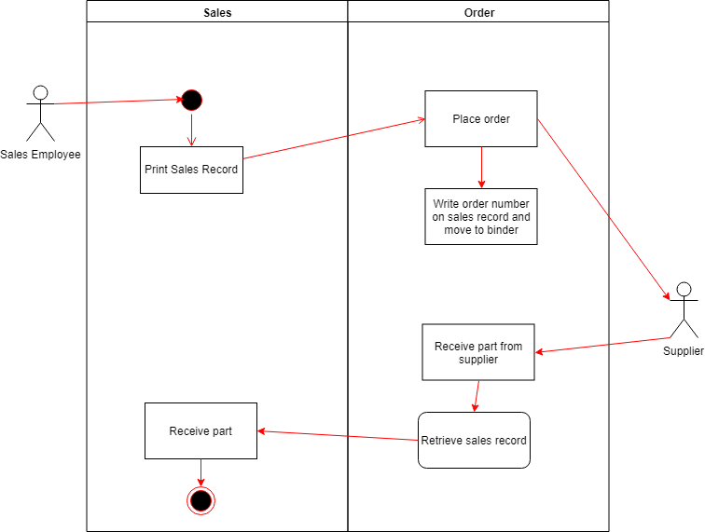
Ordering – Activity Diagram
NEXT:
Admin

Slide 15
UML
Admin
By Yorguin

Slide 16
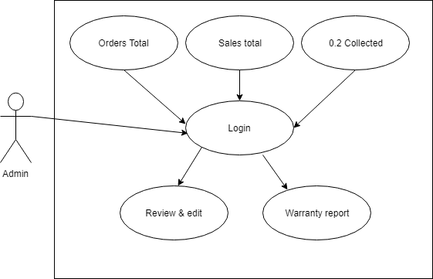
Admin – Case Diagram

Slide 17
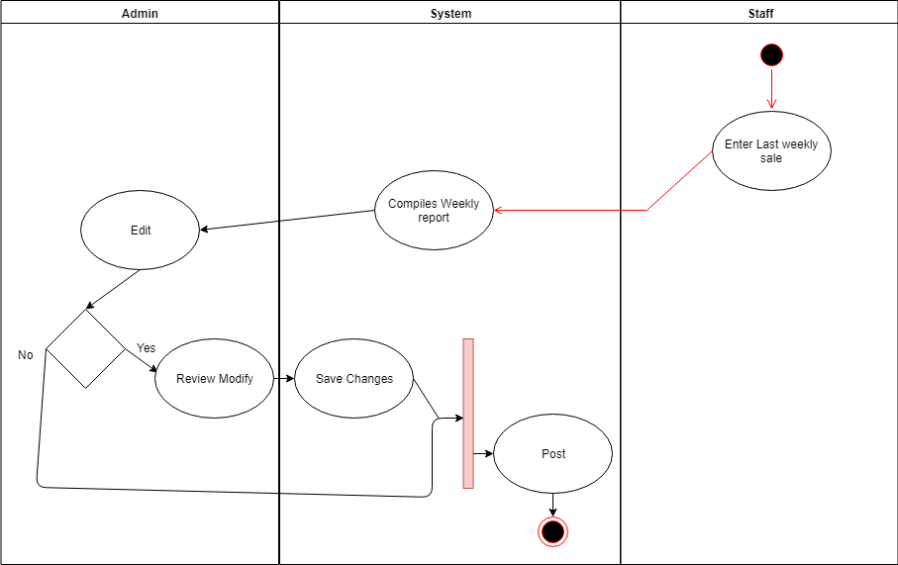
Admin – Weekly Report

Slide 18
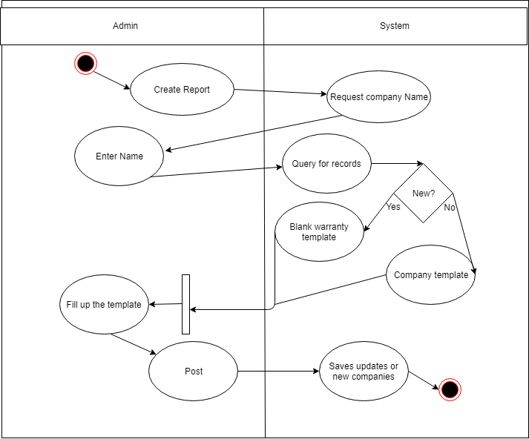
Admin – Warranty Work
NEXT:
Technicians

Slide 19
UML
Technicians
By Ryan

Slide 20
Technicians – Case Diagram
Technician
Begin Repair Request
Finish Repair Request
Login
Details
Cancel Repair Request

Slide 21
Technicians - Activity Diagram
Technician:
Login
System:
Provides Repair Request Form
Provides Warranty Info
Stores Warranty info
Starts Repair
Checks current time
Finishes Repair
Provides how long the repair took
Returns Repair Request to Sales

Slide 22
Technicians – Hidden Potential
The system also could:
Record customers info ( for return customers)
Record details regarding past repairs (Who, when)
Provide stats on who made the repair, what parts were used, what the most common parts used are, ETC.
NEXT:
Owner

Slide 23
UML
Owner
By Sebastian

Slide 24
Owner – Diagrams
No Diagrams because you’ve already seen them
Incorporates functions of all other roles
NEXT:
Database Diagram

Slide 25
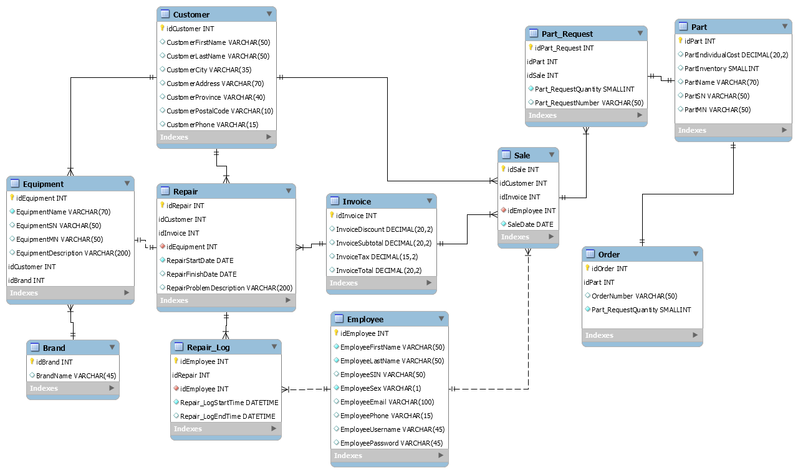
Data Model

Slide 26
Closing

