Slide 1
E-Vtol Aircraft Simulation
Kodiak North

Slide 2

Initial Thoughts
Excited to write code, but need to plan first
Brainstorm
Equations for flight time / charge time
Understand the problem
List of requirements

Slide 3
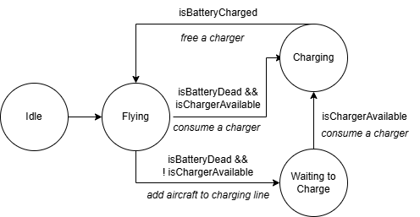
Requirements and Important Considerations
Testing the code – 1, 2, and 3 hour simulation tests
Defining the Aircraft class
Loop time step
Decision driven by Echo
State machine

Slide 4
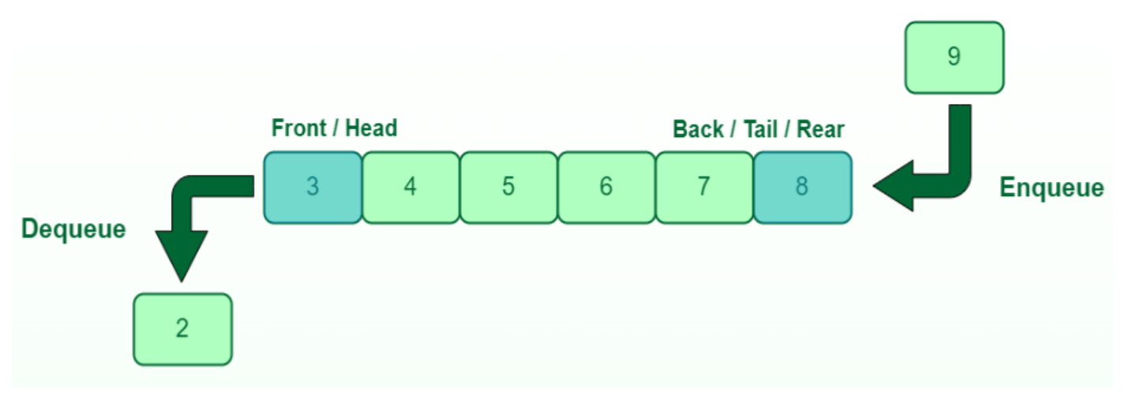
Requirements and Important Considerations Contd.
Queue of aircraft in line to charge
Assigning aircraft to queue of available chargers
Recording metrics required to calculate output
Minimize memory usage
Minimize the software to write
Notes:
Ideas more complex now but simplified in planning phase

Slide 5

Create a Plan and Prioritize
C++ Hello World
Concrete definition of the Aircraft class
Start small with one Alpha aircraft.
Incorporate one charger.
Two vehicles and two chargers.
Three vehicles and chargers. Test every vehicle type.
Increase aircraft array from 3 to 10. Create the charging line.
Random ID generation, and fault generation.
Calculate averages and totals, and write output to file.
Notes:
Touch on what was simplified. One aircraft class. Charger number. Charging line.

Slide 6

Unit Tests
Tracing state transitions
Random ID generation test
Fault generation test
Output calculations test
Notes:
Verify all IDs generated. Verify fault gen percent chance is working.

Slide 7

Key Successes
Time spent planning VS writing code
Following the plan
Test driven development
Catching mistakes right away
Minimized SW written
Short files and function sizes

Slide 8

Improvements
More planning / better organized notes
Approach to test driven development
Random ID generation – retrying if it fails
Testing for NULL pointers in function arguments
Naming conventions
Workspace cleanliness
Notes:
Hard 1 week deadline

Slide 9

Questions

Slide 10
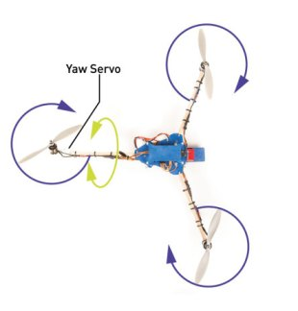
Tricopter yaw

