Slide 1
E-Vtol Aircraft Simulation
Kodiak North

Slide 2

Initial Thoughts
Excited to write code, but need to plan first
Brainstorm
Equations for flight time / charge time
Understand the problem
List of requirements

Slide 3
Requirements and Important Considerations
Testing the code – 1, 2, and 3 hour simulation tests
Defining the Aircraft class (Parent and child classes)
State machine
Loop time step
Decision driven by Echo
Queue of aircraft in line to charge
Assigning aircraft to chargers (queue of available chargers)
Recording metrics required to calculate output
Minimize memory usage
Total flight duration used to calculate total distance traveled
Minimize the software to write
Some of these ideas were more complex now, but simplified later as the plan developed.

Slide 4
Create a Plan and Prioritize
C++ Hello World
Concrete definition of the Aircraft class
Vehicle type ID to select common data
Start small with one Alpha aircraft. Run 1, 2, and 3 hour tests. Verify results.
Incorporate one charger. Repeat tests and verify.
Two vehicles and two chargers. Repeat tests.
Chargers available simplified to a number rather than a queue.
Three vehicles and chargers. Test every vehicle type in the array of three.
Slowly increase aircraft array from 3 to 10. Create the charging line.
Charging line simplified to queue of array indicies.
Random ID generation, and fault generation.
Calculate averages and totals, and write output to file.

Slide 5

Unit Tests
Tracing state transitions
Random ID generation test – verify every company ID is generated at least once. Exit simulation and re-run otherwise.
Fault generation – Alpha aircraft with 25% chance of a fault, run through fault percent chance 1000 times, should have around 250 faults.
Output calculations test

Slide 6
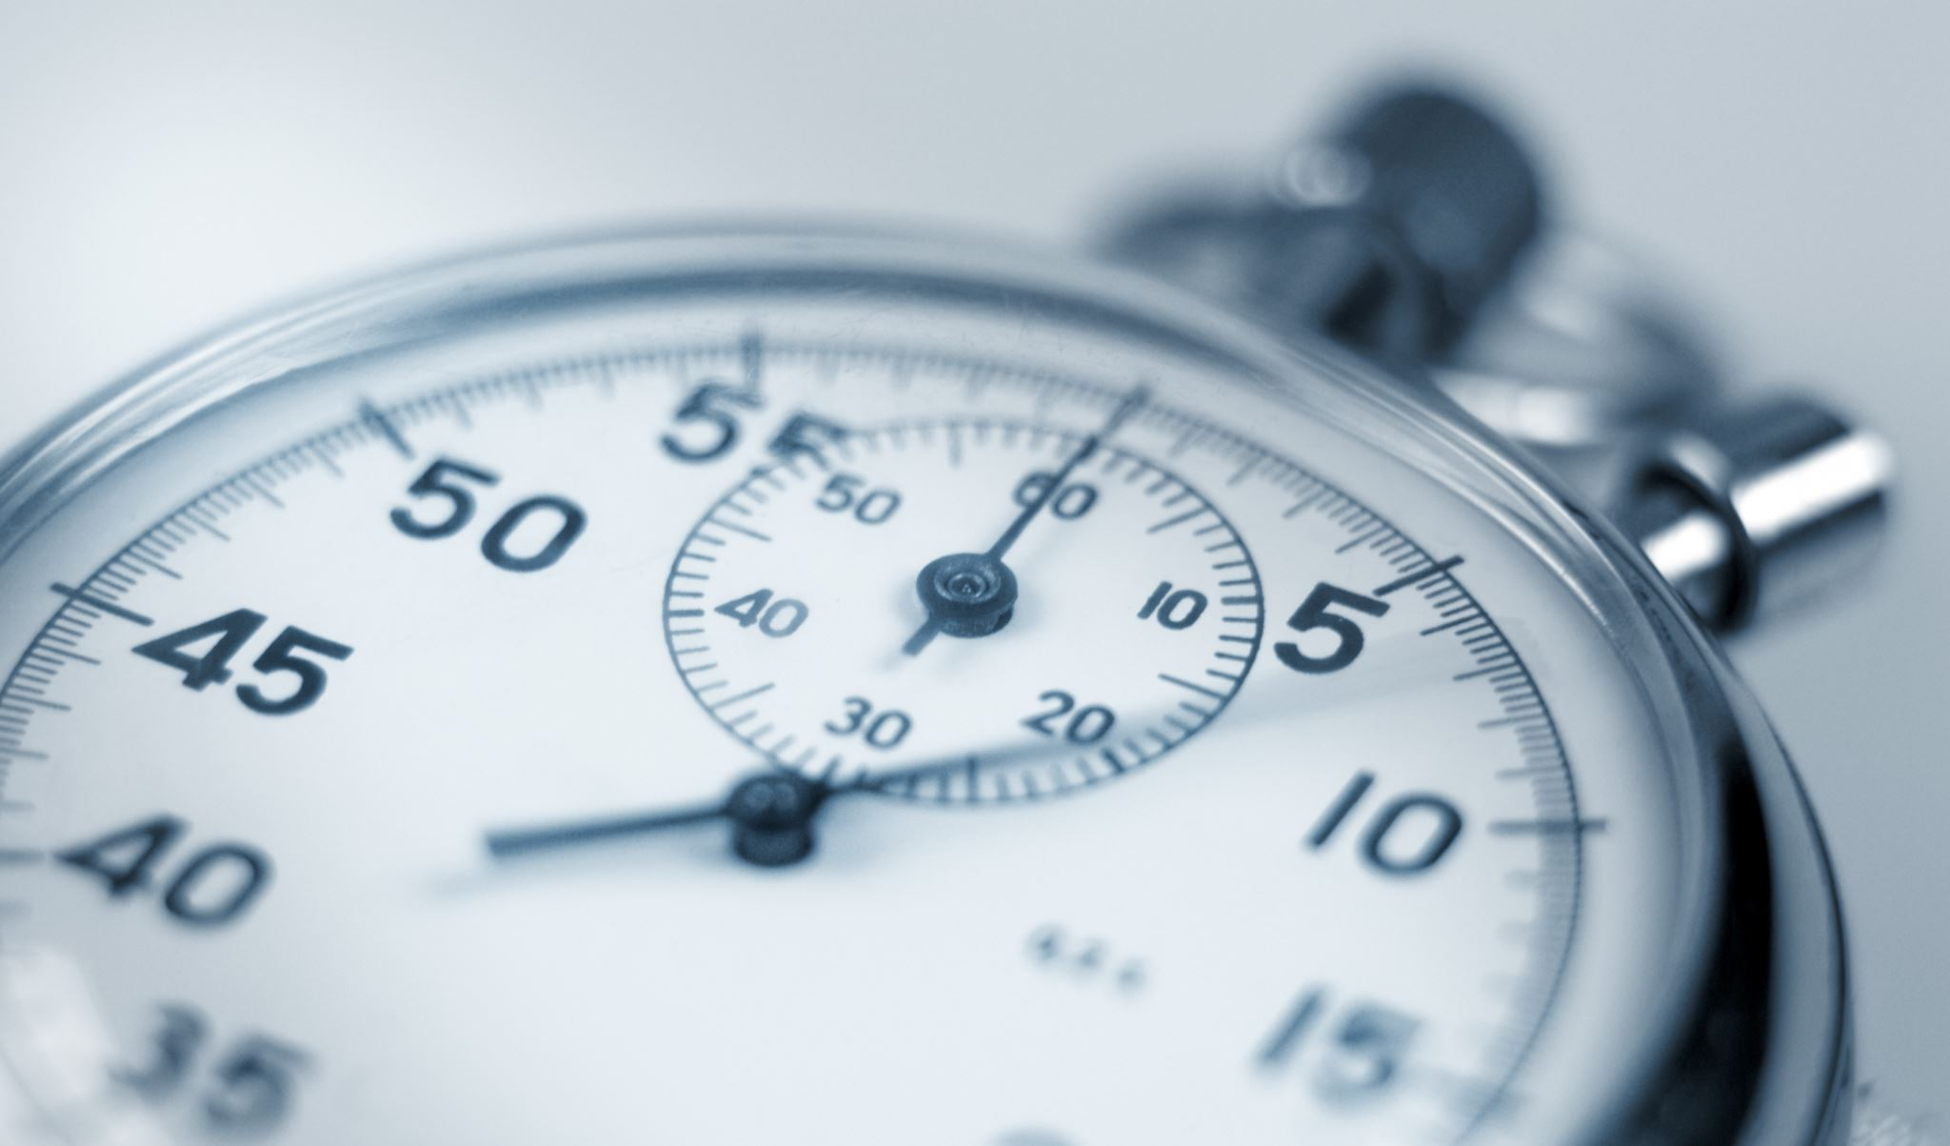
Improvements
More planning / better organized notes
Approach to test driven development
Random ID generation – retrying if it fails, rather than exiting
Testing for NULL pointers in function arguments
Naming conventions
Workspace cleanliness

Slide 7

Questions

Slide 8
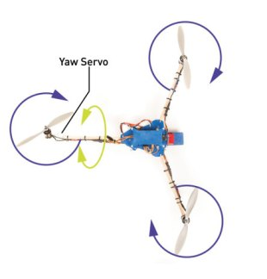
Tricopter yaw

