Slide 1

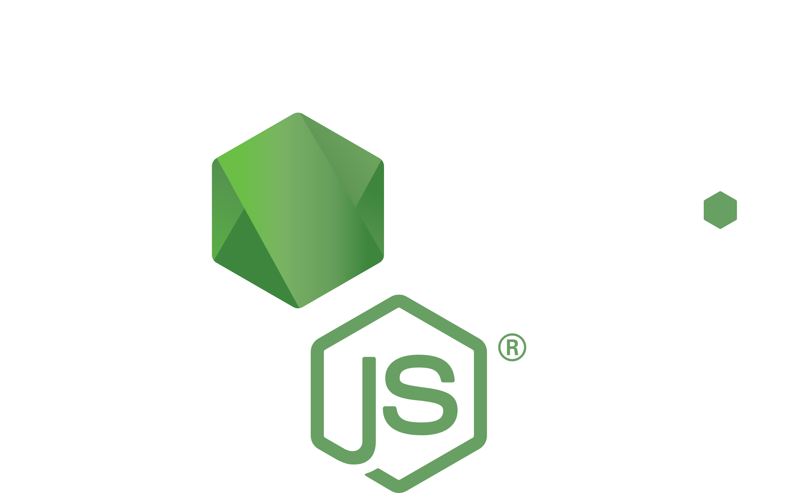
Node JS
How it works?

Slide 2



Me
Karolis Jocevičius
Studied Software Engineering in VU MIF 5 years ago
Developing software for 7 years
Currently senior software developer in SEB
Went from Java to .NET and Node.JS
Twitter: @kjocevicius
https://github.com/teraxas

Slide 3
Node JS
What Node JS is made of?
How it works?
Why is it used?
Some demos of more interesting features

Slide 4
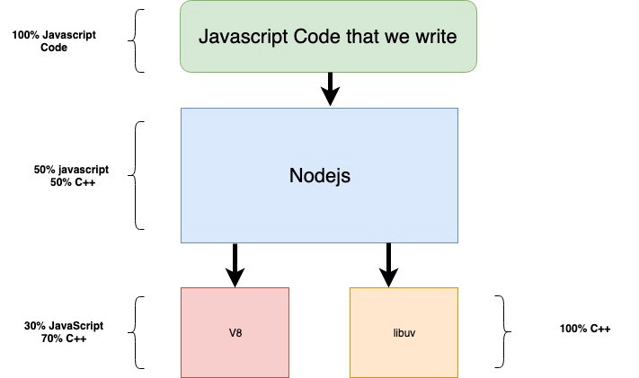
What is Node JS?

Slide 5
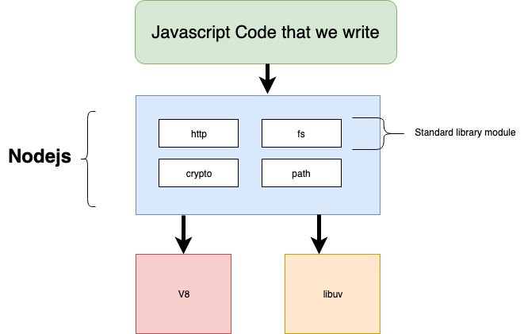


What is Node JS?

Slide 6
V8 and libuv
Google’s open source high-performance JavaScript and WebAssembly engine. It is used in Chrome and in Node.js, among others.
Multi-platform support library with a focus on asynchronous I/O. It was primarily developed for use by Node.js, but it's also used by Luvit, Julia, pyuv, and others.

Slide 7
V8 and libuv
Takes care of code execution and concurency in Node JS.
Handles I/O operations (file, TCP – everything) asynchronously, child processess, thread pool, signal handling, clock...

Slide 8
V8 and libuv
Converts Javascript code to machine code and executes it
Basically, creates events, instead of blocking operations, such as:
File is ready for writing
A socket has data ready to be read
A timer has timed out

Slide 9
An asynchronous event-driven JavaScript runtime, designed to build scalable network applications.

Slide 10


Slide 11
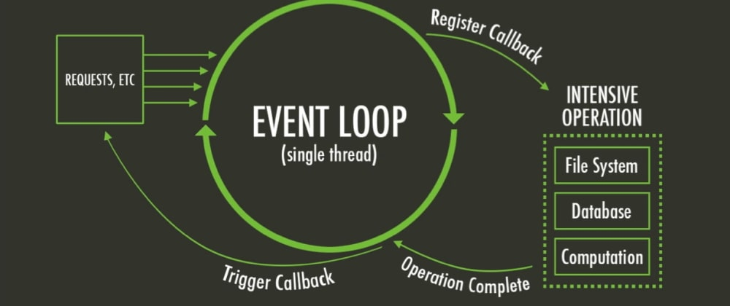
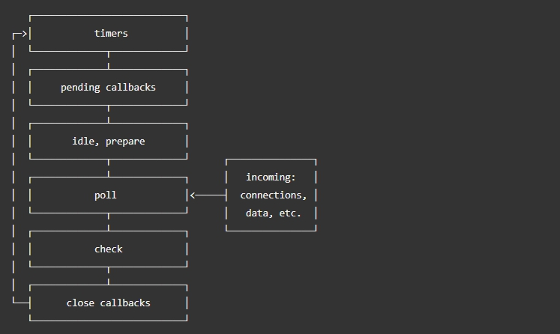
Event loop
Event loop allows non-blocking I/O operations – despite JS being single-threaded.
Modern kernels are multi-threaded, they can handle multiple operations executing in the background. When one of these operations completes, the kernel tells Node.js so that the appropriate callback may be added to the poll queue to eventually be executed.

Slide 12
Event loop
timers: this phase executes callbacks scheduled by setTimeout() and setInterval().
pending callbacks: executes I/O callbacks deferred to the next loop iteration.
idle, prepare: only used internally.
poll: retrieve new I/O events; execute I/O related callbacks (almost all with the exception of close callbacks, the ones scheduled by timers, and setImmediate()); node will block here when appropriate.
check: setImmediate() callbacks are invoked here.
close callbacks: some close callbacks, e.g. socket.on('close', ...)

Slide 13
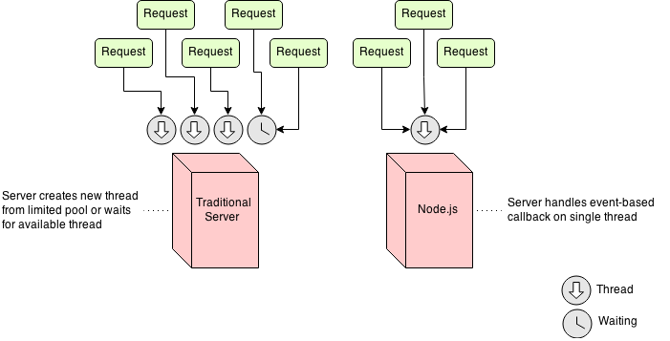
Blocking I/O vs Non-blocking I/O

Slide 14
Blocking I/O vs Non-blocking I/O
Auth service?
Logging service?
Browser
Browser
Browser
Browser
API
Search microservice
Elastic search?
DB?

Slide 15
Blocking I/O vs Non-blocking I/O
I/O is the bottleneck, not computations!
Demo 1

Slide 16
Is Node JS totally single threaded?
Not really...
We can create Worker threads for long running, blocking operations.
https://nodejs.org/api/worker_threads.html
https://developer.mozilla.org/en-US/docs/Web/API/Web_Workers_API/Using_web_workers
Demo 2

Slide 17
Async calls also enable long-polling
This is a kind of alternative to Websockets.
Client makes a request and waits for response. It might take a while…
Demo 3

Slide 18
My CPU has like 100 cores, how do I make them all work?
Clusters!
https://nodejs.org/api/cluster.html
Demo 4

Slide 19
Real programmers code in C++
If you want something to run REALLY fast, you can always write native modules with C++!
Node-gyp – “Generate Your Project” – python tool for generating projects, used in building native libs.
A good example is “node-sass” library.
Demo 5

Slide 20
Fun fact
JavaScript was released on December 4th, 1995
So it just turned 25 years old!

Slide 21

Would you like to ask something?

Slide 22
Links
https://github.com/teraxas/nodejs-demo
https://dev.to/khaosdoctor/node-js-under-the-hood-1-getting-to-know-our-tools-1465
https://medium.com/@mattmazzola/comparing-asynchronous-patterns-between-c-and-javascript-2137793d7e37
https://medium.com/jspoint/a-simple-guide-to-load-c-c-code-into-node-js-javascript-applications-3fcccf54fd32
https://developpaper.com/install-node-gyp-offline/
https://github.com/sindresorhus/awesome-nodejs

