Slide 1
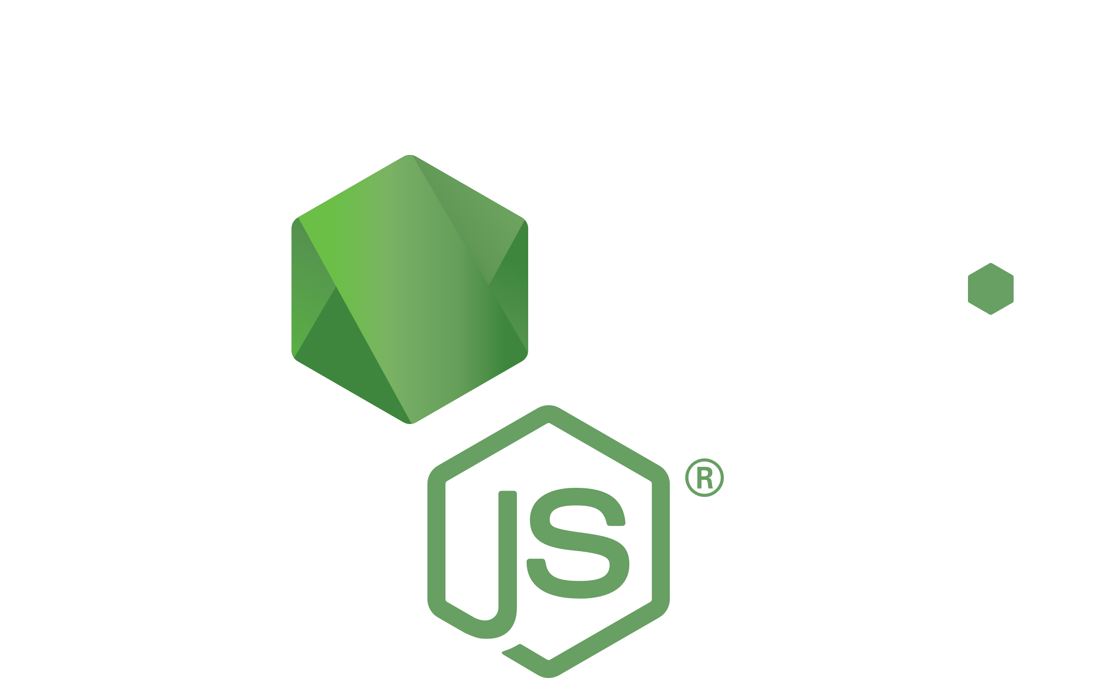
Node JS
How it works?

Slide 2
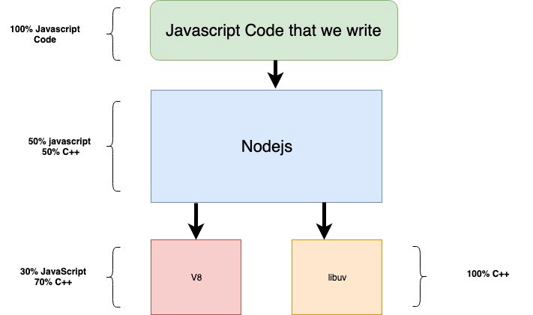
What is Node JS?

Slide 3
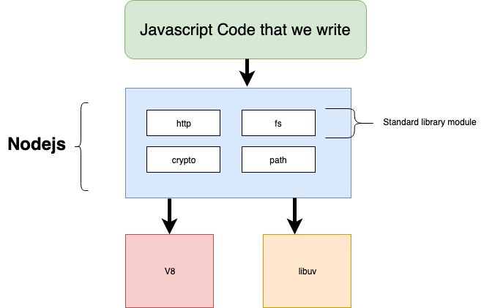


What is Node JS?

Slide 4
V8 and libuv
Google’s open source high-performance JavaScript and WebAssembly engine. It is used in Chrome and in Node.js, among others.
Multi-platform support library with a focus on asynchronous I/O. It was primarily developed for use by Node.js, but it's also used by Luvit, Julia, pyuv, and others.

Slide 5
V8 and libuv
Takes care of code execution and concurency in Node JS.
Handles I/O operations (file, TCP – everything) asynchronously, child processess, thread pool, signal handling, clock...

Slide 6
An asynchronous event-driven JavaScript runtime, designed to build scalable network applications.

Slide 7


Slide 8
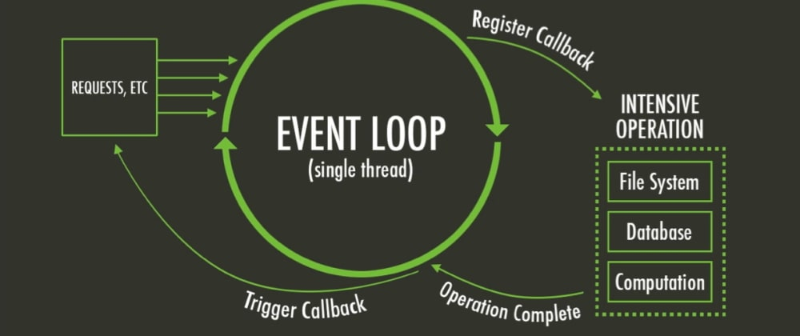
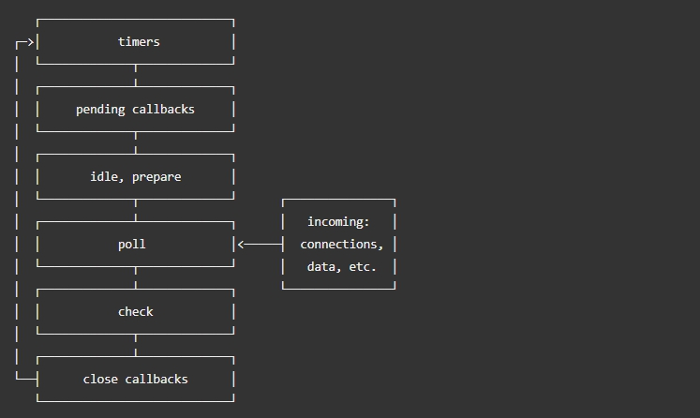
Event loop
Event loop allows non-blocking I/O operations – despite JS being single-threaded.
Modern kernels are multi-threaded, they can handle multiple operations executing in the background. When one of these operations completes, the kernel tells Node.js so that the appropriate callback may be added to the poll queue to eventually be executed.

Slide 9
Event loop
timers: this phase executes callbacks scheduled by setTimeout() and setInterval().
pending callbacks: executes I/O callbacks deferred to the next loop iteration.
idle, prepare: only used internally.
poll: retrieve new I/O events; execute I/O related callbacks (almost all with the exception of close callbacks, the ones scheduled by timers, and setImmediate()); node will block here when appropriate.
check: setImmediate() callbacks are invoked here.
close callbacks: some close callbacks, e.g. socket.on('close', ...)

Slide 10

How this compares to async/await in C#?
Single threaded (for user code)
Multi-threaded (user code can resume in different thread)
Event Loop can be implemented, but worker threads are used.
Based on Event Loop
1 thread per all the requests
1 thread per request
I/O doesn’t block the thread (idle) – it’s ready for handling other requests
I/O blocks the thread (sleep) – limits amount of concurrent connections

Slide 11
Is Node JS single threaded?
Not really...

Slide 12
My CPU has like 100 cores, how do I make them all work?
Clusters!
https://nodejs.org/api/cluster.html

Slide 13
Real programmers code in C++
If you want something to run REALLY fast, you can always write native modules with C++!
Node-gyp – “Generate Your Project” – python tool for generating projects, used in building native libs.
That’s how node-sass works, by the way.

Slide 14
Links
https://github.com/teraxas/nodejs-demo
https://dev.to/khaosdoctor/node-js-under-the-hood-1-getting-to-know-our-tools-1465
https://medium.com/@mattmazzola/comparing-asynchronous-patterns-between-c-and-javascript-2137793d7e37
https://medium.com/jspoint/a-simple-guide-to-load-c-c-code-into-node-js-javascript-applications-3fcccf54fd32
https://developpaper.com/install-node-gyp-offline/
https://github.com/sindresorhus/awesome-nodejs

