Slide 1

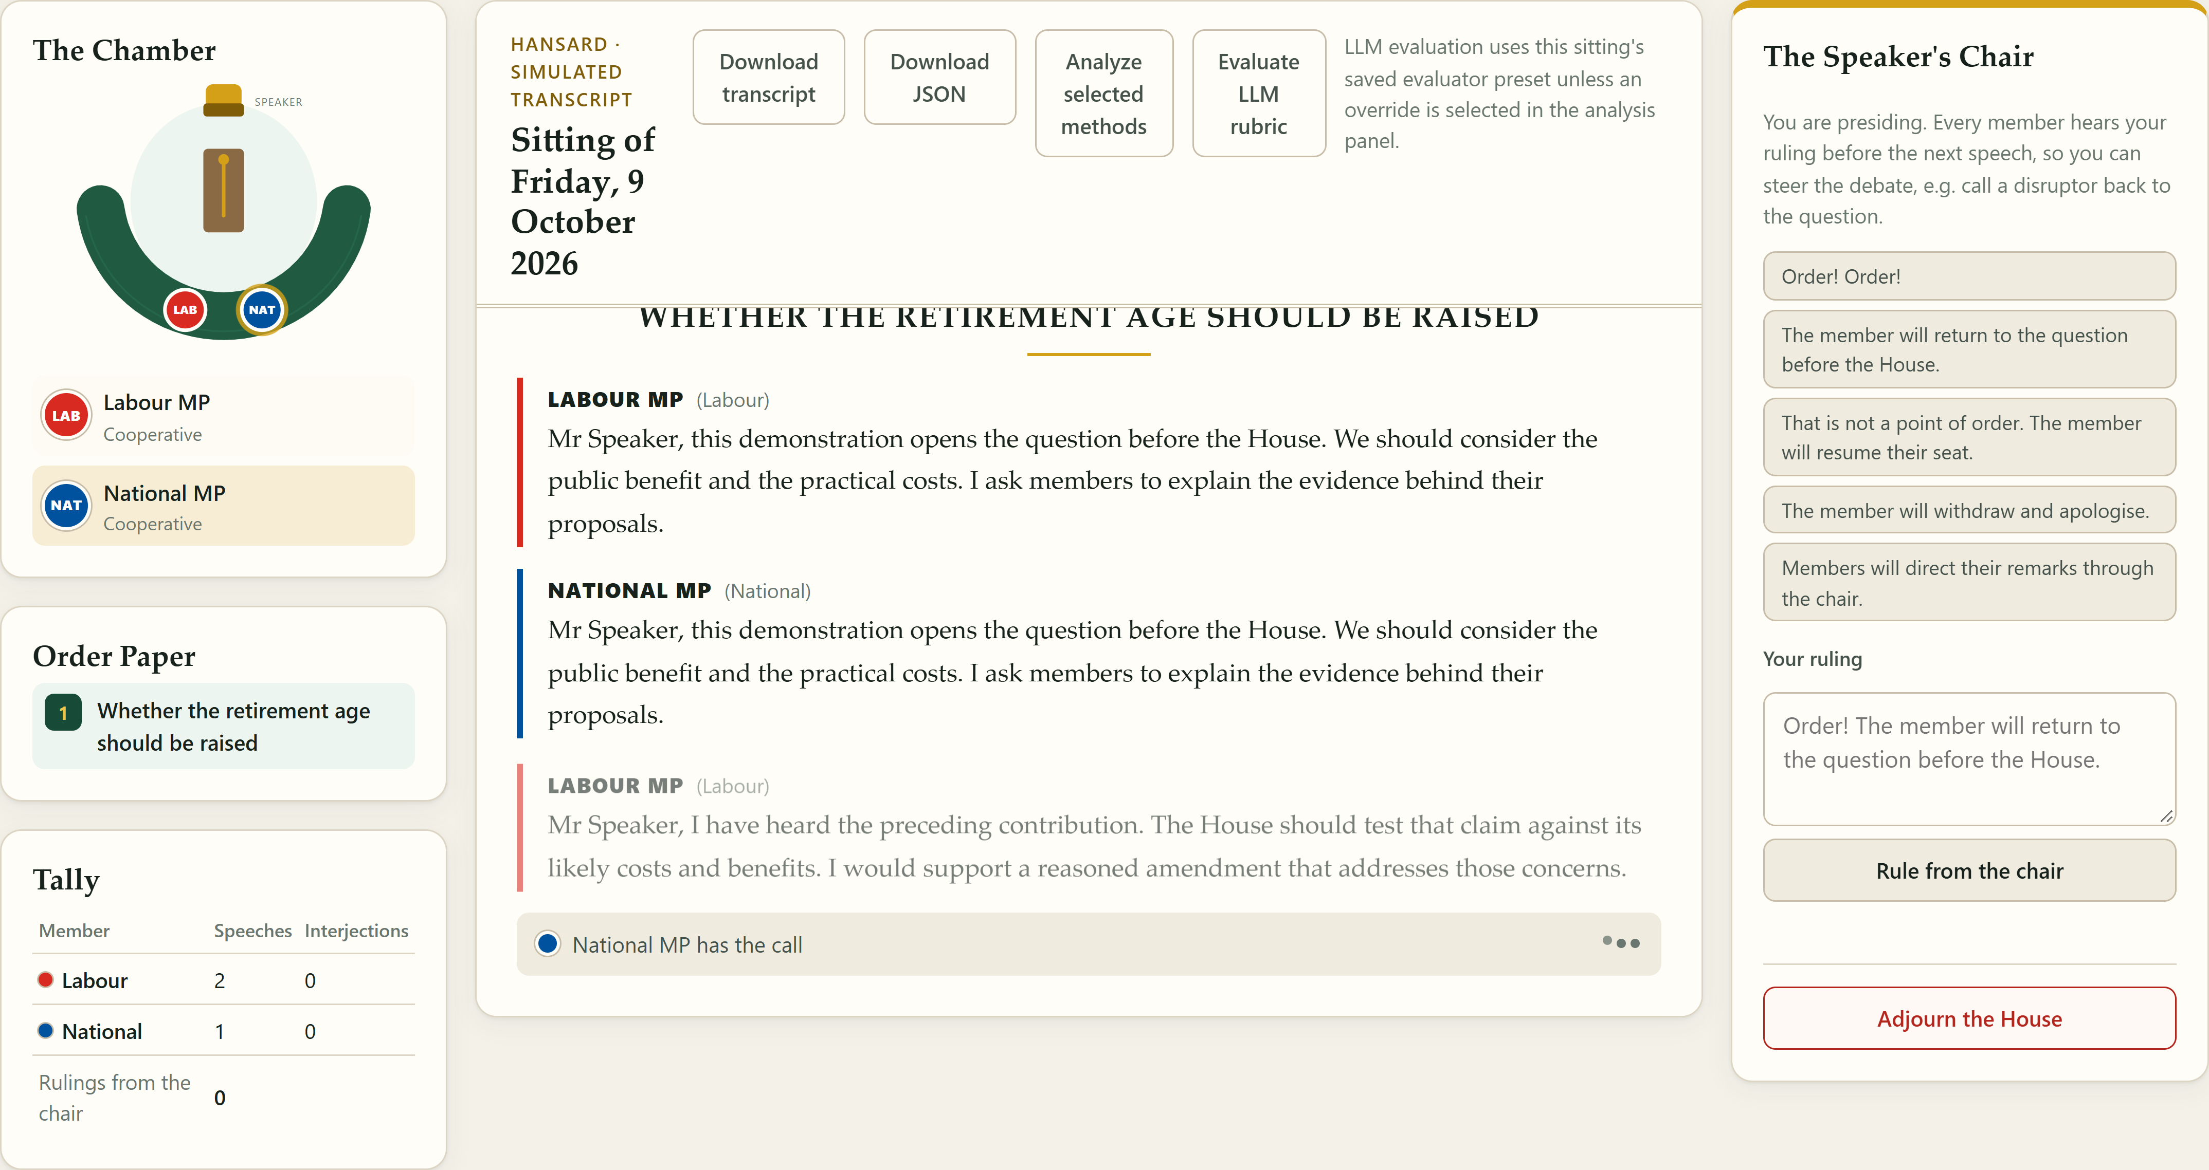
Part IV Project #123
Department of Electrical, Computer,
and Software Engineering
AI-Based Virtual Parliament
Does more Hansard grounding improve AI debate?
Albert Sun & Kieran Joe · Supervisor: Dr Joerg Wicker
We built a virtual New Zealand Parliament to study how language models debate. We tested whether more Hansard excerpts, drawn from real parliamentary speeches, improve debate quality.
1
One platform, three interfaces
D
C
A
Chamber and party agents
A
Watch who has the floor and each party’s role.
B
B
Live and saved Hansard
Speeches stream to a transcript that can be reopened after restart.
C
The Speaker’s Chair
Rulings reach every agent before the next speech.
D
Exports and evaluation
Download JSON/text and run local analysis or the separate LLM rubric.
Fig. 1 Updated browser (deterministic demo). Browser, guided CLI and commands share one backend.
2
Private agents, reproducible debates
Real Hansard
Private setup
Five AI MPs
Debate engine
Saved evidence
500 reviewed excerpts
100 per party [1]
Own persona, excerpts
and optional tactic
Own setup +
public debate evidence
Turns, topics,
reply cues and rulings
Public transcript +
separate evaluations
Independent debate and judge models, including Ollama. Captured prompts and settings preserve each run.
Five separate rubric metrics plus local sentiment and stance. Private setup stays out of public exports.
3
More grounding gave no consistent gain
2 models × 3 topics × 3 grounding levels × 3 repetitions = 54 debates, 1,350 speeches [2]
Five parties, five rounds. Retirement age, nuclear power and the four-day workweek. No adversarial tactics or interruptions.
Qwen consistency: 3.93 at 0 excerpts, 3.62 at 100 (-0.31 points). Other changes were small or mixed.
Relevance endpoints were unchanged (Luna 4.00, Qwen 3.98). Disruptive rhetoric averaged 0.00-0.04.
Nine debates per model/level, 45 party scores per metric. Common GPT-6 Luna judge. Higher rhetoric means more disruption.
Exploratory automated scores without human validation. These baseline runs do not test adversarial robustness.
4
Outcomes and next steps
Outcome
Next work
Contributions
A reproducible debate platform. Extra Hansard showed no consistent gain in rubric scores.
Test adversarial tactics. Add human review, more topics and more repetitions.
Albert Sun: frontend and live chamber.
Kieran Joe: architecture and MP agents.
References
Acknowledgements
Contact
[1] Rauh & Schwalbach (2020). ParlSpeech V2.
[2] Project 123 debate evaluation study, October 2026.
Political science collaborators, Georgetown University.
Members are AI archetypes, not real MPs.
asun555@aucklanduni.ac.nz
kjoe685@aucklanduni.ac.nz
Notes:
Sources: Poster_123.pptx (original branding, project title, author/supervisor names, contributions, acknowledgements and contacts). Current implementation at a7acbdf with application source 1ee449b: README.md, docs/grounding.md, docs/debate-behaviour.md, docs/interface-parity.md. Study source: debate-evaluation.xlsx, Summary G8:K13 and its rubric.csv/runs.csv. 54 complete debates, 1350 speeches, two models, three topics, 0/10/100 excerpts per party, three repetitions per condition, five parties and five rounds, strategy NONE and zero interruptions. Each displayed mean pools 45 participant/topic metric scores across 9 debates per model/grounding level. Speeches and participant scores within a debate are dependent. Rubric scores are separate 0–4 scales, with disruptive rhetoric higher meaning more disruption. All figures are descriptive. Same-model judging and absent human validation limit generalization. Corpus: 500 reviewed excerpts, 100 per party, from ParlSpeech V2, DOI 10.7910/DVN/L4OAKN. Automated software checks do not establish model behaviour or research accuracy.

