Slide 1

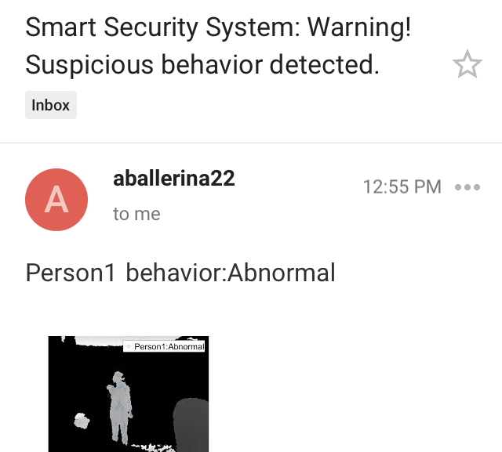
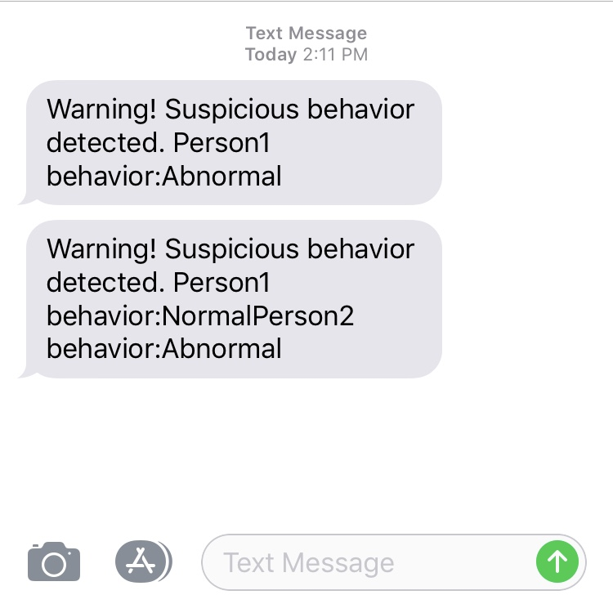
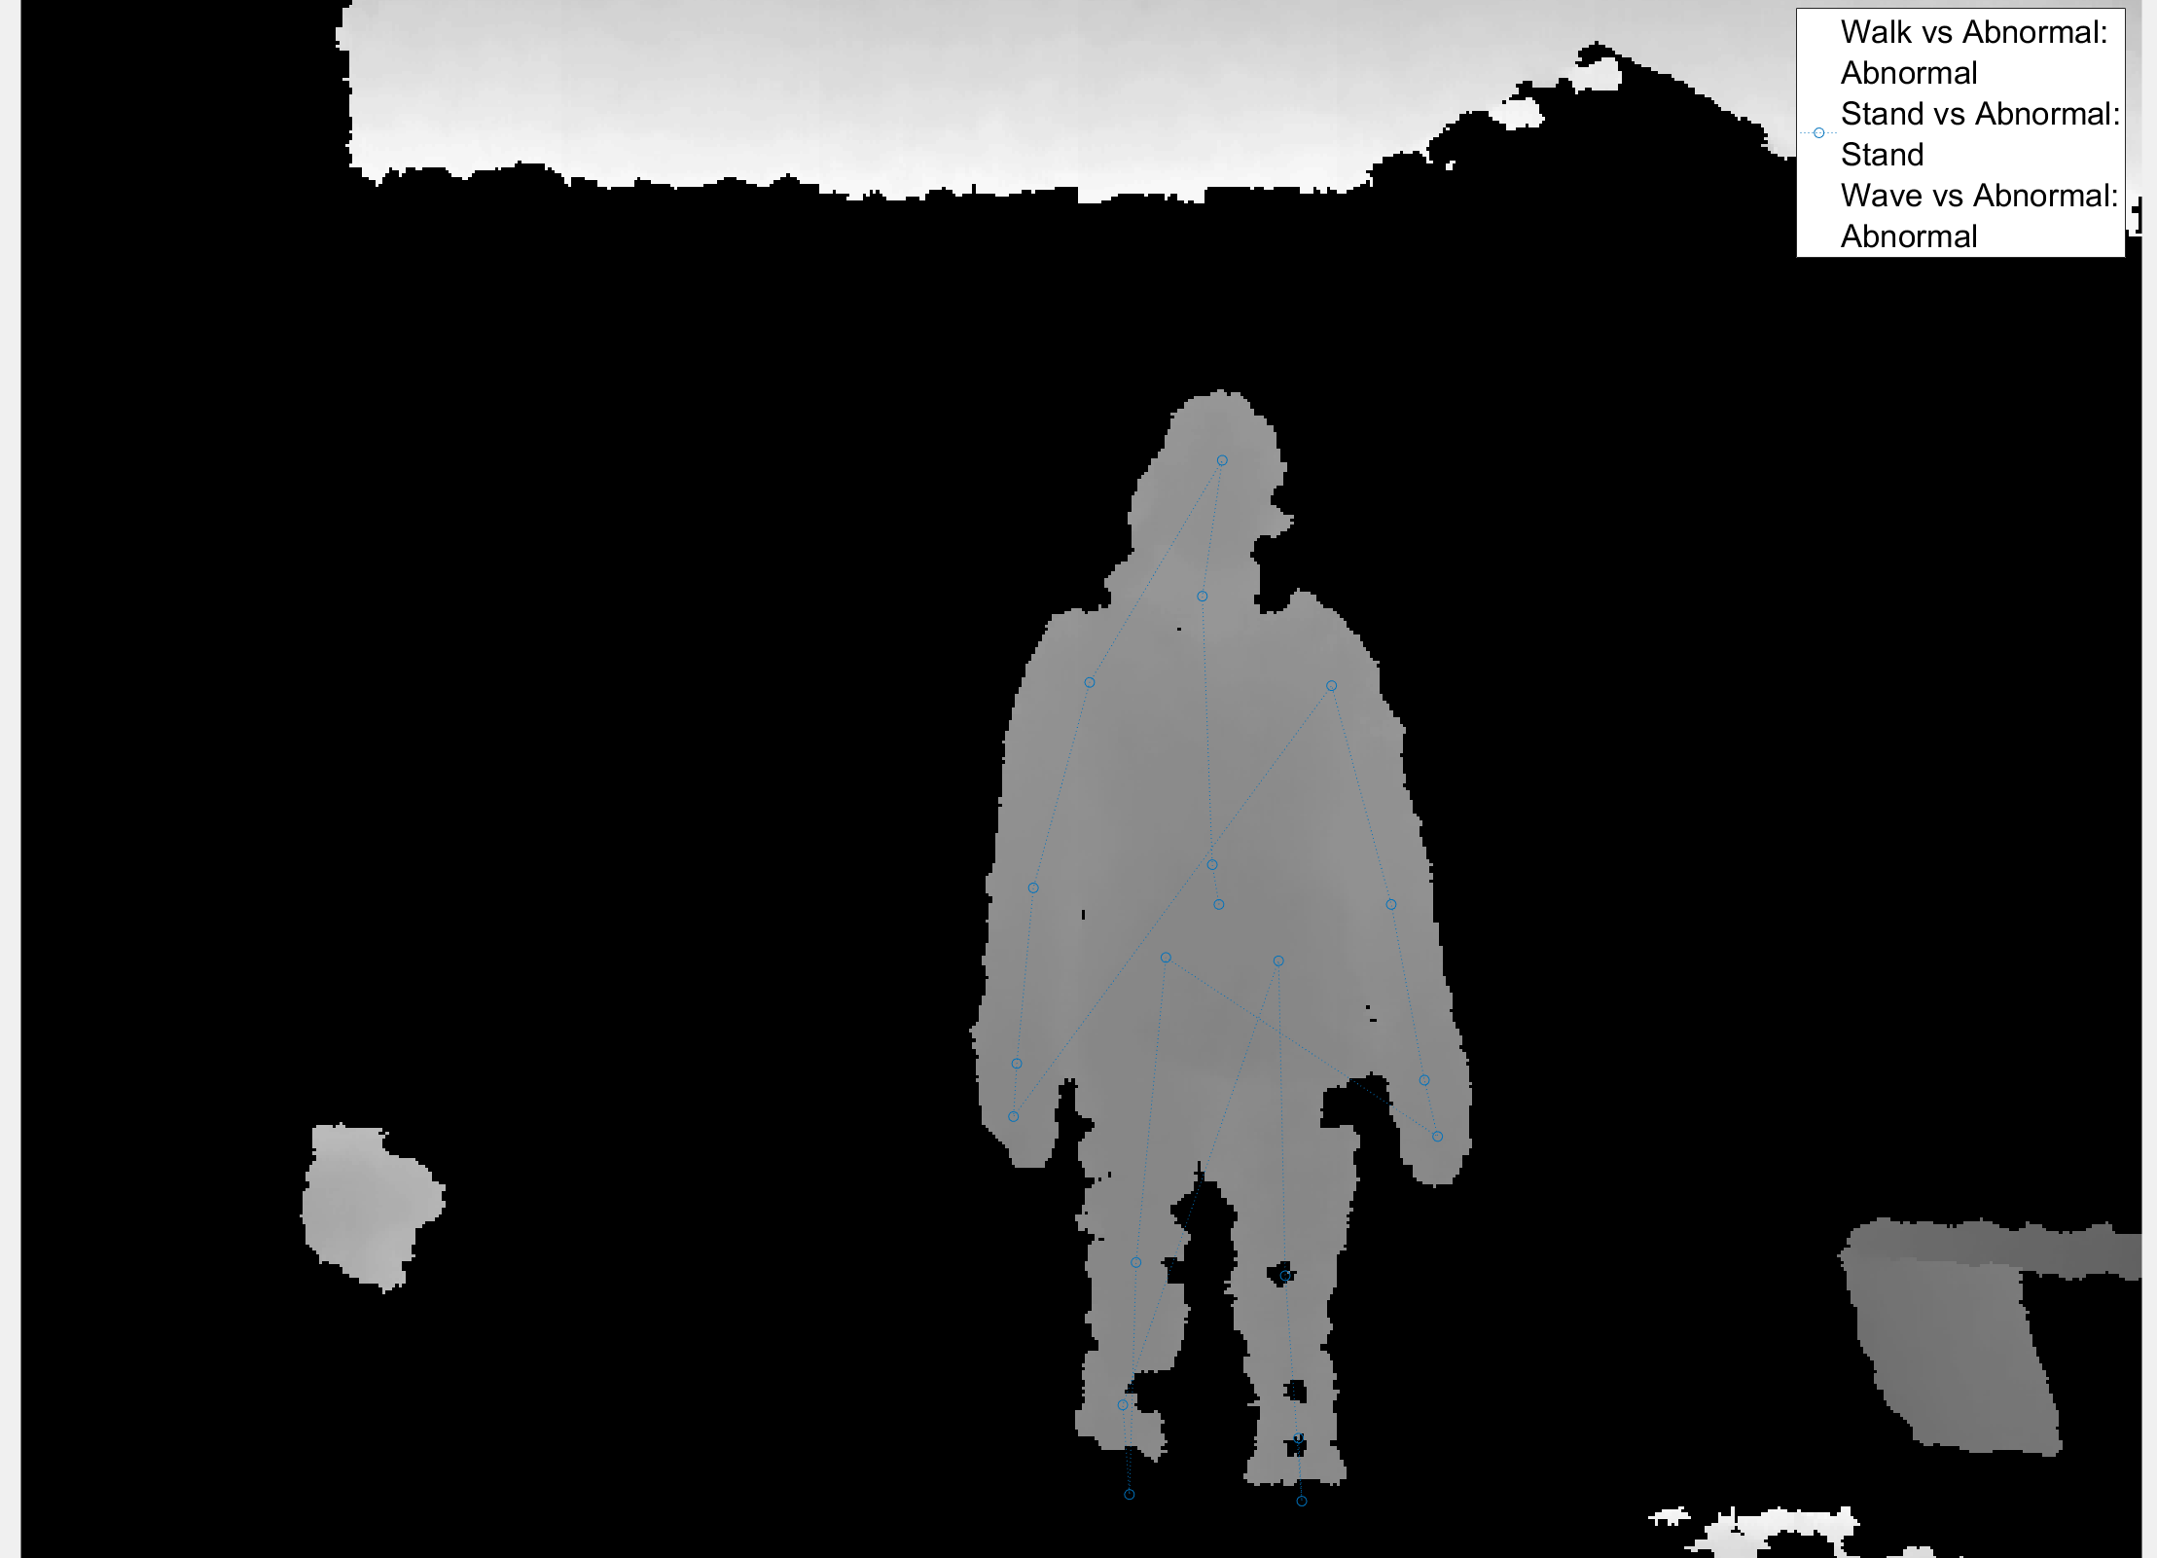
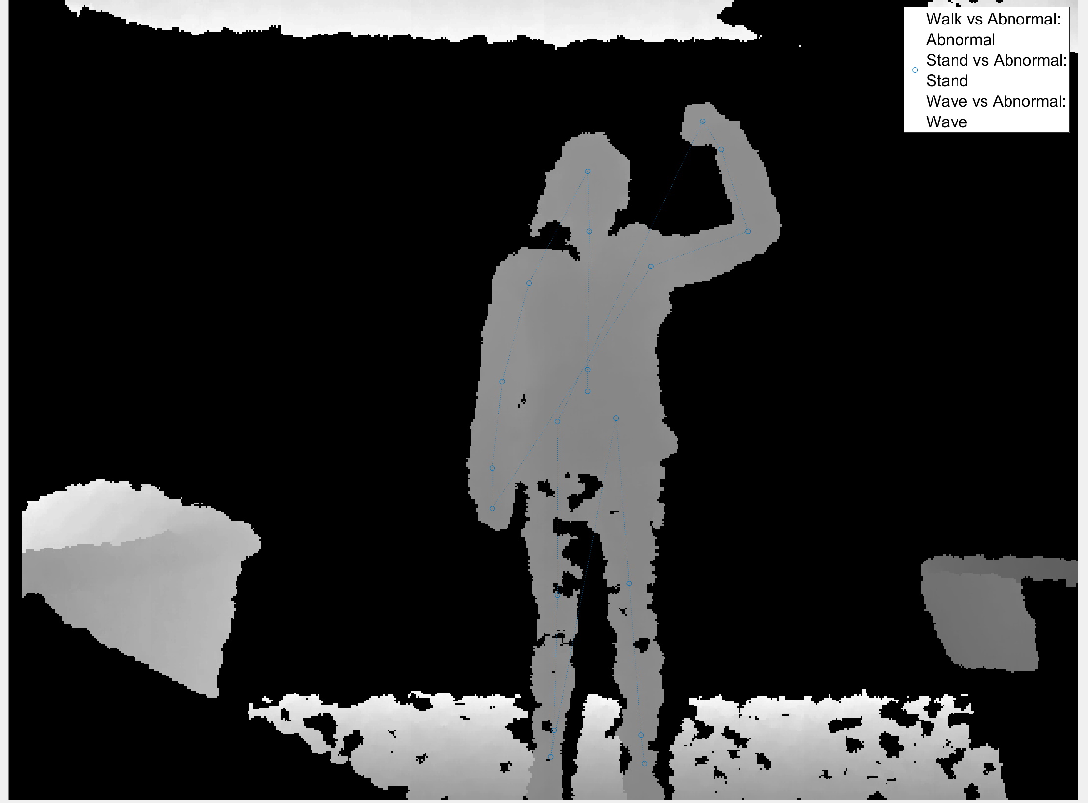
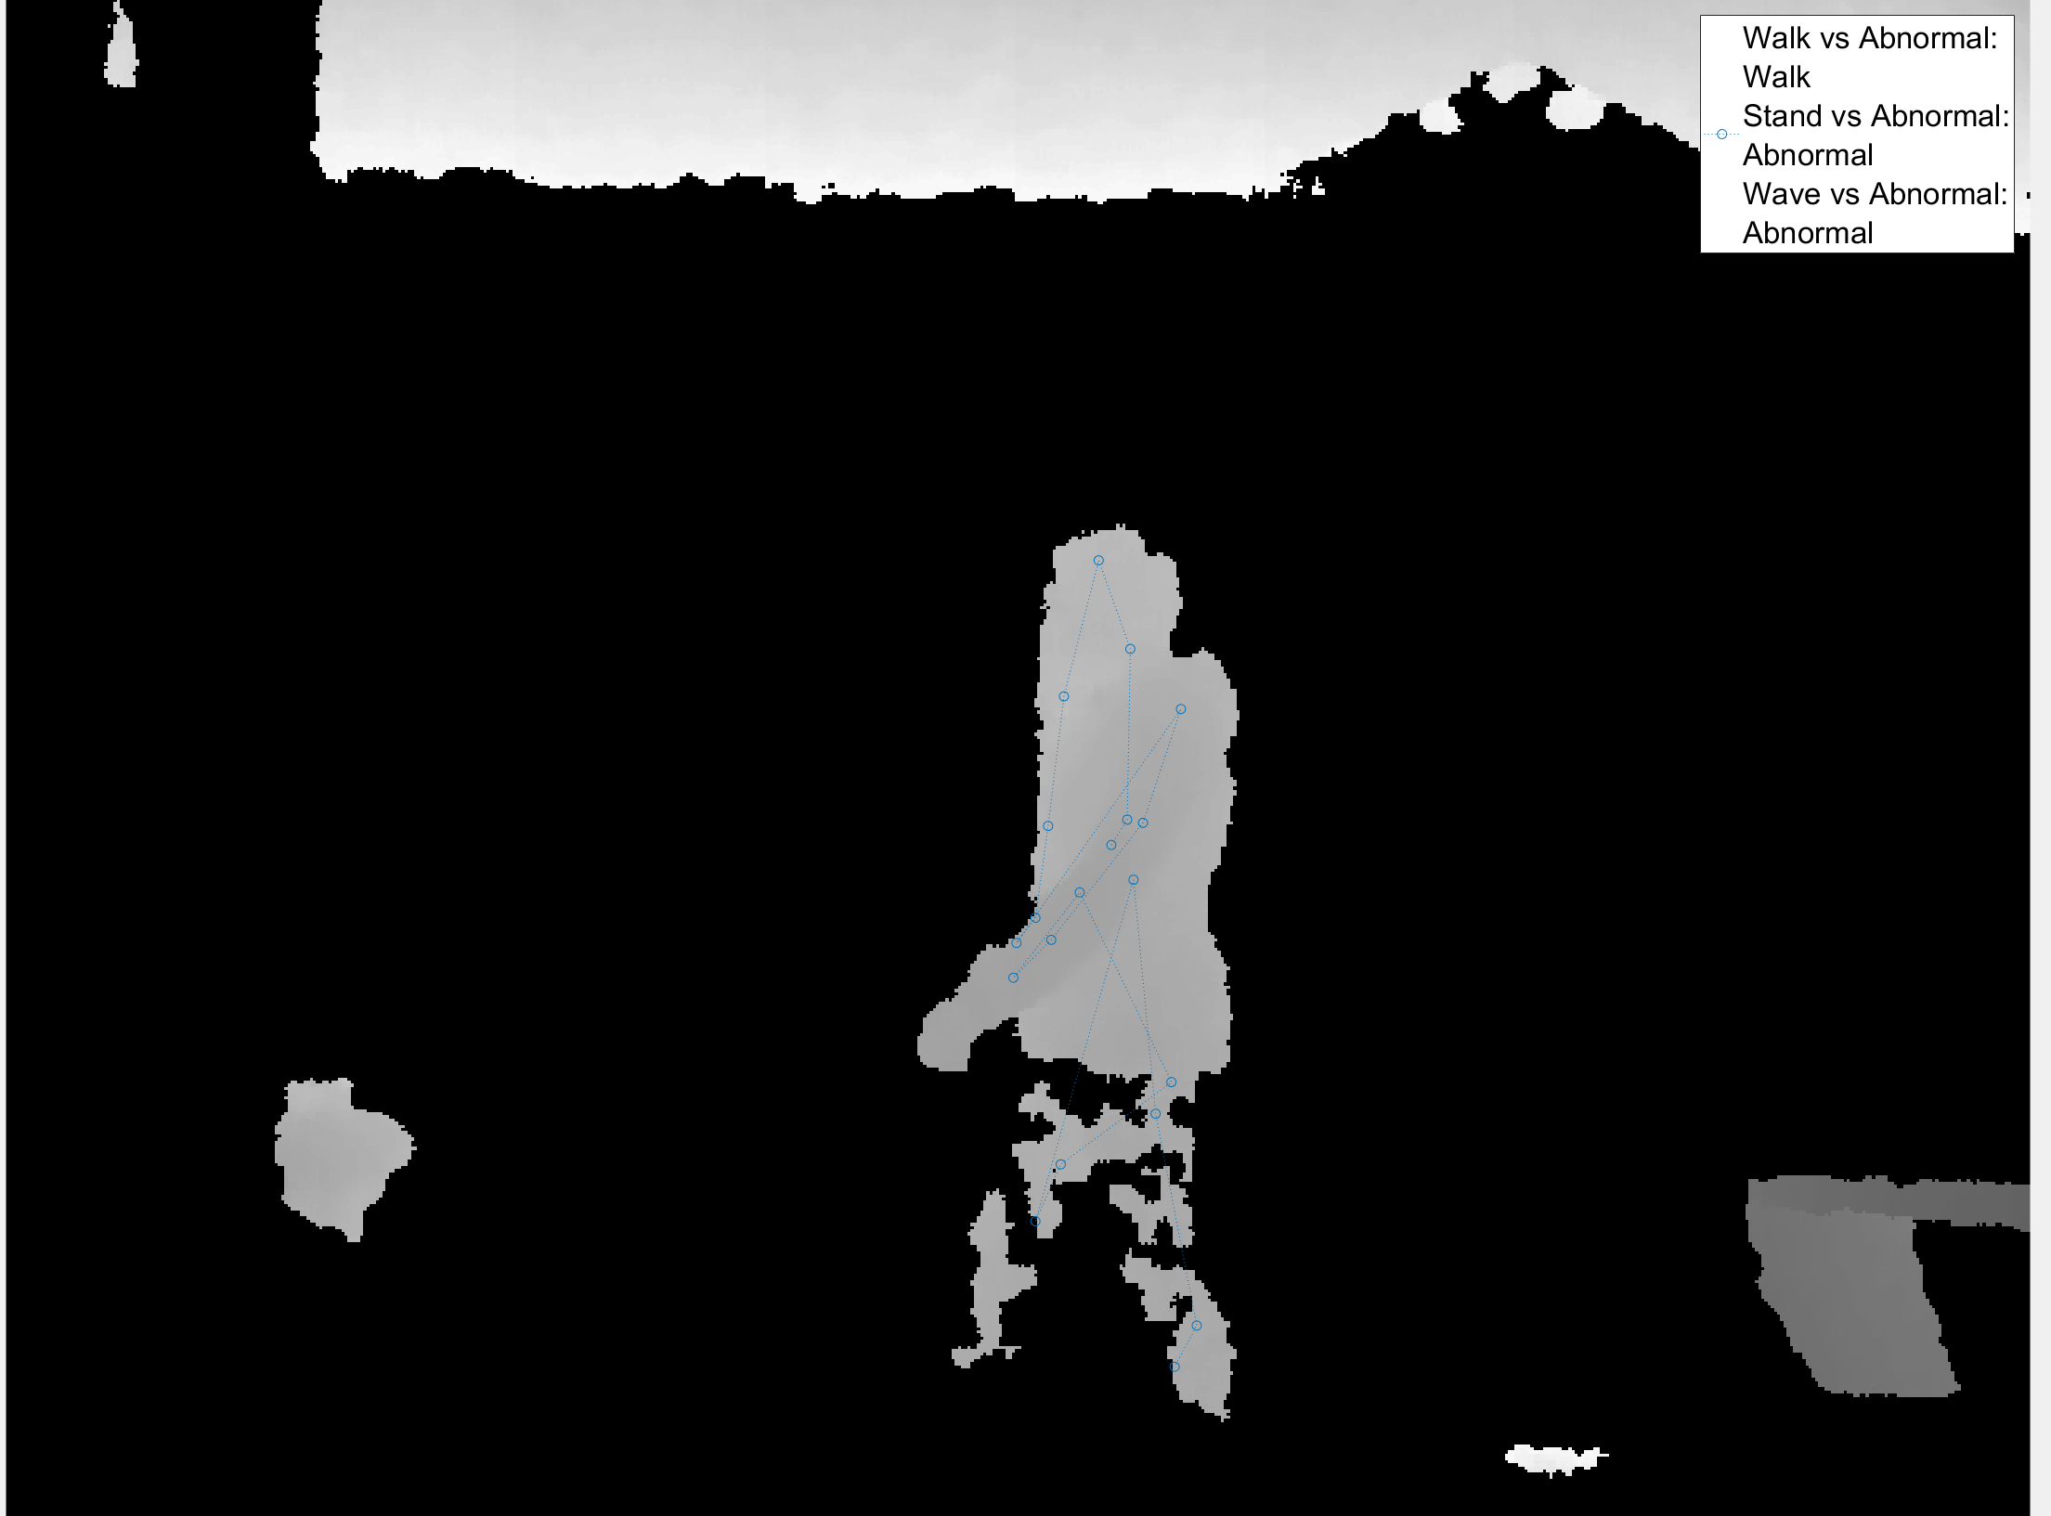
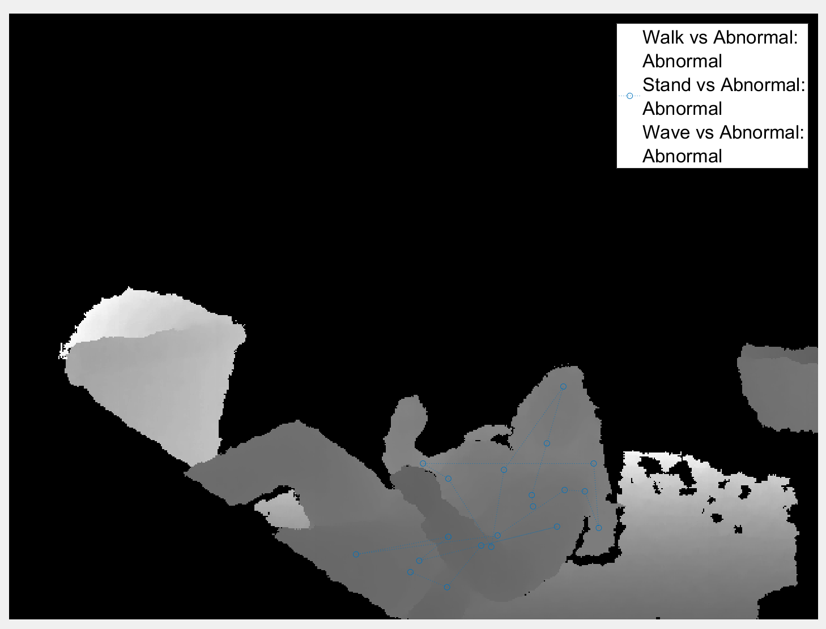
Smart Camera: The Design and Implementation of an Anonymous Security System to Intercept Assault
Keely Jones, Amy Weber, Hossein Asghari
¹Loyola Marymount University, Department of Electrical Engineering and Computer Science
Abstract
Methodology
Define normal behaviors to be detected. Detect each behavior individually, then compile the behaviors into an understanding whether the situation is normal or abnormal.
Steps to build detection of a single behavior:
Choose binary, mutually exclusive predictors (behavior, not behavior)
Collect data, save data to .csv file
Train data in Classification Learner and export best-performing algorithm
Run algorithm in real-time
Test and modify algorithm, implement feature selection (optional)
Steps to predict behaviors:
Accuracy
To determine the accuracy for the detection of behaviors, the program was run for three trials of 60 seconds, with a person acting out each movement in front of the camera. For example, if a person walked for 30 seconds in front of the camera, the ‘Walk vs. Abnormal’ would be correct to report ‘Walk’ and incorrect to report ‘Abnormal’ during that time. After 60 seconds for each behavior, the labels were sorted ‘normal’ or ‘abnormal’ and as seen in Figure 6.
This project employs a Microsoft® Kinect camera to become a smart security system which can intercept physical assaults. This system stops such crimes with an alert sent to the appropriate response team, based on decisions regarding whether the observed situation is “normal” or “suspicious.” The system will make this decision through a machine-learning program in MATLAB, with the support of specific machine learning toolboxes included within the development environment. This security system will allay concerns about rights to privacy and anonymity within public spaces by guarding the imaging output of the Kinect. This system has the potential be deployed in train stations and even bathrooms to intercept and diminish the threats of mugging and sexual assault, among other applications.
Figure 6: Results of accuracy testing for ‘normal’ vs. ‘abnormal'
Results and Discussion
After collecting the data in Figure 6, the false alarm detection rates and the anomaly detection rates were determined. The false alarm was the total number of ‘abnormals’ seen in a trial of only expected normal, divided by the total number of predictions. This gave a false alarm rate of 12.2%, and the expected value was at or below 20%, meaning the system does better than expected at predicting ‘normal.’
The value for the anomaly detection rate was also determined by the number of ‘abnormals’ predicted divided by the total number of predictions, but within a trial that was expected to be fully abnormal. The result was an anomaly detection rate of 62.9% out of an expected 70%. Numerically, this means that the system does not do as well as expected in detecting ‘abnormal.’ However, as many of the actions defined as normal took multiple frames to complete, some frames within the behavior appeared to be normal – such as the movement between falling and standing up again.
Objectives
The following objectives define the direction and method of implementation of the Smart Camera system:
The system will monitor a space in real time while protecting the privacy of those being monitored.
The system will assess whether the situation it sees is “normal” or whether the circumstance is an anomaly requiring human intervention.
Upon detecting an abnormal event, the system will alert the appropriate personnel within 30 seconds of the event.
These objectives provide measures by which to define the accuracy of the Smart Camera:
System can classify 5 behaviors as normal
System can make a decision within 30 seconds
Anomaly detection rate at or above 70%
False alarm detection rate at or below 20%
Approach
Microsoft Kinect will use depth sensor to detect people. This avoids images that might invade the individual’s right to privacy. The Kinect passes the information on how people are moving in the space to MATLAB, which uses machine learning to interpret the people’s behavior. MATLAB decides whether the observed behavior is normal or suspicious, then alerts the appropriate personnel. The five behaviors which the system will recognize are walking, standing, waving, walking in groups, and standing in groups. These behaviors will then be classified into ‘normal’ and ‘abnormal’ categories by a Hidden Markov Model.
Figure 1: Outline of process used to classify behaviors in real-time
Detected Behaviors (Color Pictures)
Future Applications
This prototype is designed to be scalable, where more normal movements can be easily added to make the detection more comprehensive.
The system has the potential to work better than traditional security cameras, as it can alert personnel to suspicious activity rather than relying on a human to monitor the images constantly. As it protects the right to privacy of the individual, this system could be used where standard security cameras would be too intrusive.
Figure 2: Stand vs. Abnormal algorithm detecting ‘Stand’
Figure 3: Wave vs. Abnormal algorithm detecting ‘Wave’ and ‘Stand’
References
X. Zhu and Z. Liu, “Behavior Clustering for Anomaly Detection,” Frontiers of Computer Science in China, pp. 14–27, 2011.
Figure 4: Walk vs. Abnormal algorithm detecting ‘Walk’
Figure 5: Falling appears as ‘Abnormal’ for all algorithms
Contact: kly_jns@yahoo.com, amyEmail

