Slide 1
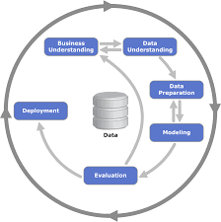
Tackling the Great Resignation Crisis
Karina Jonina c00278440

Slide 2
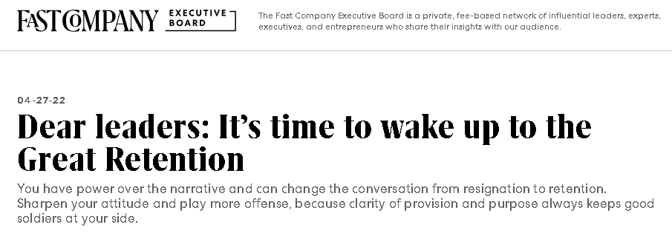
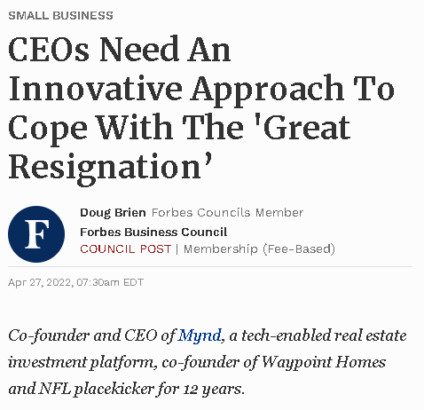
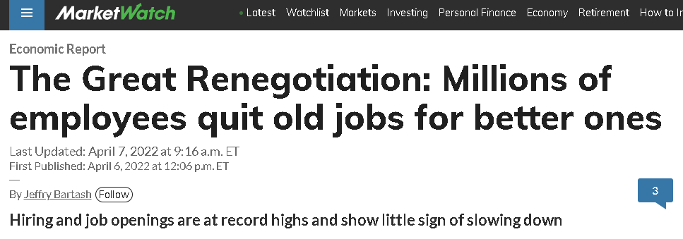
Business Understanding
https://www.forbes.com/sites/forbesbusinesscouncil/2022/04/27/ceos-need-an-innovative-approach-to-cope-with-the-great-resignation/
https://www.marketwatch.com/story/the-great-resignation-pfff-call-it-the-great-rehiring-or-great-job-hop-instead-11649261180
https://www.fastcompany.com/90745236/dear-leaders-its-time-to-wake-up-to-the-great-retention

Slide 3
Business Understanding
Average cost of recruitment - $1,200
Hidden costs to recruit a new employee:
HR costs
Limited unrenewable resources: time and labour
Reduction in productivity
Research Question
How can the business attempt to reduce employee turnover?
What can the business aim to do so that the employees stay in the company?

Slide 4
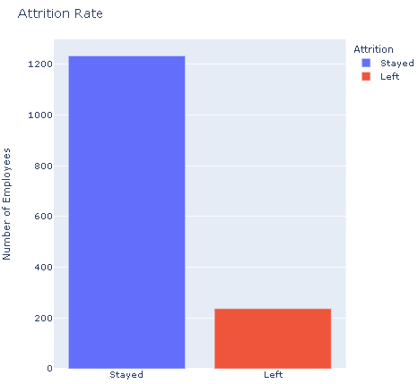
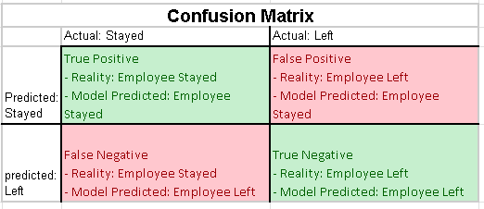
Data Understanding
The dataset has 1470 rows and 35 columns.
Independent Variables:
Age
Gender
Monthly Income
Education
Job Role
Dependent Variable: whether the employee left or stayed in the job
Stayed - 1233 observations
Left – 237 observations

Slide 5
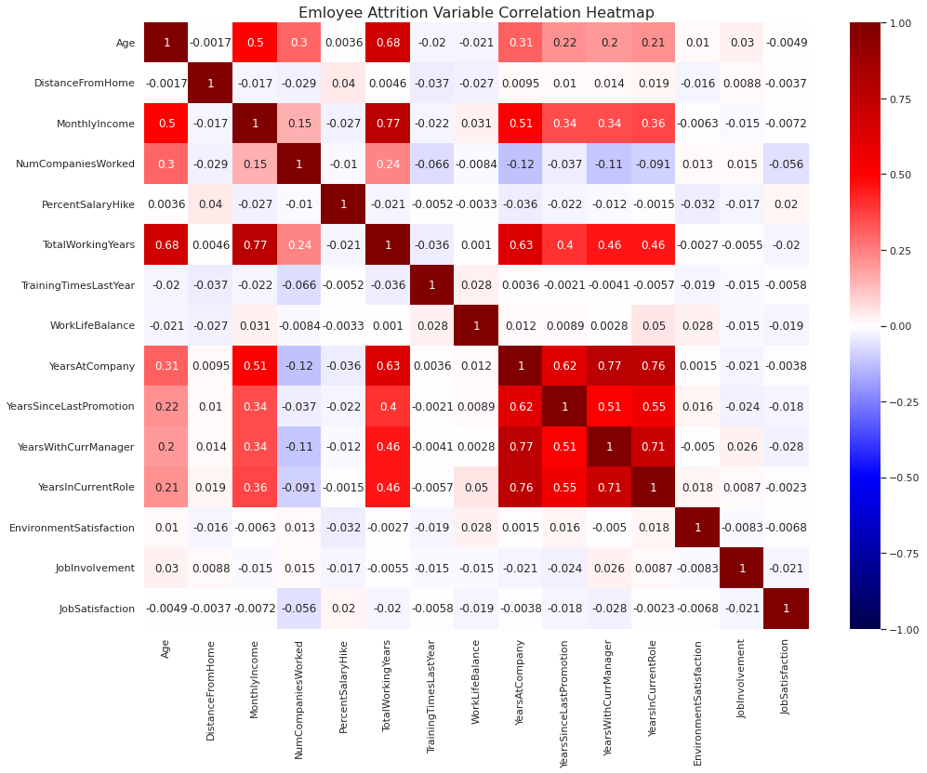
Data Preparation
Dropping irrelevant or redundant variables
Dropping highly-correlated variables
Dropping variables after high multicollinearity

Slide 6
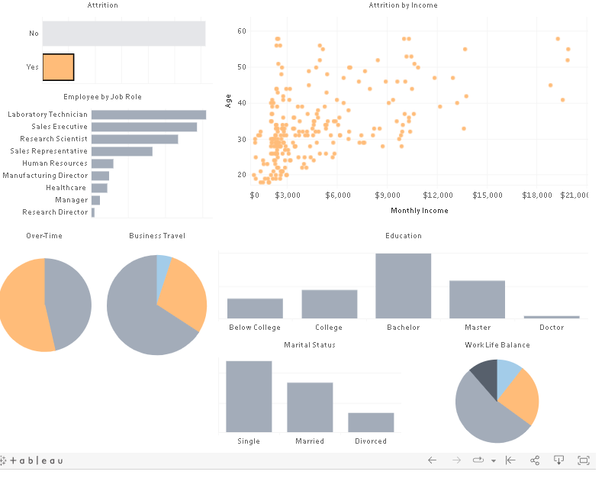

Slide 7
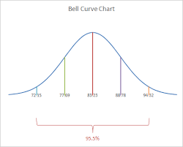
Final Data Preparation
Normalising numeric data – Monthly income and Age
Creating dummy variables
Splitting the data into a training and test set (70/30)
Using SMOTE technique to upsample the minority class

Slide 8
Modelling
Built initial models
Evaluated using the confusion Matrix
Extracted Important Features
Used GridSearch to find best hyperparameters for each model
Re-evaluated the fine-tuned model

Slide 9
Evaluation
Significant Features
Monthly Income
Marital Status -Married
Job Satisfaction
Marital Status Divorced
Job Involvement
Age
Work Life Balance
Distance From Home
Education Field - Medical
Business Travel - Rarely
Training Times Last Year
Business Travel – No Travel
 | DT | RF | LR
Accuracy | 77% | 83% | 77%
Sensitivity | 47% | 30% | 47%
Specificity | 83% | 94% | 83%
Precision | 34% | 44% | 34%
Recall | 47% | 30% | 47%
AUC Curve | 72% | 72% | 72%

Slide 10
Limitations
Only 1,470 observations
Overlearned majority class
Did not use Bootstrapping, OOB, AdaBoost Classification, Gradient Boosting, RMSE
Deployment
Not possible to reduce False Positives and improve True Negative
Would not recommend deploying at this time.
Recommend to get more data and use other techniques to build models.

Slide 11


