Slide 1
AirBnB: Cause of Housing Crisis in Ireland?
Karina Jonina
c00278440

Slide 2
Introduction
AirBnB
Over 30,000 Irish listings on the site in Ireland for short-term lease (Pope, 2021)
Nearly half of those listings rooms in private homes
Over 10,000 entire homes all-year-round
Planning permission
Entire rental units in Rent Pressure Zones (RPZs) if the property is leased for more than 90 days out of the year in total (Citizensinformation.ie, no date).
Housing Crisis
Shortage of affordable accommodation for renting or buying
Irish government plans to create affordable and social housing
Worry for adults of all ages

Slide 3
Research Questions
What is the impact of AirBnB on Irish Housing Crisis?
Can moving entire rental units and private rooms from AirBnB listings take the pressure of the Irish Housing Crisis?

Slide 4
Used CSV
# | csv | Description
1 | listings.csv | AirBnB listings in Ireland from the beginning of AirBnB operating in Ireland
2 | homeless_September_2021.csv | Homeless Report published every month by the Irish government captures statistics about homelessness (Department of Housing, Local Government and Heritage, 2021).
3 | rent_pressure_zones.csv | Rent Pressure Zones (RPZs) are areas located in parts of the country where rents are the highest and rising, and where households have the greatest difficulty finding affordable accommodation (Residential Tenancies Board, 2021).
4 | rent_in_ireland.csv | The website daft.ie publishes reports on the Irish housing market every quarter. The report Q2 2021 was used to find out the rent in each city and county in Ireland (Lyons, 2021).
5 | calendar.csv | AirBnB listings from 23rd October 2021 to 21st October 2021 (dates not chosen by student, supplied by AirBnB), contains 9 million rows.

Slide 5
Data Preparation
Dropping
outliers in price
AirBnB Listings available between 23rd October 2021 and 21st October 2022.
‘Hotel room’ from dataset
Creating new variables:
Threshold: under-90 and over-90 days lease
Planning permission: Required and Not Required
Student Accommodation: True or False
Rent or AirBnB: compares (available_nights * price) and (rent_per_month * 12)

Slide 6
Final Dataset
17,935 rows
34 columns
AirBnB listings between 23rd October 2021 to 21st October 2022

Slide 7

AirBnB Overview

Slide 8
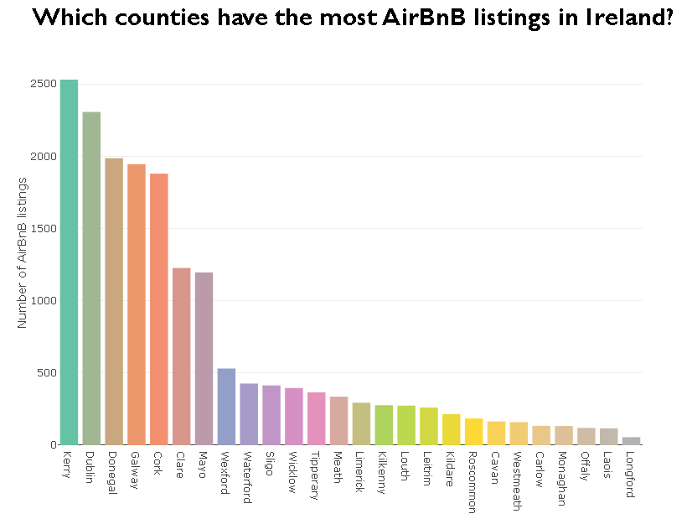
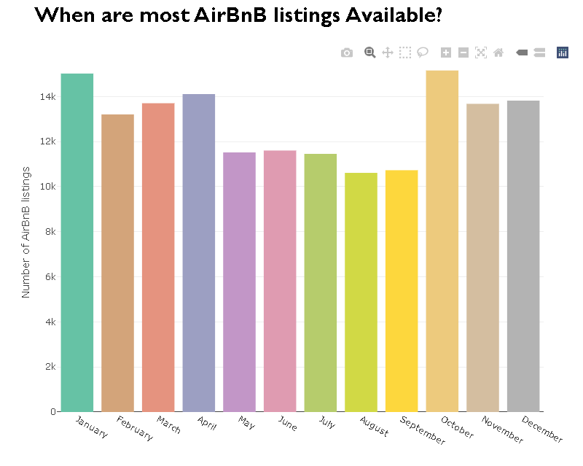
AirBnB Overview

Slide 9
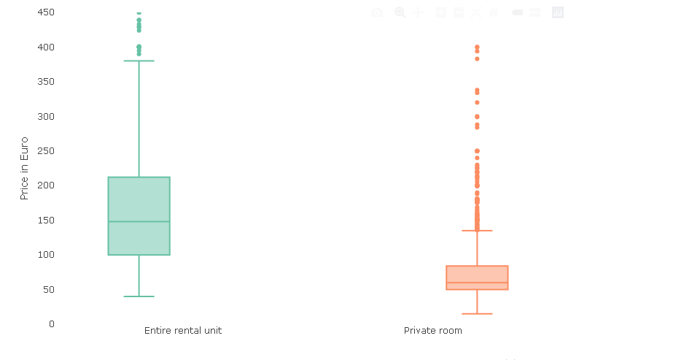
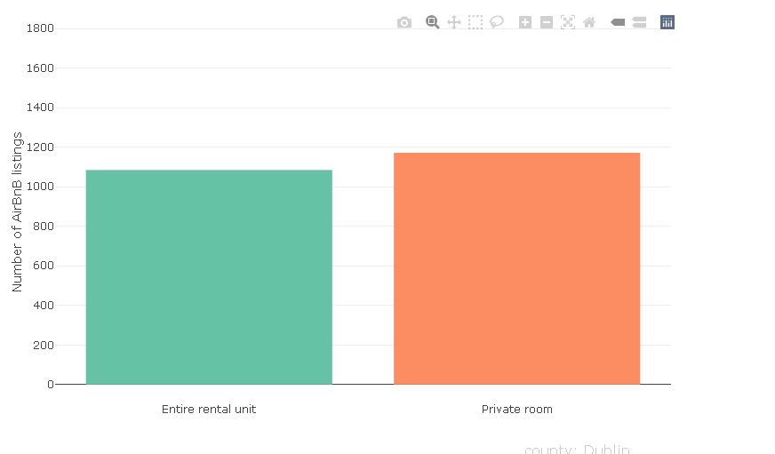
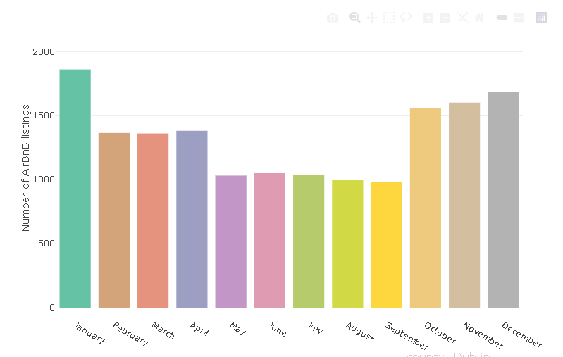
Dublin Breakdown

Slide 10
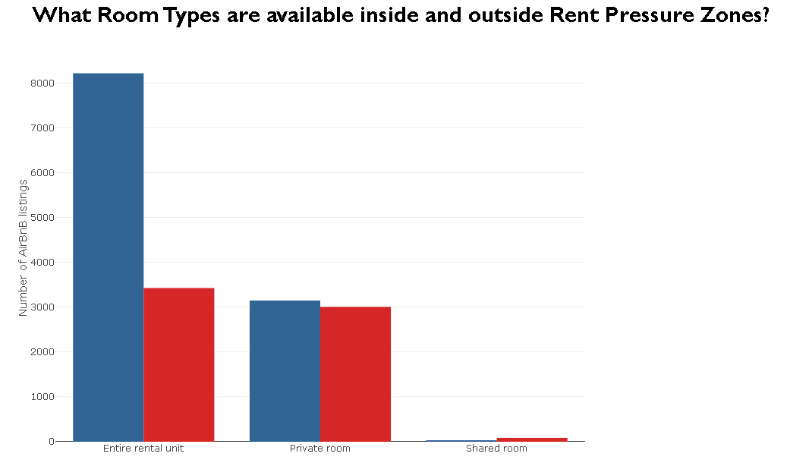
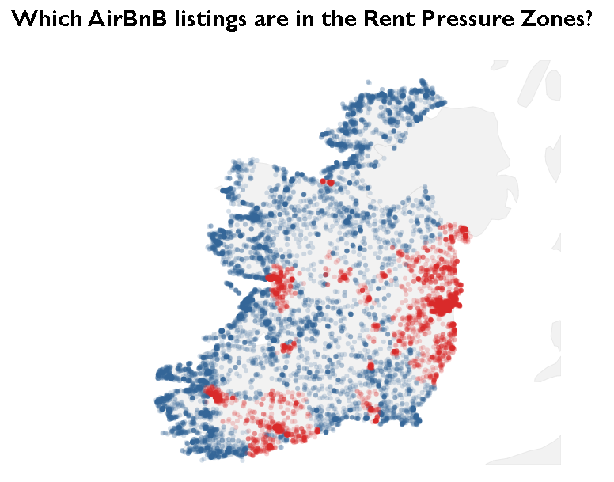
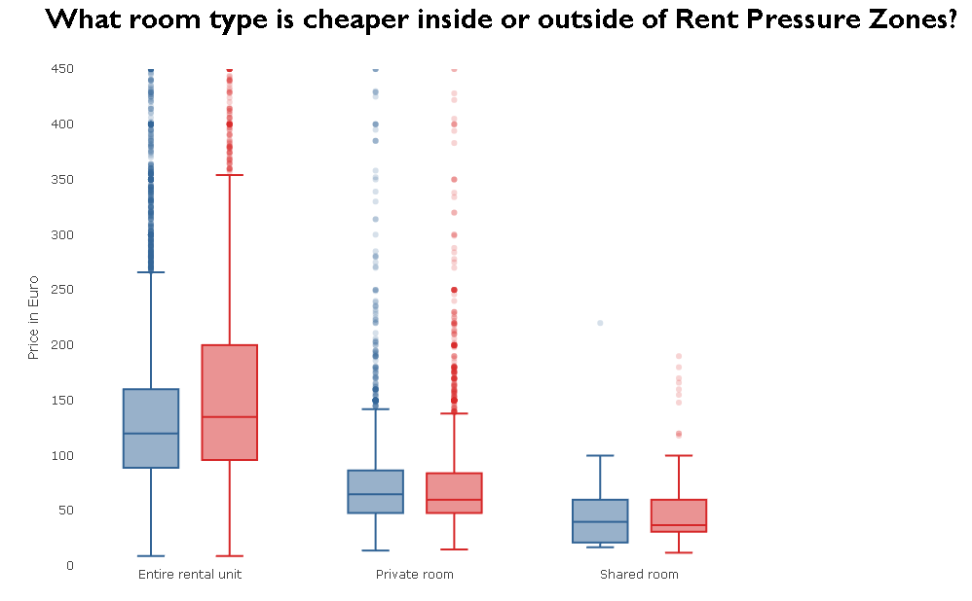
Rent Pressure Zones

Slide 11
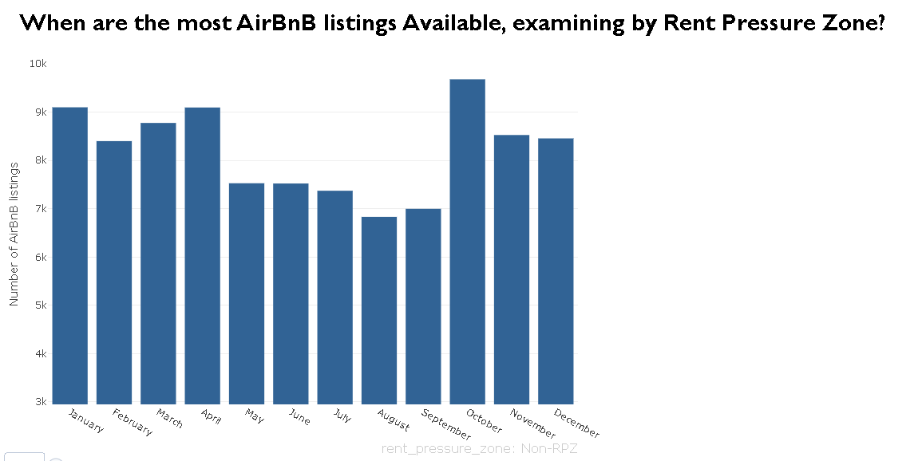
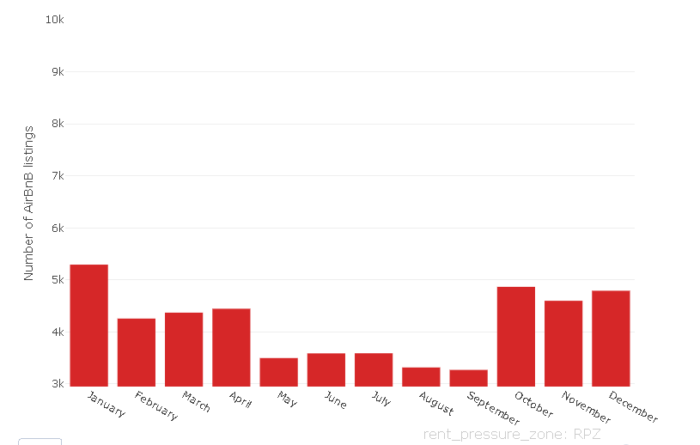
Rent Pressure Zones

Slide 12
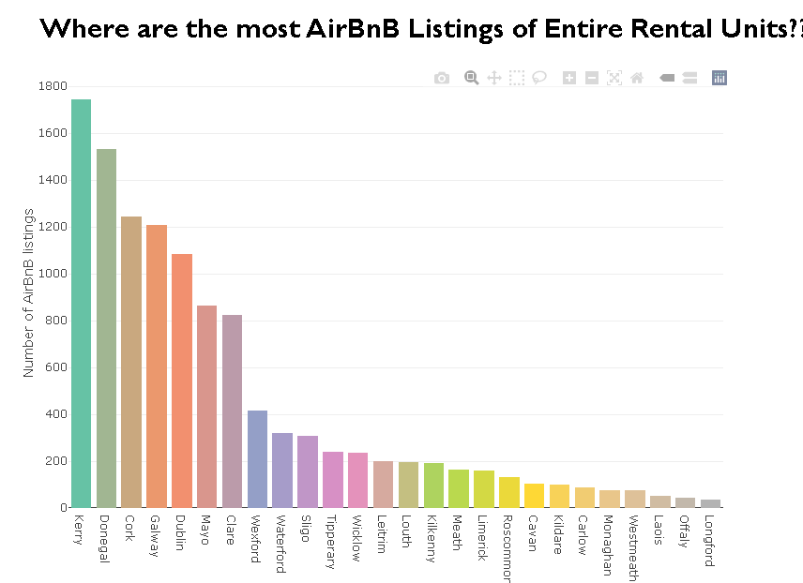
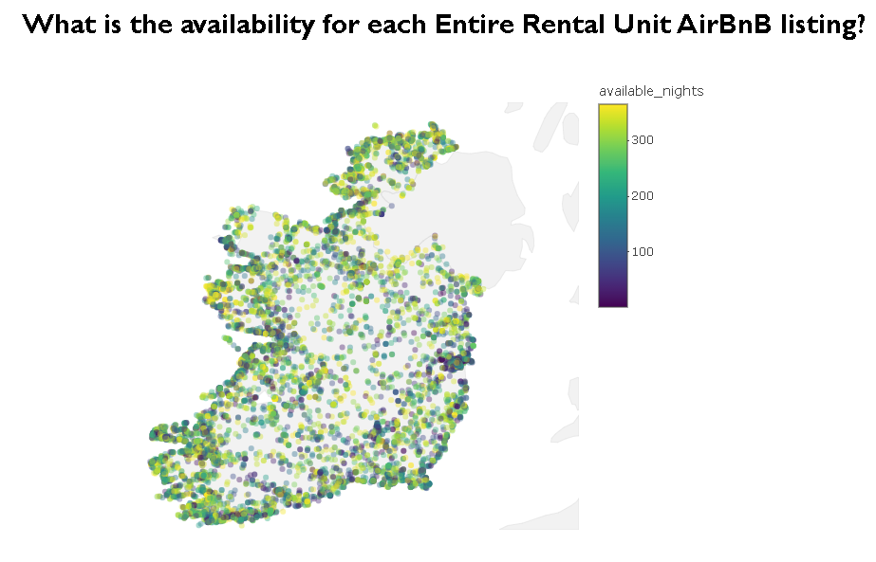
Entire Rental Unit

Slide 13
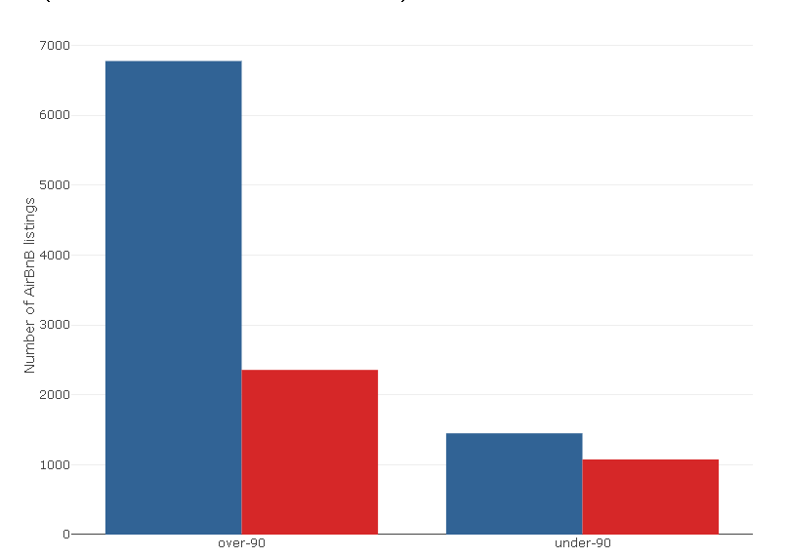
Which Entire Rental Units require Planning Permission?
Planning permission:
- for listing in Rent Pressure Zones if entire rental unit is leased for short-term lets of more than 90 days in total
2,356 entire rental units

Slide 14
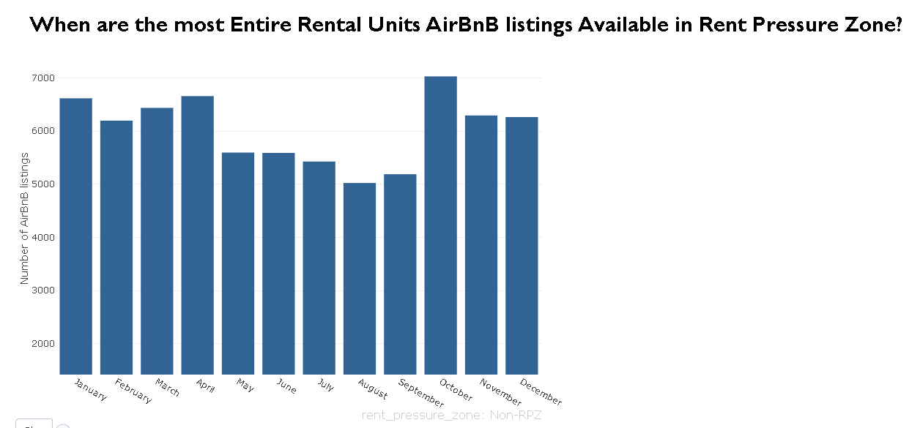
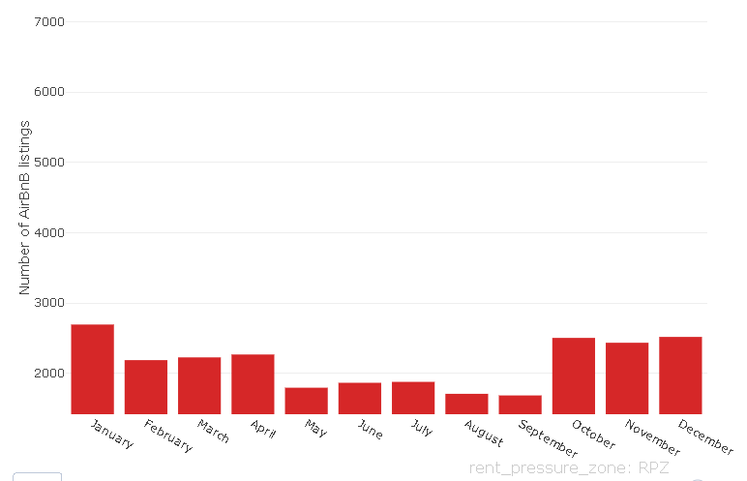
Entire Rental Unit

Slide 15
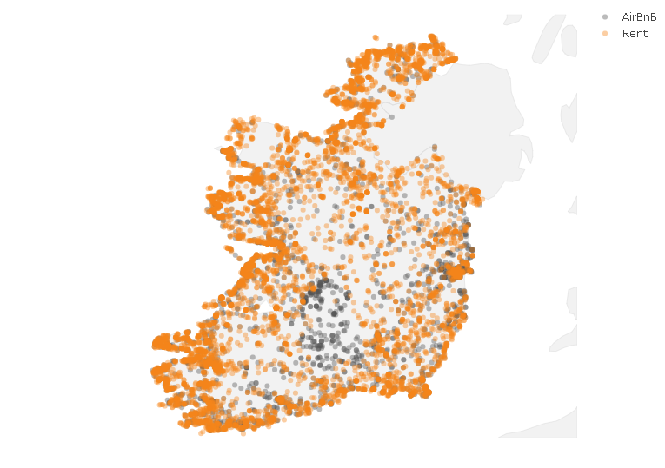
Which Entire Rental Units should be rented out?
Rent or AirBnB:
compares potential income from AirBnB (available_nights * price) and Rent (rent_per_month * 12)

Slide 16
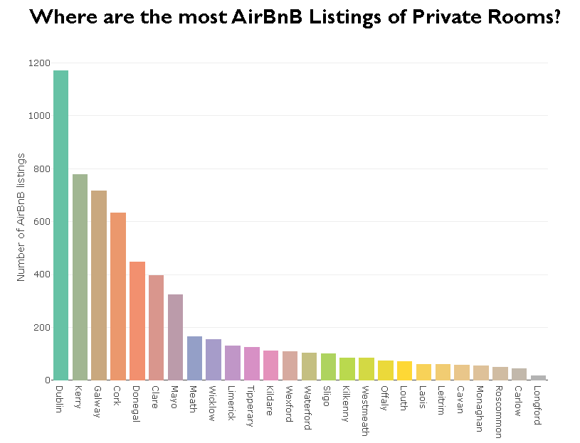
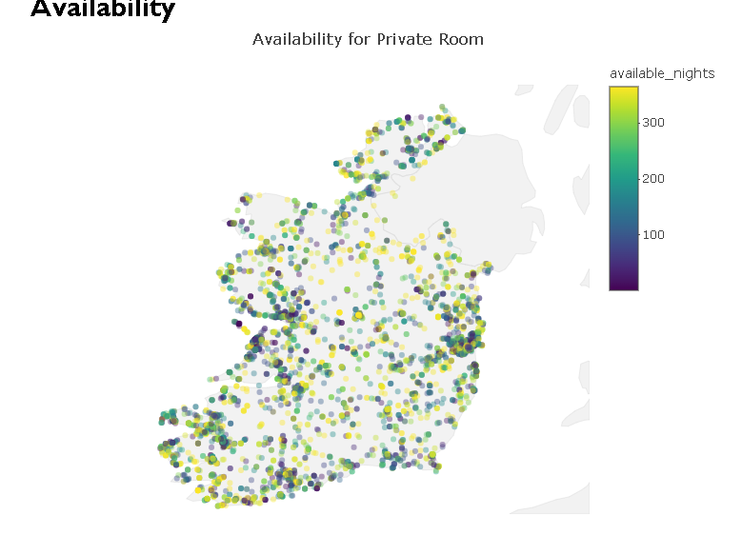
Private Rooms

Slide 17
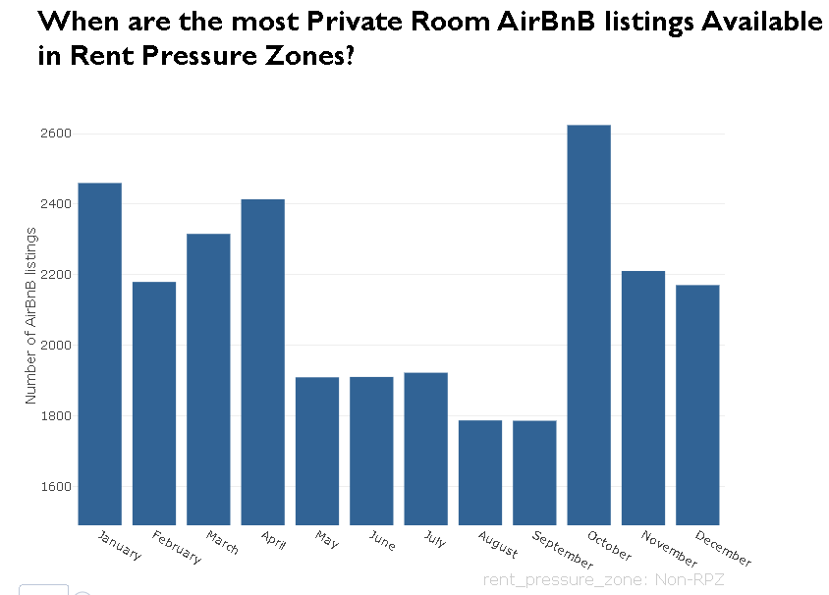
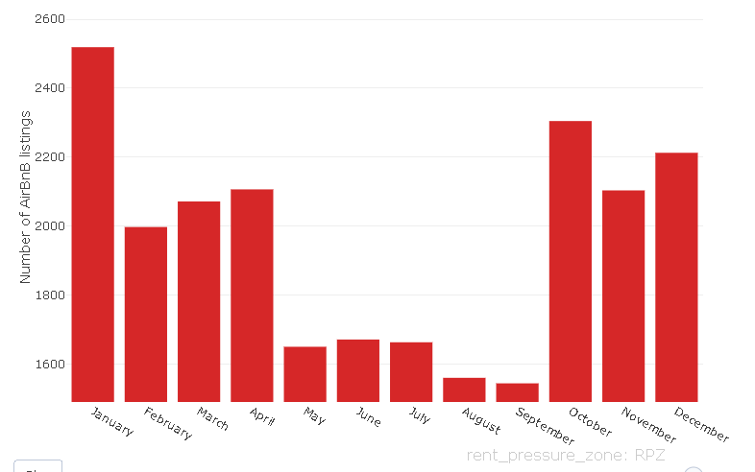
Private Rooms

Slide 18
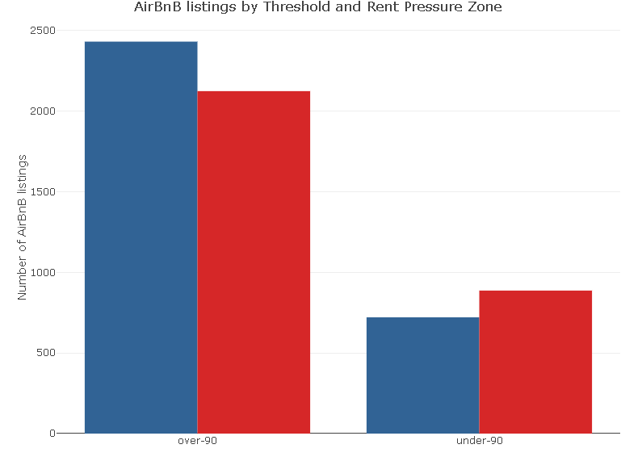
Which Private Rooms would require Planning Permission?
Planning permission:
- for listing in Rent Pressure Zones if entire rental unit is leased for short-term lets of more than 90 days in total
2,124 private rooms

Slide 19
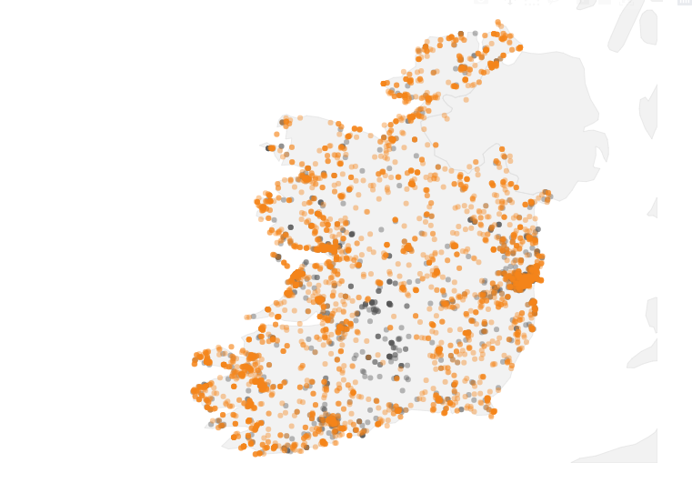
Which Private Rooms should be rented out?
Rent or AirBnB:
compares potential income from AirBnB (available_nights * price) and Rent (rent_per_month * 12)

Slide 20
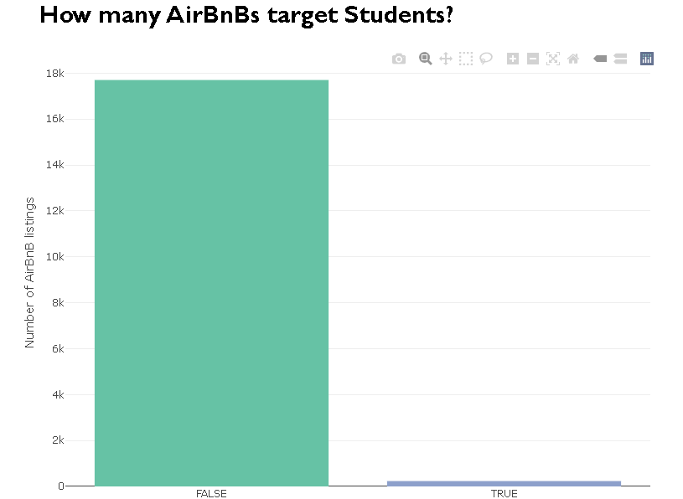
Student Accommodation
17,701 listings do not include ‘student’ in description
234 listings include ‘student’ in description

Slide 21
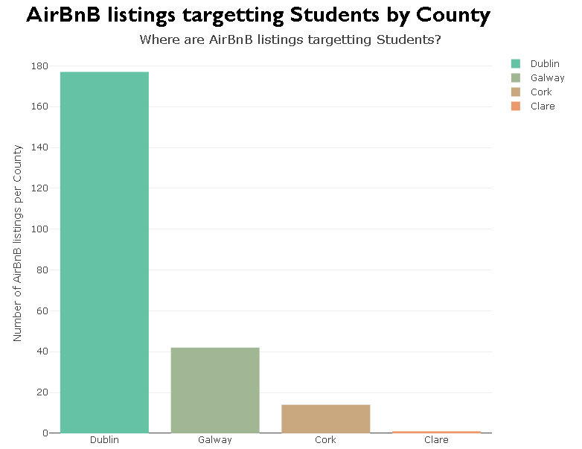
Student Accommodation
County Breakdown
Dublin – 177
Galway – 42
Cork -14
Clare - 1

Slide 22
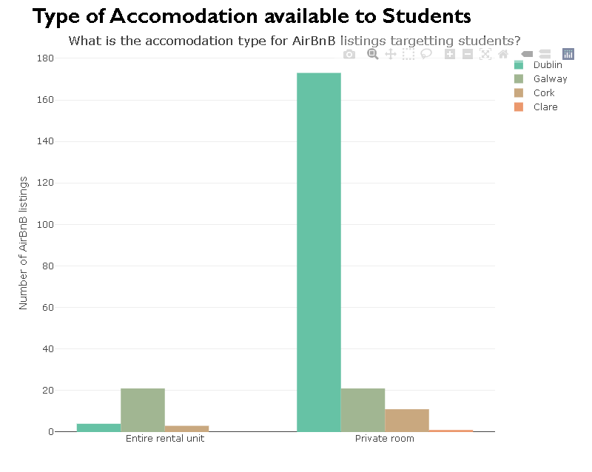
Student Accommodation

Slide 23
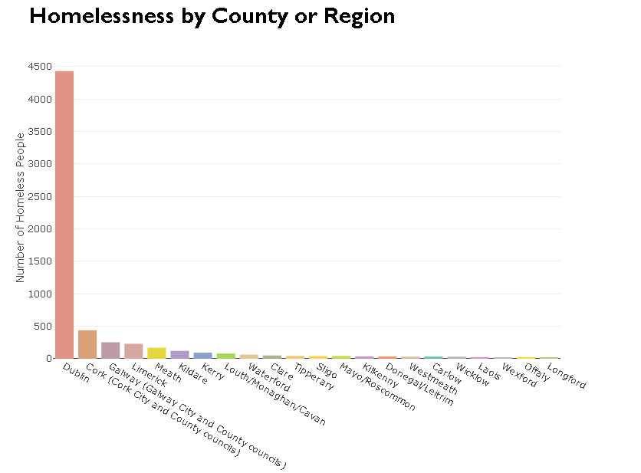
Homelessness

Slide 24
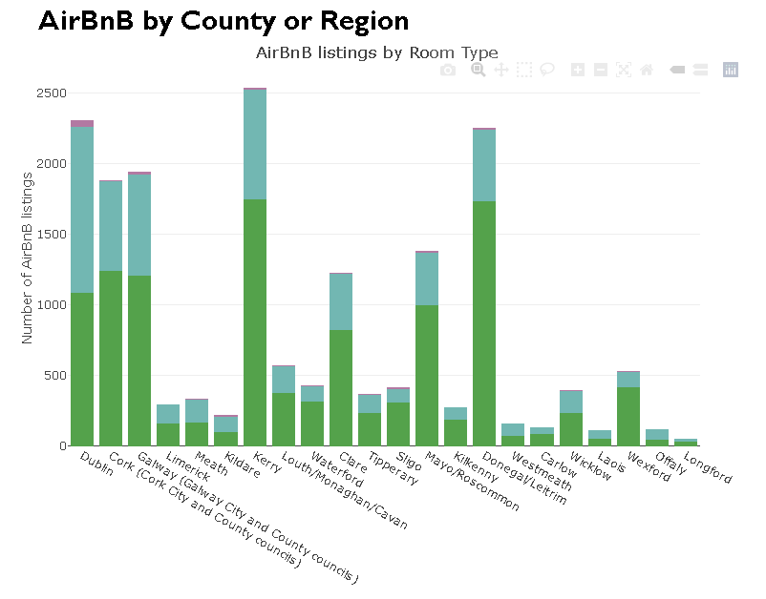
Can AirBnB solve Homelessness?

Slide 25
Conclusion
Rent Pressure Zones: properties in Dublin City and surrounding areas, Cork City and commuting towns, and Galway City.
Leasing is better: AirBnB hosts would earn more by leasing long-term
Student Accommodation:
277 listing – majority in Dublin
Planning Permission:
2,356 entire rental units
2,124 private rooms (should be viewed by the Irish government)
Housing Crisis Solution:
AirBnB removes a lot of potential houses from the long-term leasing or housing market.
Decrease the number of properties (both entire rental units and private rooms)
Move these properties to the long-term rental market to release pressure on the Housing Crisis

Slide 26
Thank you for your time.
Any Questions?

