Slide 1
Equivalence Relations
Section 9.5

Slide 2
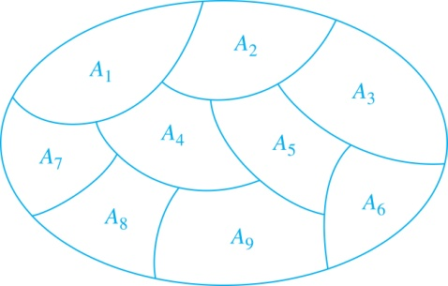
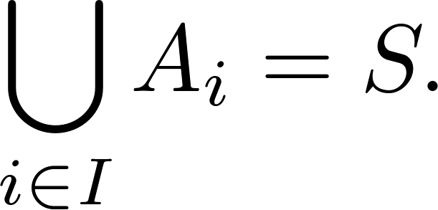
Partition of a Set 集合的划分
Definition: A partition of a set S is a collection of disjoint nonempty subsets of S that have S as their union. In other words, the collection of subsets A_{i}, where i ∈ I (where I is an index set), forms a partition of S if and only if
A_{i} ≠ ∅ for i ∈ I,
A_{i} ∩ A_{j}=∅ when i ≠ j,
and
A Partition of a Set

Slide 3
Example
Let A = {1, 2, 3, 4} and consider the partition P = {{1, 2, 3}, {4}} of A. Find the relation R on A determined by P .
Solution
The blocks of P are {l, 2, 3} and {4}.
Each element in a block is related to every other element in the same block and only to those elements.
Thus R = {(1, 1), (1, 2), (1, 3), (2, 1), (2, 2), (2, 3), (3, l), (3, 2), (3, 3), (4, 4)}.

Slide 4
Equivalence Relations等价关系
Definition 1: A relation on a set A is called an equivalence relation if it is reflexive, symmetric, and transitive.
Definition 2: Two elements a, and b that are related by an equivalence relation are called equivalent. The notation a ∼ b is often used to denote that a and b are equivalent elements with respect to a particular equivalence relation.

Slide 5
Equivalence Relations has 3 elements
1
2
1
2
1
2
1
1
2
2
1
2
3
3
3
3
3
3
Count the number of equivalence relations on a set A with n elements.
Can you find a recurrence relation? (参考练习68题)

Slide 6
Strings 字符串按长度划分
Example: Suppose that R is the relation on the set of strings of English letters such that aRb if and only if l(a) = l(b), where l(x) is the length of the string x. Is R an equivalence relation?
Solution: Show that all of the properties of an equivalence relation hold.
Reflexivity: Because l(a) = l(a), it follows that aRa for all strings a.
Symmetry: Suppose that aRb. Since l(a) = l(b), l(b) = l(a) also holds and bRa.
Transitivity: Suppose that aRb and bRc. Since l(a) = l(b),and l(b) = l(c), l(a) = l(a) also holds and aRc.

Slide 7
Congruence Modulo m同余关系
Example: Let m be an integer with m > 1. Show that the relation R = {(a,b) | a ≡ b (mod m)}
is an equivalence relation on the set of integers.
Solution: Recall that a ≡ b (mod m) if and only if m divides a − b.
Reflexivity: a ≡ a (mod m) since a − a = 0 is divisible by m.
Symmetry: Suppose that a ≡ b (mod m). Then a − b is divisible by m, and so a − b = km, where k is an integer. It follows that b − a = (− k) m, so b ≡ a (mod m).
Transitivity: Suppose that a ≡ b (mod m) and b ≡ c (mod m). Then m divides both a − b and b − c. Hence, there are integers k and l with a − b = km and b − c = lm. We obtain by adding the equations:
a − c = (a − b) + (b − c) = km + lm = (k + l) m.
Therefore, a ≡ c (mod m).

Slide 8
Divides 整除关系
Example: Show that the “divides” relation on the set of positive integers is not an equivalence relation.
Solution: The properties of reflexivity, and transitivity do hold, but there relation is not symmetric. Hence, “divides” is not an equivalence relation.
Not Symmetric: For example, 2 ∣ 4, but 4 ∤ 2. Hence, the relation is not symmetric.

Slide 9
Equivalence Classes等价类
Definition 3: Let R be an equivalence relation on a set A. The set of all elements that are related to an element a of A is called the equivalence class of a. denoted by [a]_{R}.
Note that [a]_{R} = {s|(a,s) ∈ R}.
If b ∈ [a]_{R}, then b is called a representative of this equivalence class. Any element of a class can be used as a representative of the class.
When only one relation is under consideration, we can write [a], without the subscript R, for this equivalence class.

Slide 10
Example 同余关系的等价类
The equivalence classes of the relation congruence modulo m are called the congruence classes modulo m. The congruence class of an integer a modulo m is denoted by [a]_{m}, so [a]_{m} = {…, a−2m, a−m, a+2m, a+2m, … }. For example,
[0]₄ = {…, −8, −4 , 0, 4 , 8 , …}
[1]₄ = {…, −7, −3 , 1, 5 , 9 , …}
[2]₄ = {…, −6, −2 , 2, 6 , 10 , …}
[3]₄ = {…, −5, −1 , 3, 7 , 11 , …}

Slide 11
Equivalence Classes and Partitions
Theorem 1: let R be an equivalence relation on a set A. These statements for elements a and b of A are equivalent:
(i) aRb
(ii) [a] = [b]
(iii) [a] ∩ [b] = ∅
Proof: We show that (i) implies (ii).
Assume that aRb. Now suppose that c ∈ [a]. Then aRc. Because aRb and R is symmetric, bRa. Because R is transitive and bRa and aRc, it follows that bRc. Hence, c ∈ [b]. Therefore, [a]⊆ [b]. A similar argument (omitted here) shows that [b]⊆ [a]. Since [a]⊆ [b] and [b]⊆ [a], we have shown that [a] = [b].

Slide 12
Proof continued
Let c ∈ [a] ∩ [b]
a R c, b R c
c R b, since R is symmetric
a R b, since R is transitive
[a] = [b] by Theroem (ii)
So, If [a] ∩ [b] ≠ ∅ , then [a] = [b] .
else [a] and [b] are not identical, then [a] ∩ [b] = ∅.
QED

Slide 13
An Equivalence Relation Partitions a Set
Theorem 2: Let R be an equivalence relation on a set S. Then the equivalence classes of R form a partition of S.
Conversely, given a partition {A_{i} | i ∈ I} of the set S, there is an equivalence relation R that has the sets A_{i}, i ∈ I, as its equivalence classes.

Slide 14
The quotient set A/R 商集
Definition :
If R is an equivalence relation on A,
The partition P consists of all equivalence classes of R is denoted by A/R and called
the quotient set (商集), or
the partition of A induced by R, or,
A modulo R.

Slide 15
Example
Let
A = {1, 2, 3, 4}
R = {(1, 1), (1, 2), (2, 1), (2, 2), (3, 4), (4, 3), (3, 3), (4, 4)}.
Determine A/R.
Solution
R(1) = {1, 2} = R(2)
R(3) = {3, 4} = R(4).
Hence A/R = {{1, 2}, {3, 4}}

Slide 16

Theroem
Let R be a relation on set A, then tsr(R) is an equivalence relation on A.
tsr(R) is the reflexive, symmetric, transitive closure of R, is called the equivalence relation induced by R.

