Slide 1
Partial orderings
Section 9.6

Slide 2
Content
Partial Order
Linear order（线序）
Quasiorder（拟序）
Product Partial Order（乘积偏序）
Lexicographic Order（词典顺序）
Hasse Diagram（哈斯图）
Topological Sorting（拓扑排序）
Lattices （格）

Slide 3
Review
Properties of relations on a set A:
Reflexive ∀x[x ∈Α → ( x, x )∈R]
Irreflexive ∀x[x ∈Α → ( x, x ) ∉ R]
Symmetric ∀x∀y[( x, y ) ∈ R → (y, x ) ∈ R]
Asymmetric ∀x∀y[( x, y ) ∈ R → ( y, x ) ∉ R]
Antisymmetric
∀x∀y[(x, y)∈R ∧ ( y, x )∈R → x = y]
Transitive
∀x∀y∀z[( x, y ) ∈ R ∧ ( y, z ) ∈ R → ( x, z ) ∈ R]
Notes:
集合A上的二元关系R,如果具有自反、对称和传递三种性质，就被称为等价关系。
等价关系R中，如果元素aRb，称a~b a等价b。
为什么呢？我们通过观察仅有三个元素的等价关系，发现等价关系是由多个不相关的局部全关系构成。只要两个元素相关，就一定在同一个局部全关系中，元素地位对等，元素名可以交换。
我们如何找出这些局部全关系呢？任取一个元素a，找它的相对集R(a)，因为一个相对集就包含所有和a等价的元素，所以等价关系的相对集又叫等价类。多个等价类之间要么相等，要么不相交。这种特质，符合集合的划分特征。
所以，一个等价关系的所有等价类的集合，就是使用等价关系R对集合A进行的一个划分，划分就是除运算，我们又将等价类集合叫做A模除R的商集。
由于等价关系这个显著的特征，等价关系问题可以简化为对等价类集合的研究。

Slide 4
Partial Orderings 偏序关系
Partial order（偏序关系）: A relation R on a set A is called a partial order if R is reflexive（自反）, antisymmetric（反对称）, and transitive（传递）.
Partially ordered set: The set A together with the partial order R is called a partially ordered set, or simply a poset, and we will denote this poset by (A, R).
Notes:
等价关系其实是其上各个等价类集合的全关系 组合. 少见, 主要应用是集合A的划分.
非等价关系的应用更广泛,其中一类是偏序关系.

Slide 5
Partial Orderings
Example 1: Show that the “greater than or equal” relation (≥) is a partial ordering on the set of integers.
Reflexivity: a ≥ a for every integer a.
Antisymmetry: If a ≥ b and b ≥ a , then a = b.
Transitivity: If a ≥ b and b ≥ c , then a ≥ c.
These properties all follow from the order axioms for the integers. (See Appendix 1).

Slide 6
Partial Orderings
Example 2: Show that the divisibility relation (∣) is a partial ordering on the set of integers.
Reflexivity: a ∣ a for all integers a. (see Example 9 in Section 9.1)
Antisymmetry: If a and b are positive integers with a | b and b | a, then a = b. (see Example 12 in Section 9.1)
Transitivity: Suppose that a divides b and b divides c. Then there are positive integers k and l such that b = ak and c = bl. Hence, c = a(kl), so a divides c. Therefore, the relation is transitive.
(Z⁺, ∣) is a poset.

Slide 7
Partial Orderings
Example 3: Show that the inclusion relation (⊆) is a partial ordering on the power set of a set S.
Reflexivity: A ⊆ A whenever A is a subset of S.
Antisymmetry: If A and B are subsets of S with A ⊆ B and B ⊆ A, then A = B.
Transitivity: If A ⊆ B and B ⊆ C, then A ⊆ C.
The properties all follow from the definition of set inclusion.

Slide 8
Comparability 可比性
Definition 2: The elements a and b of a poset (S,≼ ) are comparable(可比的) if either a ≼ b or b ≼ a.
When a and b are elements of S so that neither a ≼ b nor b ≼ a, then a and b are called incomparable (不可比的).
The symbol ≼ is used to denote the relation in any poset.

Slide 9
Comparability 可比性
Definition 2: The elements a and b of a poset (S,≼ ) are comparable if either a ≼ b or b ≼ a. When a and b are elements of S so that neither a ≼ b nor b ≼ a, then a and b are called incomparable.
Definition 3: If (S,≼ ) is a poset and every two elements of S are comparable, S is called a totally ordered or linearly ordered set, and ≼ is called a total order or a linear order. A totally ordered set is also called a chain.
The symbol ≼ is used to denote the relation in any poset.

Slide 10
linear order 线序关系
Definition 3: If (S,≼ ) is a poset and every two elements of S are comparable, S is called a totally ordered or linearly ordered set, and ≼ is called a total order or a linear order. A totally ordered set is also called a chain(链).
(Z⁺,≤)
(Z⁺,|) is not a chain.
Notes:
偏序关系，从结构上可分为 全序关系和 非全序关系。

Slide 11
良序集与良序归纳
Definition 4: (S,≼ ) is a well-ordered set if it is a poset such that ≼ is a total ordering and every nonempty subset of S has a least element.
Theorem 1 : The principle of well-ordered induction: Suppose (S,≼) is a well-ordered set. Then P(x) is true for all x∈S, if
INDUCTIVE STEP: for every y∈S, if P(x) is true for all x∈S with x≼y, Then P(y) is true.
意义:良序集的命题证明简化.
Notes:
可对应5.2 强归纳法 去理解。

Slide 12
Quasiorder 拟序关系
A relation R on a set A is called quasiorder if it is transitive and reflexive.
Example:
(P(S),⊆)

Slide 13
Product partial order乘积偏序
This ordering is called product partial order.

Slide 14
Lexicographic order词典顺序
This ordering is called lexicographic, or “dictionary” order.

Slide 15
Hasse Diagrams哈塞图
Definition: A Hasse diagram is a visual representation of a partial ordering that leaves out edges that must be present because of the reflexive and transitive properties.
the digraph of a partial order on a finite set A that
deletes all self-cycles
eliminates all edges that are implied by the transitive property
draws the digraph with all edges pointing upward

Slide 16
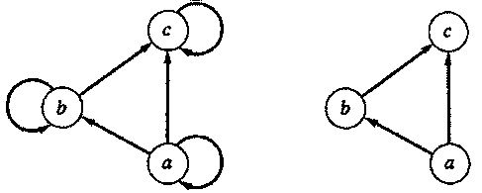
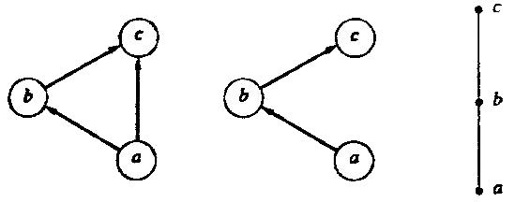
Hasse Diagram

Slide 17
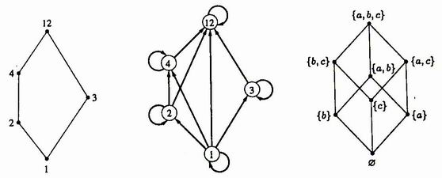
Hasse Diagram
({1, 2, 3, 4, 12}, |)
(P({a, b, c}), ⊆)

Slide 18
Topological Sorting拓扑排序
If A is a poset with partial order ≤, we sometimes need to find a linear order ° for the set A that will merely be an extension of the given partial order in the sense that if a ≤ b, then a ° b.
The process of constructing a linear order such as ° is called topological sorting .

Slide 19
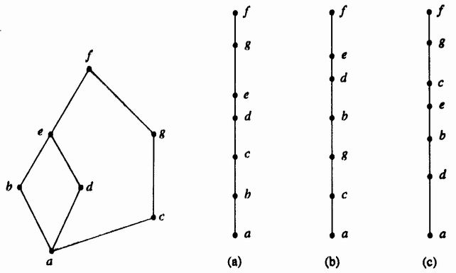
Example

Slide 20
Topological Sorting Algorithm
For finding a topological sorting of a finite poset (A, ≼ ).
Step1 Choose a minimal element a of A.
Step2 Make a the next entry of SORT and replace A with A-{a}.
Step3 Repeat steps 1 and 2 until A={}.
End of Algorithm

Slide 21
Maximal(minimal) element
An element a ∈ A is called a maximal element (极大元) of A if there is no element c in A such that a≼ c.
An element b ∈ A is called a minimal element (极小元) of A if there is no element c in A such that c≼ b.

Slide 22
Greatest (least ) element
An element a ∈A is called a greatest element (最大元) of A if x ≤ a for all x ∈ A.
An element a ∈A is called a least element (最小元) of A if a ≤ x for all x ∈ A.

Slide 23
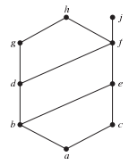
Lub最小上界,Glb最大下界）
Consider a poset and a subset B of A.
An element a ∈ A is called a upper bound（上界） of B if b≼a for all b ∈ B.
An element a ∈ A is called a lower bound（下界）of B if a≼b for all b ∈ B.
An element a ∈ A is called a least upper bound (LUB) of B if a is an upper bound of B and a≼a’, whenever a’ is an upper bound of B.
An element a ∈ A is called a greatest lower bound (GLB) of B if a is an lower bound of B and a’≼a, whenever a’ is an lower bound of B.

Slide 24
Theorem
Let (A, ≼) be a poset
If A is a finite nonempty, then A has at least one maximal element and at least one minimal element.
A has at most one greatest element and at most one least element.
A subset B of A has at most one LUB and at most one GLB.

Slide 25
Isomorphism关系同构
Let (A, ≤) and (A’, ≤’) be posets and let f :A→A’ be a one-to-one correspondence between A and A’. The function f is called an isomorphism from (A, ≤) to (A’, ≤’) if, for any a and b in A,
a ≤ b if and only if f(a) ≤’ f(b).
If f : A→A’ is an isomorphism, we say that (A, ≤) and (A’, ≤’) are isomorphic posets.

Slide 26
Isomorphism: Example
Let (Z⁺, ≤) and (E⁺, ≤) be posets. The function f : Z⁺ → E⁺ given by
f(a) = 2a
is an isomorphism from (Z⁺ , ≤) to (E⁺ , ≤)
Proof
First, is onto and one-to-one
Second, a ≤ b iff 2a ≤ 2b

Slide 27
Principle of correspondence（对应原理）
Suppose that f：A→A’ is an isomorphism from a poset (A, ≤) to a poset (A’, ≤’). Suppose also that B is a subset of A, and B’ = f(B) is the corresponding subset of A’. Then
If the elements of B have any property relating to one another or to other elements of A, and if this property can be defined entirely in terms of the relation ≤, then the elements of B’ must possess exactly the same property, defined in terms of ≤’ .
two finite isomorphic posets must have the same Hasse diagram.

Slide 28
Theorem
Suppose that (A, ≤) and (A’, ≤’) are isomorphic posets under the isomorphism f: A→A’.
If a is a maximal (minimal) element of (A, ≤), then f(a) is a maximal (minimal) element of (A’, ≤’).
If a is a greatest (least) element of (A, ≤), then f(a) is a greatest (least) element of (A’, ≤’).
If a is an upper bound (lower bound, least upper bound, greatest lower bound) of (A, ≤), then f(a) is an upper bound (lower bound, least upper bound, greatest lower bound) of (A’, ≤’).
If every subset of (A, ≤) has a LUB (GLB), then every subset of (A’, ≤’) has a LUB (GLB).

Slide 29
Lattice 格
A lattice is a poset in which every subset {a,b} consisting of two elements has a least upper bound and a greatest lower bound.
denote LUB({a,b}) by a∨b and call it the join（并） of a and b.
denote GLB({a,b}) by a∧b and call it the meet（交） of a and b.

Slide 30
Example
Let S be a set and let L = P(S).
As we have seen, ⊆, containment, is a partial order on L. Let A and B belong to the poset (L, ⊆).
A∨B is the set A∪B.
To see that, note that A⊆A∪B, B ⊆ A∪B, and if A ⊆ C and B ⊆ C, then it follows that A∪B ⊆ C.
Similarly, A∧B is the set A∩B.
Thus, L is a lattice.

Slide 31
Example
S={a,b,c}
(P(S),⊆)
{a,b,c}
{a,c}
{b,c}
{a,b}
{c}
{a}
{b}
{}

Slide 32
Example
Let n be a positive integer and D_{n} be the set of all positive divisors of n.
D₃₀={1,2,3,5,6,10,15,30}
a ∨ b=LCM(a,b)
a ∧ b=GCD(a,b)
30
10
15
6
2
5
3
1

Slide 33
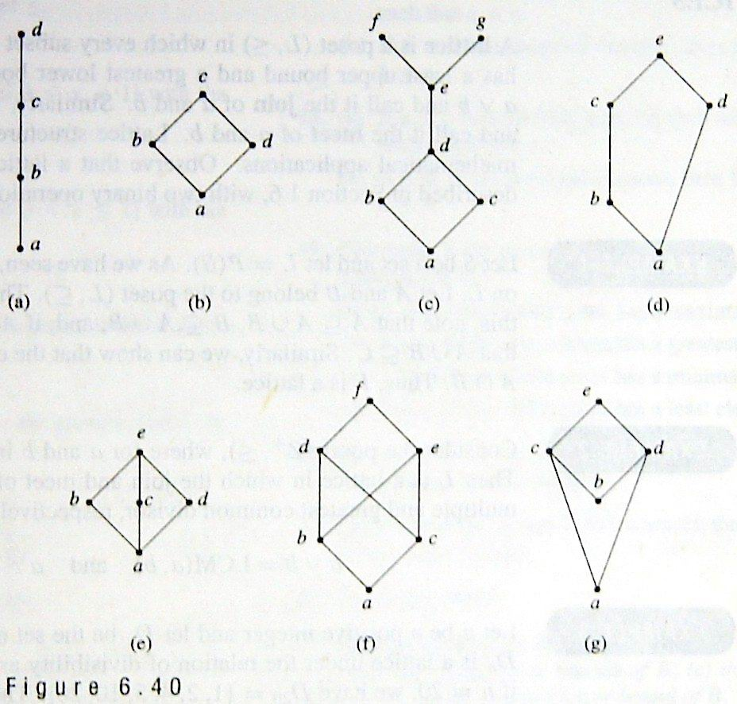
Example
Notes:
f is not a lattice, because neither GLB(d,e) nor LUB(b,c) exist.
g is not a lattice, because GLB(c,d) not exist.

Slide 34
Theorem 乘积格
If (L₁, ≤) and (L₂, ≤) are lattices, then (L, ≤) is a lattice, where
L = L₁×L₂
the partial order ≤ of L is the product partial order.

Slide 35
Proof
We denote the join and meet in L₁ by ∨₁ and∧₁, respectively, and the join and meet in L₂ by ∨₂ and ∧₂, respectively. Then L is a poset.
We now need to show that if (a₁, b₁) and (a₂, b₂)∈L, then (a₁, b₁)∨(a₂, b₂) and (a₁, b₁)∧(a₂, b₂) exist in L. We leave it as an exercise to verify that
(a₁, b₁)∨(a₂, b₂) = (a₁ ∨₁ a₂, b₁ ∨₂ b₂)
(a₁, b₁)∧(a₂, b₂) = (a₁ ∧₁ a₂, b₁ ∧₂ b₂).
Thus L is a lattice.

Slide 36
Example
L₁ L_{2’} =L₁ × L₁ L₂ L= L₁× L₂
(1₁ ,1₂)
1₁
(1₁ ,1₁)
1₂
(1₁ ,a)
(1₁ ,b)
(0₁ ,1₂)
(0₁ ,1₁)
a
b
(1₁ ,0₁)
(1₁ ,0₂)
(0₁ ,a)
(0₁ ,b)
0₁
(0₁ ,0₁)
0₂
(0₁ ,0₂)

Slide 37
Sublattice（子格）
Let (L, ≤) be a lattice. A nonempty subset S of L is called a sublattice of L
if a∨b ∈ S and a∧b∈S whenever a ∈ S and b ∈ S.

Slide 38
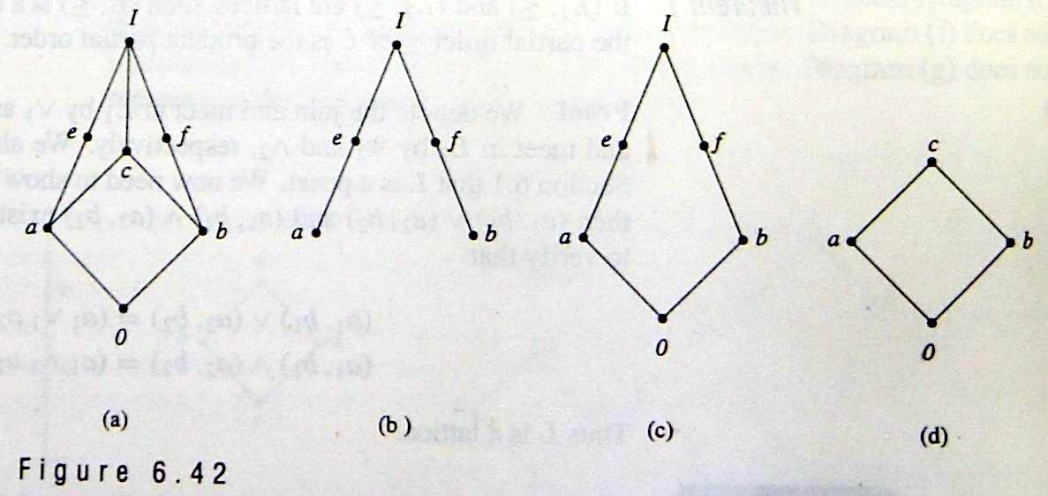
Sublattice
Example : (D_{n}, |) is a sublattice of (Z⁺, |)
Example

Slide 39
Theorem
Let L be a lattice. Then
Idempotent Properties（等幂律）
(a) a∨a = a
(b) a∧a = a
Commutative Properties（交换律）
(a) a∨b = b∨a
(b) a∧b = b∧a
Associative Properties（结合律）
(a) a∨(b∨c) = (a∨b)∨c
(b) a∧(b∧c) = (a∧b) ∧c
Absorption Properties（吸收律）
(a) a∨(a∧b) = a
(b) a∧(a∨b) = a

Slide 40
Proof of 4. (a)
Since a∧b≤a and a≤a, we see that a is an upper bound of a∧b and a; so a∨(a∧b)≤a. On the other hand, by the definition of LUB, we have a≤a∨(a∧b), so a∨(a∧b) = a.
Q.E.D
It follows from property 3 that we can write a∨(b∨c) and (a∨b) ∨c merely as a∨b∨c, and similarly for a∧b∧c.

Slide 41
Complement（补元）
Let L be a bounded lattice with greatest element I and least element 0, and let a ∈ L. An element a’ L is called a complement of a if
a∨a’ = I and a∧a’ = 0
Note that
0’ = I and I’ = 0.
An element a in a lattice need not have a complement, and it may have more than one complement.

Slide 42
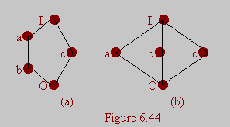
Complemented（有补格）
A lattice is called complemented if it is bounded and if every element in L has a complement.
In this case, the complements are not unique.

Slide 43
Distributive lattice（分配格）
A lattice is called distributive if for any elements a, b, and c in L we have the following distributive properties.
a∧(b∨c) = (a∧b)∨(a∧c)
a∨(b∧c) = (a∨b)∧(a∨c)
If L is not distributive, we say that L is nondistributive

Slide 44
Isomorphic Lattices（同构格）
If f: L₁→L₂ is an isomorphism from the poset (L₁, ≤₁) to the poset (L₂, ≤₂)
L₁ is a lattice if and only if L₂ is a lattice.
If a and b are elements of L₁, then
f(a∧b) = f(a) ∧ f(b)
f(a∨b) = f(a) ∨ f(b).
If two lattices are isomorphic, as posets, we say they are Isomorphic Lattices.

