Slide 1
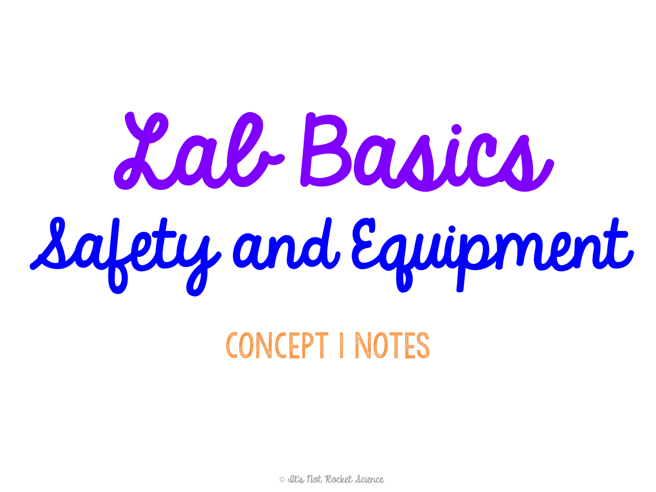
Notes:
I like to have the equipment set up on my front demo table so I can show it to them and they can touch and see it for themselves!

Slide 2

Lab Safety
We will be spending a lot of time doing labs together, so it is important you know how to act appropriately.
General Guidelines:
Read lab through ALL THE WAY before doing anything else.
Notes:
I like to have students guess the guideline based on the picture, to spice the lecture up a bit!

Slide 3
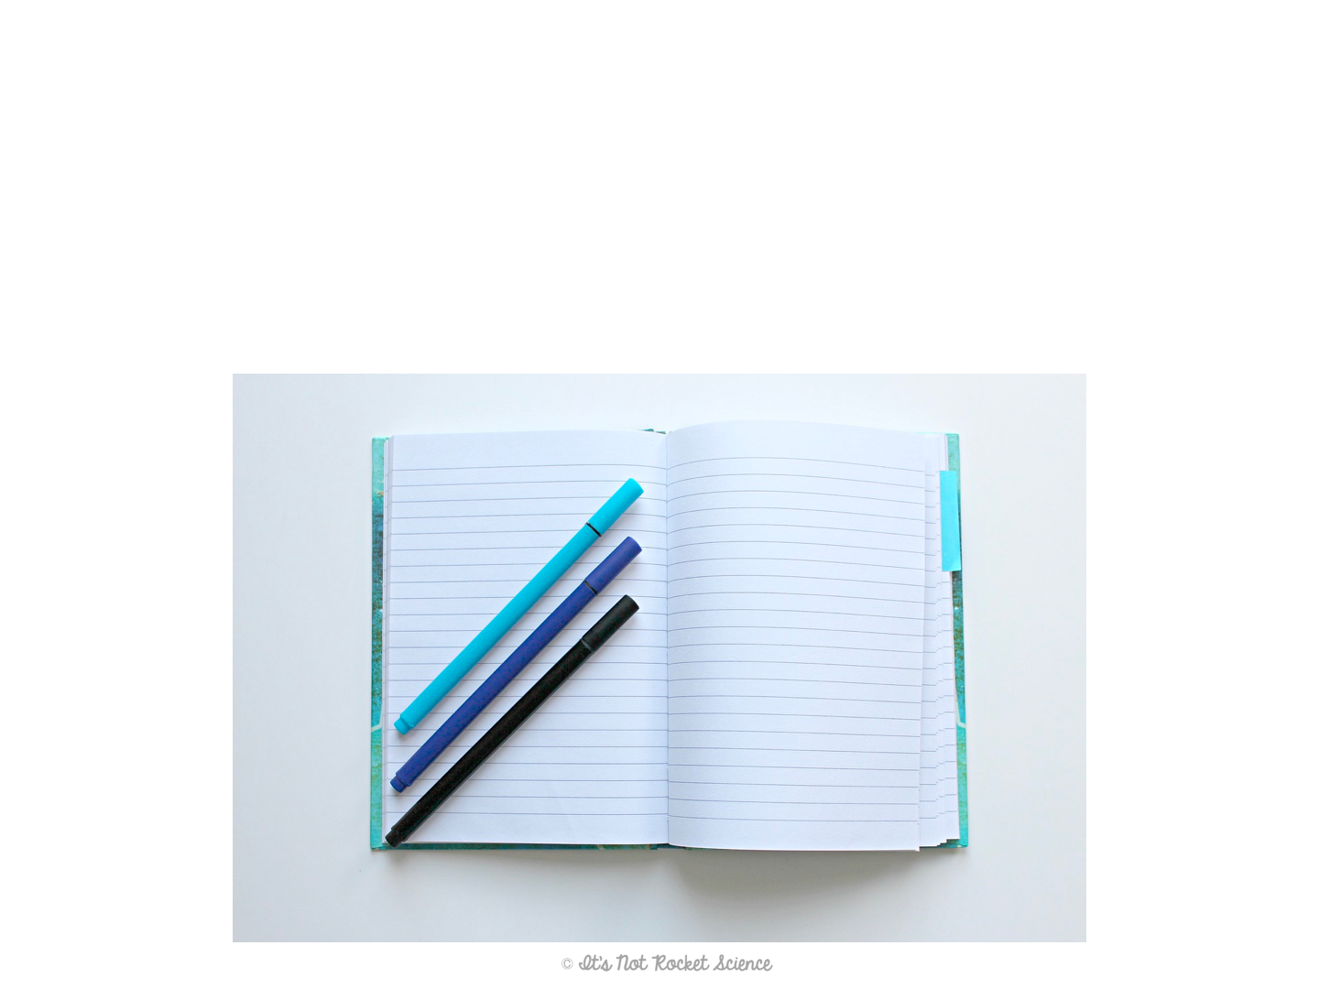
Lab Safety
General Guidelines:
Keep lab table or desk neat and organized to avoid spilling or breaking anything while working.
Notes:
I like to have students guess the guideline based on the picture, to spice the lecture up a bit!

Slide 4
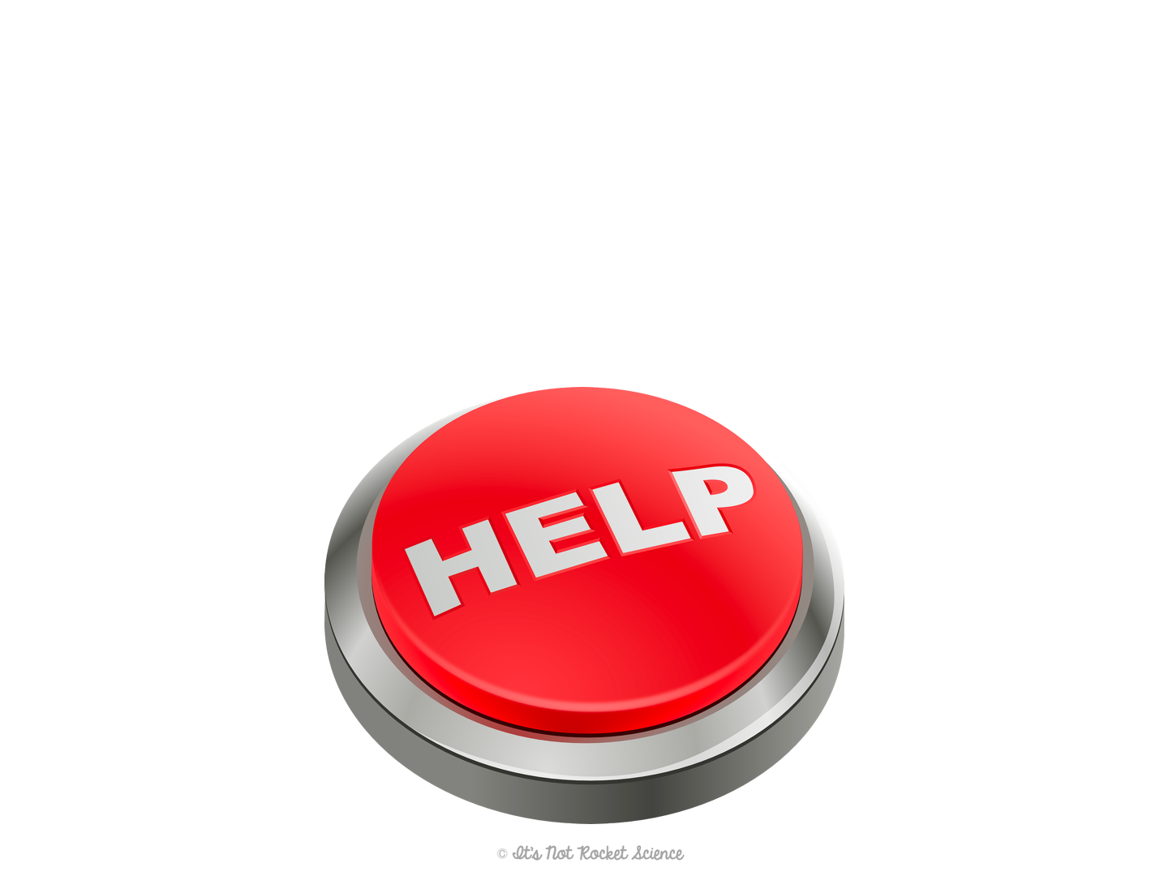
Lab Safety
General Guidelines:
In case of emergency, always tell the teacher before doing anything else!
No matter how minor, I want to know!!
Notes:
I like to have students guess the guideline based on the picture, to spice the lecture up a bit!

Slide 5

Lab Safety
General Guidelines:
Take lab seriously! Never goof around.
Notes:
I like to have students guess the guideline based on the picture, to spice the lecture up a bit!

Slide 6
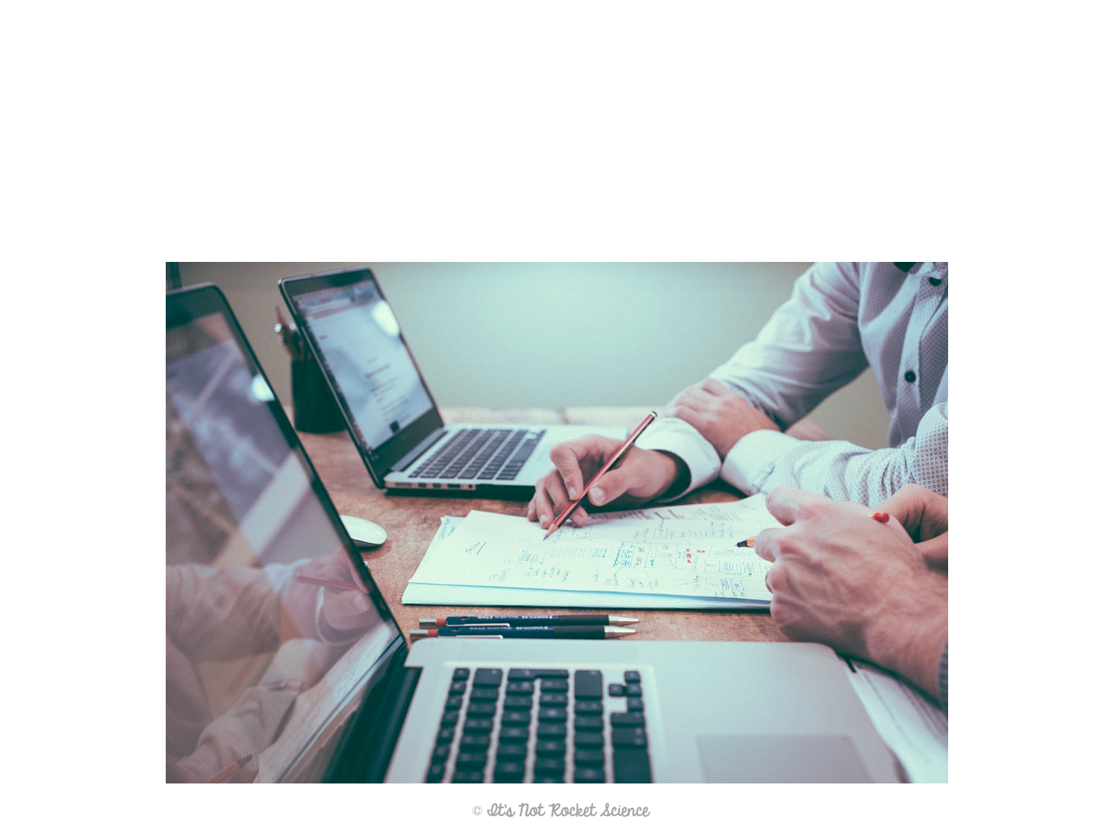
Lab Safety
General Guidelines:
When in doubt, ask the teacher!
Notes:
I like to have students guess the guideline based on the picture, to spice the lecture up a bit!

Slide 7
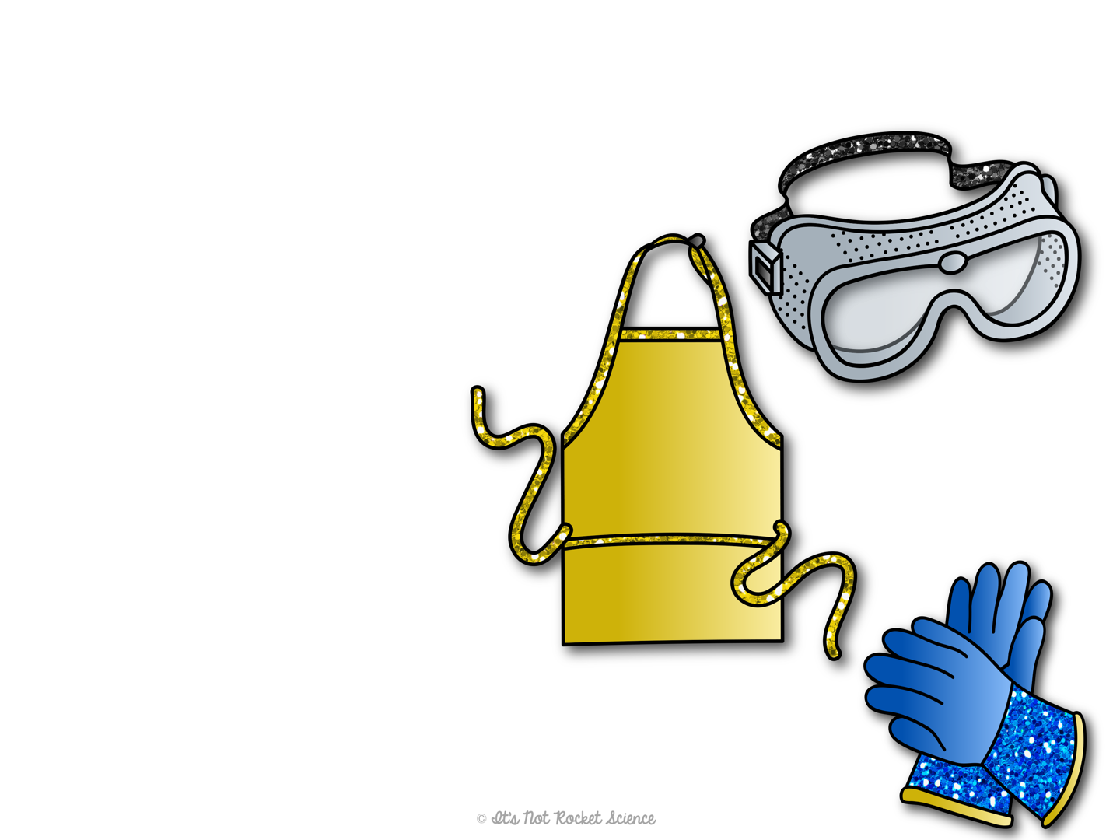
Lab Safety - Equipment
Safety Goggles: always wear when using chemicals or fire to protect your eyes.
These stay on, even through clean up!
Lab Apron: Wear to protect clothing.
Heat-resistant gloves: Wear when using hot objects to avoid burning yourself!

Slide 8
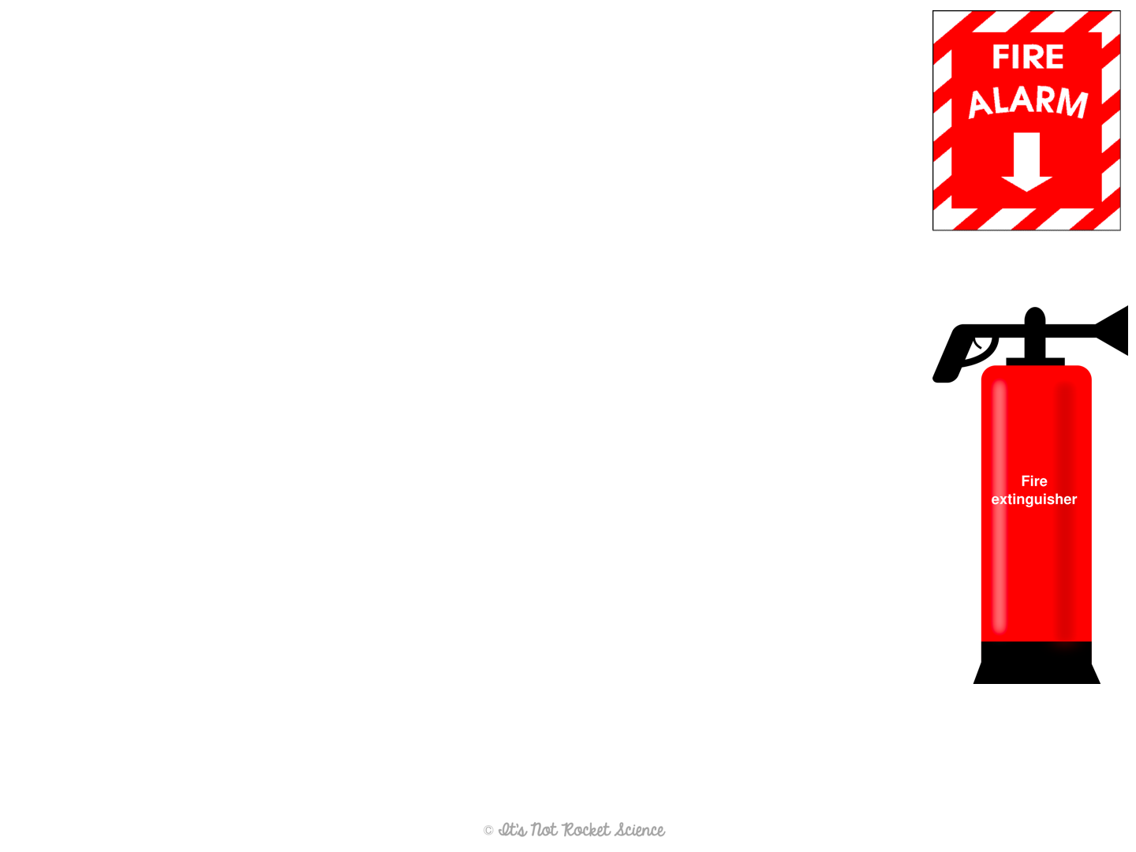
Lab Safety - Fire
To prevent fires:
Never walk away from an open flame or a plugged in hot plate.
Keep hair tied back when working in lab.
Do not wear loose clothing or jewelry in lab.
A fire extinguisher can be used to put out fires.
PASS = Pull, Aim, Squeeze, Sweep
A fire blanket is best to use when a person is on fire

Slide 9
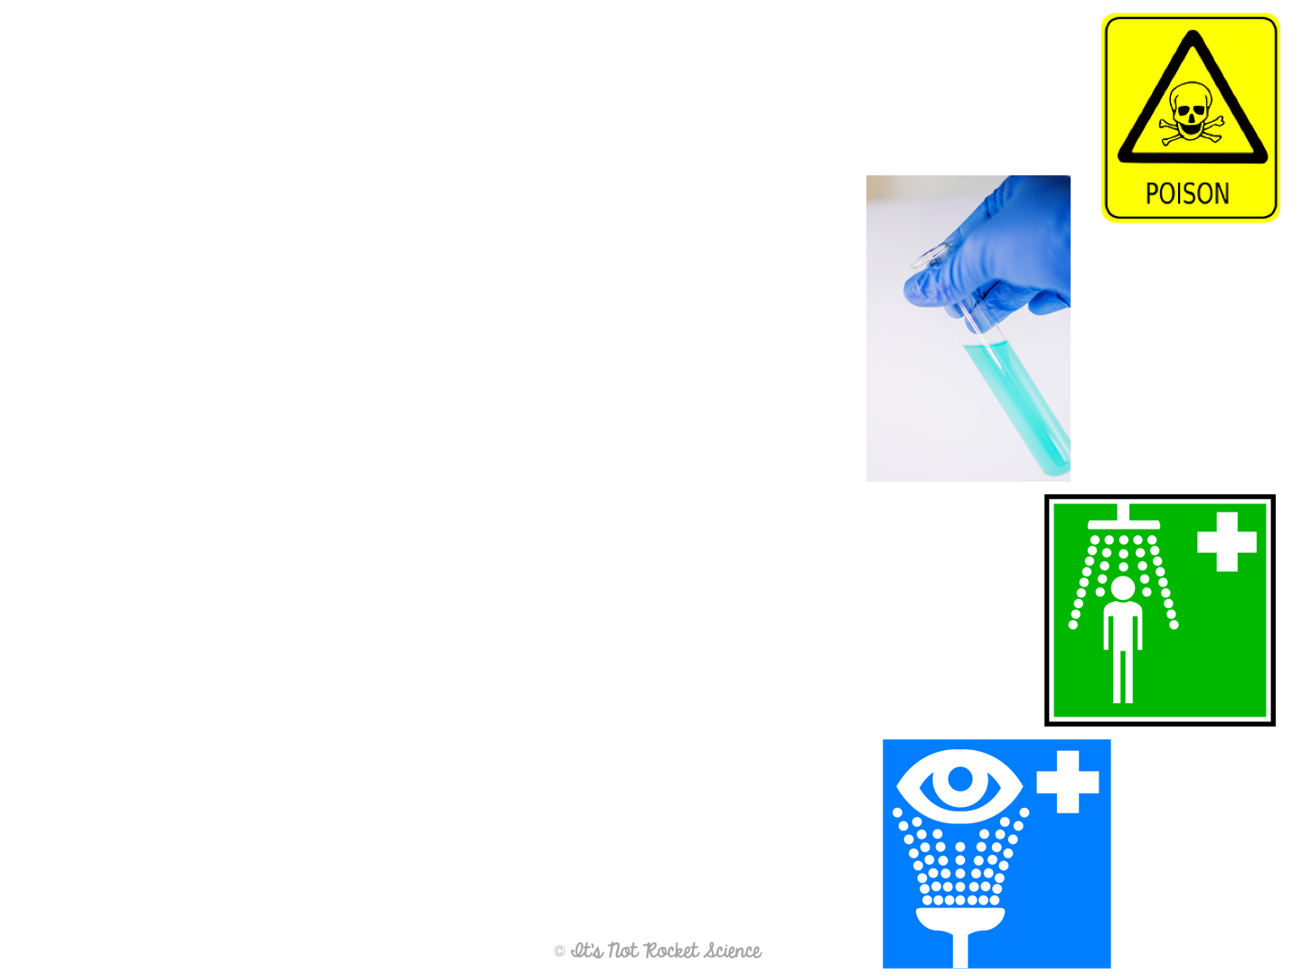
Lab Safety - Chemicals
No eating and drinking in lab!!
Don’t ever taste a chemical.
When smelling, make sure to waft.
Wear gloves when handling toxic chemicals.
Always dispose of chemicals correctly.
Ask before pouring down the sink!!
Tell the teacher if you spill!
If you get a chemical on yourself…
Use eye wash or safety shower
Notes:
Be sure to demonstrate how to waft!

Slide 10
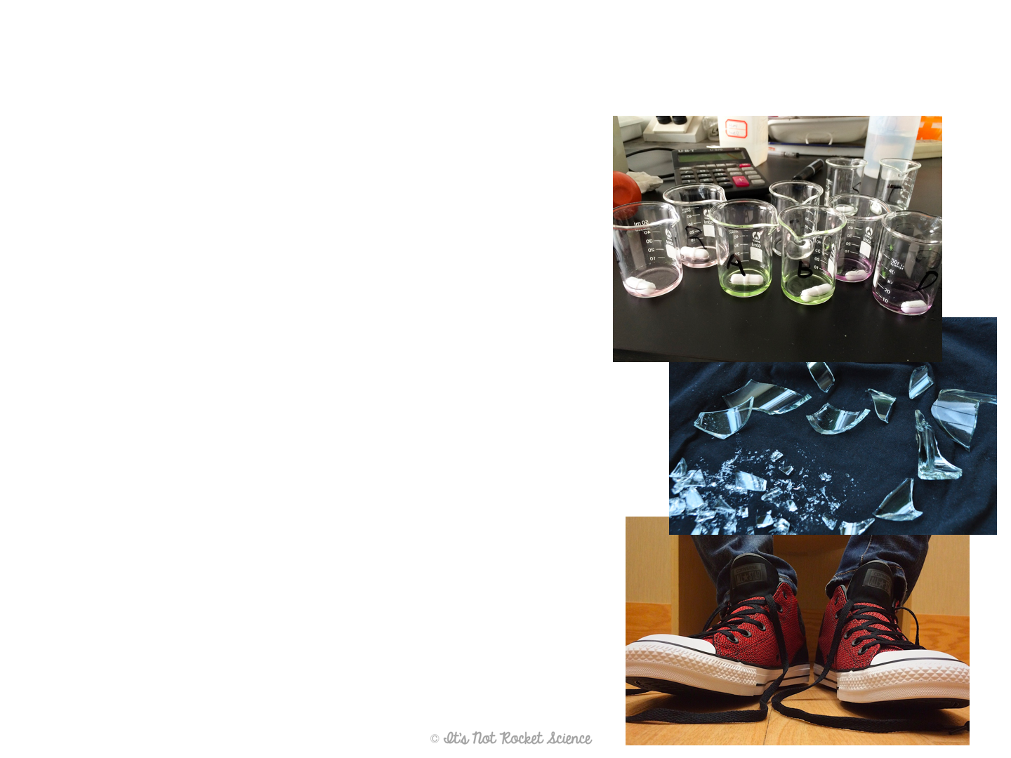
Lab Safety - Glassware
Hot glass looks just like cold glass.
Be careful, and always use safety equipment to handle!
Broken glass goes in special disposal, not the trash can.
Notify me if your glassware is cracked before using!
Closed toed shoes and long pants are the safest attire for working in lab.

Slide 11
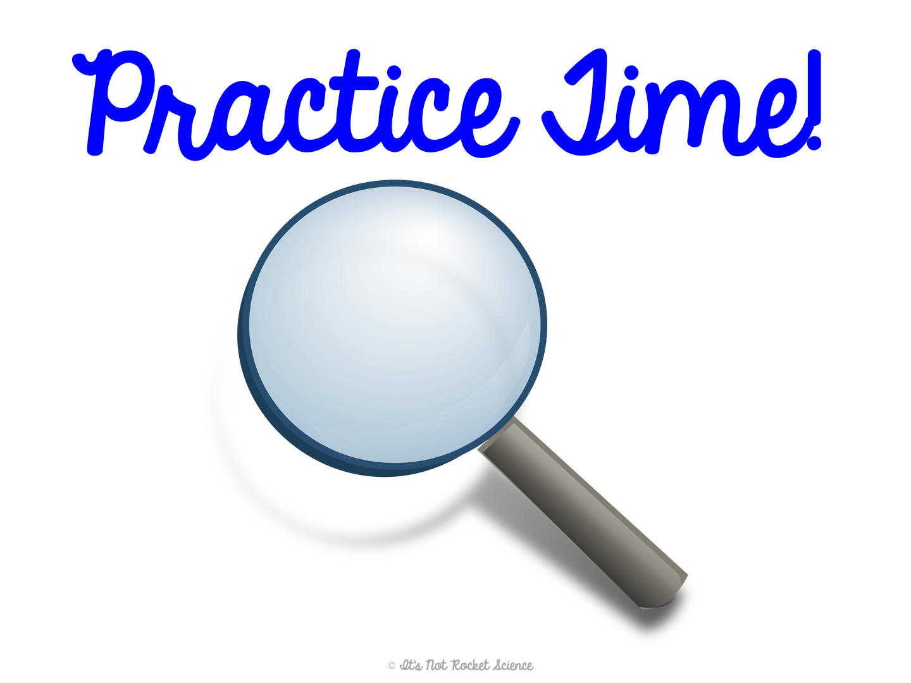
Notes:
Have students locate various safety equipment around your classroom (or wherever the nearest are) such as:
Fire blanket
Fire extinguisher
Fire alarm
Safety eye wash
Safety shower
Safety goggles and lab aprons (wherever they are stored)
Broken glass disposal

Slide 12
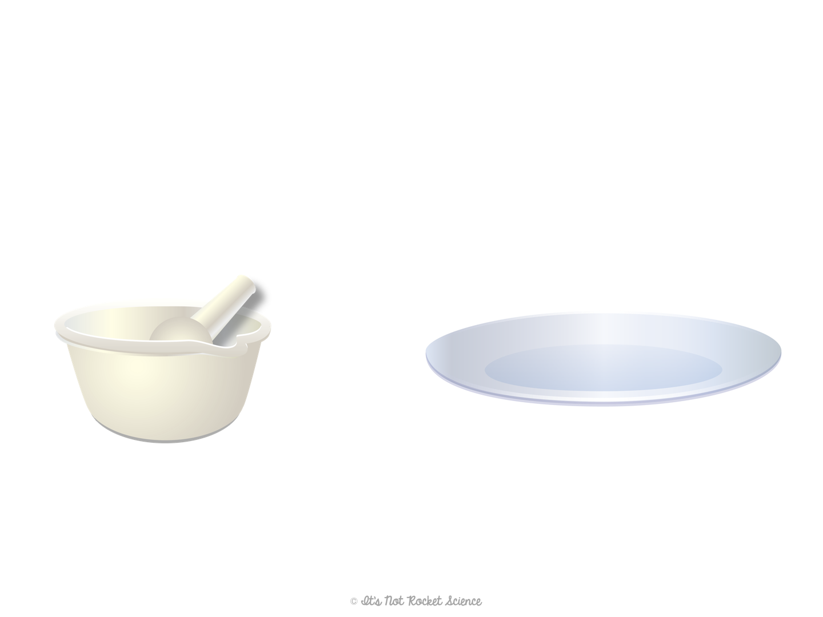
Lab Equipment
Each piece of lab equipment is designed for a specific job.
There is tons of equipment, so we will just focus on what we will use in this class.
Mortar and Pestle: For grinding solids into a powder.
Watch glass: Can be used as a lid on a beaker to prevent splattering
Notes:
I like to have the equipment set up on my front demo table so I can show it to them and they can touch and see it for themselves!
Hide this slide if you don’t use this equipment. Or replace with a slide of your own extras!

Slide 13
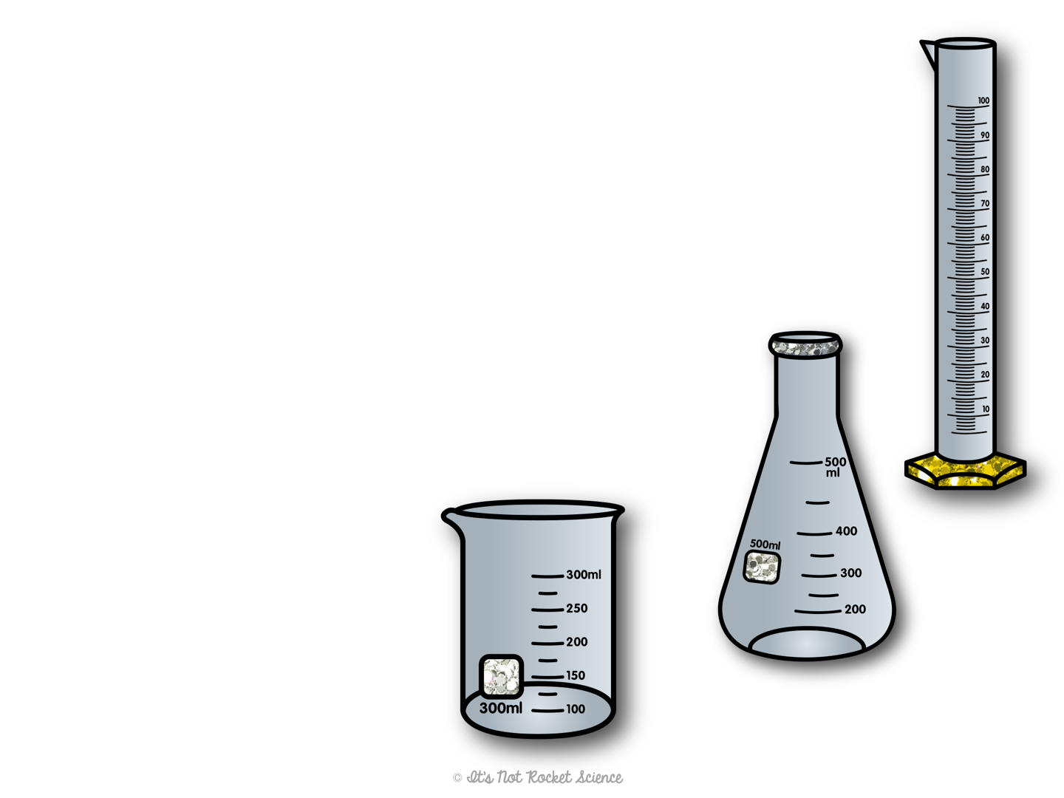
Lab Equipment
Glassware
Graduated cylinder: Makes precise volume measurements of liquids
Erlenmeyer flask: Heating liquids, but can also measure and hold them.
Beaker: Holding, mixing, heating, and measuring liquids (and some solids)
Notes:
I like to have the equipment set up on my front demo table so I can show it to them and they can touch and see it for themselves!

Slide 14
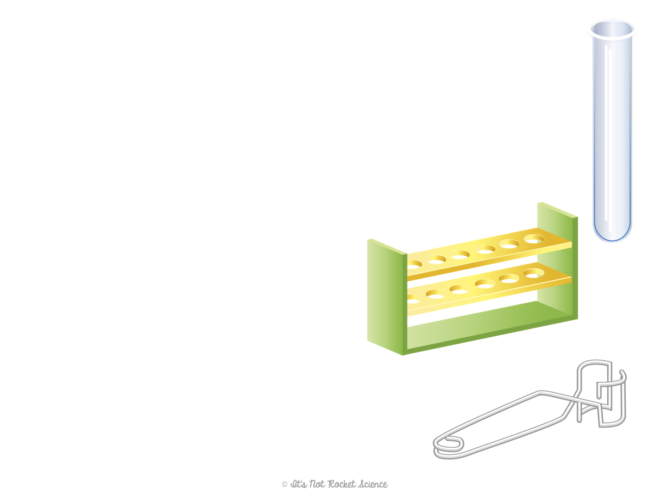
Lab Equipment
Glassware
Test tubes: Used for performing small chemical reactions
Test tube rack: Holds up multiple test tubes at one time.
Test tube holder: To hold test tube when heating.
Always angle the open end of test tube away from you and others while heating.
Notes:
I like to have the equipment set up on my front demo table so I can show it to them and they can touch and see it for themselves!

Slide 15
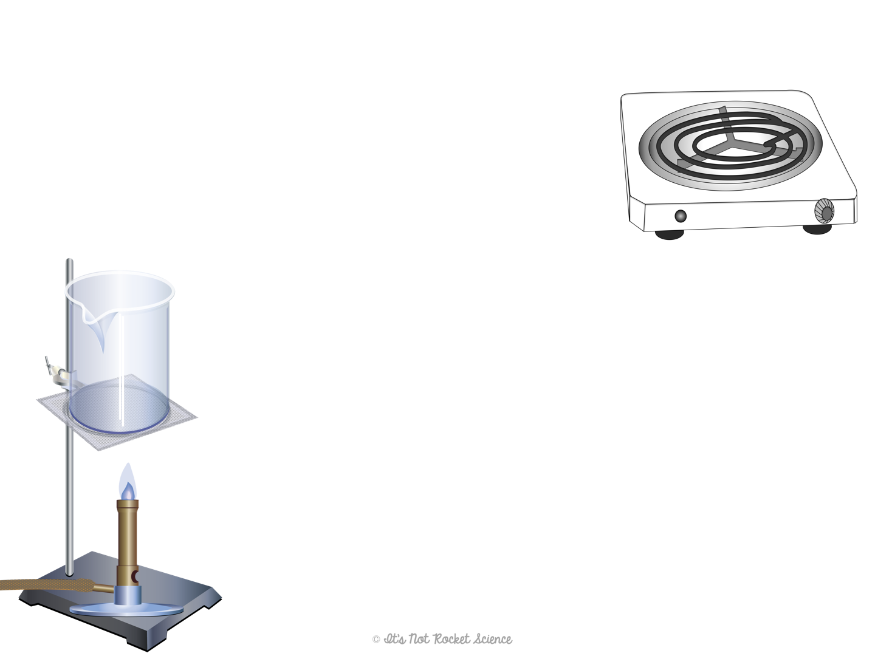
Lab Equipment
Heating
Hot plate: Electricity powered plate for heating chemicals.
Bunsen Burner: Gas powered flame for heating chemicals.
Ring stand
Iron ring
Wire gauze
Used to support heated objects above the flame
Notes:
I like to have the equipment set up on my front demo table so I can show it to them and they can touch and see it for themselves!

Slide 16
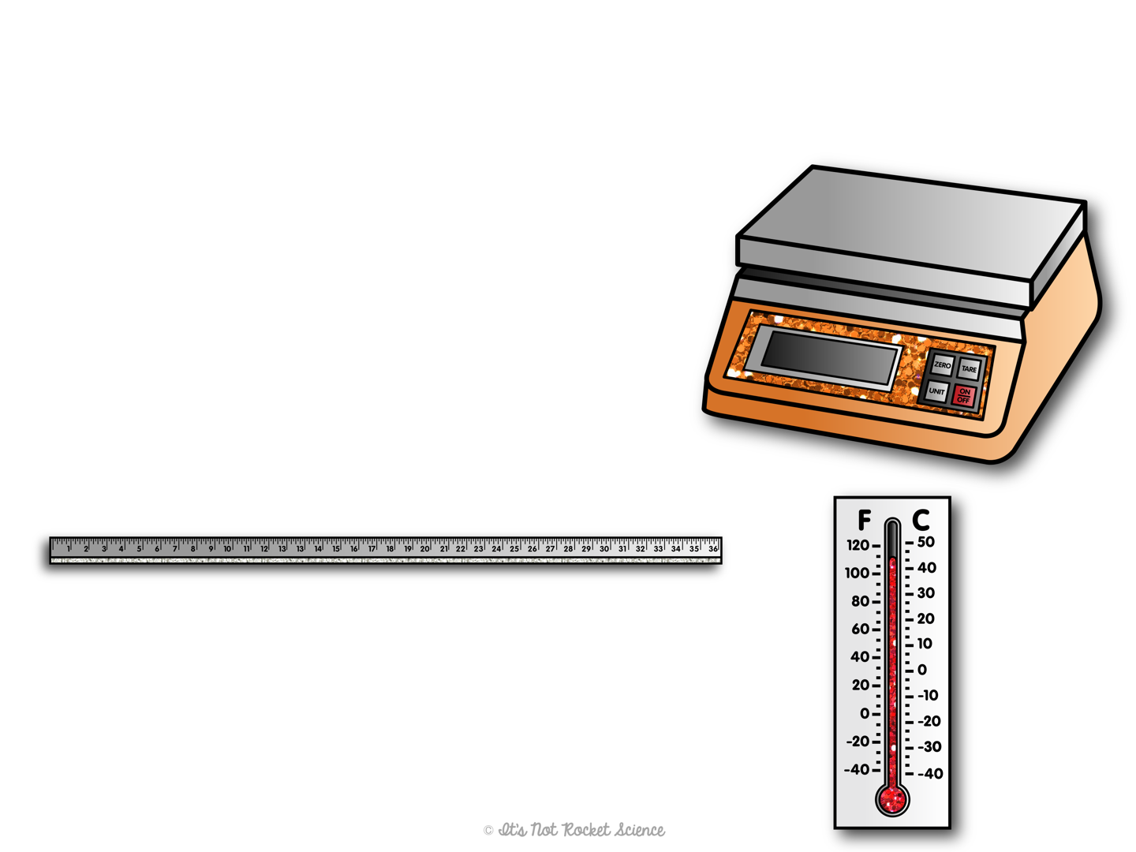
Lab Equipment
Measuring
Digital scale: Measures mass (usually in grams)
Meter stick: Measures length in mm, cm, or m
Thermometer: Measures temperature in degrees Fahrenheit or Celsius

Slide 17
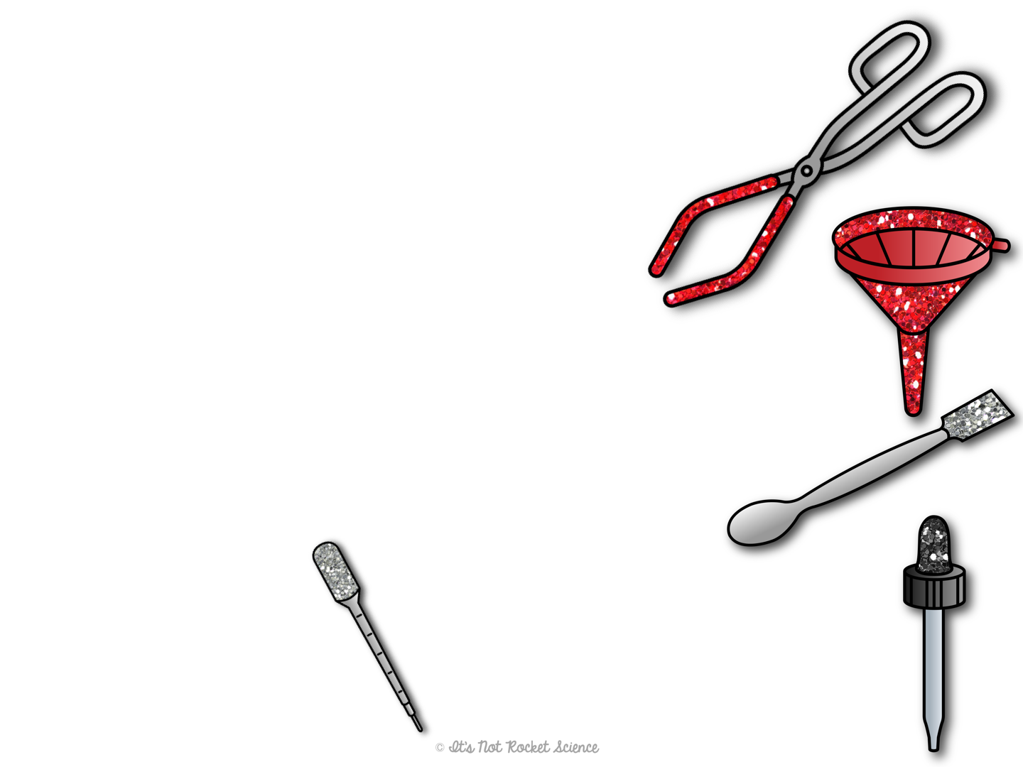
Lab Equipment
Transferring
Beaker tongs: Moving and holding a hot beaker
Funnel: Transferring liquids from larger containers to smaller
Spatula: Transferring solid chemicals from larger containers to smaller
Pipette: Transferring liquids in small precise amounts
Dropper: Transferring liquids drop by drop

Slide 18
