Slide 1
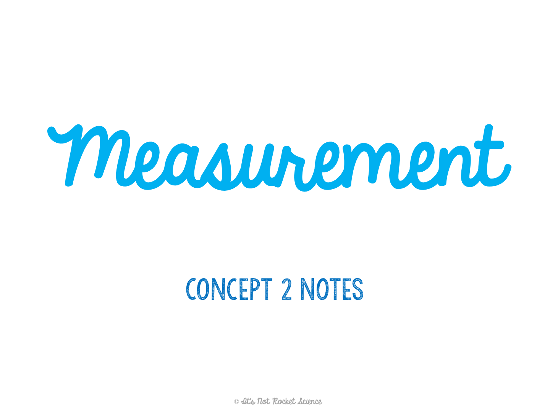

Slide 2
Measurement
The best measurements are both accurate and precise.
Accuracy: the degree to which the experimental result agrees with the accepted value.
How correct the measurement is
Precision: the degree to which measurements agree with one other.
How specific the measurement is; or how consistent multiple measurements are to each other

Slide 3
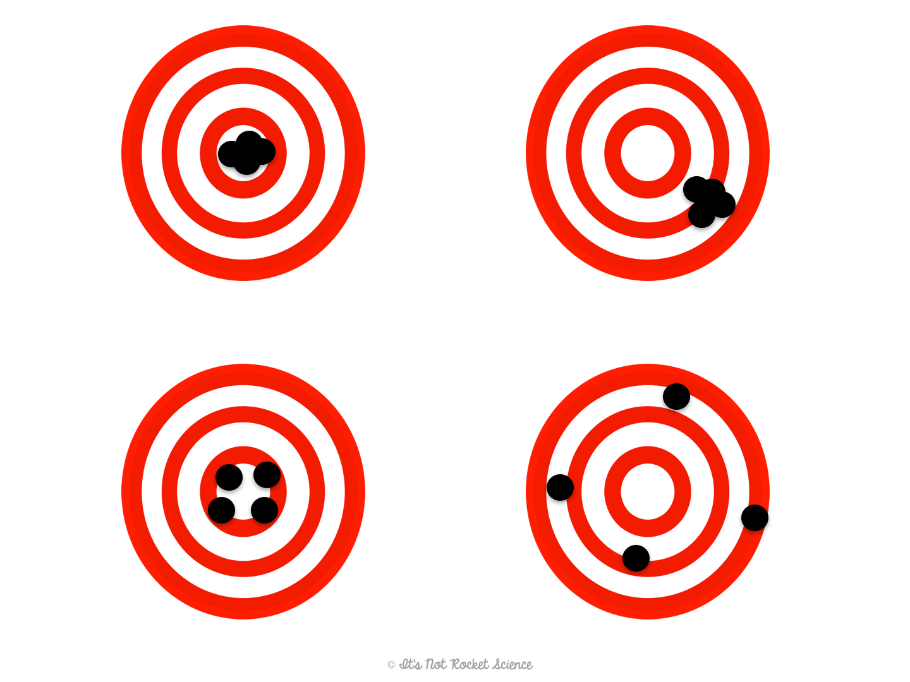
Precise and Accurate
Precise but not Accurate
Accurate but not Precise
Not Accurate or Precise
Notes:
Practice: Label the different bulls-eyes.
Discuss how the accurate/correct place to throw the dart is in the center of the bullseye.
A precise/consistent dart thrower will always hit the same place.

Slide 4
Measurement
The best measurements are both accurate and precise.
Example #1: If a student knows 85% of the material for the test but makes a 70% on the test, is the measurement accurate, precise, or neither?
Answer: The measurement isn’t precise or accurate.
Example #2: Mrs. Joyner’s dog, Millie, is known to weigh 65 lbs. Millie goes to the vet and is weighed three times at 71 lbs, 70.5 lbs, and 71.1 lbs. Are these measurements accurate, precise, or neither?
Answer: The measurements are precise but not accurate.

Slide 5
Measurement
Often when we make measurements in labs to collect data, you will have to find the average.
Average: Add up all values and divide by the total number of values.
Example #3: Callie measures her flower to be 30 cm tall. Jeff measures the plant to be 45 cm tall. Liam measures the plant to be 36 cm tall. Find the plant’s average height.
30 cm + 45 cm + 36 cm
111 cm
=
=
37 cm
3
3

Slide 6
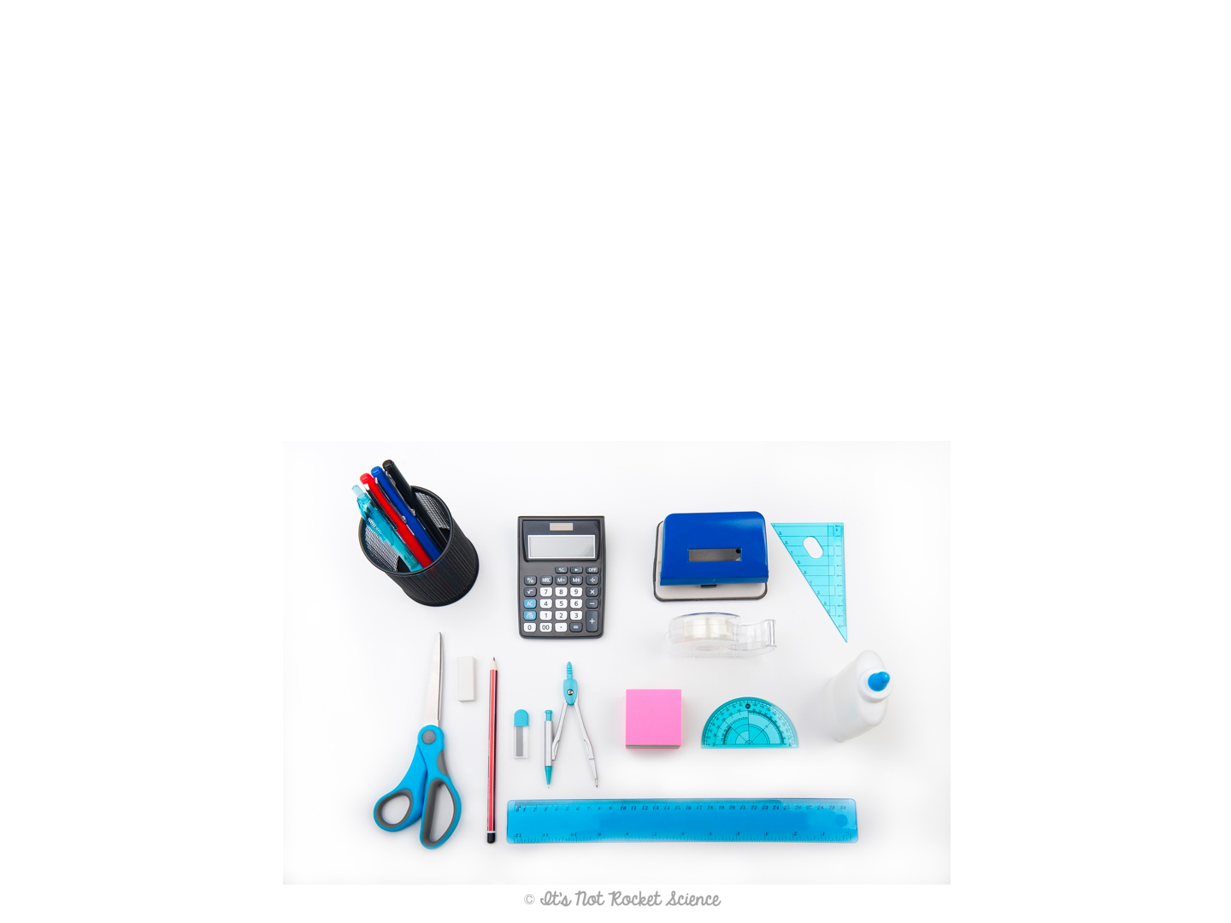
Standard Units
Standard: an exact quantity that people use for comparison.
SI System: the system used by scientists around the world to make measurements.
Prefixes are used with base units that are based on multiples of ten.
Each type of measurement has a base unit.

Slide 7
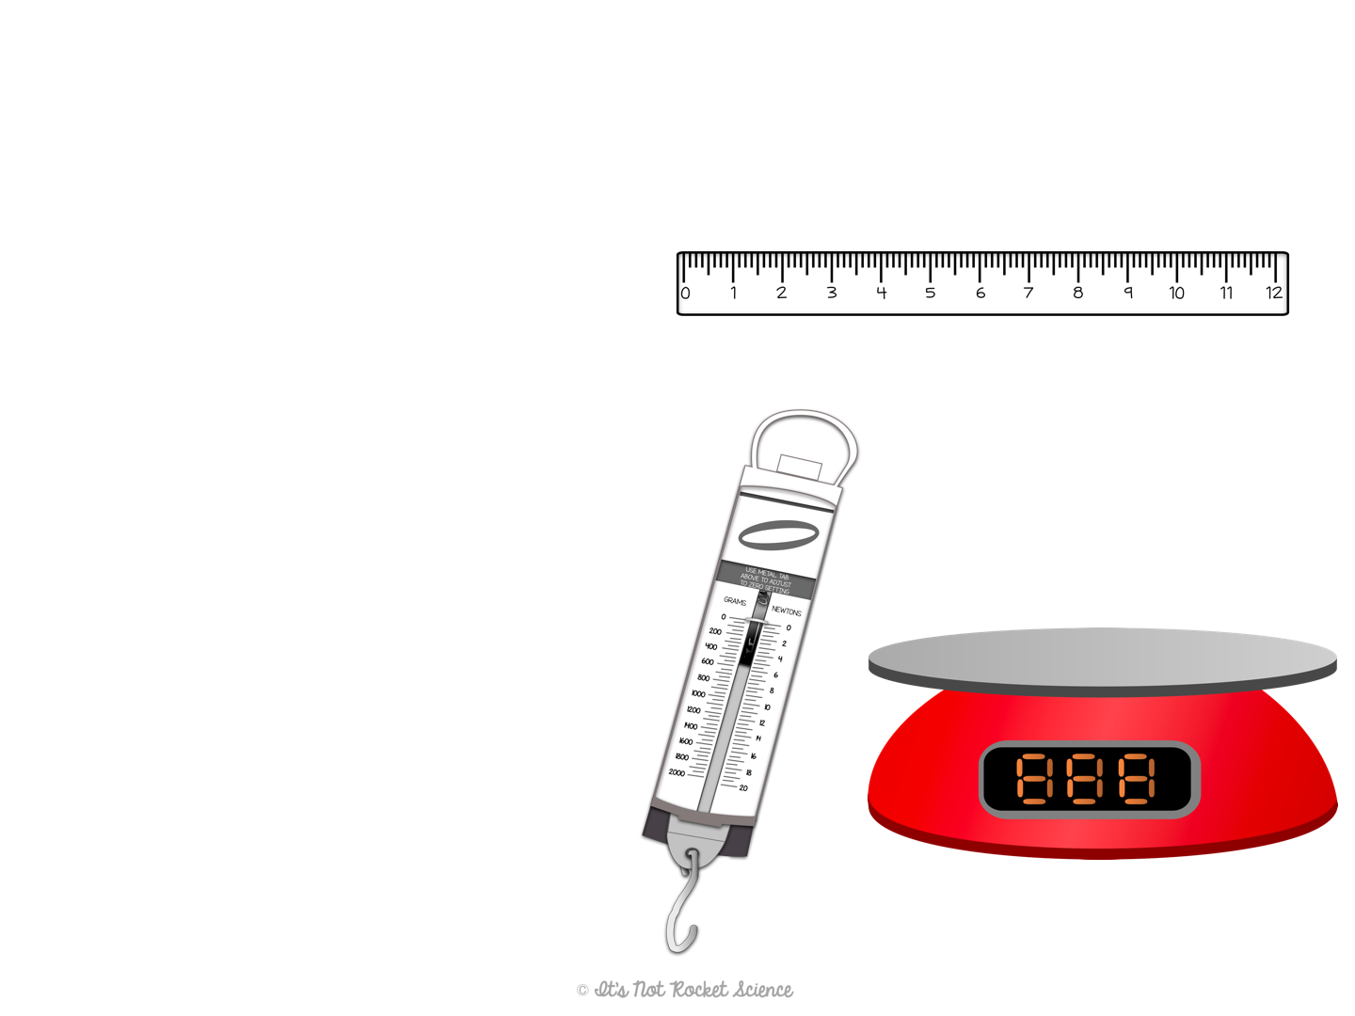
Units
Length: distance between two points.
Unit = meter = m
Often measured using a meter stick or ruler
Mass: amount of matter in an object
Unit = kilogram = kg
Often measured using a digital scale or a spring scale

Slide 8
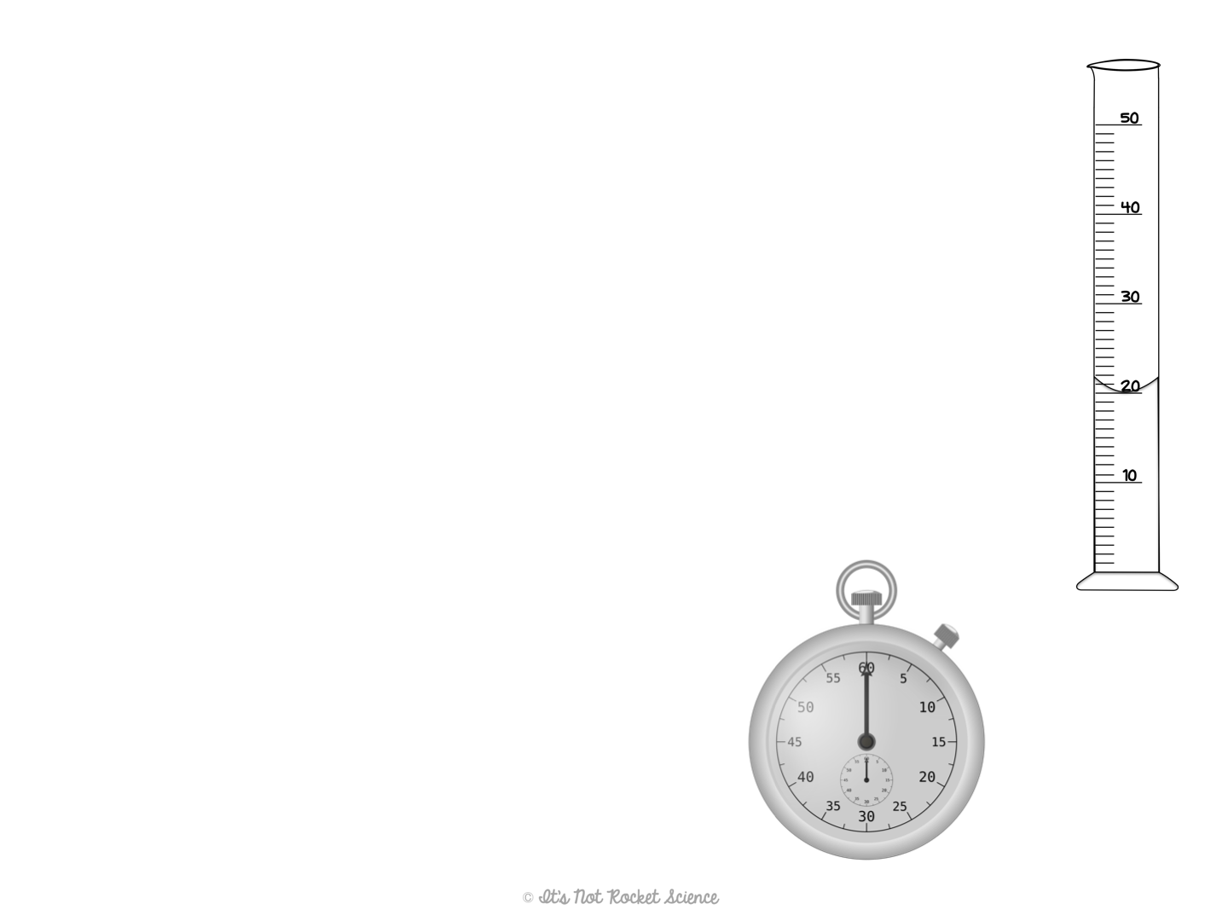
Units
Volume: amount of space occupied by an object
Unit = Liter = L
Often measured using a graduated cylinder or can be calculated with a geometric equation.
Time: interval between two events.
Unit = seconds = s
Often measured using a stopwatch.
When measuring with a graduated cylinder, always measure to the bottom of the meniscus (the curve in the liquid)
Notes:
Note: Volume is a derived unit, thus it isn’t officially an SI unit

Slide 9
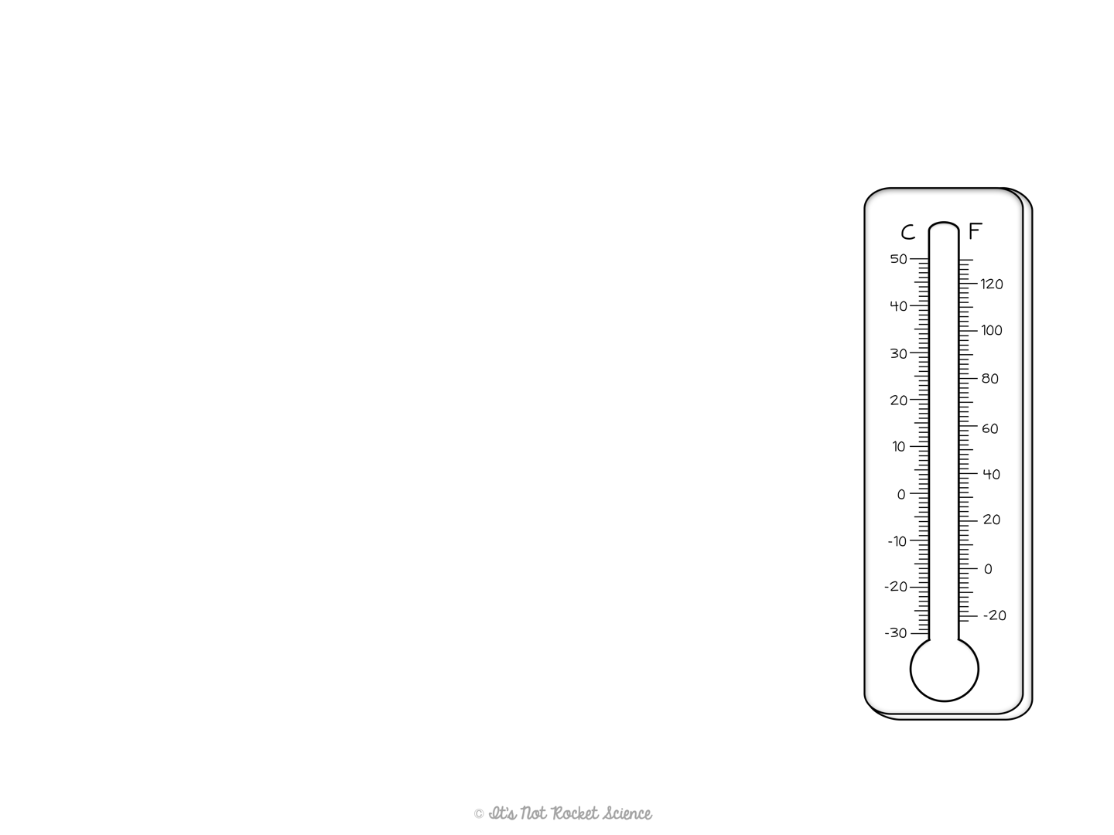
Units
Temperature: the amount of heat in an object.
Unit = Kelvin = K
The metric system uses Celsius (°C)
The U.S. uses Fahrenheit (°F)
Often measured using a thermometer.
Note: we will learn a more scientifically accurate definition in the future.
Temperature conversions:
K = °C + 273
°C = 5/9 (°F - 32)
°F = (°C * 9/5) + 32
Notes:
Later on in the year I give them the appropriate definition of heat (the average kinetic energy of particles in an object) but for now I want to focus on units and measuring, so I don’t get into energy.
Also to convert to Kelvin it is technically K = C + 273.15 but I just do 273 for simplicity’s sake, but feel free to change if you prefer more precision.

Slide 10
Temperature Conversions
K = °C + 273
°C = 5/9 (°F - 32)
°F = (°C * 9/5) + 32
Example #4: Mrs. Smith is going on vacation to Greece for her anniversary and the weather is predicted to be 27°C. Mrs. Smith lives in the U.S. though and doesn’t know what to pack for this weather. Help her to determine the temperature in °F so she can pack.
°C = 27
°F = ?
°F = (°C * 9/5) + 32
°F = (27 * 9/5) + 32
°F = (48.6) + 32
°F = 80.6 °F

Slide 11
Practice Time!
Convert 23°C to °F.
Convert 48°F to °C.
Convert 83°F to Kelvin.
73.4°F
8.89°C
301.3K
Notes:
Teaching Tip: Student should be able to do #1 on their own, since it is the same conversion as the example on the previous slide. If they are struggling with 2 and 3, I have them at least set up the problem. It also may help to warn them that #3 is a two-step problem. After a few minutes I go over the problems (work them out in their entirety) on the whiteboard, and if time permitting, I let students work them out first on the board, and then I correct as needed.

Slide 12


Slide 13
Prefixes
These prefixes are used to avoid very large or very small numbers.
They attach to the unit name. Ex. Milligram = mg
1 Mega (M)= 1,000,000 units
1 Kilo (k) = 1,000 units
1 hecto (h) = 100 units
1 deka (da) = 10 units
^{UNIT}
10 deci (d) = 1 unit
100 centi (c) = 1 unit
1000 milli (m) = 1 unit
1,000,000 micro (u) = 1 unit
1,000,000,000 nano (n) = 1 unit
Remember, the unit is either m, L, s, or g depending on what you are measuring
(m, g, L, s)

Slide 14
Metric Conversions
Write down given number and unit.
Draw picket fence.
Use chart to fill in appropriate conversion factors, making sure matching units are on opposite sides of fence to cancel out.
Multiply the top line across and the bottom line across.
Divide the top by the bottom.

Slide 15
Metric Conversions
Example #5: How many meters are there in 48 km?
48 km
1,000 m
48, 000 m
1
=
=
48,000 m
1 km

Slide 16
Metric Conversions
Example #6: How many kilograms are there in 45,456 mg?
45,456 mg
1 g
1 kg
=
1000 mg
1000 g
45,456 kg
=
.045456 kg
1,000,000

Slide 17
Practice Time!
Convert 6.1 ks to s.
Convert 0.859 mg to cg.
Convert 65.4 m to mm.
6,100 s
0.0859 cg
65,400 mm

