Slide 1
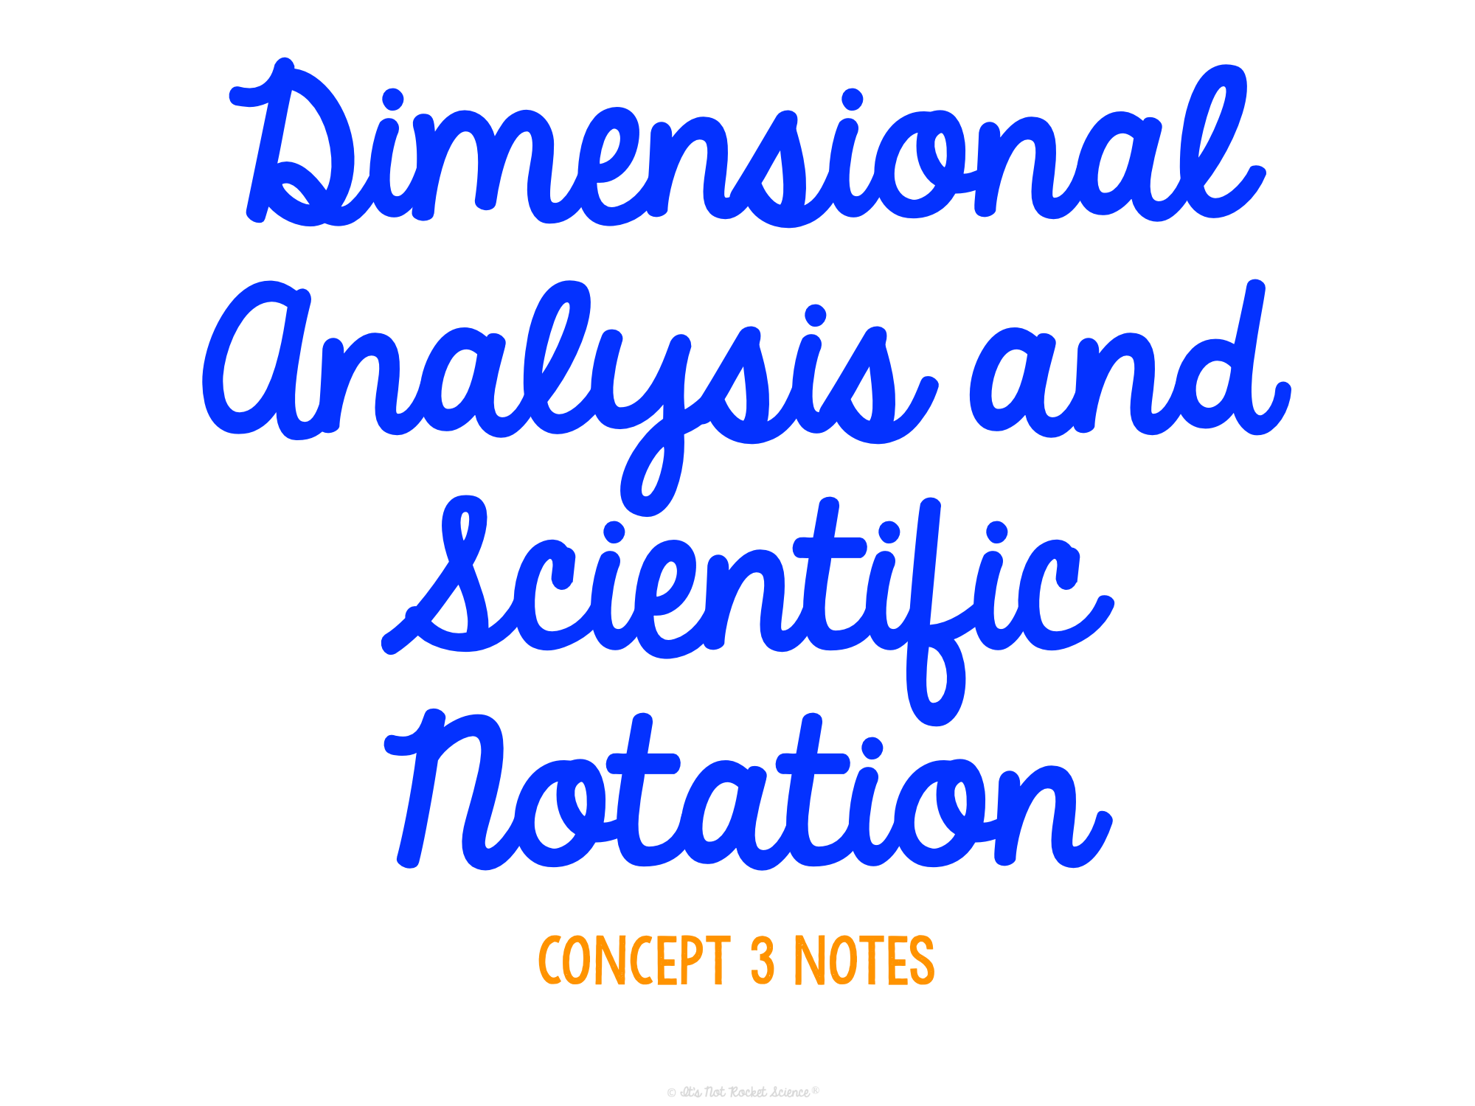

Slide 2
Dimensional Analysis
Purpose: A technique of converting numbers into different units, without changing their value
Useful when:
Baking or cooking
Traveling to foreign countries that use different units than us
Building or engineering
Done by multiplying given numbers by conversion factors in order to get number into desired units

Slide 3
Dimensional Analysis
Conversion factors: ratios of equivalent values (meaning they equal 1)
Used in dimensional analysis to alter the number without changing its value
Example #1:
How many hours are in a day?
24 hours = 1 day, or…
Both of these formats are useful when converting units with conversion factors
24 hours
1 day
1 day
24 hours
or

Slide 4
Dimensional Analysis
Conversion Factor Ex. #2:
12 inches = 1 foot, or…
Your turn! What would be the conversion factor for days in a week?
7 days = 1 week, or…
12 inches
1 foot
1 foot
12 inches
or
7 days
1 week
1 week
7 days
or

Slide 5
Steps to apply this method in a real problem:
Dimensional Analysis
Write down the given (starting) number and unit.
Draw a “picket fence.”
Use chart to fill in appropriate conversion factors, making sure matching units are on opposite sides of fence to cancel out.
Multiply the top line across and the bottom line across.
Divide the top by the bottom.

Slide 6
Putting it into Practice:
Dimensional Analysis
Example #3: How many seconds are in one year?
1 year
365 days
24 hours
60 min
60 s
1 year
1 day
1 hour
1 min
31,536,000 s
=
=
31, 536, 000 s
1

Slide 7
Putting it into Practice:
Dimensional Analysis
Example #4: How many feet are in 250.4 cm?
250.4 cm
1 inch
1 ft
=
2.54 cm
12 inches
250.4 ft
=
8.22 ft
30.48

Slide 8
Useful and common conversion factors:
Dimensional Analysis
MASS | VOLUME | LENGTH
1000 g = 1kg 1 ounce = 28.35 g 1 kg = 2.2 lbs 16 ounces (oz) = 1 lb 2000 lbs = 1 ton | 1 tsp = 5 mL 1 cup = 236 mL 1 fluid oz = 29.6 mL 1000 mL = 1 L 3 tsp = 1 Tbsp 16 Tbsp = 1 cup 8 oz = 1 cup 2 cups = 1 pint 2 pints = 1 quart 4 quarts = 1 gallon | 1 inch = 2.54 cm 12 inches = 1 ft 1 mile = 5,280 ft 3 ft = 1 yard

Slide 9
Practice Time!
.951
3.6 L =_______ gallons
600 g = _______ lbs
100 cm = ________ yds
1.32
1.09

Slide 10
Scientific Notation
Purpose: A technique used to rewrite very large or very small numbers into a format that is easier to use
Format: Just the digits with a decimal point after the first digit, followed by x 10 to the power which represents how many places the decimal was moved
Example: 50,500 = 5.05 x 10⁴

Slide 11
Steps to apply this method in a real problem:
Scientific Notation
Move decimal so that there is only 1 digit in front (to the left) of it.
Rewrite the number as #. with a x 10 after.
Add an exponent to the 10 to represent the number of places you moved the decimal.
Make the exponent:
+ if you started with a big number (> 1)
or
- if you started with a small number (< 1)

Slide 12
Putting it into Practice:
Scientific Notation
Example #5: Convert 101,000 into scientific notation.
101,000.
Where we want it to be for scientific notation
Where decimal is now
5 because we moved the decimal 5 places
1.01
x 10
⁵
+ because we started with a large number
1.01 x 10⁵

Slide 13
Putting it into Practice:
Scientific Notation
Example #6: Convert 0.0098 into scientific notation.
0.0098
Where we want it to be for scientific notation
Where decimal is now
3 because we moved the decimal 3 places
9.8
x 10
⁻³
- because we started with a small number
9.8 x 10⁻³

Slide 14
Putting it into Practice:
Scientific Notation
Example #7: Convert 2.057 x 10² into standard notation.
(This just means take it out of scientific notation)
2 means we will move the decimal 2 times
2.057 x 10²
+ means we will make it a bigger number
205.7

Slide 15
Putting it into Practice:
Scientific Notation
Example #8: Convert 3.1 x 10⁻⁴ into standard notation.
(This just means take it out of scientific notation)
4 means we will move the decimal 4 times
.
0
0
0
3.1 x 10⁻⁴
- means we will make it a smaller number
Fill in zeros in empty spaces
.00031

Slide 16
Practice Time!
Place in scientific notation.
3.54 x 10⁸
354,000,000 =
0.000096 =
2.76 x 10⁻³ =
4.011 x 10⁴ =
9.6 x 10⁻⁵
Place in standard notation.
.00276
40,110

