Slide 1


Slide 2
Science
Science: a method for studying the natural world by gaining knowledge through observations and investigations.
Scientists gather information through observations and design investigations based on inferences.
Observation: objective; based on the 5 senses, not opinion.
Ex. The ground is wet.
Inference: subjective; a guess about an observation.
Ex. It rained. Someone spilled something.
Notes:
Teaching Tip: Have students make observations and inferences about your classroom.

Slide 3

Observation vs. Inference
Notes:
Teaching Tip: Have students make observations and inferences about the picture above.

Slide 4
Laws vs. Theories
Law: description of how things happen in nature.
Ex. Newton’s Laws of Motion
Theory: an explanation, based on evidence, of why things happen.
Ex. Evolutionary Theory
Laws cannot become theories, and vice versa.
All theories start as hypotheses until substantiated by evidence.
Notes:
Transition: I always explain how scientific observations, inferences and investigations lead to the develop of theories and laws

Slide 5
Scientific Method
Scientific Method: technique for investigating phenomenon.
Summarized (usually) into 6 steps.
Ask a question.
Research and gather background information.
Form a hypothesis.
Test the hypothesis.
Analyze the data.
Draw conclusions.
Notes:
Emphasize that it doesn’t HAVE to follow this sequence!! Science isn’t limited to a “scientific method”. However, it is helpful to walk through how we think through scientific investigations and design experiments in an organized way.

Slide 6

1. Ask a question.
Observations we make should lead us to ask questions.
This clearly stated question will define our purpose for conducting an investigation.
Try it!
Notes:
Try it: Have students make observations about their daily life. Work as a class to come up with questions that we could investigate in an experiment.
Note: I put the parts of a lab report in bold and purple and point that out to students as we go.

Slide 7

2. Research and gather background information.
Gather information to see what others have studied about this question, summarizing in an introduction.
What would be trustworthy sources we could look to for useful background information?
What would be not trustworthy sources to find useful background information?
Notes:
Answer: Textbooks, scientific journals, scholarly articles, interviews with experts in the field we are investigating, etc. Not trustworthy = social media, forum posts, personal blogs, etc.
Ex. I’ve noticed my legs always get itchy when I run after not exercising for a while. 🡪 Question: Why do legs itch sometimes when we exercise?
Ex. I’ve noticed people at our school get sick a lot. 🡪 Question: What areas of our school carry the most bacteria?

Slide 8
3. Form a hypothesis.
Hypothesis: a testable prediction that attempts to answer a question.
Usually predicts a cause and effect relationship between variables.
Format: If…(IV), then…(DV), because…
Independent
variable
“Cause”
Dependent
variable
“Effect”
Notes:
This format isn’t required, I just like it because it forces students to write solid predictions.

Slide 9
3. Form a hypothesis.
Independent variable: what is being purposefully changed; what is being tested; the “cause”
Dependent variable: what is being measured; the data collected as a response; the “effect”
Example #1: I always notice that many runners drink Gatorade. I want to know if Gatorade makes them run faster.
What would the independent variable be?
What would the dependent variable be?
Write a hypothesis.
Notes:
IV = the runner’s drink, Gatorade or water
DV = the runner’s time
Hypothesis could be: If the runners drink Gatorade, then they will run faster because the electrolytes will give them more energy. (You don’t have to make students do the “because”, just up to you.)

Slide 10
4. Test the hypothesis.
Design an experiment. List all materials you will need and write out each step in your experiment in a procedure.
A good experiment should always have:
Control Group: the normal group used for comparison.
Experimental Group(s): the group that is being tested and purposefully changed.
Constants: factors that do not change in the experiment; conditions kept the same for all groups.
Examples of each for the Gatorade experiment?
Notes:
Control group: runners who drink water
Experimental group: runners who drink Gatorade
Constants: same age, same gender, same training, same shoes/equipment, same track/environment, same length of race, same amount of drink, etc.

Slide 11
4. Test the hypothesis.
Design an experiment. List all materials you will need and write out each step in your experiment in a procedure.
A good experiment should always have:
Control Group: the normal group used for comparison.
Experimental Group(s): the group that is being tested and purposefully changed.
Constants: factors that do not change in the experiment; conditions kept the same for all groups.
Examples of each for the Gatorade experiment?
Notes:
Control group: runners who drink water
Experimental group: runners who drink Gatorade
Constants: same age, same gender, same training, same shoes/equipment, same track/environment, same length of race, same amount of drink, etc.

Slide 12

5. Analyze the data.
Organize results into tables and graphs.
Quantitative: numerical data
Qualitative: descriptive data
Notes:
Teaching Tip: Have students make quantitative observations, qualitative observations, and inferences about the picture above.

Slide 13
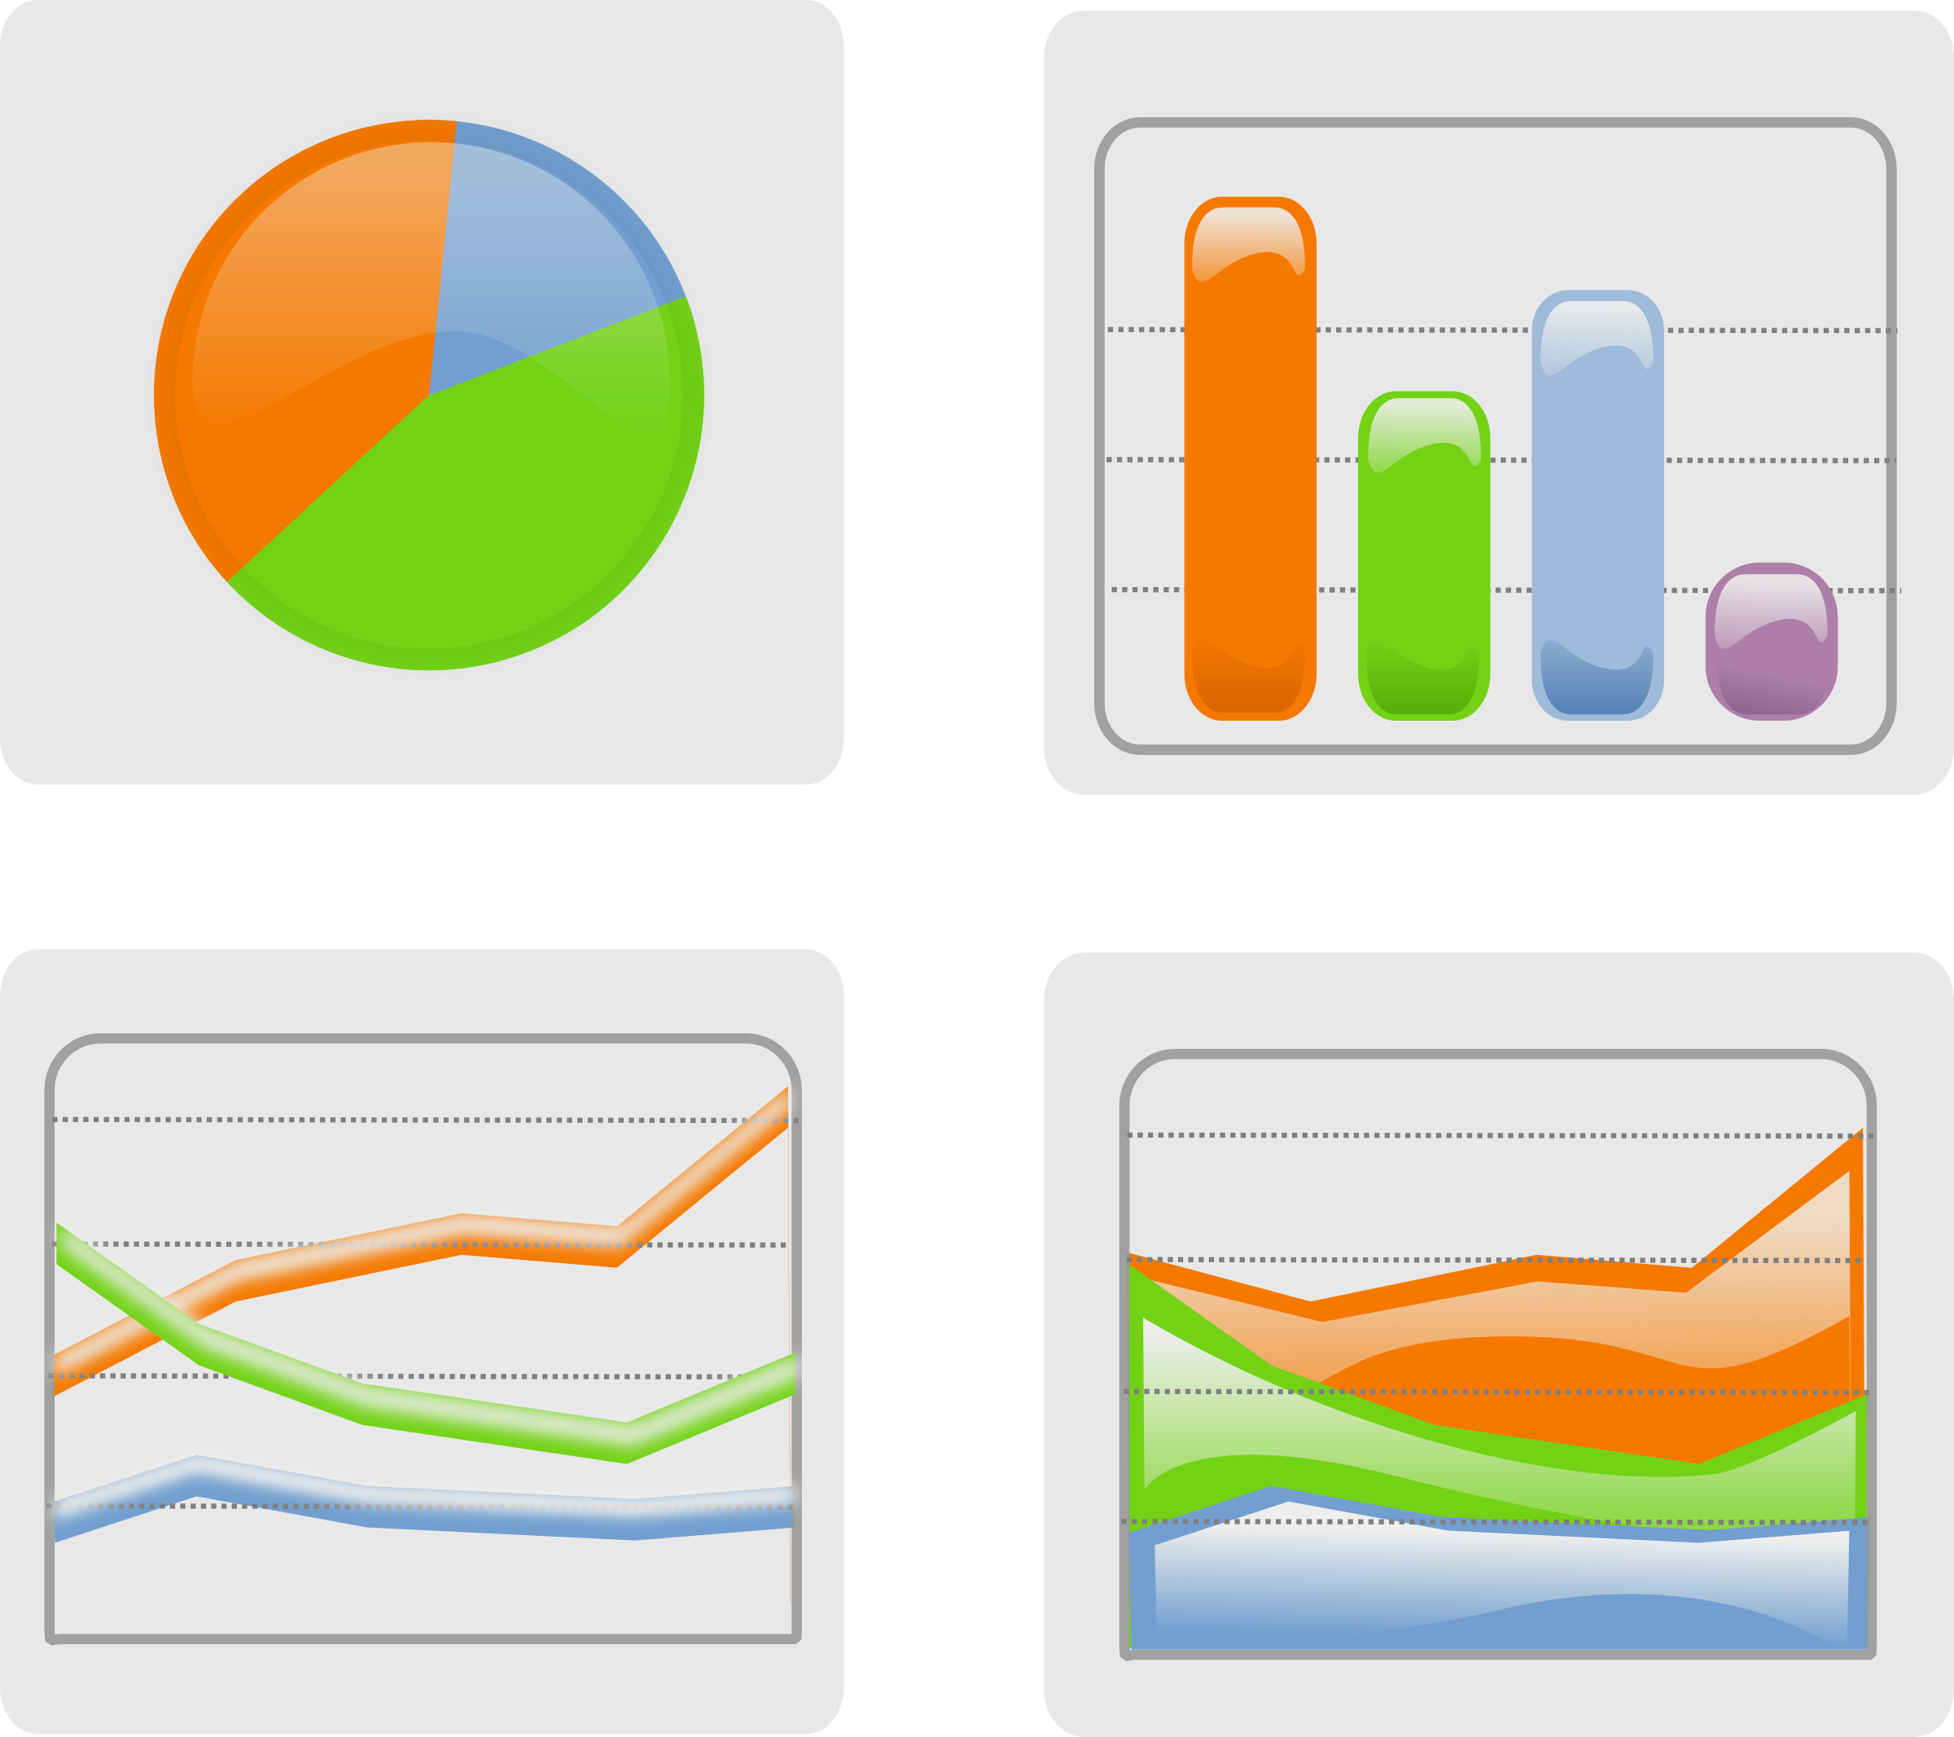
5. Analyze the data.
3 Main Types of Graphs:
Line Graph: quantitative data vs. quantitative data
Ex. Plant growth over time
Bar Graph: qualitative data vs. quantitative data
Ex. # of students and favorite classes
Circle (Pie) Graph: percentages
Ex. % of students who got A’s, B’s, C’s, D’s, and F’s on a test
The change in plant height over time
Height (cm)
Time (days)
Student Subject Preferences
# of Students
Subject
Grade Breakdown for Test
15% C’s
40% A’s
45% B’s

Slide 14
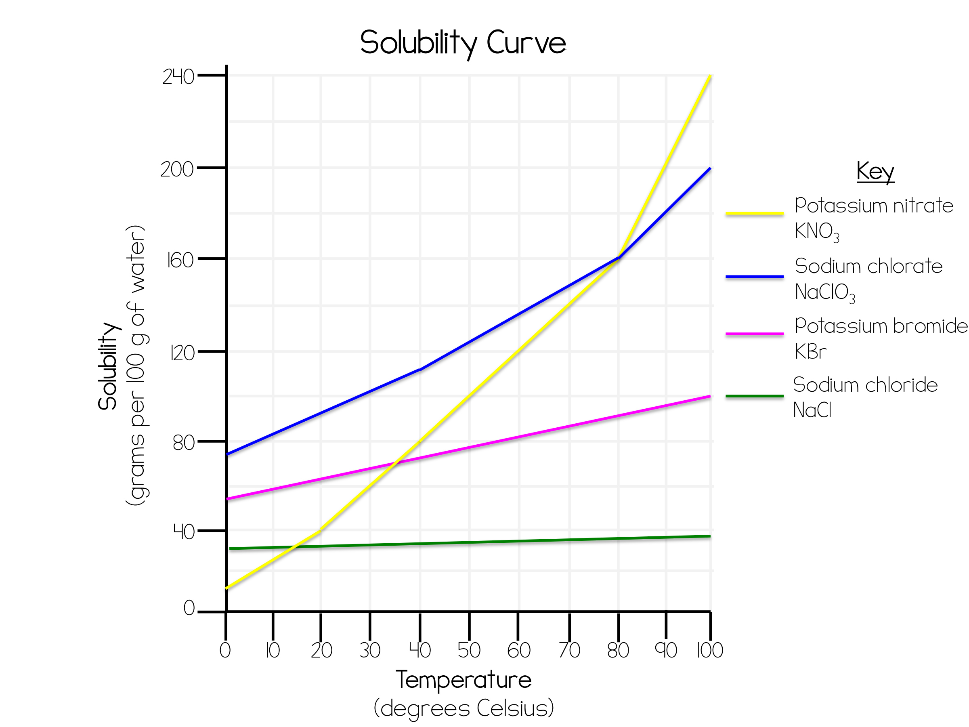
5. Analyze the data.
Graphs Must Have:
Title
X-Axis and Y-Axis labels
Including units, if needed
Even scale
Key, if needed
Notes:
I always emphasize the importance of starting numerical scales at 0, skipping the same amount each time, and going up by the same amount each time.
I do NOT let my students omit values on the Y-axis because it makes the data appear skewed, but that’s just my preference!

Slide 15
5. Analyze the data.
In a written analysis include:
A brief overview of the variables
Independent variable, dependent variable, control group, experimental group, and constants.
Clear explanation of what the data shows
Refer to graphs!
Infer why you got the results you did
Error analysis
Describe at least 3 factors not held constant that could have messed with results and how to prevent in future

Slide 16
6. Draw Conclusions.
Conclusion should include:
A clear statement of if the data supports the hypothesis or not.
Never say “proven,” “disproven,” ”correct,” or “incorrect”!!
What was learned
Real world application

