Slide 1
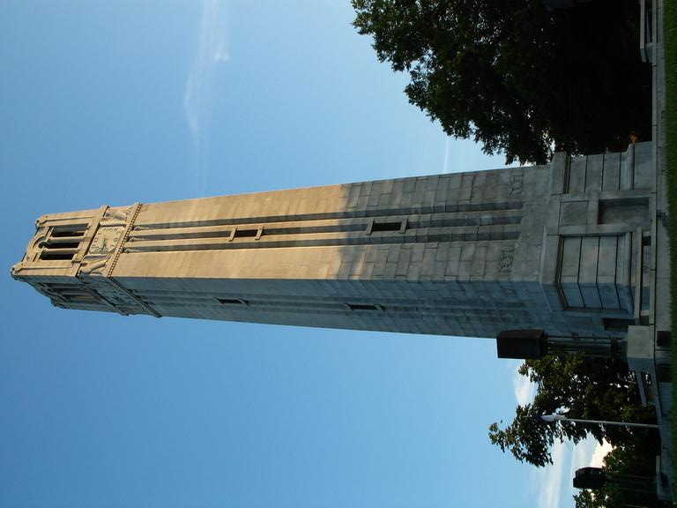



Mathematical Modeling of the COVID-19 Pandemic
Kate Pearce¹ & Mansoor Haider^{1,2,3}
¹Department of Mathematics ²Biomathematics Graduate Program
³Associate Director, Statistical & Applied Mathematical Sciences Institute
SAMSI Virtual Undergraduate Workshop, May 16, 2021

Slide 2
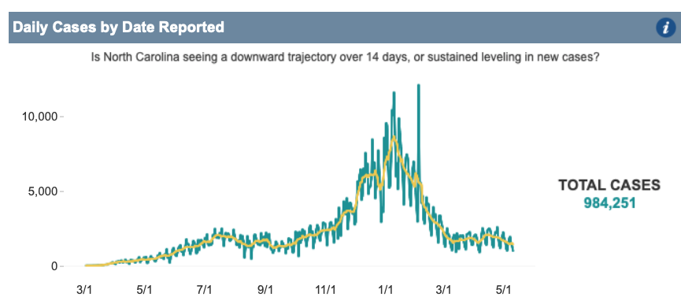
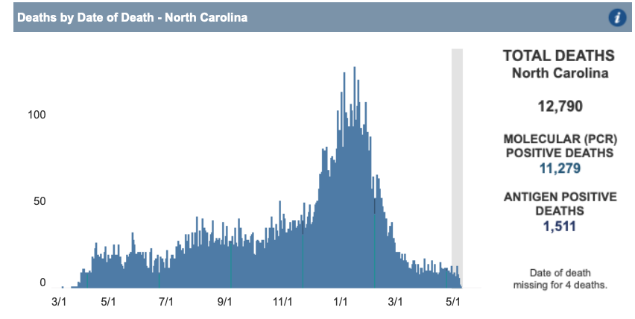
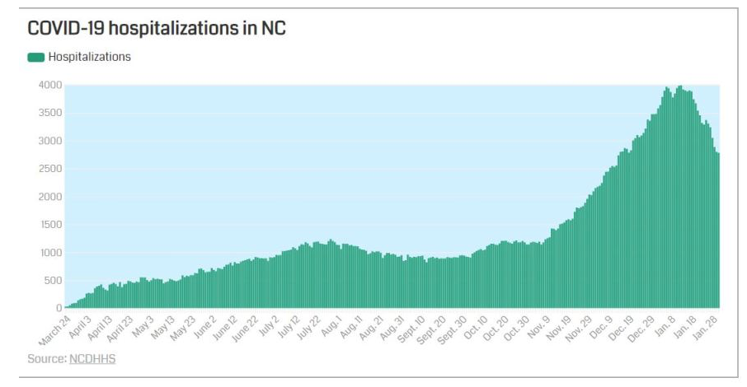
COVID-19 Pandemic in NC
Source: NC DHHS

Slide 3
SIR Model
Compartment Model:
𝛃
𝛄
S
I
R
State Variables:
Parameters:
S: Susceptible (fraction)
𝛃: Transmission coefficient (product of the rate susceptible and
infectious individuals come into contact & probability of transmission)
I: Infected
R: Recovered
𝛄: Rate of progression through infectious stage
Notes:
Mansoor will discuss what happens when you add equations
Cons Law allows you to eliminate one variable
Model has no birth or death
Model can’t capture lag between exposure and becoming infected and that is the crux of the matter

Slide 4
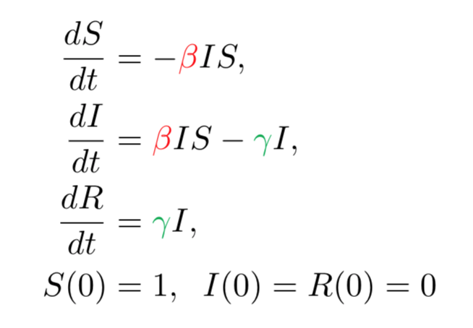
SIR Model
𝛃
𝛄
S
I
R
Mathematical Model:
MATLAB Simulation:
Conservation Law: S(t) + I(t) + R(t) = 1
Notes:
Mansoor will discuss what happens when you add equations
Cons Law allows you to eliminate one variable
Model has no birth or death
Model can’t capture lag between exposure and becoming infected and that is the crux of the matter

Slide 5
SEIR Model
𝛍
𝛃
𝛒
𝛄
S
E
I
R
𝛅
𝛅
𝛅
𝛅
State Variables:
Parameters:
S: Susceptible (fraction)
𝛍: Birth rate
E: Exposed
𝛅: Death rate (baseline)
I: Infected
𝛃: Transmission coefficient (product of the rate susceptible and
infectious individuals come into contact & probability of transmission)
R: Recovered
𝛒: Rate of progression to infectiousness (following infection)
𝛄: Rate of progression through infectious stage

Slide 6
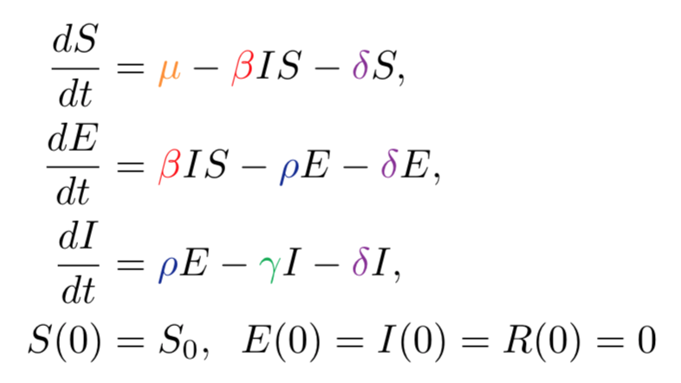
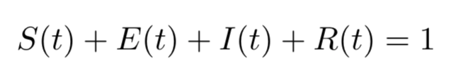
SEIR Model
𝛍
𝛃
𝛒
𝛄
S
E
I
R
𝛅
𝛅
𝛅
𝛅
Mathematical Model:
MATLAB Simulation:
Conservation Law:
(assuming equal birth and death rates)
Solve for R(t)

Slide 7
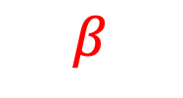


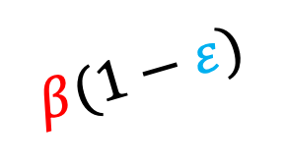









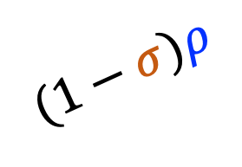

Compartment Diagram for COVID-19 Pandemic
$$δ$$
$$γ$$
A
$$μ$$
S
$$(1−σ)ρ$$
$$δ$$
$$β$$
$$δ$$
$$(1−κ)γ$$
E
I
$$υ$$
$$σρ$$
$$δ$$
V
$$β(1−ε)$$
$$κγ$$
$$η$$
H
$$δ$$
$$δ$$
Source: Perkins, T.A., España, G. Optimal Control of the COVID-19 Pandemic with Non-pharmaceutical Interventions. Bull Math Biol 82, 118 (2020). https://doi.org/10.1007/s11538-020-00795-y

Slide 8




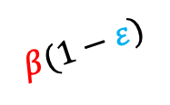









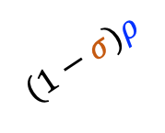

Mathematical Model
$$δ$$
$$γ$$
New Parameters:
A
$$μ$$
$σ$: Proportion of infections resulting in symptoms
S
$$β$$
$$(1−σ)ρ$$
$$δ$$
$$δ$$
$$υ$$
: Rate of vaccination
$$(1−κ)γ$$
E
I
$ε$: Per exposure protection from vaccine
$$υ$$
$$σρ$$
$$δ$$
$κ$: Probability of hospitalization among symptomatic
V
$$β(1−ε)$$
$$κγ$$
$η$: Rate of progression through hospitalization
$$η$$
$α$: Relative infectiousness of asymptomatic (not shown)
$$δ$$
H
$$δ$$
State Variables:
Birth and death rates still assumed equal
S: Susceptible (fraction)
A: Asymptomatic Infected
V: Vaccinated
I: Symptomatic Infected
E: Exposed
H: Hospitalized Infected

Slide 9
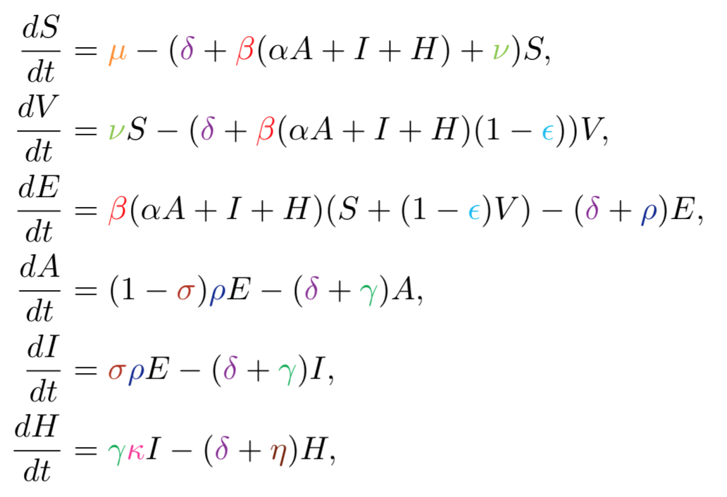
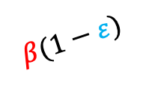











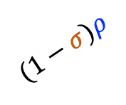



Mathematical Model
$$δ$$
$$γ$$
A
$$μ$$
S
$$(1−σ)ρ$$
$$δ$$
$$β$$
$$δ$$
$$γ(1−κ)$$
$$υ$$
E
I
$$σρ$$
$$δ$$
V
$$β(1−ε)$$
$$γκ$$
$$η$$
$$δ$$
H
$$δ$$
Initial Conditions TBD

Slide 10
Project Description
Investigate different simulations of COVID-19 spread in MATLAB
Baseline case roughly calibrated to hospitalization data in NC
Three scenarios to analyze with provided MATLAB codes
No prior knowledge of MATLAB required

