Slide 1


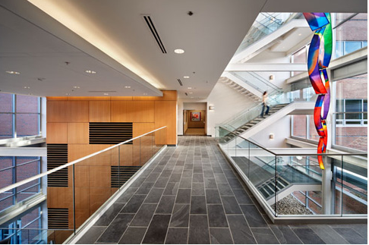

Mathematical Modeling of the COVID-19 Pandemic
Kate Pearce¹ & Mansoor Haider^{1,2,3}
¹Department of Mathematics ²Biomathematics Graduate Program
³Associate Director, Statistical & Applied Mathematical Sciences Institute
SAMSI Virtual Undergraduate Workshop, May 17, 2021

Slide 2
Project Description
Investigate different simulations of COVID-19 spread in MATLAB
Baseline case roughly calibrated to hospitalization data in NC
Three scenarios to analyze with provided MATLAB codes
No prior knowledge of MATLAB required

Slide 3




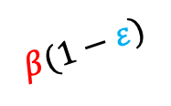









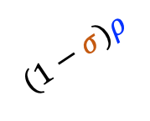

Mathematical Model
$$δ$$
$$γ$$
New Parameters:
A
$$μ$$
$σ$: Proportion of infections resulting in symptoms
S
$$β$$
$$(1−σ)ρ$$
$$δ$$
$$δ$$
$$υ$$
: Rate of vaccination
$$(1−κ)γ$$
E
I
$ε$: Per exposure protection from vaccine
$$υ$$
$$σρ$$
$$δ$$
$κ$: Probability of hospitalization among symptomatic
V
$$β(1−ε)$$
$$κγ$$
$η$: Rate of progression through hospitalization
$$η$$
$α$: Relative infectiousness of asymptomatic (not shown)
$$δ$$
H
$$δ$$
State Variables:
Birth and death rates still assumed equal
S: Susceptible (fraction)
A: Asymptomatic Infected
V: Vaccinated
I: Symptomatic Infected
E: Exposed
H: Hospitalized Infected

Slide 4
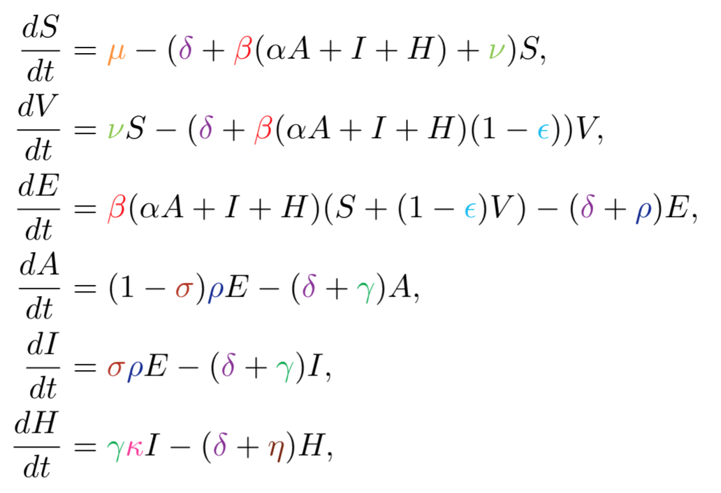
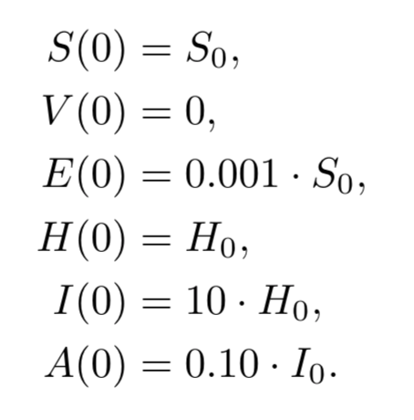
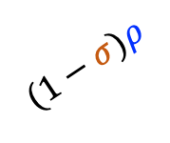





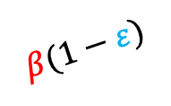







Mathematical Model
$$δ$$
$$γ$$
A
$$μ$$
S
$$(1−σ)ρ$$
$$δ$$
$$β$$
$$δ$$
$$γ(1−κ)$$
$$υ$$
E
I
$$σρ$$
$$δ$$
V
$$β(1−ε)$$
$$γκ$$
$$η$$
$$δ$$
H
$$δ$$
Assume individuals in A (with , I, and H can infect individuals in S (and V)
Initial conditions start at roughly Sept 1, 2020

Slide 5
MATLAB Demo of Baseline Case

Slide 6
Lab Objectives
Run the baseline case and interpret the figures (in the context of the pandemic)
What is the relative size of the population in each compartment plotted?
What are some characteristics of the curves and how do these features differ between curves?
Run the three scenarios and interpret the figures in light of the perturbed parameter values in the code
What is being modeled in each of the three scenarios?
In the context of the pandemic, what do the parameter perturbations represent?
Bonus Questions (time permitting):
How could you model death as an additional compartment? What would be the corresponding system of ODEs?
How could you get R₀ (basic reproduction number) as a function of the model parameters? (Challenging)

