Slide 1

Majorization-subordination theorems for locally univalent functions. IV
A Verification of Campbell’s Conjecture
Roger W. Barnard, Kent Pearce
Texas Tech University
Presentation: May 2008
Notes:
Illustrate via of papers out of the last ten years scenarios where inequalities arose and and illustrate the mechanisms which we used to analytically verify that the inequalities held.

Slide 2
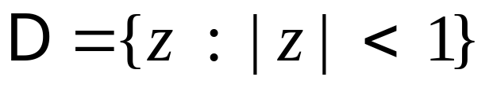
Notation

Slide 3
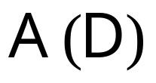
Notation

Slide 4
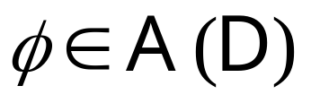
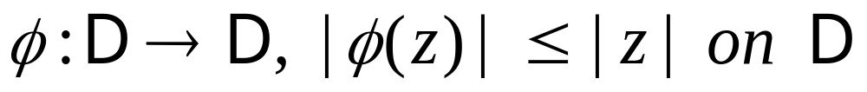
Notation
Schwarz Function

Slide 5
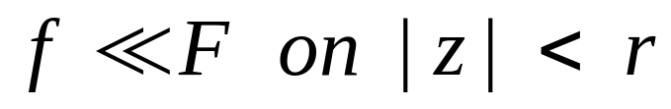
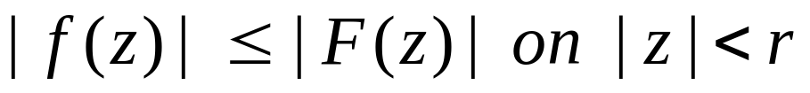
Notation
Schwarz Function
Majorization:

Slide 6
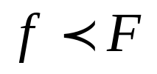

Notation
Schwarz Function
Majorization:
Subordination:

Slide 7
Notation
 : Univalent Functions 
   😐 : Convex Univalent Functions

Slide 8
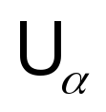

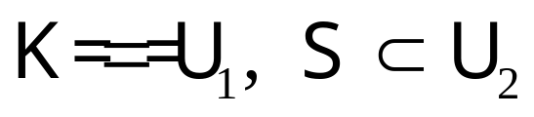
Notation
 : Univalent Functions 
   😐 : Convex Univalent Functions
     : Linearly Invariant Functions of order

Slide 9

Notation
 : Univalent Functions 
   😐 : Convex Univalent Functions
     : Linearly Invariant Functions of order
Footnote: , 😐 and are normalized by

Slide 10

Majorization-Subordination
Classical Problems (Biernacki, Goluzin, Tao Shah, Lewandowski, MacGregor)
  Let

Slide 11

Majorization-Subordination
Classical Problems (Biernacki, Goluzin, Tao Shah, Lewandowski, MacGregor)
  Let
  A.

Slide 12

Majorization-Subordination
Classical Problems (Biernacki, Goluzin, Tao Shah, Lewandowski, MacGregor)
  Let
  A.
  B.

Slide 13
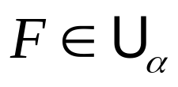
Majorization-Subordination
Campbell (1971, 1973, 1974)
Let
Notes:
Subsumed the results of MacGregor for convex and univalent functions
Subsumed the results of Tao Shah for univalent functions

Slide 14
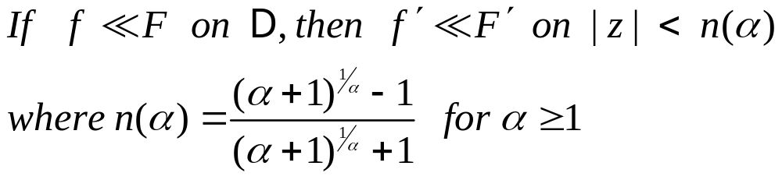
Majorization-Subordination
Campbell (1971, 1973, 1974)
Let
  A.
Notes:
Subsumed the results of MacGregor for convex and univalent functions
Subsumed the results of Tao Shah for univalent functions

Slide 15
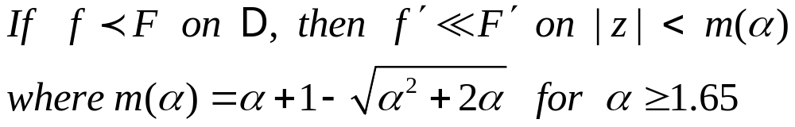
Majorization-Subordination
Campbell (1971, 1973, 1974)
Let
  A.
  B.
Notes:
Subsumed the results of MacGregor for convex and univalent functions
Subsumed the results of Tao Shah for univalent functions

Slide 16

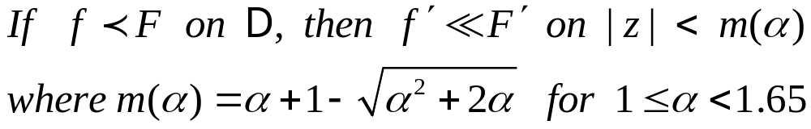
Campbell’s Conjecture
Let

Slide 17

Campbell’s Conjecture
Let
Footnote: Barnard, Kellogg (1984) verified Campbell’s for

Slide 18



Summary of Campbell’s Proof
Let and suppose that so that
for some Schwarz

Slide 19


Summary of Campbell’s Proof
Let and suppose that so that
for some Schwarz
Suppose that f has been rotated so that
satisfies

Slide 20
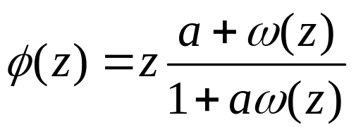

Summary of Campbell’s Proof
Let and suppose that so that
for some Schwarz
Suppose that f has been rotated so that
satisfies
Note we can write where
is a Schwarz function

Slide 21
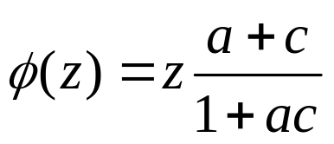
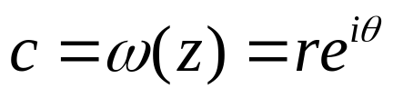
Summary of Campbell’s Proof
Let and suppose that so that
for some Schwarz
Suppose that f has been rotated so that
satisfies
Note we can write where
is a Schwarz function
Let . We can write

Slide 22


Summary of Campbell’s Proof
Let and suppose that so that
for some Schwarz
Suppose that f has been rotated so that
satisfies
Note we can write where
is a Schwarz function
Let . We can write
For we have

Slide 23
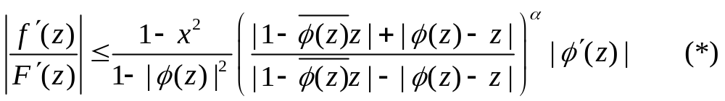
Summary of Proof (Campbell)
Fundamental Inequality [Pommerenke (1964)]

Slide 24
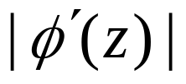
Summary of Proof (Campbell)
Fundamental Inequality [Pommerenke (1964)]
Two lemmas for estimating

Slide 25
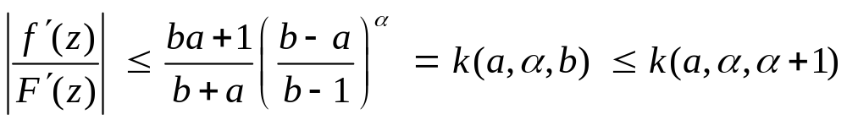
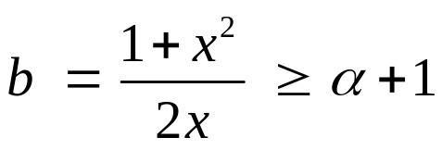
“Small” a
Campbell used “Lemma 2” to obtain
where

Slide 26
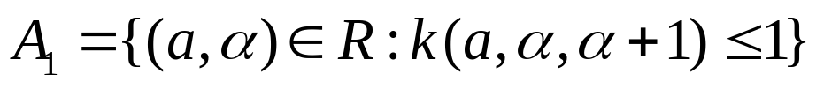

“Small” a
Campbell used “Lemma 2” to obtain
where
He showed there is a set R on which k is increasing in a
Let
Let

Slide 27
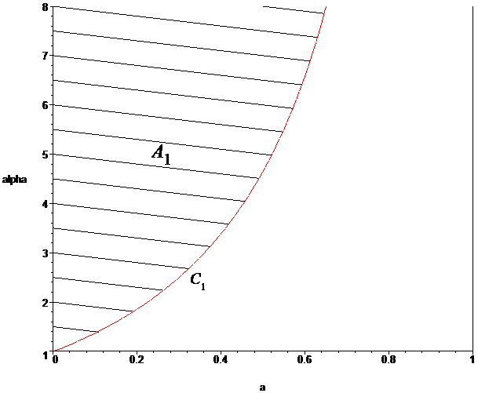
“Small” a

Slide 28
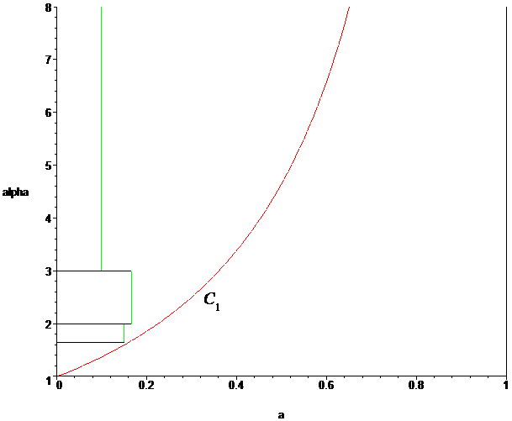
“Small” a

Slide 29
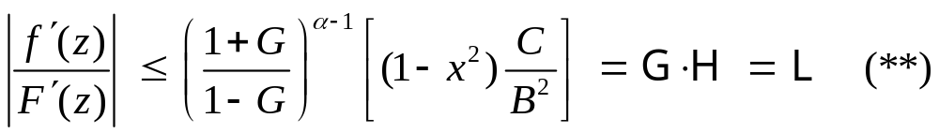
“Large” a
Campbell used “Lemma 1” to obtain
where G,C,B are functions of c, x and a

Slide 30
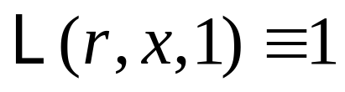
“Large” a
Campbell used “Lemma 1” to obtain
where G,C,B are functions of c, x and a
He showed there is a set S on which ☹ maximizes at c=r
He showed that ☹(r,x,a) increases on S in a and that

Slide 31
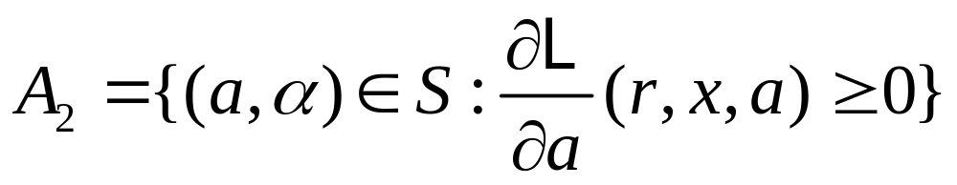
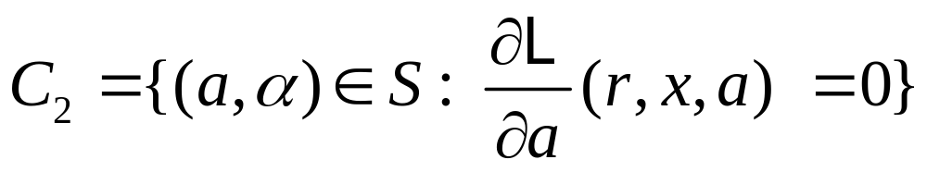
“Large” a
Let
Let

Slide 32
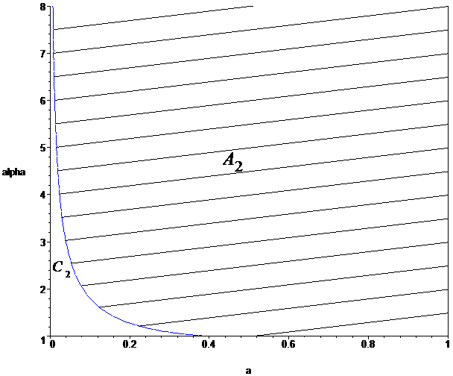
“Large” a

Slide 33
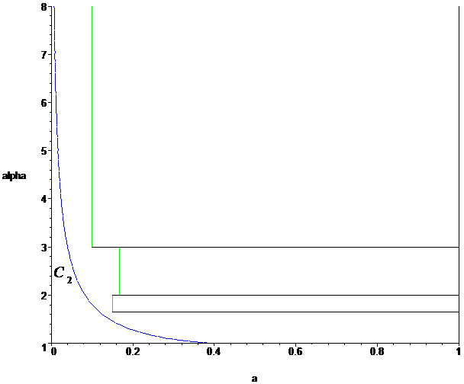
“Large” a

Slide 34
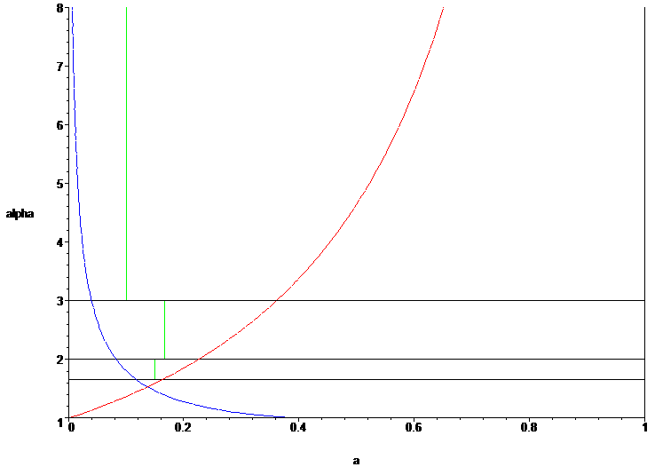
Combined Rectangles

Slide 35

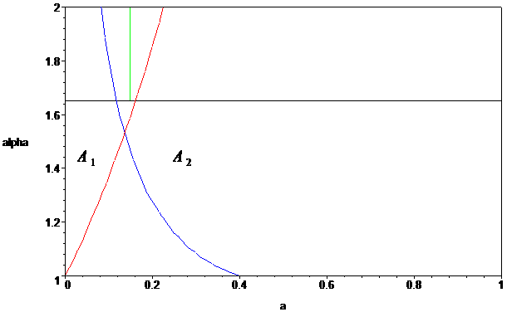
Problematic Region
Parameter space below

Slide 36
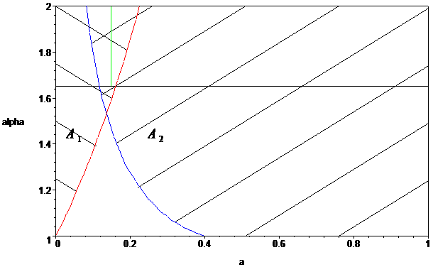
Verification of Conjecture
Campbell’s estimates valid in A₁ union A₂

Slide 37
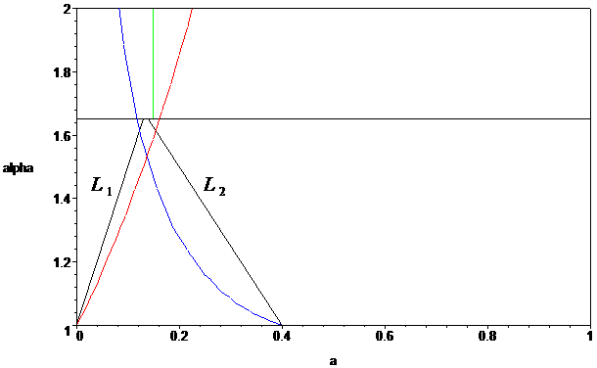
Verification of Conjecture
Find L₁ in A₁ and L₂ in A₂

Slide 38
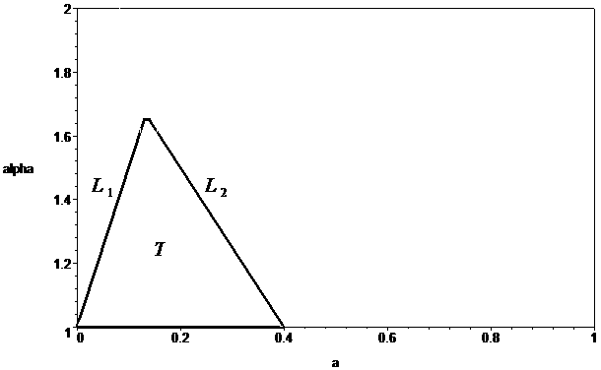
Verification of Conjecture
Reduced to verifying Campbell’s conjecture on T

Slide 39

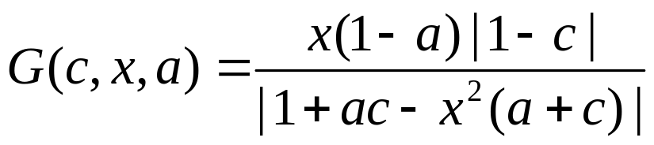
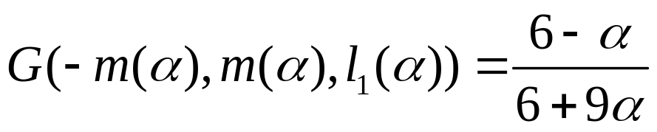
Step 1
Consider the inequality
Show for that
maximizes at

Slide 40
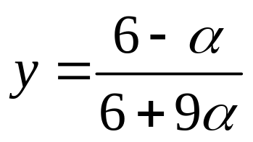
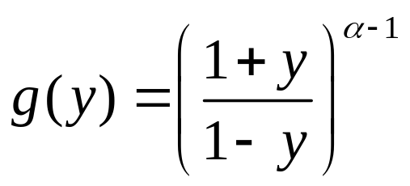
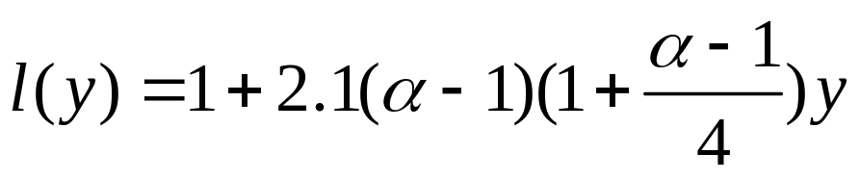
Step 2
Consider the inequality
Show at that
is bounded above by

Slide 41
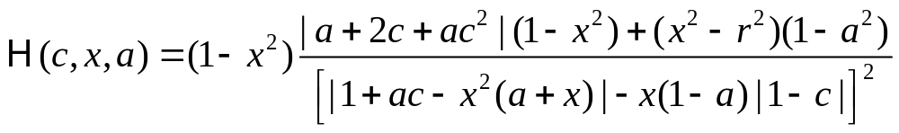
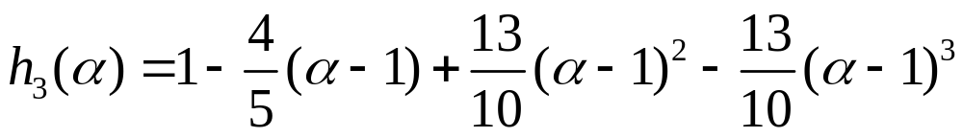
Step 3
Consider the inequality
Show for that
is bounded above by

Slide 42
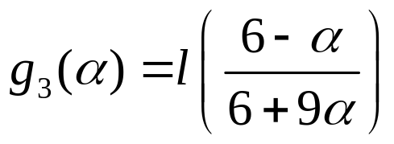
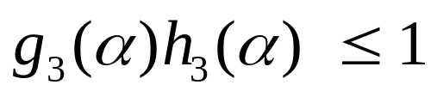
Step 4
Consider the inequality
Let and
Show that

