Slide 1

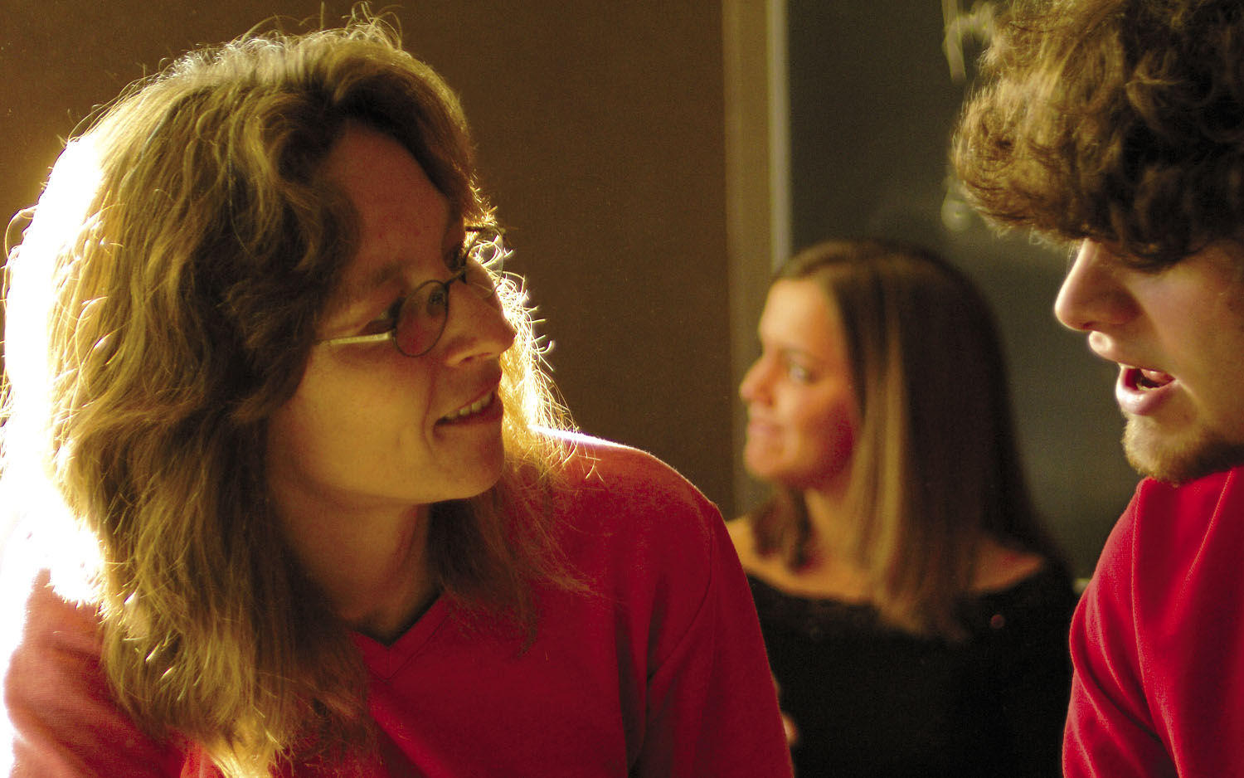
Mentoring Paradigms for Underrepresented Groups in STEM Scholarship Programs
Jerry Dwyer, Kent Pearce, Brock Williams
Department of Mathematics and Statistics
10 January 2013
Notes:
This is a summary of the efforts and the learning experiences of many people in the department and not just a report about my tangential involvement. Furthermore, I am aware that it is difficult to follow with someone as simulating and as dynamic as Brock. So, I am ready from the getgo to pardon any of you who zone out and fall asleep.

Slide 2
MENTORING PARADIGMS FOR UNDERREPRESENTED GROUPS IN STEM SCHOLARSHIP PROGRAMS
Model 1: One-on-One, Assigned Pairs
Notes:
My role here is to capture for you a summary of what we have learned and what we are currently inventing. Being “social nerds” as Brock has stated on various occasions, we started out assuming that mentoring meant one-on-one sit-down sessions between the mentor and the mentee.

Slide 3
Model 1: One-to-One, Assigned Pairs
South Plains Math Scholars Program [2007]
NSF – Scholarships in Science, Technology, Engineering, and Mathematics (S-STEM)
Scholarship program for students from low-income households
Math Department faculty assigned to protégés by PI team
Mentors and protégés expected to manage meeting schedule
Very limited success
Notes:
Our initial venture into this arena began with the successful awarding to a proposal team within the department an S-STEM scholarship program from NSF. The program was targeted towards attracting students whose resources would otherwise never permitted them to enter college. The proposal promoted that faculty from the department would “mentor” the attracted protégés. Applicants were screened, faculty were solicited to participate, and the program kicked off . . . . Brock how did you describe the inevitability of the outcome? [Here you had these faculty with limited social skills combined with students who weren’t really sure they wanted to be there . . . .]

Slide 4
Model 1: One-to-One, Assigned Pairs
Supplemental Mentoring
Michael O’Boyle, Professor, Human Development and Family Studies
Introduced himself as the “non-math” mentor
Met with each protégé over lunch
Provided opportunities for feedback on program and intervention
Notes:
There was one bright spot. One of the Co-Pis was a faculty member from another department.

Slide 5
Model 1: One-to-One, Assigned Pairs
Targeted Mentor-Protégé Matching
Mentoring program revised on protégé feedback
Mentor-protégé pairings restructured based on personalities and academic interests
Somewhat improved success
Notes:
The feedback changed the way we interfaced mentors and mentees.

Slide 6
Model 1: One-to-One, Assigned Pairs
Noyce Scholars Program [2008]
NSF – Robert Noyce Teacher Scholarship Program
Scholarship program designed to recruit gifted math and science students into teaching positions at high needs schools
Incorporated similar one-to-one faculty mentorship model
Feedback indicated mentoring program felt “too artificial”
Dominick Casadonte, Minnie Stevens Piper Professor, Department of Chemistry & Biochemistry
Took on three protégés
Led group mentoring sessions over meals
Notes:
A year after the awarding of the S-STEM grant, another proposal team within the department was awarded an NSF funded scholarship program. This one was focused on an entirely different student audience. How did I say that before? The proposal promoted that faculty from the department would “mentor” the attracted protégés. Applicants were screened, faculty were solicited to participate, and the program kicked off

Slide 7
MENTORING PARADIGMS FOR UNDERREPRESENTED GROUPS IN STEM SCHOLARSHIP PROGRAMS
Assessment Strategies

Slide 8
Assessment Strategies
Mentoring Roundtables
Sponsored by NSF – Innovation through Institutional Integration (I3) [2009]
Roundtables offered faculty mentors opportunities to provide feedback
Faculty recommendations led to the following changes:
Creation of protégé training curriculum
Restructuring of mentoring format (discussed later)
Compilation and dissemination of faculty mentor training resources
Notes:
Another proposal team (this one included the university president as the PI), was awarded an NSF grant.

Slide 9
Assessment Strategies
Mentoring Studies
Tara Stevens, Associate Professor and Program Coordinator, Educational Psychology
Leading on-going study of Noyce scholar self-efficacy measures
Provided feedback leading to positive program changes
Levi Johnson, Mathematics Graduate Student and Assistant Coordinator of STEM Outreach
Conducted study on impacts of faculty mentoring programs on faculty skills development
Observed mentoring sessions from three major NSF scholarship programs (S-STEM, Noyce, PRISM)

Slide 10
MENTORING PARADIGMS FOR UNDERREPRESENTED GROUPS IN STEM SCHOLARSHIP PROGRAMS
Model 2: Group Mentoring

Slide 11
Model 2: Group Mentoring
Noyce Scholars Program [2008]
Fall 2010 Onward
Mentors and scholars attend weekly seminar meetings
Each week is centered around a different math & science education topic
Faculty and scholars discuss topics as peers – tone is very collaborative
Seminar: “reason to meet”, structure, talking points
Notes:
After the mentioned student feedback and after the mentor round tables, the mentoring structure of the Noyce Scholars Program was restructured.

Slide 12
Model 2: Group Mentoring
GK-12: Building Bridges: Integrating Mathematics, Engineering, and Science on the South Plains [2008]
Fall Semester (2010 Onward)
Semester: Mentors and scholars attend weekly seminar meetings
Scholars prepare and give presentations relevant to their research which could be presented to high school audience
Mentors and scholars give feedback and critique to presenter on presentation style, applicability, etc.
Seminar: “reason to meet”, structure, talking points
Notes:
The same year the Noyce Scholars Program was awarded, another proposal team within the department was awarded an NSF funded program. The GK-12 program takes graduate students in the sciences and in mathematics and pairs them with high science and mathematics teachers and their high school science and mathematics classes. The scholars spend 10 hours per week in the classrooms interacting with the high school science and mathematics students.

Slide 13
Model 2: Group Mentoring
GK-12: Building Bridges: Integrating Mathematics, Engineering, and Science on the South Plains [2008]
Spring Semester (2011 Onward)
Mentors and scholars transition from seminar setting to informal group discussions
Group discussions: “reason to meet”, talking points

Slide 14
Model 2: Group Mentoring
PRISM: Proactive Recruitment in Introductory Science & Mathematics [2010]
Freshman (Cohort group of 12)
Bi-weekly IS 1100 class meetings
“reason to meet”
structure
talking points
Notes:
In 2010, another proposal team was awarded and NSF funded scholarship/recruitment program. This program targets students over their introductory lower division year. How did I say that before? The proposal promoted that faculty from the department would “mentor” the attracted protégés. Applicants were screened, faculty were solicited to participate, and the program kicked off . . . . But for this program, from the getgo, the PI team built its mentoring around a group model. IS 1100 is a Interdisciplinary Studies class which generically addresses transition to college-life, student success skills, etc. It was used as mechanism to support group mentoring of the freshman cohorts

Slide 15
Model 2: Group Mentoring
PRISM: Proactive Recruitment in Introductory Science & Mathematics [2010]
Sophomores (Cohort group of 12)
Each mentor is paired with a small research group (2-4 proteges)
Research groups meet weekly , “explore” directed/focused subject
Research group members will present their work
Sectional MAA Meeting
Local Undergraduate Research Conference
Research groups: “reason to meet”, structure

Slide 16
Model 2: Group Mentoring (Contrasted)
South Plains Math Scholars [2007]
Fall 2012
Juniors & Seniors (Cohort remnants)
Fallout from Original Mentoring Model
Single Group Meeting (Missed? / Avoided?)
Sophomores (Cohort group of 3)
PRISM Students
Freshman (Cohort group of 6)
Half PRISM
Half non-PRISM

Slide 17


