Slide 1
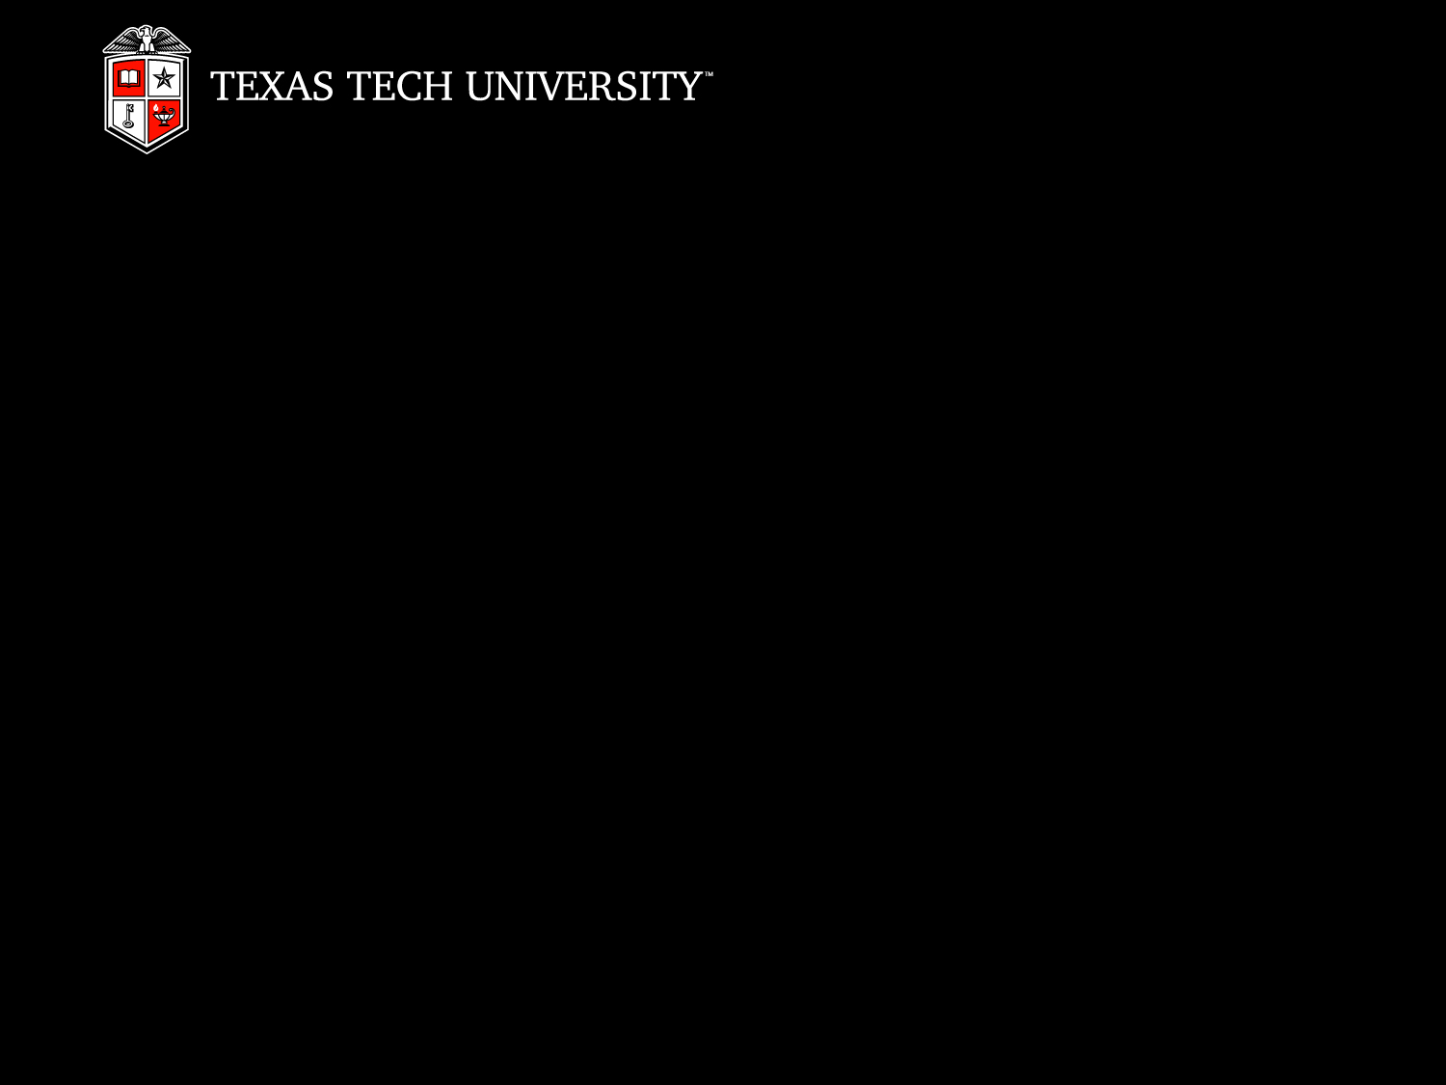

Mentoring Paradigms in Undergraduate STEM Scholarship Programs
Kent Pearce, PhD
Department Chair & Professor,
Department of Mathematics and Statistics
13 April 2012

Slide 2
MENTORING PARADIGMS IN UNDERGRADUATE STEM SCHOLARSHIP PROGRAMS
Model 1: One-to-One, Assigned Pairs

Slide 3
Model 1: One-to-One, Assigned Pairs
South Plains Math Scholars Program [2007]
  NSF – Scholarships in Science, Technology, Engineering, and Mathematics (S-STEM)
  Scholarship program for students from low-income households
  Math Department faculty assigned to protégés by PI team
  Mentors and protégés expected to manage meeting schedule
  Very limited success

Slide 4
Model 1: One-to-One, Assigned Pairs
Supplemental Mentoring
  Michael O’Boyle, Professor, Human Development and Family Studies
  Introduced himself as the “non-math” mentor
  Met with each protégé over lunch
  Provided opportunities for feedback on program and intervention

Slide 5
Model 1: One-to-One, Assigned Pairs
Targeted Mentor-Protégé Matching
  Mentoring program revised on protégé feedback
  Mentor-protégé pairings restructured based on personalities and academic interests
  Somewhat improved success

Slide 6
Model 1: One-to-One, Assigned Pairs
Noyce Scholars Program [2008]
  NSF – Robert Noyce Teacher Scholarship Program
  Scholarship program designed to recruit gifted math and science students into teaching positions at high needs schools
  Incorporated similar one-to-one faculty mentorship model
  Feedback indicated mentoring program felt “too artificial”
  Dominick Casadonte, Minnie Stevens Piper Professor, Department of Chemistry & Biochemistry
    Took on three protégés
    Led group mentoring sessions over meals

Slide 7
MENTORING PARADIGMS IN UNDERGRADUATE STEM SCHOLARSHIP PROGRAMS
Assessment Strategies

Slide 8
Assessment Strategies
Mentoring Roundtables
  Sponsored by NSF – Innovation through Institutional Integration (I³) [2009]
  Roundtables offered faculty mentors opportunities to provide feedback
  Faculty recommendations led to the following changes:
    Creation of protégé training curriculum
    Restructuring of mentoring format (discussed later)
    Compilation and dissemination of faculty mentor training resources

Slide 9
Assessment Strategies
Mentoring Studies
  Tara Stevens, Associate Professor and Program Coordinator, Educational Psychology
    Leading on-going study of Noyce scholar self-efficacy measures
    Provided feedback leading to positive program changes
  Levi Johnson, Mathematics Graduate Student and Assistant Coordinator of STEM Outreach
    Conducting study on impacts of faculty mentoring programs on faculty skills development
    Observing mentoring sessions from three major NSF scholarship programs (S-STEM, Noyce, PRISM)

Slide 10
MENTORING PARADIGMS IN UNDERGRADUATE STEM SCHOLARSHIP PROGRAMS
Model 2: Group Mentoring

Slide 11
Model 2: Group Mentoring
Noyce Scholars Program
  Mentors and scholars attend weekly seminar meetings
  Each week is centered around a different math & science education topic
  Faculty and scholars discuss topics as peers – tone is very collaborative
  Seminar provides:
    “reason” to meet
    structure
    talking points

Slide 12
Model 2: Group Mentoring
PRISM: Proactive Recruitment in Introductory Science & Mathematics [2010]
  Faculty pairs mentor protégé pairs centered around undergraduate research projects
  Mentors and scholars meet as a group once per month
  Program coordinator leads meetings
South Plains Math Scholars
  SPMS will be shifting to a group mentoring model in Fall 2012

Slide 13


