Slide 1

Three Extremal Problems for
Hyperbolically Convex Functions
Roger W. Barnard, Kent Pearce, G. Brock Williams
Texas Tech University
[Computational Methods and Function Theory 4
(2004) pp 97-109]

Slide 2

Notation & Definitions
Notes:
The unit disk D forms the Poincare model for the hyperbolic plane

Slide 3

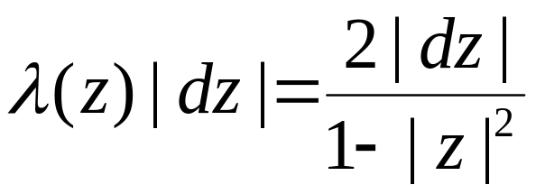
Notation & Definitions
Notes:
under the usual metric.

Slide 4
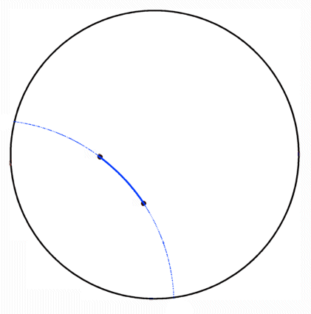
Notation & Definitions
Hyberbolic Geodesics
Notes:
In this model a hyperbolic geodesic is an arc connecting two points in D which lie on the arc of a circle which intersects the boundary of D orgothonally

Slide 5
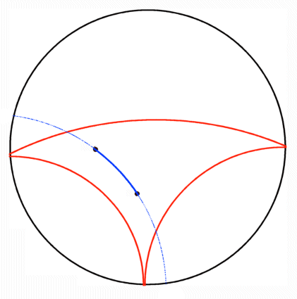
Notation & Definitions
Hyberbolic Geodesics
Hyberbolically Convex Set
Notes:
A subset of D is hyperbolically convex if each geodesic connecting points in the set again lies in the set

Slide 6
Notation & Definitions
Hyberbolic Geodesics
Hyberbolically Convex Set
Hyberbolically Convex Function
Notes:
A analytic function mapping D in to D is hyperbolically convex if its range is a hyperbolically convex subset of D

Slide 7
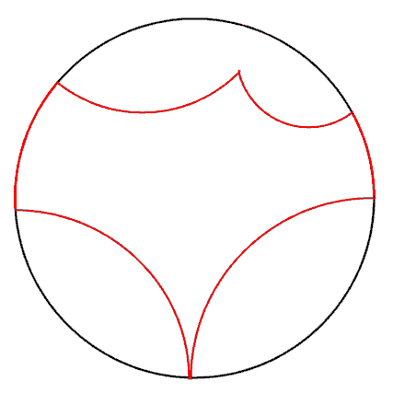
Notation & Definitions
Hyberbolic Geodesics
Hyberbolically Convex Set
Hyberbolically Convex Function
Hyberbolic Polygon
  o Proper Sides
Notes:
A hyperbolic polygon is a subset of D bounded by a finite number of geodesics in D and/or arc on the boundary of D.
We will call the bounding geodesics proper sides of the hyperbolic polygon.

Slide 8
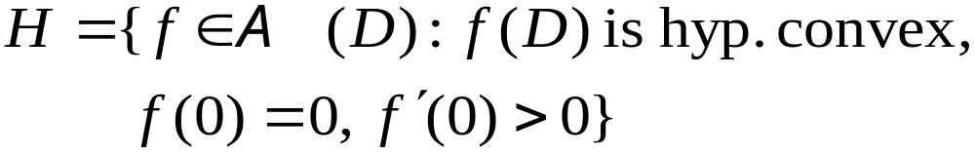
Classes
Notes:
We will consider the following classes of analytic functions. First, the class H of all hyperbolically convex functions normalized at the origin.

Slide 9
Classes
Notes:
H^poly is the subclass of all functions in H which map D to a hyperbolic polygon

Slide 10
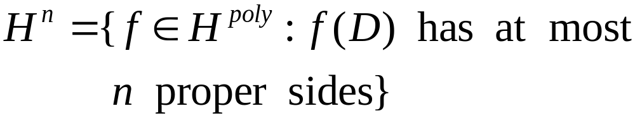
Classes
Notes:
H^n is the subclass of H^poly of functions for which the range is a hyperbolic polygon with at most n sides.

Slide 11
Classes
Notes:
For fixed alpha between 0 and 1, let H_alpha be the subclass of H of hyperbolically convex functions normalized so that the derivative at the origin is alpha.
Note that H and H^n are not compact, but can be compactified by adding in 0. On the otherhand H_alpha is compact.
These classes were studied over the last 15 years by Minda & Ma and Pommerenke with various authors. They established growth and distortion theorems and gave characterizations for hyperbolic convexity.

Slide 12
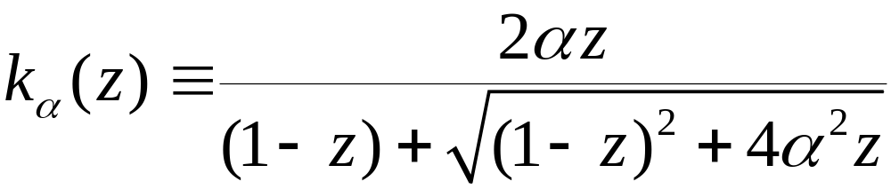
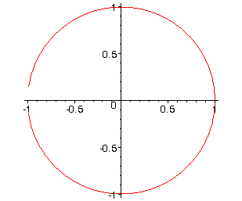

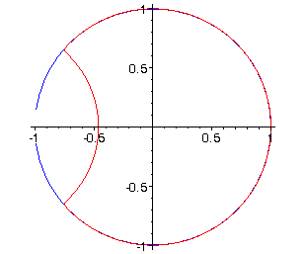
Examples
Notes:
The so called “Koebe” functions for these classes are the maps from D to the hyperbolic polygons bounded by exactly one proper side.
In the growth and distortion theorems established by previously mentioned authors, these functions frequently extremal for those problems.

Slide 13
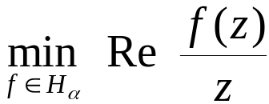
Problems
1.
Notes:
Minda & Ma and Pommerenke posed in their papers problems for hyperbolically convex functions whose solutions did not directly follow from the techniques they developed in those papers. We have investigated three of these problems.
The first problem is, for fixed alpha and fixed z, to minimize over H_alpha the functional Re f(z)/z.

Slide 14
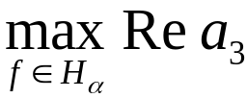
Problems
1.
2.
Find
Notes:
The second problem is, for fixed alpha, to maximize over H_alpha the real part of the third coefficient in the standard MacLaurin series expansion for a function in H_alpha.

Slide 15
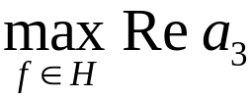
Problems
1.
2.
Find
3.
Notes:
The third problem is to maximize over the entire class H the real part of the third coefficient in the standard MacLaurin series expansion for a function in H.
Using variational methods we have the following solutions/partial solutions for these problems.

Slide 16
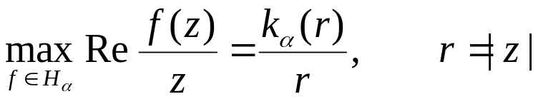

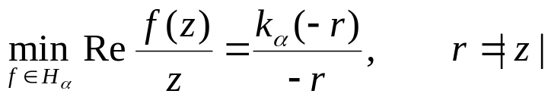
Theorem 1
Notes:
We note that the maximum value for Re f(z)/z was previously given by Ma & Minda using different methods.

Slide 17


Theorem 2
Remark Minda & Ma observed that cannot be extremal
for
Notes:
Theorem 2 reduces the problem to of maximizing Re a_3 over H_alpha to a calculus problem on H^2 intersect H_alpha.
Minda & Ma’s observation was that for alpha=1/2 the third coefficient of k_alpha is 0. Hence, the reduction to “at most two proper sides” is, in general, best possible.

Slide 18
Theorem 3

Slide 19
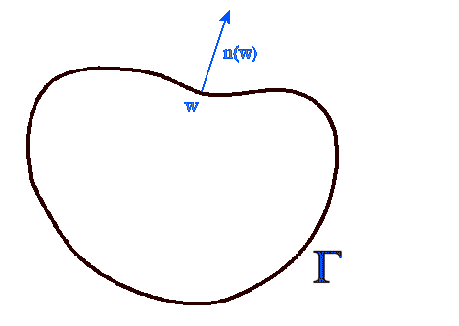
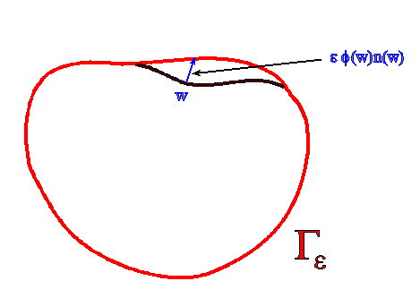
Julia Variation
Notes:
The technique which we employed is an extension of the Julia variation, as developed by Barnard & Lewis.
Technically, the weight-function phi needs to vanish at points of non-analyticity on Gamma. The extension of Barnard & Lewis allowed the Julia variational formula to represent variations on polygonal domains where there are corners and allowed the weight-function phi to remain positive at the corner.

Slide 20
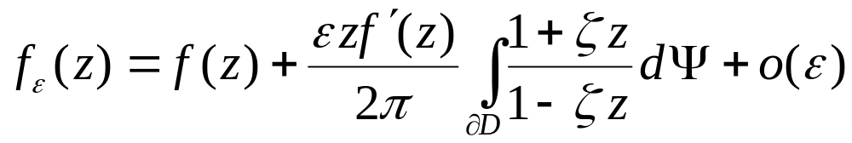

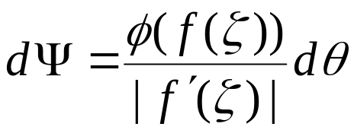

Julia Variation (cont.)

Slide 21

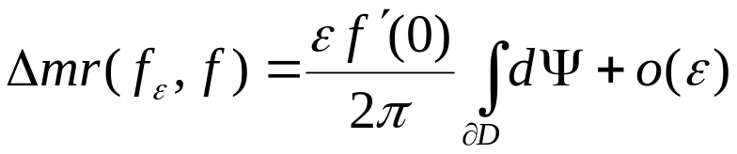
Julia Variation (cont.)

Slide 22
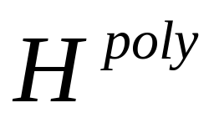
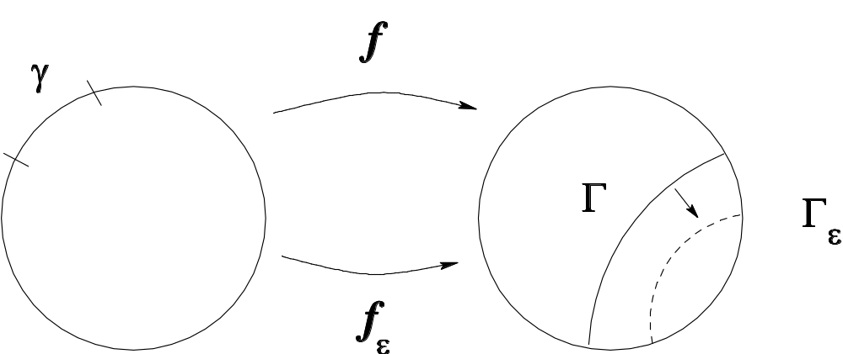
Variations for (Var. #1)
Notes:
In order to apply the Julia variation to functions in H^poly we need variations which preserve H^poly. We introduced two variations are constructed geometrically to move one geodesic to another and hence preserve the hyperbolic convexity of the range.
The first variation preserves the class H^n – it creates a varied function which is again in H^n. The variation moves the whole side Gamma from one geodesic to a nearby geodesic. The sign of epsilon determines whether the side Gamma is pushed in or out.

Slide 23
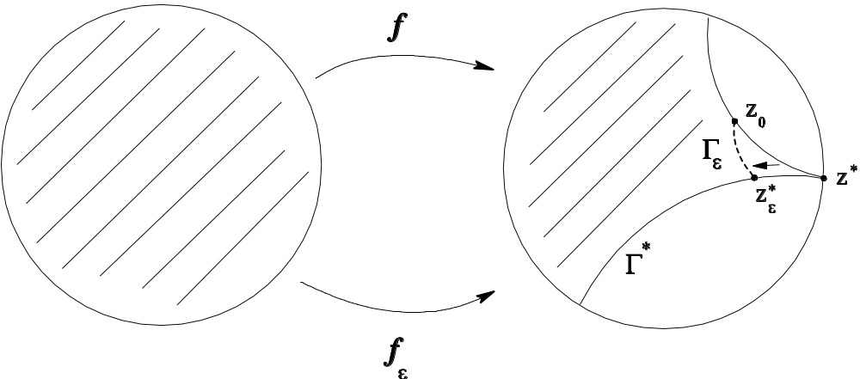
Variations for (Var. #2)
Notes:
The second variation “adds a side” to the range of the function, i.e., it creates from a function in H^n a varied function in H^{n+1}.
In order to preserve hypberbolic convexity, the variation can only “push in” the end of the side Gamma. Consequently, it strictly decreases the mapping radius of the varied function.

Slide 24

Proof (Theorem 1)

Slide 25
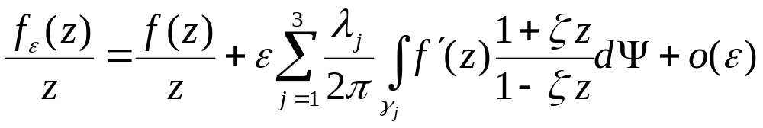
Proof (Theorem 1)
Notes:
We will describe the solution for the minimization problem. The maximization problem is similar. Note, H^n_alpha is compact.

Slide 26

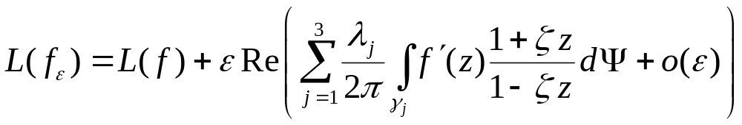

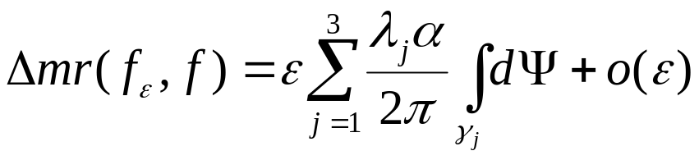
Proof (Theorem 1)

Slide 27
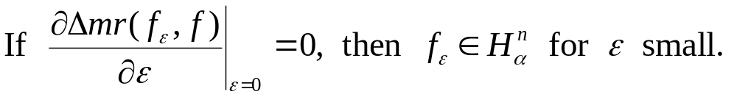
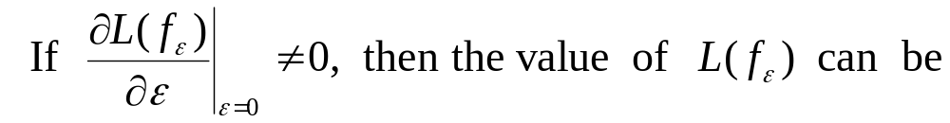
Proof (Theorem 1)
From the Calculus of Variations:

Slide 28

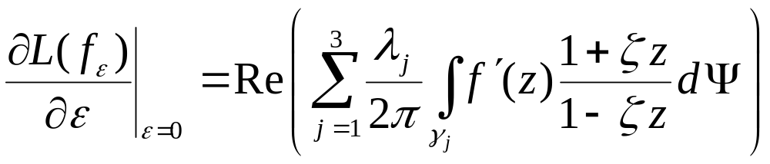

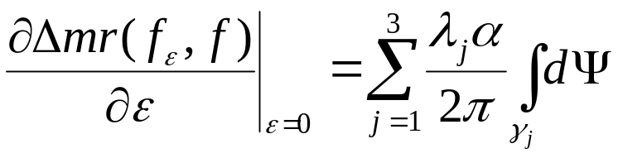

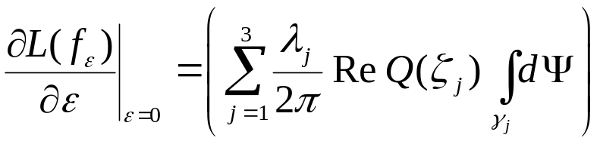
Proof (Theorem 1)

Slide 29

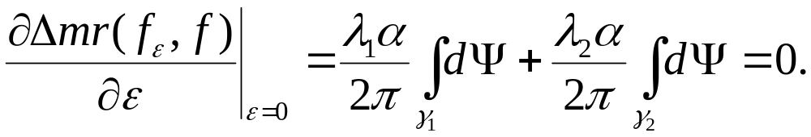
Proof (Theorem 1)

Slide 30

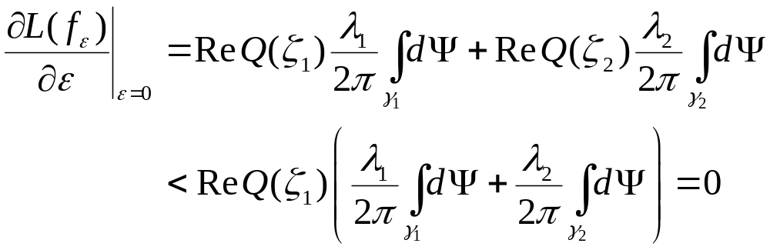
Proof (Theorem 1)

Slide 31

Proof (Theorem 1)

Slide 32

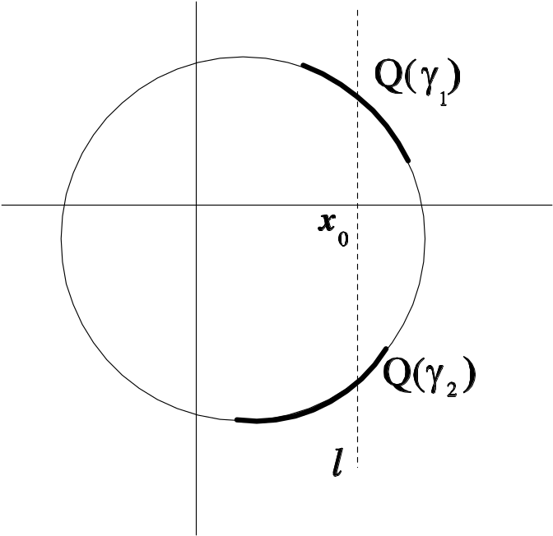
Proof (Theorem 1)

Slide 33

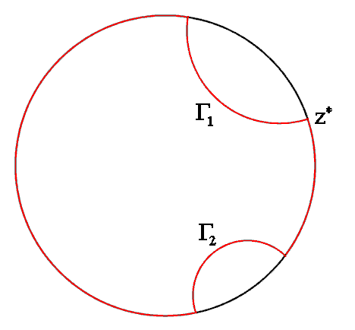

Proof (Theorem 1)

Slide 34
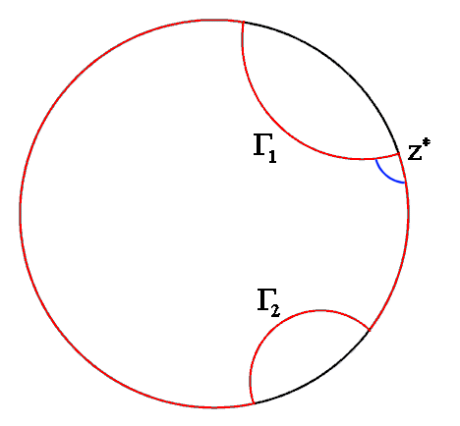
Proof (Theorem 1)

Slide 35
Proof (Theorem 1)

Slide 36
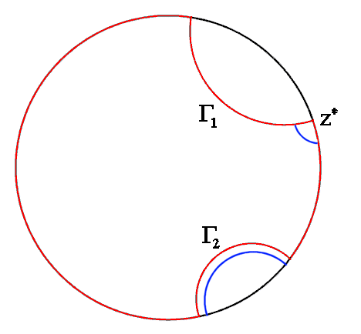
Proof (Theorem 1)

Slide 37

Proof (Theorem 1)

Slide 38
Proof (Theorem 1)

Slide 39
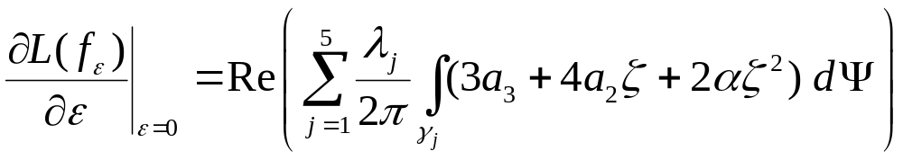
Proofs (Theorem 2 & 3)

