Slide 1


The Verification of an Inequality
Roger W. Barnard, Kent Pearce, G. Brock Williams
Texas Tech University
Leah Cole
Wayland Baptist University
Presentation: Chennai, India

Slide 2

Notation & Definitions
Notes:
The unit disk D forms the Poincare model for the hyperbolic plane

Slide 3
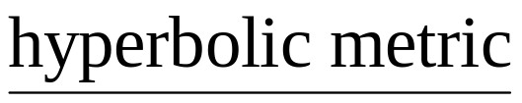
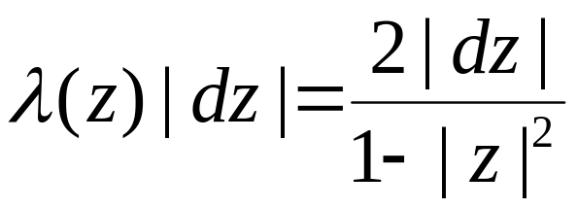
Notation & Definitions
Notes:
under the usual metric.

Slide 4
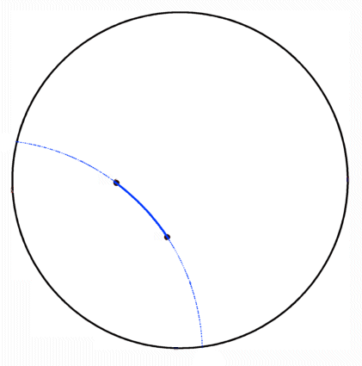
Notation & Definitions
Hyberbolic Geodesics
Notes:
In this model a hyperbolic geodesic is an arc connecting two points in D which lie on the arc of a circle which intersects the boundary of D orgothonally

Slide 5
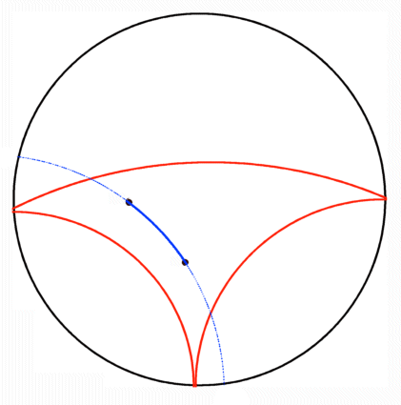
Notation & Definitions
Hyberbolic Geodesics
Hyberbolically Convex Set
Notes:
A subset of D is hyperbolically convex if each geodesic connecting points in the set again lies in the set

Slide 6
Notation & Definitions
Hyberbolic Geodesics
Hyberbolically Convex Set
Hyberbolically Convex Function
Notes:
A analytic function mapping D in to D is hyperbolically convex if its range is a hyperbolically convex subset of D

Slide 7
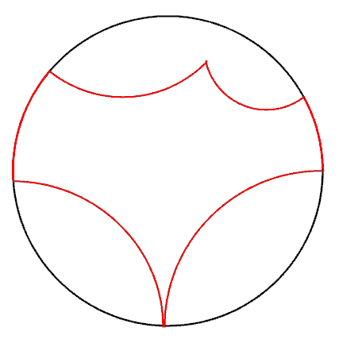
Notation & Definitions
Hyberbolic Geodesics
Hyberbolically Convex Set
Hyberbolically Convex Function
Hyberbolic Polygon
  o Proper Sides
Notes:
A hyperbolic polygon is a subset of D bounded by a finite number of geodesics in D and/or arc on the boundary of D.
We will call the bounding geodesics proper sides of the hyperbolic polygon.

Slide 8
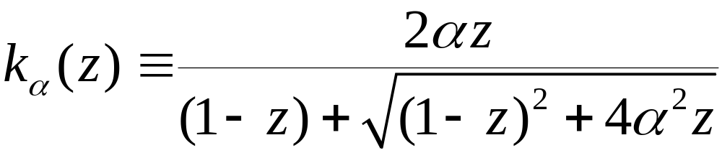
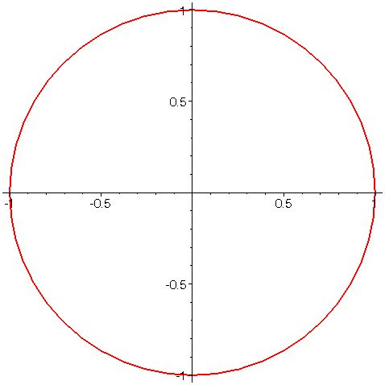
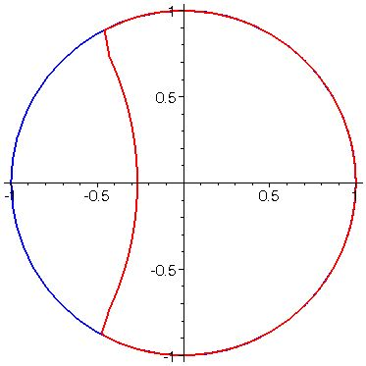

Examples
Notes:
The so called “Koebe” functions for these classes are the maps from D to the hyperbolic polygons bounded by exactly one proper side.
In the growth and distortion theorems established by previously mentioned authors, these functions frequently extremal for those problems.

Slide 9
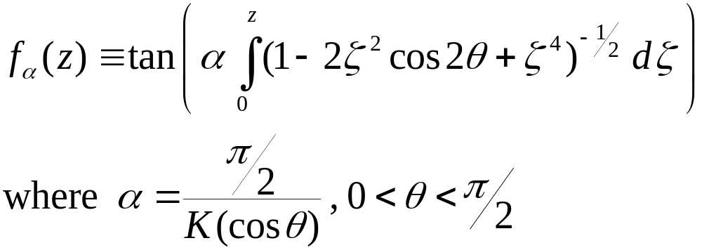
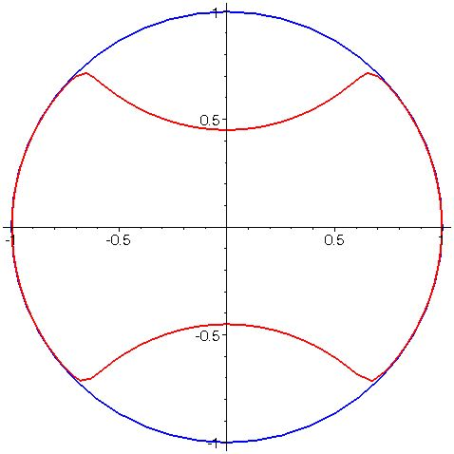

Examples
Notes:
The so called “Koebe” functions for these classes are the maps from D to the hyperbolic polygons bounded by exactly one proper side.
In the growth and distortion theorems established by previously mentioned authors, these functions frequently extremal for those problems.

Slide 10
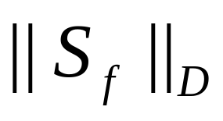

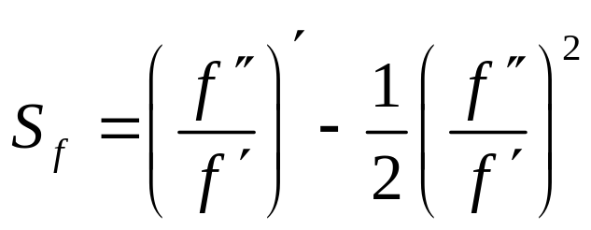
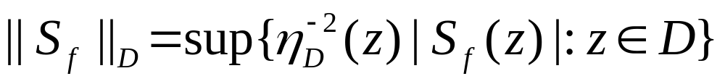
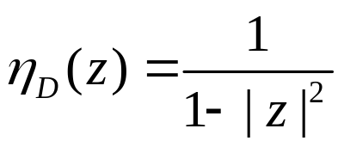
Schwarz Norm
For let
and
where
Notes:
Minda & Ma and Pommerenke posed in their papers problems for hyperbolically convex functions whose solutions did not directly follow from the techniques they developed in those papers. We have investigated three of these problems.
The first problem is, for fixed alpha and fixed z, to minimize over H_alpha the functional Re f(z)/z.

Slide 11


Extremal Problems for
Euclidean Convexity
  Nehari (1976):

Slide 12


Extremal Problems for
Euclidean Convexity
  Nehari (1976):
Spherical Convexity
  Mejía, Pommerenke (2000):

Slide 13
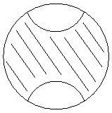
Extremal Problems for
Euclidean Convexity
  Nehari (1976):
Spherical Convexity
  Mejía, Pommerenke (2000):
Hyperbolic Convexity
  Mejía, Pommerenke Conjecture (2000):

Slide 14
Verification of M/P Conjecture
“The Sharp Bound for the Deformation of a Disc under a Hyperbolically Convex Map,” Proceedings of London Mathematical Society (accepted), R.W. Barnard, L. Cole, K.Pearce, G.B. Williams.
http://www.math.ttu.edu/~pearce/preprint.shtml

Slide 15
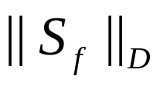
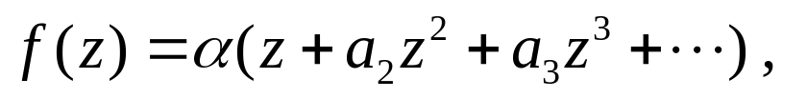
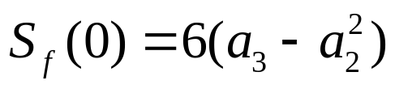
Verification of M/P Conjecture
Invariance of hyperbolic convexity under disk automorphisms
Invariance of under disk automorphisms
For

Slide 16
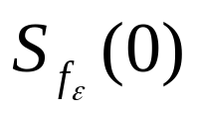
Verification of M/P Conjecture
Classes H and H_{n}
Julia Variation and Extensions
Two Variations for the class H_{n}
Representation for
Reduction to H₂

Slide 17
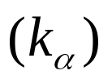
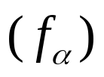
Computation in H₂
Functions whose ranges are convex domains bounded by one proper side
Functions whose ranges are convex domians bounded by two proper sides which intersect inside D
Functions whose ranges are odd symmetric convex domains whose proper sides do not intersect

Slide 18

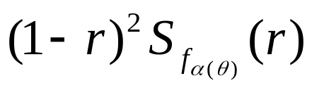
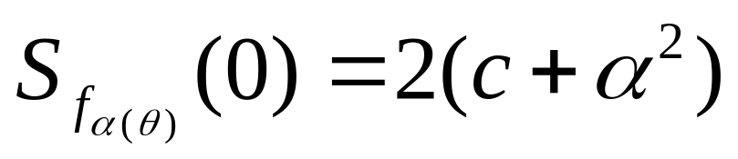

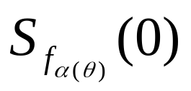

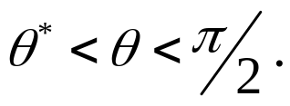

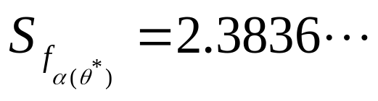
Leah’s Verification
For each fixed that is maximized at r = 0, 0 ≤ r < 1
The curve is unimodal, i.e., there exists a unique so that
  increases for and
  decreases for At

Slide 19
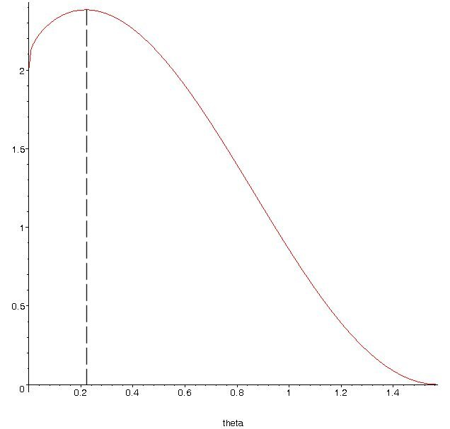

Graph of

Slide 20

Innocuous Paragraph
“Recall that is invariant under pre-composition with disc automorphisms. Thus by pre-composing with an appropriate rotation, we can ensure that the sup in the definition of the Schwarz norm occurs on the real axis.”

Slide 21
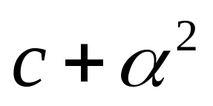
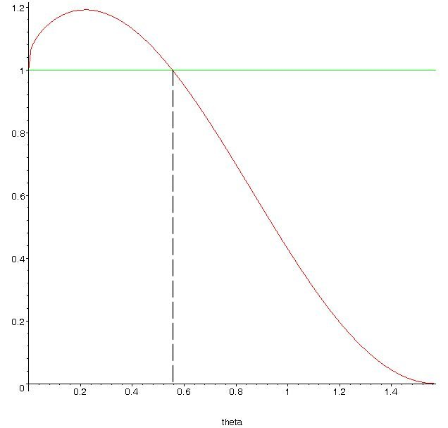

Graph of

Slide 22
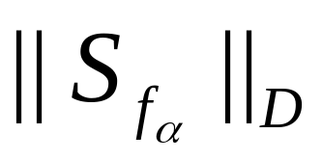
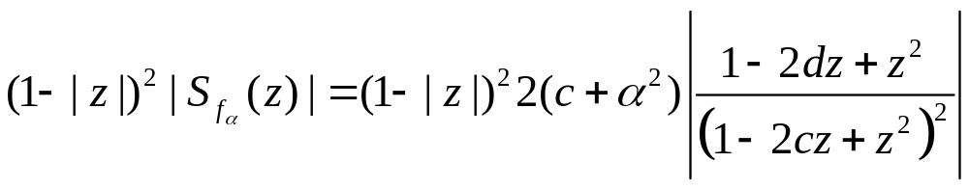
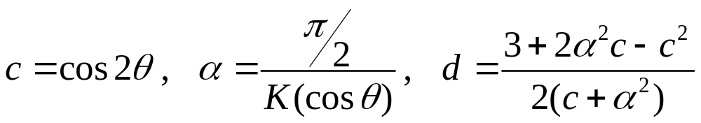
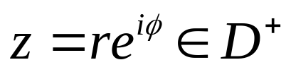
where
and

Slide 23
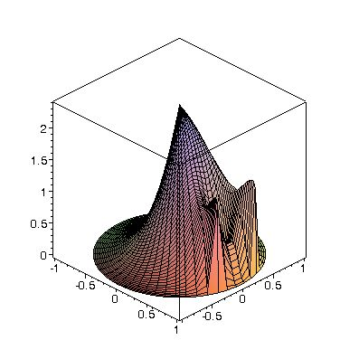
θ = 0.1π /2

Slide 24
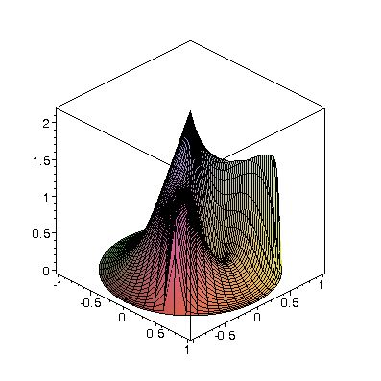
θ = 0.3π /2

Slide 25
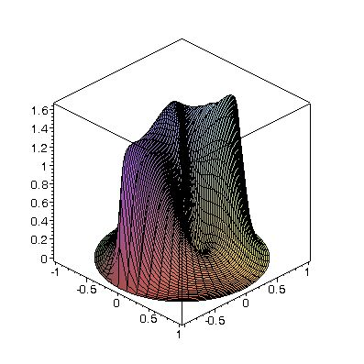
θ = 0.5π /2

Slide 26
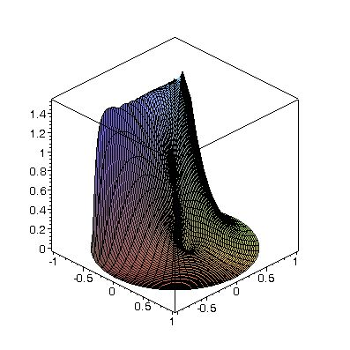
θ = 0.7π /2

Slide 27
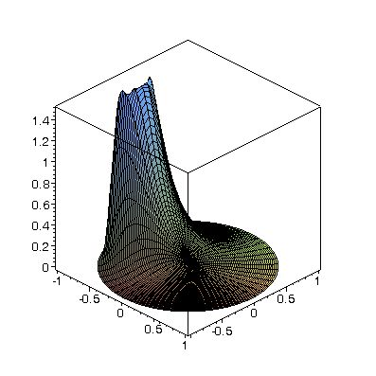
θ = 0.9π /2

Slide 28
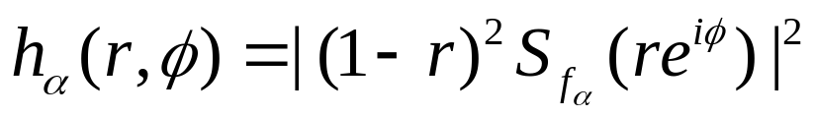

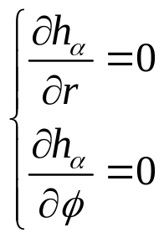


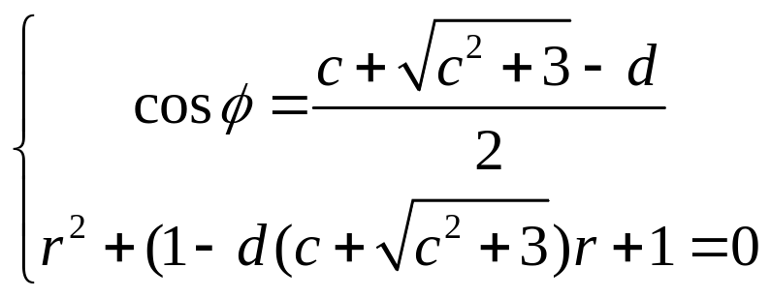
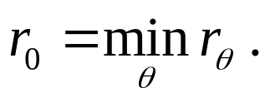
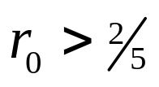
Locate Local Maximi
For fixed let
Solve For there exists unique solution which satisfies
Let Claim

Slide 29
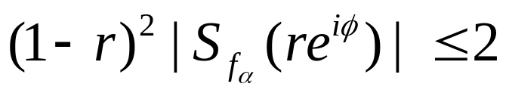
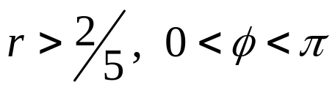


Strategy #1
Case 1. Show
for
Case 2. Case (negative real axis)
Case 3. Case originally resolved.

Slide 30
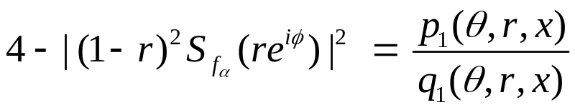







Strategy #1 – Case 1.
Let where The
numerator p₁ is a reflexive 8th-degree polynomial in r.
Make a change of variable Rewrite p₁ as
where p₂ is 4th-degree in cosh s . Substitute
to obtain
which is an even 8th-degree polynomial in
Substituting we obtain a 4th-degree polynomial

Slide 31
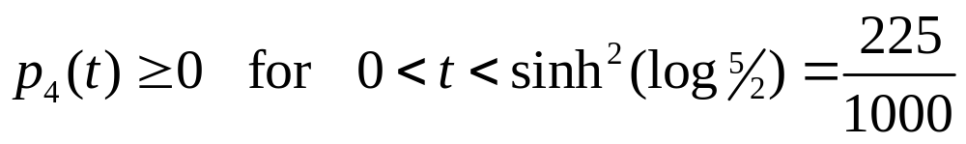
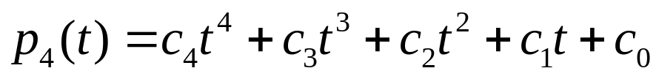

Strategy #1 – Case 1. (cont)
We have reduced our problem to showing that
Write
It suffices to show that p₄ is totally monotonic, i.e.,
that each coefficient

Slide 32
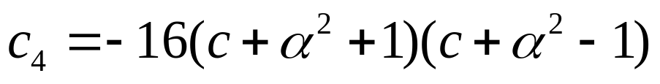

Strategy #1 – Case 1. (cont)
It can be shown that c₃, c₁, c₀ are non-negative.
However,
which implies that for that c₄ is negative.

Slide 33

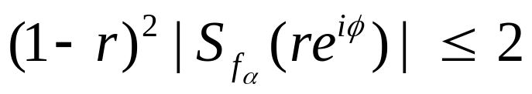
Strategy #1 – Case 1. (cont)
In fact, the inequality is false;
or equivalently,
the original inequality
is not valid for

Slide 34




Problems with Strategy #1
The supposed local maxima do not actually exist.
For fixed near 0, the values of
stay near for large values of r , i.e., the values of are not bounded by 2 for

Slide 35



Problems with Strategy #1

Slide 36





Strategy #2
Case 1-a.
  Show for
Case 1-b.
  Show for
Case 2. Case (negative real axis)
Case 3. Case originally resolved.

Slide 37


Strategy #2 – Case 1-a.
Let where
The numerator p₁ is a reflexive 6th-degree polynomial in r.
Make a change of variable Rewrite p₁ as
where p₂ is 3rd-degree in cosh s . Substitute
to obtain
which is an even 6th-degree polynomial in
Substituting we obtain a 3rd-degree polynomial

Slide 38



Strategy #2 – Case 1-a. (cont)
We have reduced our problem to showing that
for t > 0 under the assumption that
It suffices to show that p₄ is totally monotonic, i.e.,
that each coefficient

Slide 39

Strategy #2 – Case 1-a. (cont)
c₃ is linear in x. Hence,

Slide 40

Strategy #2 – Case 1-a. (cont)
It is easily checked that

Slide 41


Strategy #2 – Case 1-a. (cont)
write

Slide 42

Strategy #2 – Case 1-a. (cont)
c₂ is quadratic in x. It suffices to show that the vertex
of c₂ is non-negative.

Slide 43

Strategy #2 – Case 1-a. (cont)
The factor in the numerator satisifes

Slide 44

Strategy #2 – Case 1-a. (cont)
Finally, clearly
are non-negative

Slide 45
Strategy #2
Case 1-a.
  Show for
Case 1-b.
  Show for
Case 2. Case (negative real axis)
Case 3. Case originally resolved.

Slide 46
Strategy #2 – Case 1-b.
Let where The
numerator p₁ is a reflexive 8th-degree polynomial in r.
Make a change of variable Rewrite p₁ as
where p₂ is 4th-degree in cosh s . Substitute
to obtain
which is an even 8th-degree polynomial in
Substituting we obtain a 4th-degree polynomial

Slide 47



Strategy #2 – Case 1-b. (cont)
We have reduced our problem to showing that
under the assumption
that
It suffices to show that p₄ is totally monotonic, i.e.,
that each coefficient

Slide 48
Strategy #2 – Case 1-b. (cont)
It can be shown that the coefficients c₄, c₃, c₁, c₀ are
non-negative.
Given,
and that , it follows that c₄ is positive.

Slide 49
Coefficients c₃, c₁, c₀
Since c₃ is linear in x, it suffices to show that
Rewriting q_{p} we have

Slide 50





Coefficients c₃, c₁, c₀ (cont.)
Making a change of variable we have
where Since all of the coefficients of α are negative,
then we can obtain a lower bound for q_{m} by replacing α with
an upper bound
Hence, is a 32nd degree polynomial
in y with rational coefficients. A Sturm sequence
argument shows that has no roots (i.e., it is positive).

Slide 51


Coefficients c₃, c₁, c₀ (cont.)
The coefficients c₁ and c₀ factor

Slide 52


Strategy #2 – Case 1-b. (cont)
However, c₂ is not non-negative.
Since c₄, c₃, c₁, c₀ are non-negative, to show that
for 0 < t < ¼ it would suffice to show that
or
was non-negative – neither of which is true.

Slide 53


Strategy #2 – Case 1-b. (cont)
We note that it can be shown that
is non-negative for -0.8 < x < 1 and

Slide 54
Strategy #2 – Case 1-b. (cont)
We will show that
is non-negative for -1 < x < -0.8 and
and 0 < t < ¼ from which will follow that

Slide 55




Strategy #2 – Case 1-b. (cont)
1. Expand q in powers of α
2. Show d₄ and d₂ are non-positive
3. Replace and use the upper bound
where to obtain a
lower bound q* for q
which has no α dependency

Slide 56
Strategy #2 – Case 1-b. (cont)
4. Expand q* in powers of t
  where
Note: e₀(y,x) ≥ 0 on R.
Recall 0 < t < ¼

Slide 57
Strategy #2 – Case 1-b. (cont)
5. Make a change of variable (scaling)
where

Slide 58

Strategy #2 – Case 1-b. (cont)
6. Partition the parameter space R* into
subregions where the quadratic q* has
specified properties

Slide 59

Strategy #2 – Case 1-b. (cont)
Subregion A
  e₂(y,w) < 0
  Hence, it suffices to verify that q*(0) > 0 and q*(0.25) > 0

Slide 60

Strategy #2 – Case 1-b. (cont)
Subregion B
  e₂(y,w) > 0 and e₁(y,w) > 0
  Hence, it suffices to verify q*(0) > 0

Slide 61

Strategy #2 – Case 1-b. (cont)
Subregion C
  e₂(y,w) > 0 and e₁(y,w) < 0 and the location of the vertex of q* lies to the right of t = 0.25
  Hence, it suffices to verify that q*(0.25) > 0

Slide 62

Strategy #2 – Case 1-b. (cont)
Subregion D
  e₂(y,w) > 0 and e₁(y,w) < 0 and the location of the vertex of q* lies between t = 0 and t = 0.25
  Required to verify that the vertex of q* is non-negative

Slide 63


Strategy #2 – Case 1-b. (cont)
7. Find bounding curves for D

Slide 64
Strategy #2 – Case 1-b. (cont)
8. Parameterize y between by
  Note: q* = q*(z,w,t) is polynomial in z, w, t with rational coefficients, 0 < z < 1, 0 < w < 1, 0 < t < 0.25, which is quadratic in t
9. Show that the vertex of q* is non-negative, i.e., show that the discriminant of q* is negative.

Slide 65
Strategy #2
Case 1-a.
  Show for
Case 1-b.
  Show for
Case 2. Case (negative real axis)
Case 3. Case originally resolved.

Slide 66







Strategy #2 – Case 2.
Show there exists which is the unique solution of d = 2c + 1 such that for
is strictly decreasing, i.e., for
we have takes its maximum value at x = 0.
Note:

Slide 67



Strategy #2 – Case 2. (cont)
Let for The
numerator p₁ is a reflexive 4th-degree polynomial in r.
Make a change of variable Rewrite p₁ as
where p₂ is 2nd-degree in cosh s . Substitute
to obtain
which is an even 4th-degree polynomial in
Substituting we obtain a 2nd-degree polynomial

Slide 68



Strategy #2 – Case 2. (cont)
Show that the vertex of p₄ is non-negative
Rewrite
Show

Slide 69


Strategy #2 – Case 2. (cont)
Since all of the coefficients of α in q₂ are negative,
then we can obtain a lower bound for q₂ by replacing α with
an upper bound (also writing c = 2y²-1)
Hence, is a 32nd degree polynomial
in y with rational coefficients. A Sturm sequence
argument shows that has no roots (i.e., it is positive).

Slide 70
Strategy #2
Case 1-a.
  Show for
Case 1-b.
  Show for
Case 2. Case (negative real axis)
Case 3. Case originally resolved.

Slide 71
Innocuous Paragraph
“Recall that is invariant under pre-composition with disc automorphisms. Thus by pre-composing with an appropriate rotation, we can ensure that the sup in the definition of the Schwarz norm occurs on the real axis.”

Slide 72

New Innocuous Paragraph
Using an extensive calculus argument which considers several cases (various interval ranges for |z|, arg z, and α) and uses properties of polynomials and K, one can show that this problem can be reduced to computing

