Slide 1

Use of Computer Technology for Insight and Proof
Strengths, Weaknesses and Practical Strategies
(i) The role of CAS in analysis
(ii) Four practical mechanisms
(iii) Applications
Kent Pearce
Texas Tech University
Presentation: Fresno, California, 24 September 2010

Slide 2
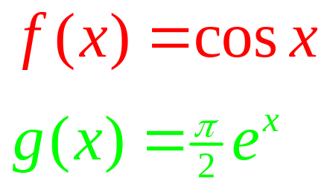
Question
Consider
Notes:
What do you know about them?
exp(x) increasing, exp(0) = 1, asymptote at –infinity, domain : all reals, range : all positive reals, absolutely monotonic
r(x) := 1/(1-x), (-infinity,1)
cos(x) periodic, period 2pi, identities, domain all reals, range : [-1,1]
complex extensions, twisted relatives of each other
Do their graphs intersect?

Slide 3
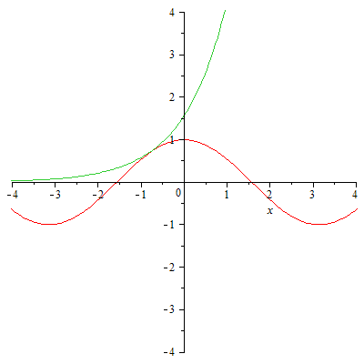
Question
Consider

Slide 4
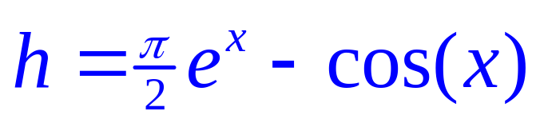
Question
Consider

Slide 5
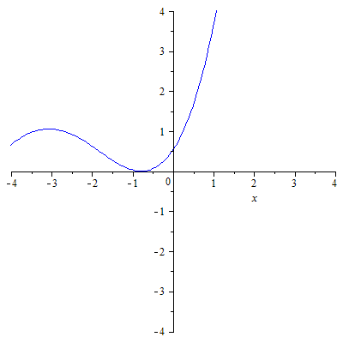
Question
Consider

Slide 6
Question
Given a function f on an interval [a, b], what does it take to show that f is non-negative on [a, b]?

Slide 7
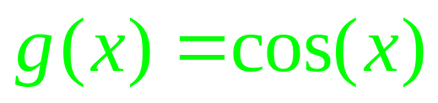
Transcendental Functions
Consider

Slide 8
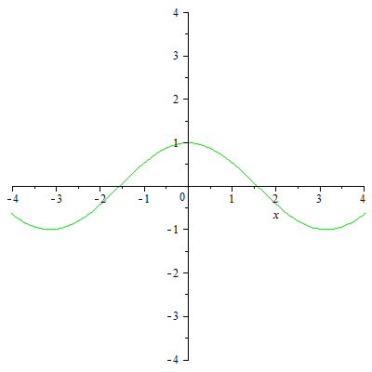
Transcendental Functions
Consider
Notes:
Leave aside Screen Resolution (Pixel vs Point)
Calculating values of cosine correctly??

Slide 9
Transcendental Functions
cos(0)
        1
cos(0.95)
0.5816830895
cos(0.95 + 2000000000*π)
0.5816830895
cos(0.95 + 2000000000.*π)
cos(0.95 + 2000000000.*π)

Slide 10

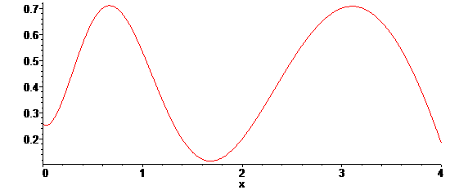
Blackbox Approximations
Transcendental / Special Functions

Slide 11
Polynomials/Rational Functions
CAS Calculations
  Integer Arithmetic
    Rational Values vs Irrational Values
Floating Point Calculation

Slide 12
Question
Given a function f on an interval [a, b], what does it take to show that f is non-negative on [a, b]?

Slide 13
(P)Lots of Dots

Slide 14
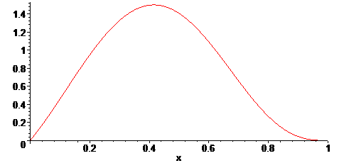
(P)Lots of Dots

Slide 15
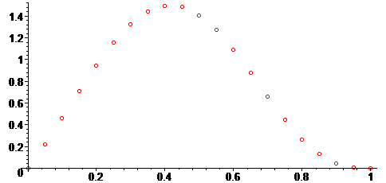
(P)Lots of Dots
Notes:
Tutor??
Math 3 ??
21 dots vs 11th degree polynomial
21 dots vs 30th degree polynomial
21 dota vs algebraic/transcendental function

Slide 16
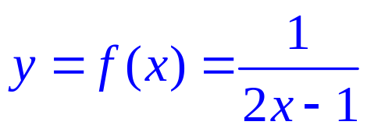
(P)Lots of Dots
Notes:
Rational function
In Math 6 (precalculus) intercepts, asymptotes, vertical, horizontal,

Slide 17
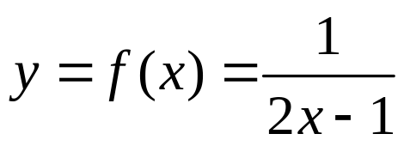
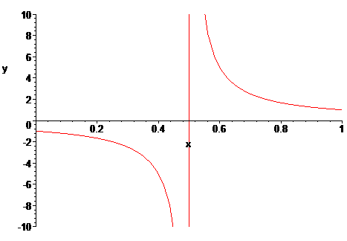
(P)Lots of Dots

Slide 18
Question
Given a function f on an interval [a, b], what does it take to show that f is non-negative on [a, b]?
Proof by Picture
  Maple, Mathematica, Matlab, Mathcad,
  Excel, Graphing Calculators, Java Applets

Slide 19
Practical Methods
A. Sturm Sequence Arguments
B. Linearity / Monotonicity Arguments
C. Special Function Estimates
D. Grid Estimates

Slide 20
Applications
"On a Coefficient Conjecture of Brannan," Complex Variables. Theory and Application. An International Journal 33 (1997) 51_61, with Roger W. Barnard and William Wheeler.
"A Sharp Bound on the Schwarzian Derivatives of Hyperbolically Convex Functions," Proceeding of the London Mathematical Society 93 (2006), 395_417, with Roger W. Barnard, Leah Cole and G. Brock Williams.
"The Verification of an Inequality," Proceedings of the International Conference on Geometric Function Theory, Special Functions and Applications (ICGFT) (accepted) with Roger W. Barnard.
"Iceberg-Type Problems in Two Dimensions," with Roger.W. Barnard and Alex.Yu. Solynin

Slide 21
Practical Methods
A. Sturm Sequence Arguments
B. Linearity / Monotonicity Arguments
C. Special Function Estimates
D. Grid Estimates

Slide 22
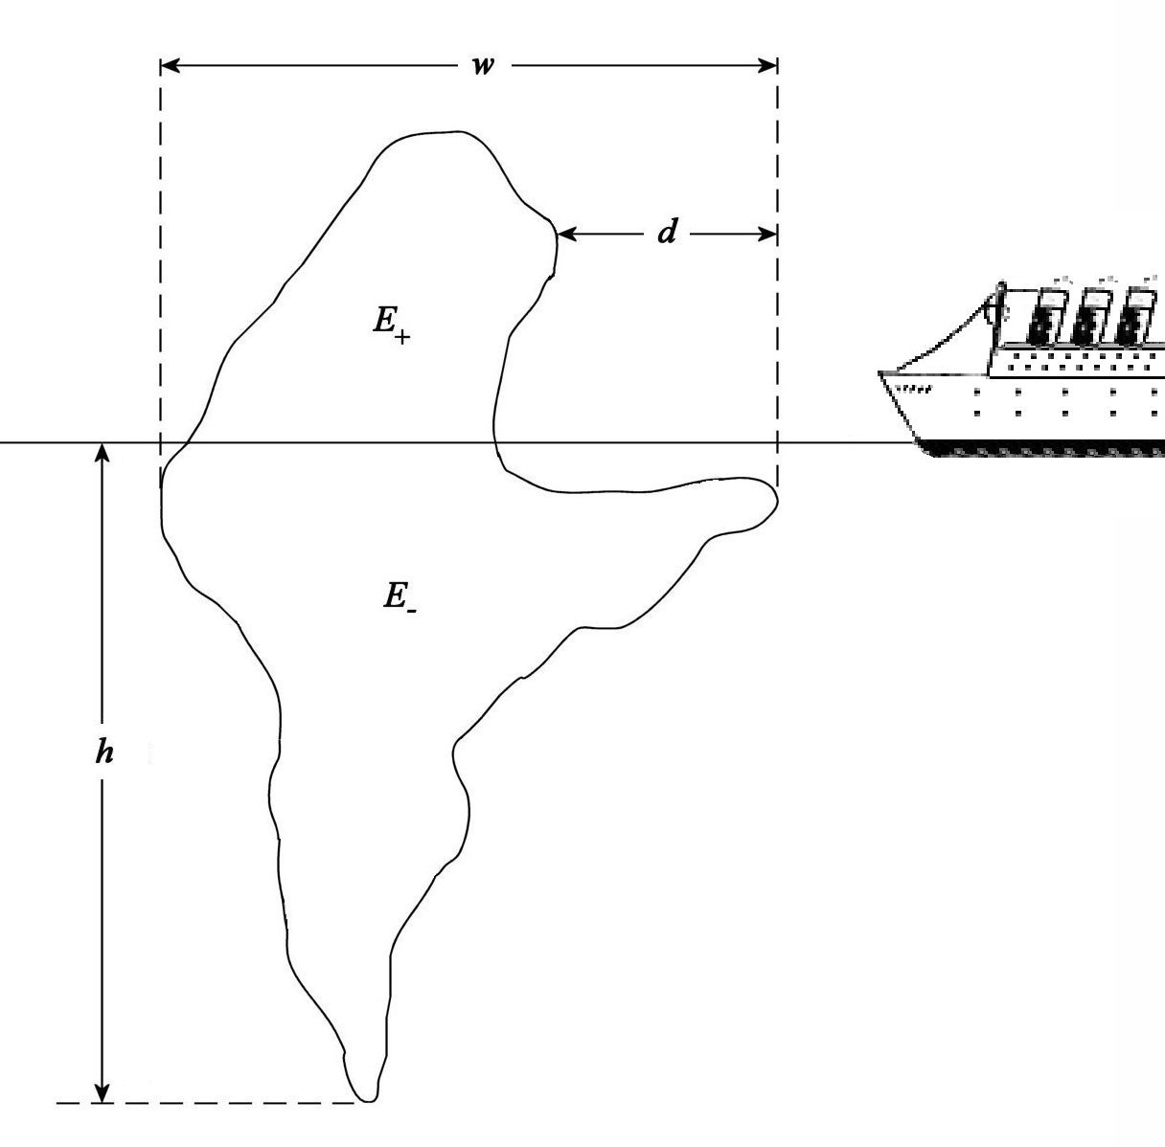
Iceberg-Type Problems

Slide 23
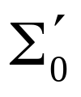

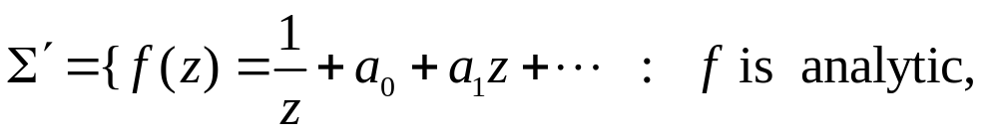


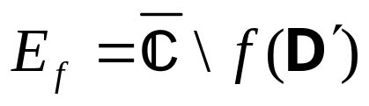
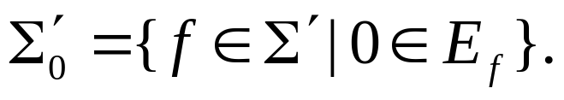
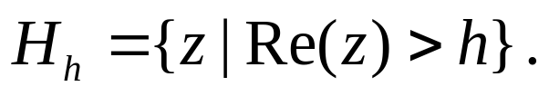
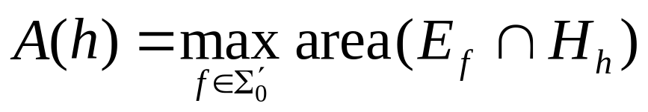
Iceberg-Type Problems
Dual Problem for Class
  Let and let
  For let
  and For 0 < h < 4, let
  Find

Slide 24
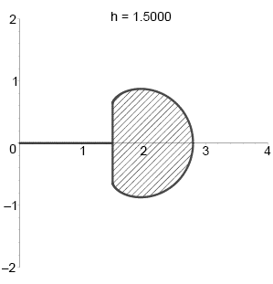
Iceberg-Type Problems
Extremal Configuration
  Symmetrization
  Polarization
  Variational Methods
  Boundary Conditions

Slide 25
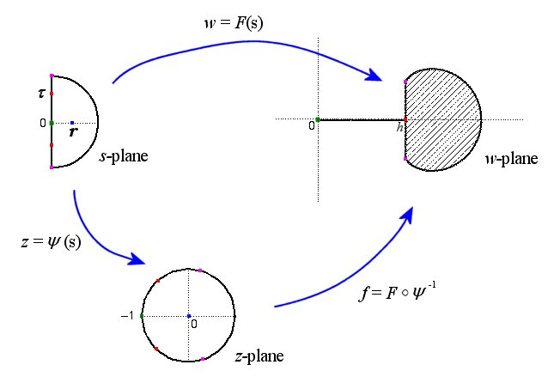
Iceberg-Type Problems

Slide 26
Iceberg-Type Problems
We obtained explicit formulas for A = A(r)
and h = h(r). To show that we could write
A = A(h), we needed to show that h = h(r) was monotone.
Notes:
Montonic??
Show h’(r) >= 0 (or <= 0), i.e., show h’(r) is non-negative (non-positive)

Slide 27
Practical Methods
A. Sturm Sequence Arguments
B. Linearity / Monotonicity Arguments
C. Special Function Estimates
D. Grid Estimates

Slide 28
Sturm Sequence Arguments
General theorem for counting the number of distinct roots of a polynomial f on an interval (a, b)
N. Jacobson, Basic Algebra. Vol. I., pp. 311-315,W. H. Freeman and Co., New York, 1974.
H. Weber, Lehrbuch der Algebra, Vol. I., pp. 301-313, Friedrich Vieweg und Sohn, Braunschweig, 1898
Notes:
Turing machine 1937 (other than abacuses (abaci?))
Chair Stefaan Delcroix

Slide 29
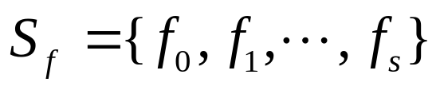

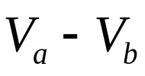

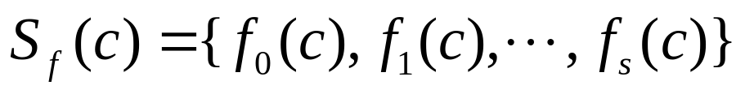
Sturm Sequence Arguments
Sturm’s Theorem. Let f be a non-constant polynomial with rational coefficients and let a < b be rational numbers. Let
be the standard sequence for f . Suppose that
Then, the number of distinct roots of f on (a, b) is where denotes the number of sign changes of

Slide 30

Sturm Sequence Arguments
Sturm’s Theorem (Generalization). Let f be a non-constant polynomial with rational coefficients and let a < b be rational numbers. Let
be the standard sequence for f . Then, the number of distinct roots of f on (a, b] is where denotes the number of sign changes of

Slide 31

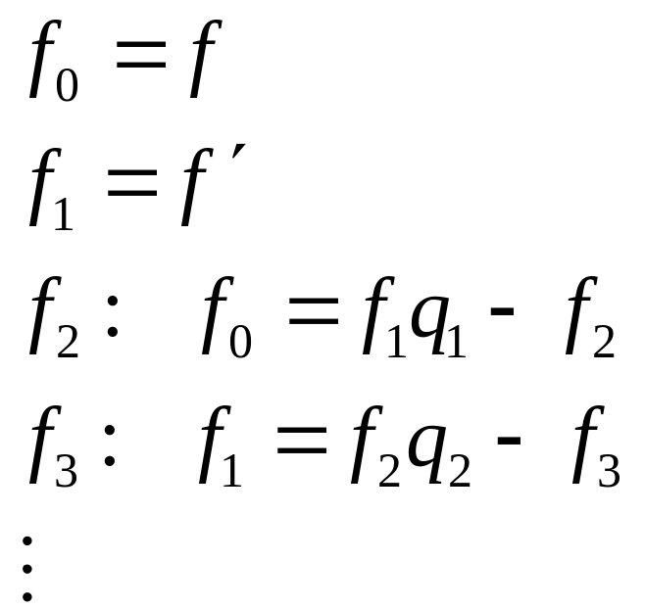
Sturm Sequence Arguments
For a given f, the standard sequence is constructed as:
Notes:
f _0= x^3 + 3x^2 + 6x -2
f_1 = 3x^2 + 6x + 6
f_2 = -2x + 4
f_3 = -30
V(-2) = //{-10,6,8,-30}//=2
V(0) = //{-2,6,4,-30}// = 2
V(2) = //{30,30,0,-30}// =1
V(4) =//{134, 78,-4,-30}//=1

Slide 32
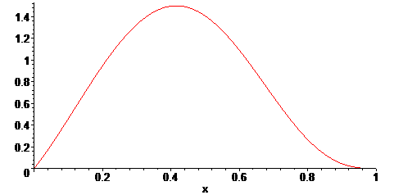
Sturm Sequence Arguments
Polynomial

Slide 33
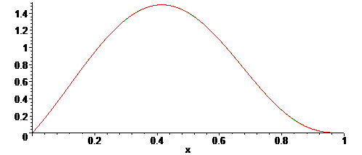
Sturm Sequence Arguments
Polynomial

Slide 34
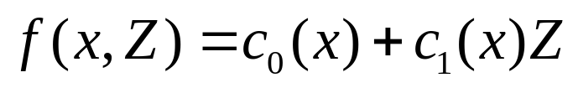

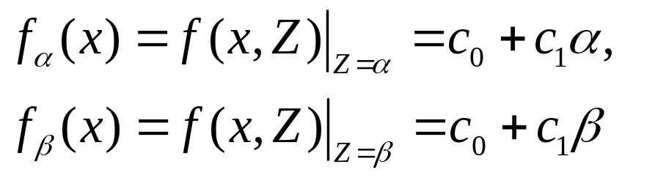
Linearity / Monotonicity
Consider
where
Let
Then,

Slide 35
Iceberg-Type Problems
We obtained explicit formulas for A = A(r)
and h = h(r). To show that we could write
A = A(h), we needed to show that h = h(r) was monotone.

Slide 36
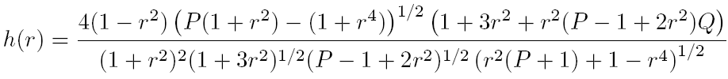

Iceberg-Type Problems
From the construction we explicitly found
where

Slide 37
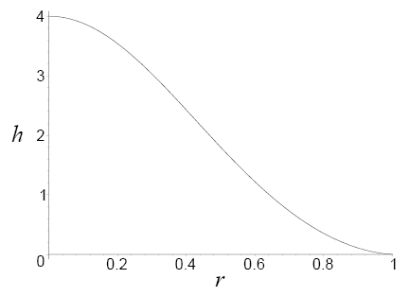
Iceberg-Type Problems

Slide 38

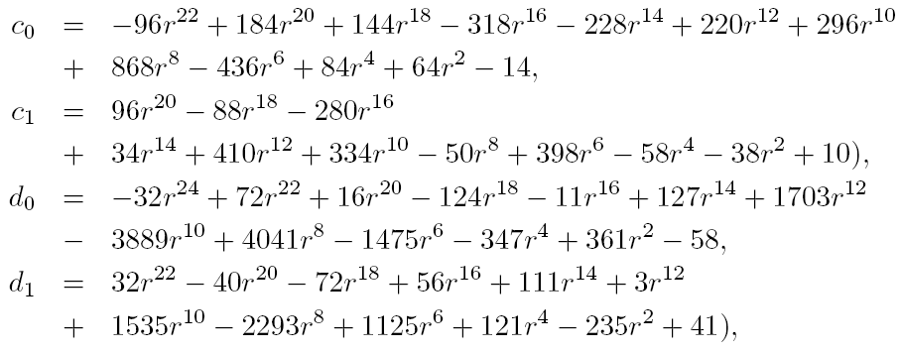
Iceberg-Type Problems
where

Slide 39
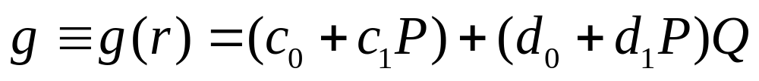
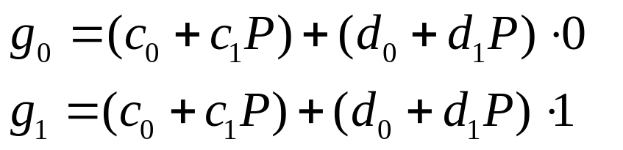
Iceberg-Type Problems
It remained to show
was non-negative. In a separate lemma, we showed 0 < Q < 1. Hence, using the linearity of
Q in g, we needed to show
were non-negative

Slide 40
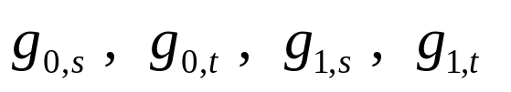
Iceberg-Type Problems
In a second lemma, we showed s < P < t where
Let
Each is a polynomial with rational coefficients for which a Sturm sequence argument show that it is non-negative.

Slide 41
Practical Methods
A. Sturm Sequence Arguments
B. Linearity / Monotonicity Arguments
C. Special Function Estimates
D. Grid Estimates

Slide 42

Notation & Definitions
Notes:
The unit disk D forms the Poincare model for the hyperbolic plane

Slide 43
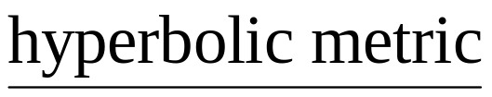
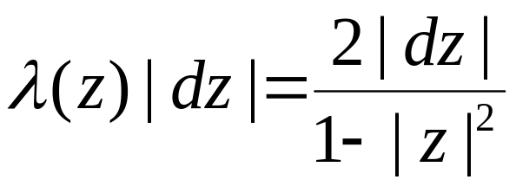
Notation & Definitions
Notes:
under the usual metric.

Slide 44
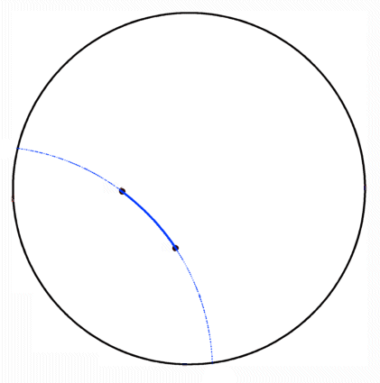
Notation & Definitions
Hyberbolic Geodesics
Notes:
In this model a hyperbolic geodesic is an arc connecting two points in D which lie on the arc of a circle which intersects the boundary of D orgothonally

Slide 45
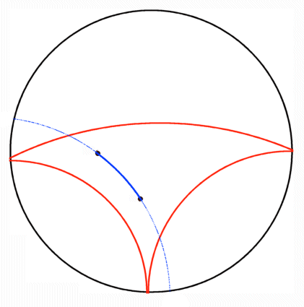
Notation & Definitions
Hyberbolic Geodesics
Hyberbolically Convex Set
Notes:
A subset of D is hyperbolically convex if each geodesic connecting points in the set again lies in the set

Slide 46
Notation & Definitions
Hyberbolic Geodesics
Hyberbolically Convex Set
Hyberbolically Convex Function
Notes:
A analytic function mapping D in to D is hyperbolically convex if its range is a hyperbolically convex subset of D

Slide 47
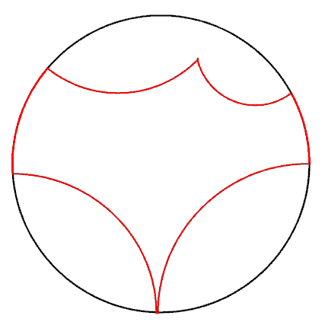
Notation & Definitions
Hyberbolic Geodesics
Hyberbolically Convex Set
Hyberbolically Convex Function
Hyberbolic Polygon
  o Proper Sides
Notes:
A hyperbolic polygon is a subset of D bounded by a finite number of geodesics in D and/or arc on the boundary of D.
We will call the bounding geodesics proper sides of the hyperbolic polygon.

Slide 48
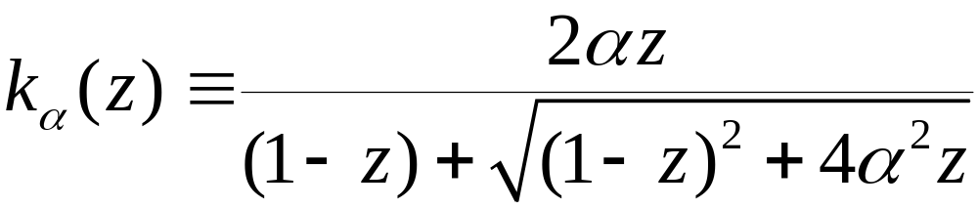
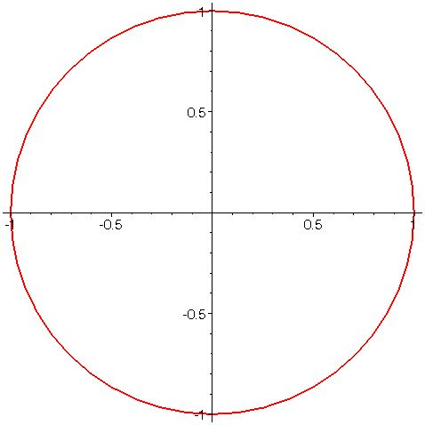
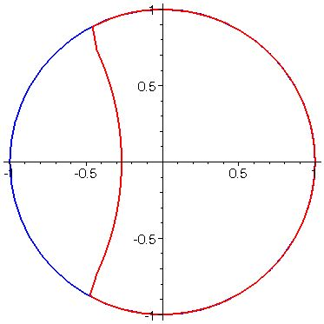

Examples
Notes:
The so called “Koebe” functions for these classes are the maps from D to the hyperbolic polygons bounded by exactly one proper side.
In the growth and distortion theorems established by previously mentioned authors, these functions frequently extremal for those problems.

Slide 49
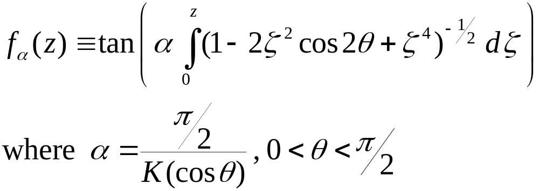
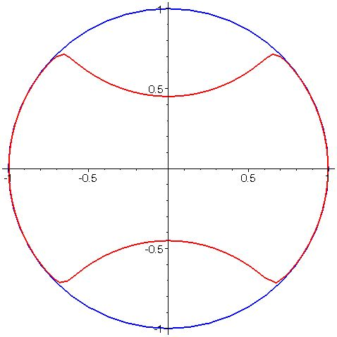

Examples
Notes:
The so called “Koebe” functions for these classes are the maps from D to the hyperbolic polygons bounded by exactly one proper side.
In the growth and distortion theorems established by previously mentioned authors, these functions frequently extremal for those problems.

Slide 50
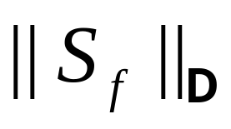

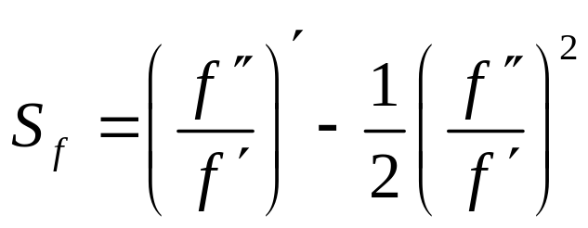
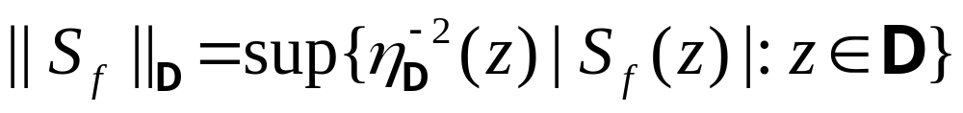
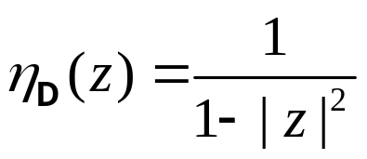
Schwarz Norm
For let
and
where
Notes:
Minda & Ma and Pommerenke posed in their papers problems for hyperbolically convex functions whose solutions did not directly follow from the techniques they developed in those papers. We have investigated three of these problems.
The first problem is, for fixed alpha and fixed z, to minimize over H_alpha the functional Re f(z)/z.

Slide 51



Extremal Problems for
Euclidean Convexity
  Nehari (1976):

Slide 52


Extremal Problems for
Euclidean Convexity
  Nehari (1976):
Spherical Convexity
  Mejía, Pommerenke (2000):

Slide 53

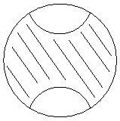
Extremal Problems for
Euclidean Convexity
  Nehari (1976):
Spherical Convexity
  Mejía, Pommerenke (2000):
Hyperbolic Convexity
  Mejía, Pommerenke Conjecture (2000):

Slide 54
Verification of M/P Conjecture
"A Sharp Bound on the Schwarzian Derivatives of Hyperbolically Convex Functions," Proceeding of the London Mathematical Society 93 (2006), 395_417, with Roger W. Barnard, Leah Cole and G. Brock Williams.
"The Verification of an Inequality," Proceedings of the International Conference on Geometric Function Theory, Special Functions and Applications (ICGFT) (accepted) with Roger W. Barnard.

Slide 55



Special Function Estimates
Parameter

Slide 56

Special Function Estimates
Upper bound

Slide 57


Special Function Estimates
Upper bound
Partial Sums

Slide 58

Special Function Estimates

Slide 59


Verification
where

Slide 60





Verification
Straightforward to show that
In make a change of variable

Slide 61





Verification
Obtain a lower bound for by estimating
via an upper bound
Sturm sequence argument shows
is non-negative

Slide 62

Grid Estimates

Slide 63







Grid Estimates
Given
  A) grid step size h
  B) global bound M for maximum of
Theorem Let f be defined on [a, b]. Let
Let and suppose that N is choosen so that . Let L be the lattice . Let
If then f is non-negative on [a, b].

Slide 64

Grid Estimates
Maximum descent argument

Slide 65

Grid Estimates
Two-Dimensional Version

Slide 66

Grid Estimates
Maximum descent argument

Slide 67
Verification
where

Slide 68






Verification
The problem was that the coefficient was not globally positive, specifically, it was not positive for
We showed that by showing that
where
0 < t < 1/4.

Slide 69



Verification
Used Lemma 3.3 to show that the endpoints
and are non-negative. We partition the parameter space into subregions:
Notes:
The polynomial r =r(w,m) for that partition was of degree 16 in w and degree 40 in m.

Slide 70



Verification
Application of Lemma 3.3 to
After another change of variable, we needed to show that where
for 0 < w < 1, 0 < m < 1
Notes:
The polynomial r =r(w,m) for that partition was of degree 16 in w and degree 40 in m.

Slide 71

Verification

Slide 72




Verification
Quarter Square [0,1/2]x[0,1/2]
Grid 50 x 50

Slide 73
Question
Given a function f on an interval [a, b], what does it take to show that f is non-negative on [a, b]?

Slide 74
Conclusions
There are “proof by picture” hazards
There is a role for CAS in analysis
  CAS numerical computations are rational number calculations
  CAS “special function” numerical calculations are inherently finite approximations
There are various useful, practical strategies for rigorously establishing analytic inequalities

