Slide 1


The Verification of an Inequality
Roger W. Barnard, Kent Pearce, G. Brock Williams
Texas Tech University
Leah Cole
Wayland Baptist University
Presentation: Pondicherry, India

Slide 2

Notation & Definitions
Notes:
The unit disk D forms the Poincare model for the hyperbolic plane

Slide 3

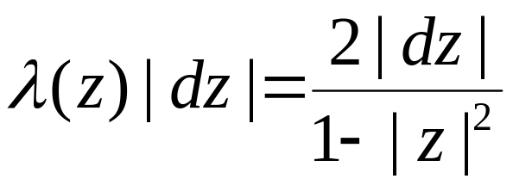
Notation & Definitions
Notes:
under the usual metric.

Slide 4
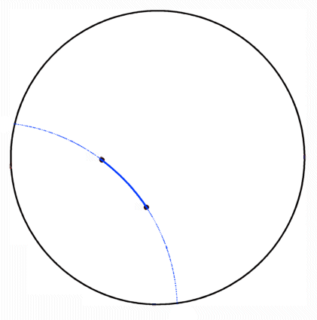
Notation & Definitions
Hyberbolic Geodesics
Notes:
In this model a hyperbolic geodesic is an arc connecting two points in D which lie on the arc of a circle which intersects the boundary of D orgothonally

Slide 5
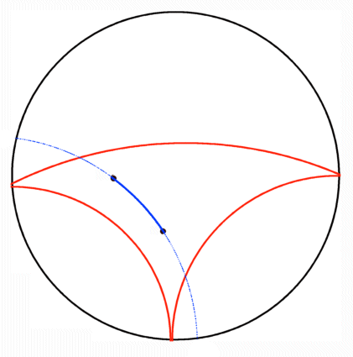
Notation & Definitions
Hyberbolic Geodesics
Hyberbolically Convex Set
Notes:
A subset of D is hyperbolically convex if each geodesic connecting points in the set again lies in the set

Slide 6
Notation & Definitions
Hyberbolic Geodesics
Hyberbolically Convex Set
Hyberbolically Convex Function
Notes:
A analytic function mapping D in to D is hyperbolically convex if its range is a hyperbolically convex subset of D

Slide 7
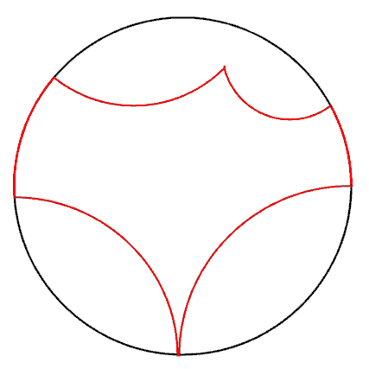
Notation & Definitions
Hyberbolic Geodesics
Hyberbolically Convex Set
Hyberbolically Convex Function
Hyberbolic Polygon
  o Proper Sides
Notes:
A hyperbolic polygon is a subset of D bounded by a finite number of geodesics in D and/or arc on the boundary of D.
We will call the bounding geodesics proper sides of the hyperbolic polygon.

Slide 8
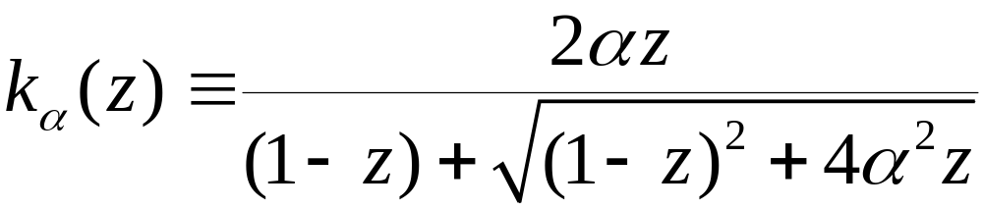
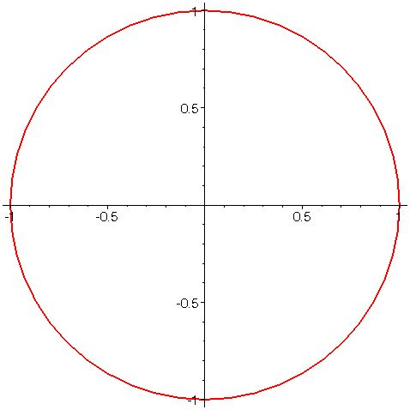
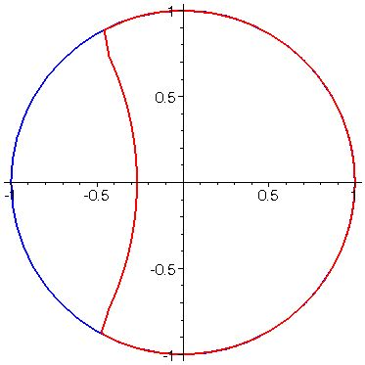

Examples
Notes:
The so called “Koebe” functions for these classes are the maps from D to the hyperbolic polygons bounded by exactly one proper side.
In the growth and distortion theorems established by previously mentioned authors, these functions frequently extremal for those problems.

Slide 9
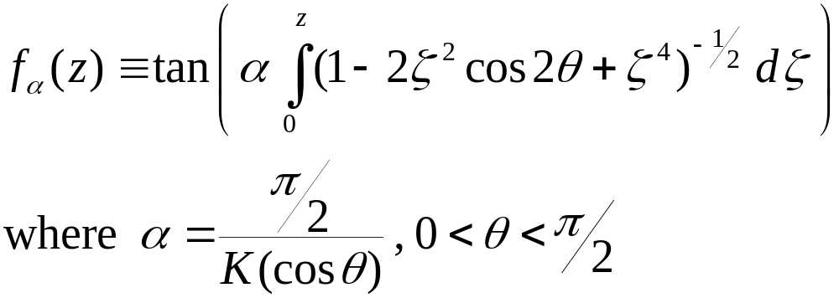
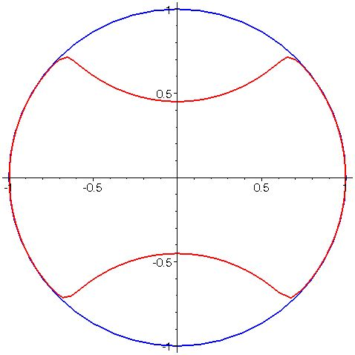

Examples
Notes:
The so called “Koebe” functions for these classes are the maps from D to the hyperbolic polygons bounded by exactly one proper side.
In the growth and distortion theorems established by previously mentioned authors, these functions frequently extremal for those problems.

Slide 10
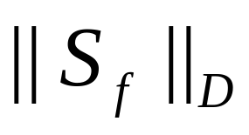

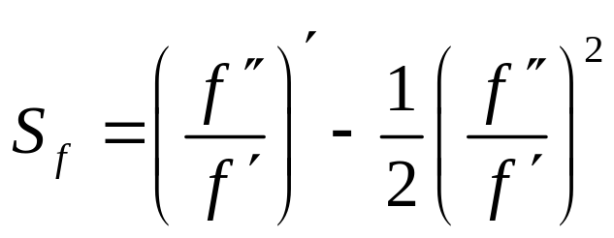
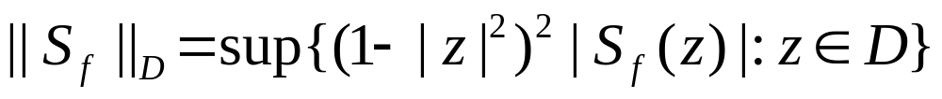
Schwarz Norm
For let
and
Notes:
Minda & Ma and Pommerenke posed in their papers problems for hyperbolically convex functions whose solutions did not directly follow from the techniques they developed in those papers. We have investigated three of these problems.
The first problem is, for fixed alpha and fixed z, to minimize over H_alpha the functional Re f(z)/z.

Slide 11


Extremal Problems for
Euclidean Convexity
  Nehari (1976):

Slide 12


Extremal Problems for
Euclidean Convexity
  Nehari (1976):
Spherical Convexity
  Mejía, Pommerenke (2000):

Slide 13
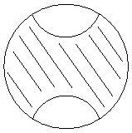
Extremal Problems for
Euclidean Convexity
  Nehari (1976):
Spherical Convexity
  Mejía, Pommerenke (2000):
Hyperbolic Convexity
  Mejía, Pommerenke Conjecture (2000):

Slide 14
Verification of M/P Conjecture
“The Sharp Bound for the Deformation of a Disc under a Hyperbolically Convex Map,” Proceedings of London Mathematical Society (accepted 3 Jan 2006), R.W. Barnard, L. Cole, K. Pearce, G.B. Williams.
http://www.math.ttu.edu/~pearce/preprint.shtml

Slide 15
Verification of M/P Conjecture
Preliminary Facts:
  Invariance of hyperbolic convexity under disk automorphisms

Slide 16
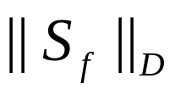

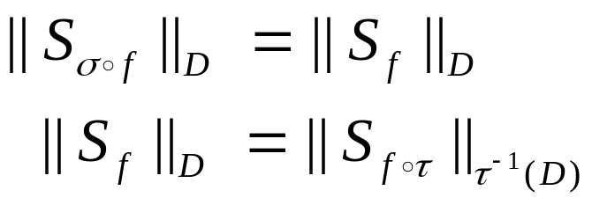
Verification of M/P Conjecture
Preliminary Facts:
  Invariance of hyperbolic convexity under disk automorphisms
  Invariance of under disk automorphisms
    For we have

Slide 17
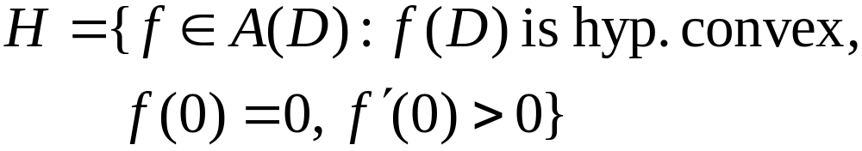
Classes H and H_{n}
Notes:
H^n is the subclass of H^poly of functions for which the range is a hyperbolic polygon with at most n sides.

Slide 18
Classes H and H_{n}
Notes:
H^n is the subclass of H^poly of functions for which the range is a hyperbolic polygon with at most n sides.

Slide 19
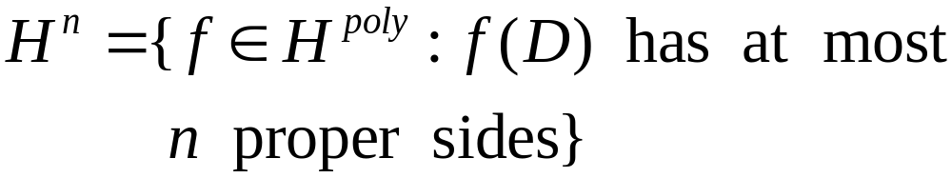
Classes H and H_{n}
Notes:
H^n is the subclass of H^poly of functions for which the range is a hyperbolic polygon with at most n sides.

Slide 20
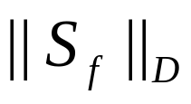
Reduction to H_{n}
Lemma 1. To determine the extremal value of
over H, it suffices to determine the value over each H_{n}. Moreover, each H_{n} is pre-compact.

Slide 21

Reduction to H_{n}
Lemma 1. To determine the extremal value of
over H, it suffices to determine the value over each H_{n}. Moreover, each H_{n} is pre-compact.
  A. H_{n} is compact

Slide 22
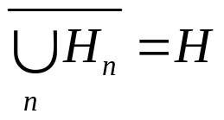
Reduction to H_{n}
Lemma 1. To determine the extremal value of
over H, it suffices to determine the value over each H_{n}. Moreover, each H_{n} is pre-compact.
  A. H_{n} is compact
  B.

Slide 23
Reduction to H_{n}
Lemma 1. To determine the extremal value of
over H, it suffices to determine the value over each H_{n}. Moreover, each H_{n} is pre-compact.
  A. H_{n} is compact
  B.
  C. Schwarz norm is lower semi-continuous

Slide 24
Examples
Notes:
The so called “Koebe” functions for these classes are the maps from D to the hyperbolic polygons bounded by exactly one proper side.
In the growth and distortion theorems established by previously mentioned authors, these functions frequently extremal for those problems.

Slide 25
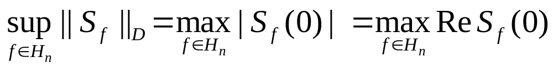
Reduction to Re S_{f} (0)
Lemma 2. For each n > 2,
  A.
  B.
  C.

Slide 26
Schwarz Norm
For let
and
Notes:
Minda & Ma and Pommerenke posed in their papers problems for hyperbolically convex functions whose solutions did not directly follow from the techniques they developed in those papers. We have investigated three of these problems.
The first problem is, for fixed alpha and fixed z, to minimize over H_alpha the functional Re f(z)/z.

Slide 27
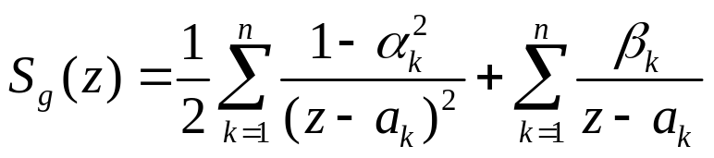
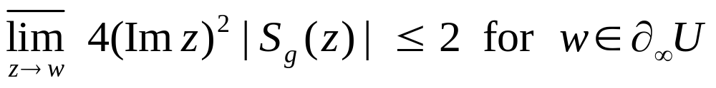
Reduction to Re S_{f} (0)
Lemma 2. For each n > 2,
  A. (Nehari)
    implies
  B.
  C.

Slide 28

Reduction to Re S_{f} (0)
Lemma 2. For each n > 2,
  A. (Nehari)
    implies
  B. There exist
  C.

Slide 29
Reduction to Re S_{f} (0)
Lemma 2. For each n > 2,
  A. (Nehari)
    implies
  B. There exist
  C. Invariance under disk automorphisms

Slide 30
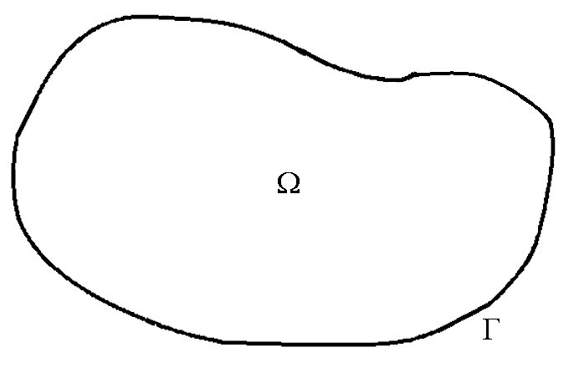
Julia Variation
Let Ω be a region bounded by a piece-wise analytic curve Γ and φ(w) piece-wise C¹ on Γ .

Slide 31
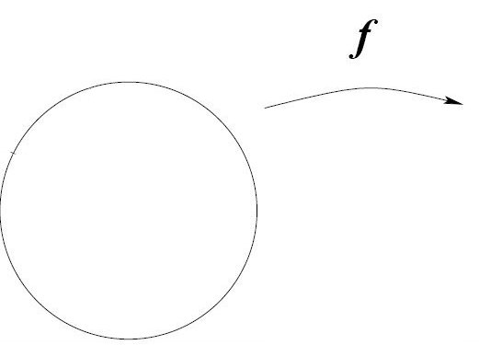
Julia Variation (cont)
Let Ω be a region bounded by a piece-wise analytic curve Γ and φ(w) piece-wise C¹ on Γ .

Slide 32
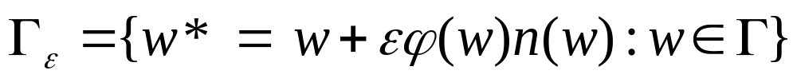
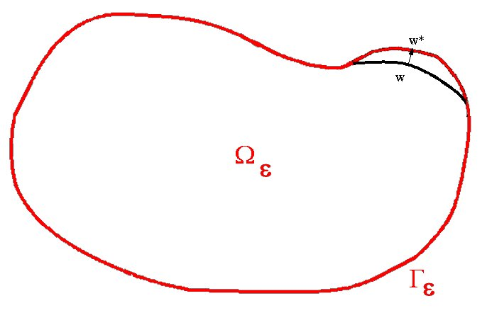
Julia Variation (cont)
Let Ω be a region bounded by a piece-wise analytic curve Γ and φ(w) piece-wise C¹ on Γ . At each point w on Γ (where Γ is smooth), let n(w) denote the unit outward normal to Γ. For small ε let
and let Ω_{ε} be the region bounded by Γ_{ε}.

Slide 33
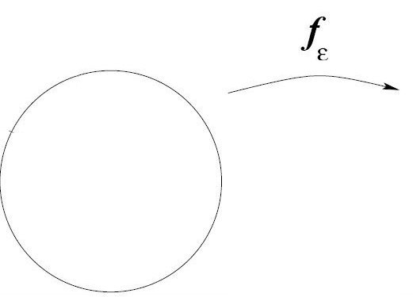
Julia Variation (cont)
Let Ω be a region bounded by a piece-wise analytic curve Γ and φ(w) piece-wise C¹ on Γ . At each point w on Γ (where Γ is smooth), let n(w) denote the unit outward normal to Γ. For small ε let
and let Ω_{ε} be the region bounded by Γ_{ε}.

Slide 34
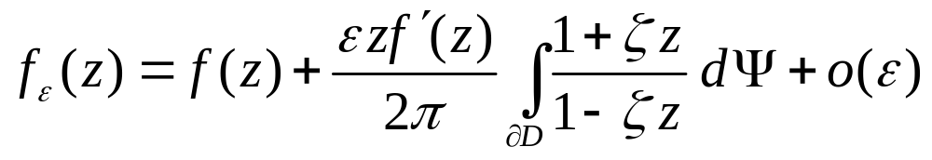
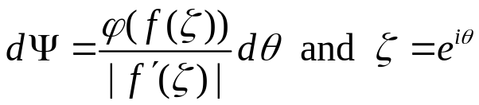
Julia Variation (cont)
Theorem. Let f be a conformal map from D on Ω with f (0) = 0 and suppose f has a continuous extension to ∂D. Then, for sufficiently small ε the map f_{ε} from D on Ω_{ε} with f_{ε} (0) = 0 is given by
where

Slide 35
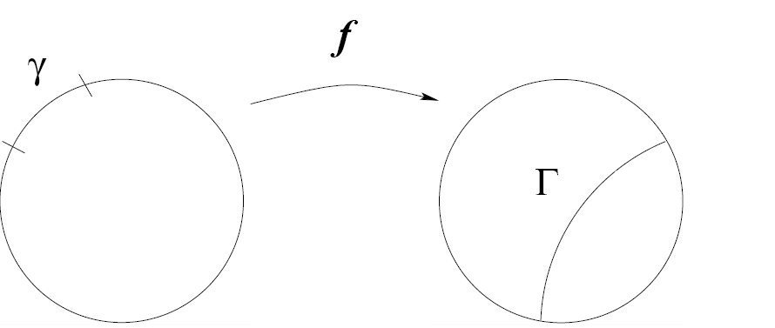
Two Variations for H_{n}
Variation #1

Slide 36
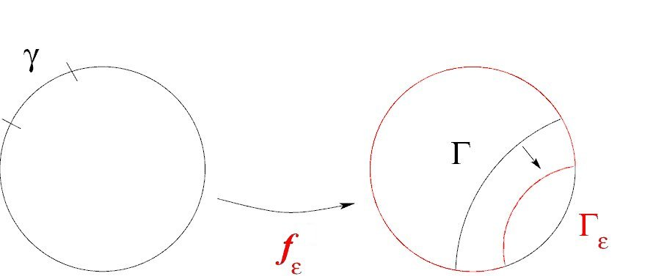
Two Variations for H_{n}
Variation #1

Slide 37
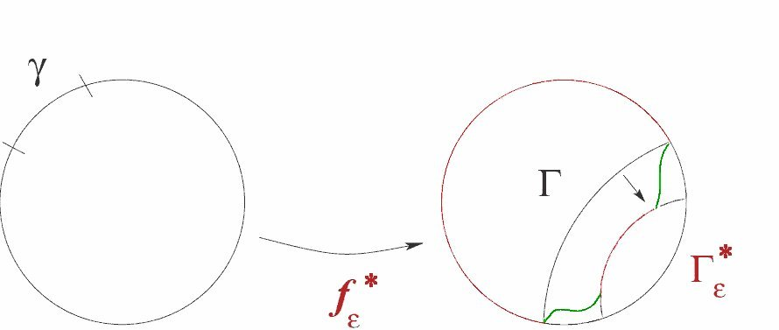
Two Variations for H_{n}
Variation #1

Slide 38
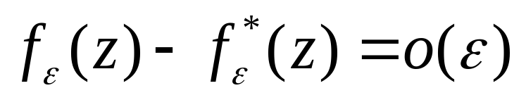
Two Variations for H_{n}
Variation #1
Barnarnd & Lewis, Subordination theorems for some classes of starlike functions, Pac. J. Math 56 (1975) 333-366.

Slide 39
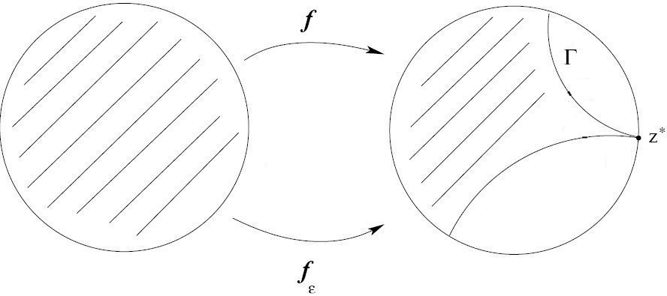
Two Variations for H_{n}
Variation #2

Slide 40
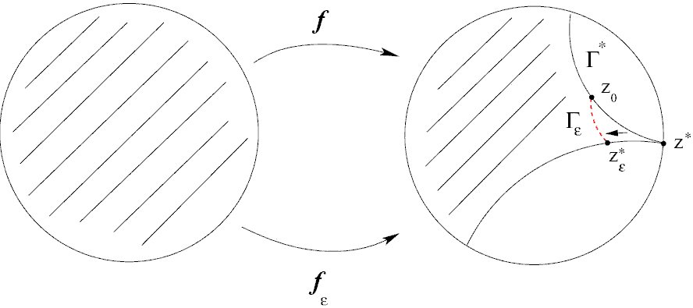
Two Variations for H_{n}
Variation #2

Slide 41

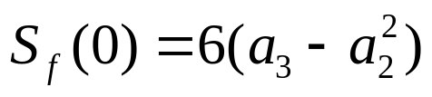

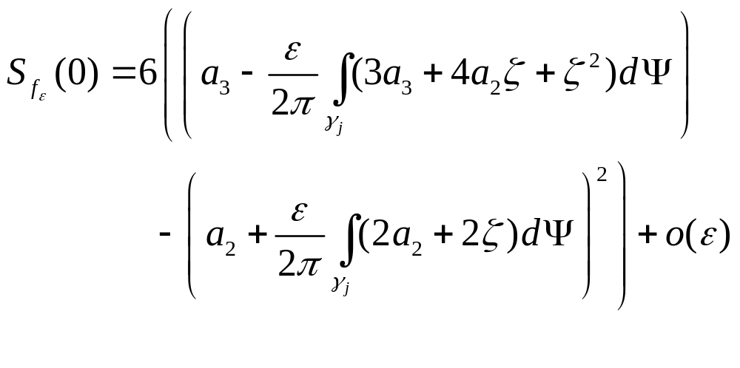
Schwarzian and Julia Variation
Lemma 3. If then
Lemma 4. If and Var. #1 or Var. #2 is applied to a side Γ_{j}, then

Slide 42
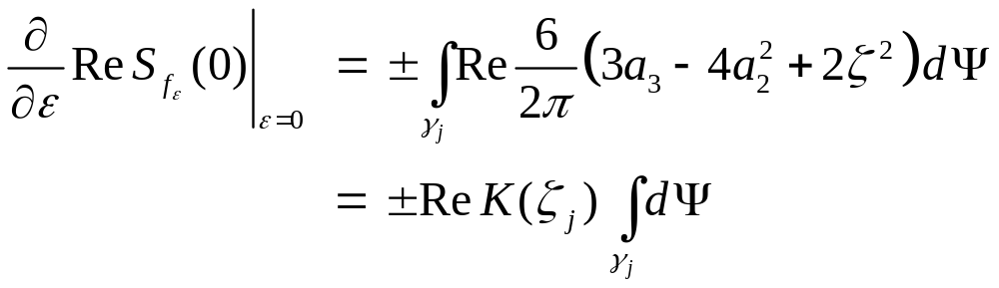
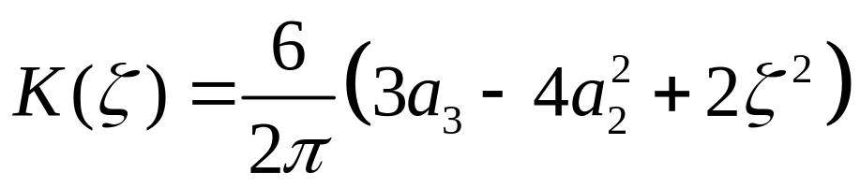
Schwarzian and Julia Variation
In particular,
where

Slide 43
Reduction to H₂
Step #1. Reduction to H₄

Slide 44
Reduction to H₂
Step #1. Reduction to H₄
Step #2. (Step Down Lemma) Reduction to H₂

Slide 45
Reduction to H₂
Step #1. Reduction to H₄
Step #2. (Step Down Lemma) Reduction to H₂
Step #3. Compute maximum in H₂

Slide 46

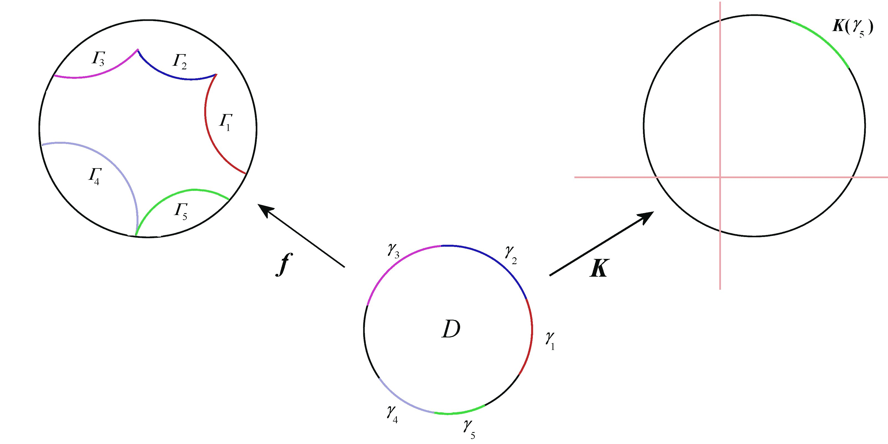
Reduction to H₂ – Step #1
Suppose is extremal and maps D to a region bounded by more than four sides.

Slide 47
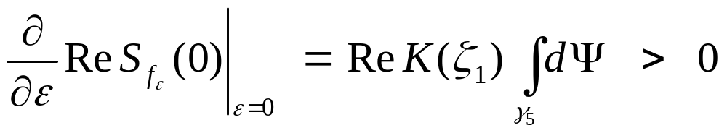
Reduction to H₂ – Step #1
Suppose is extremal and maps D to a region bounded by more than four sides.
Then, pushing Γ₅ out using Var. #1, we have

Slide 48
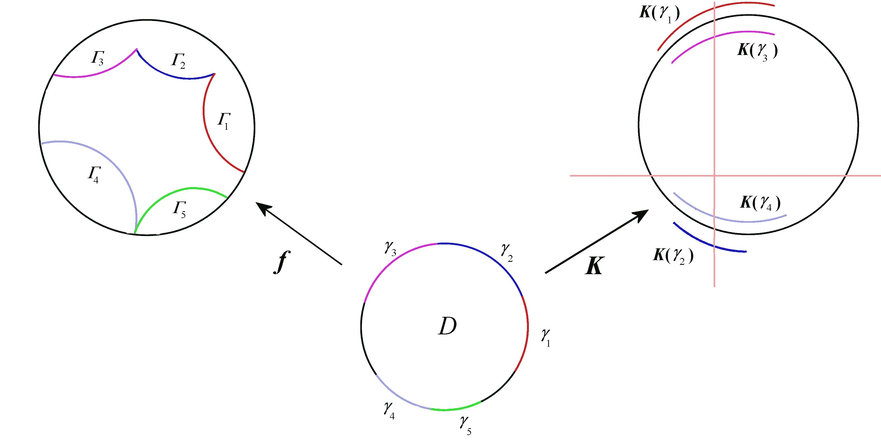
Reduction to H₂ – Step #1
Consequently, the image of each side γ_{j} under K must intersect imaginary axis

Slide 49
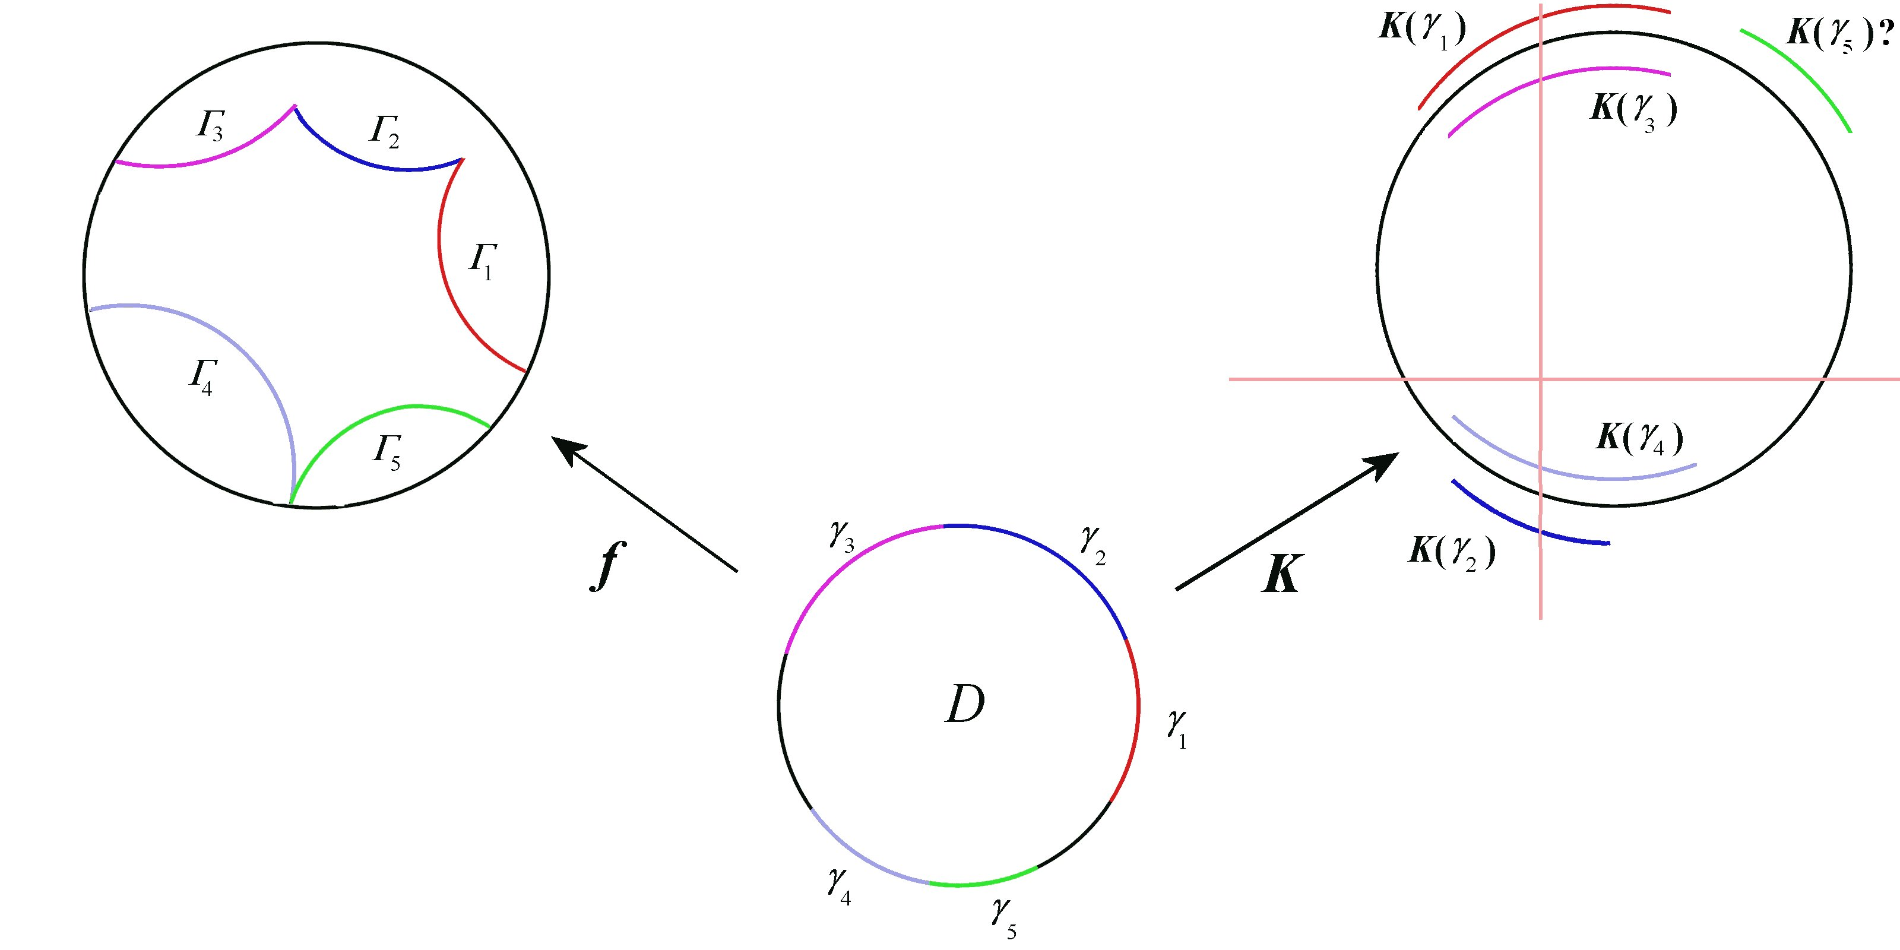
Reduction to H₂ – Step #1
Consequently, the image of each side γ_{j} under K must intersect imaginary axis

Slide 50
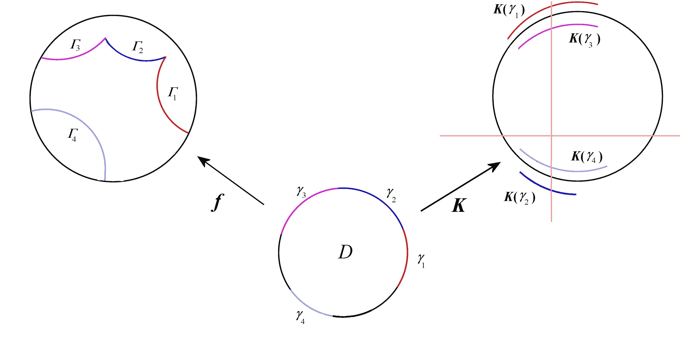
Reduction to H₂ – Step #2
Suppose is extremal and maps D to a region bounded by exactly four sides.

Slide 51
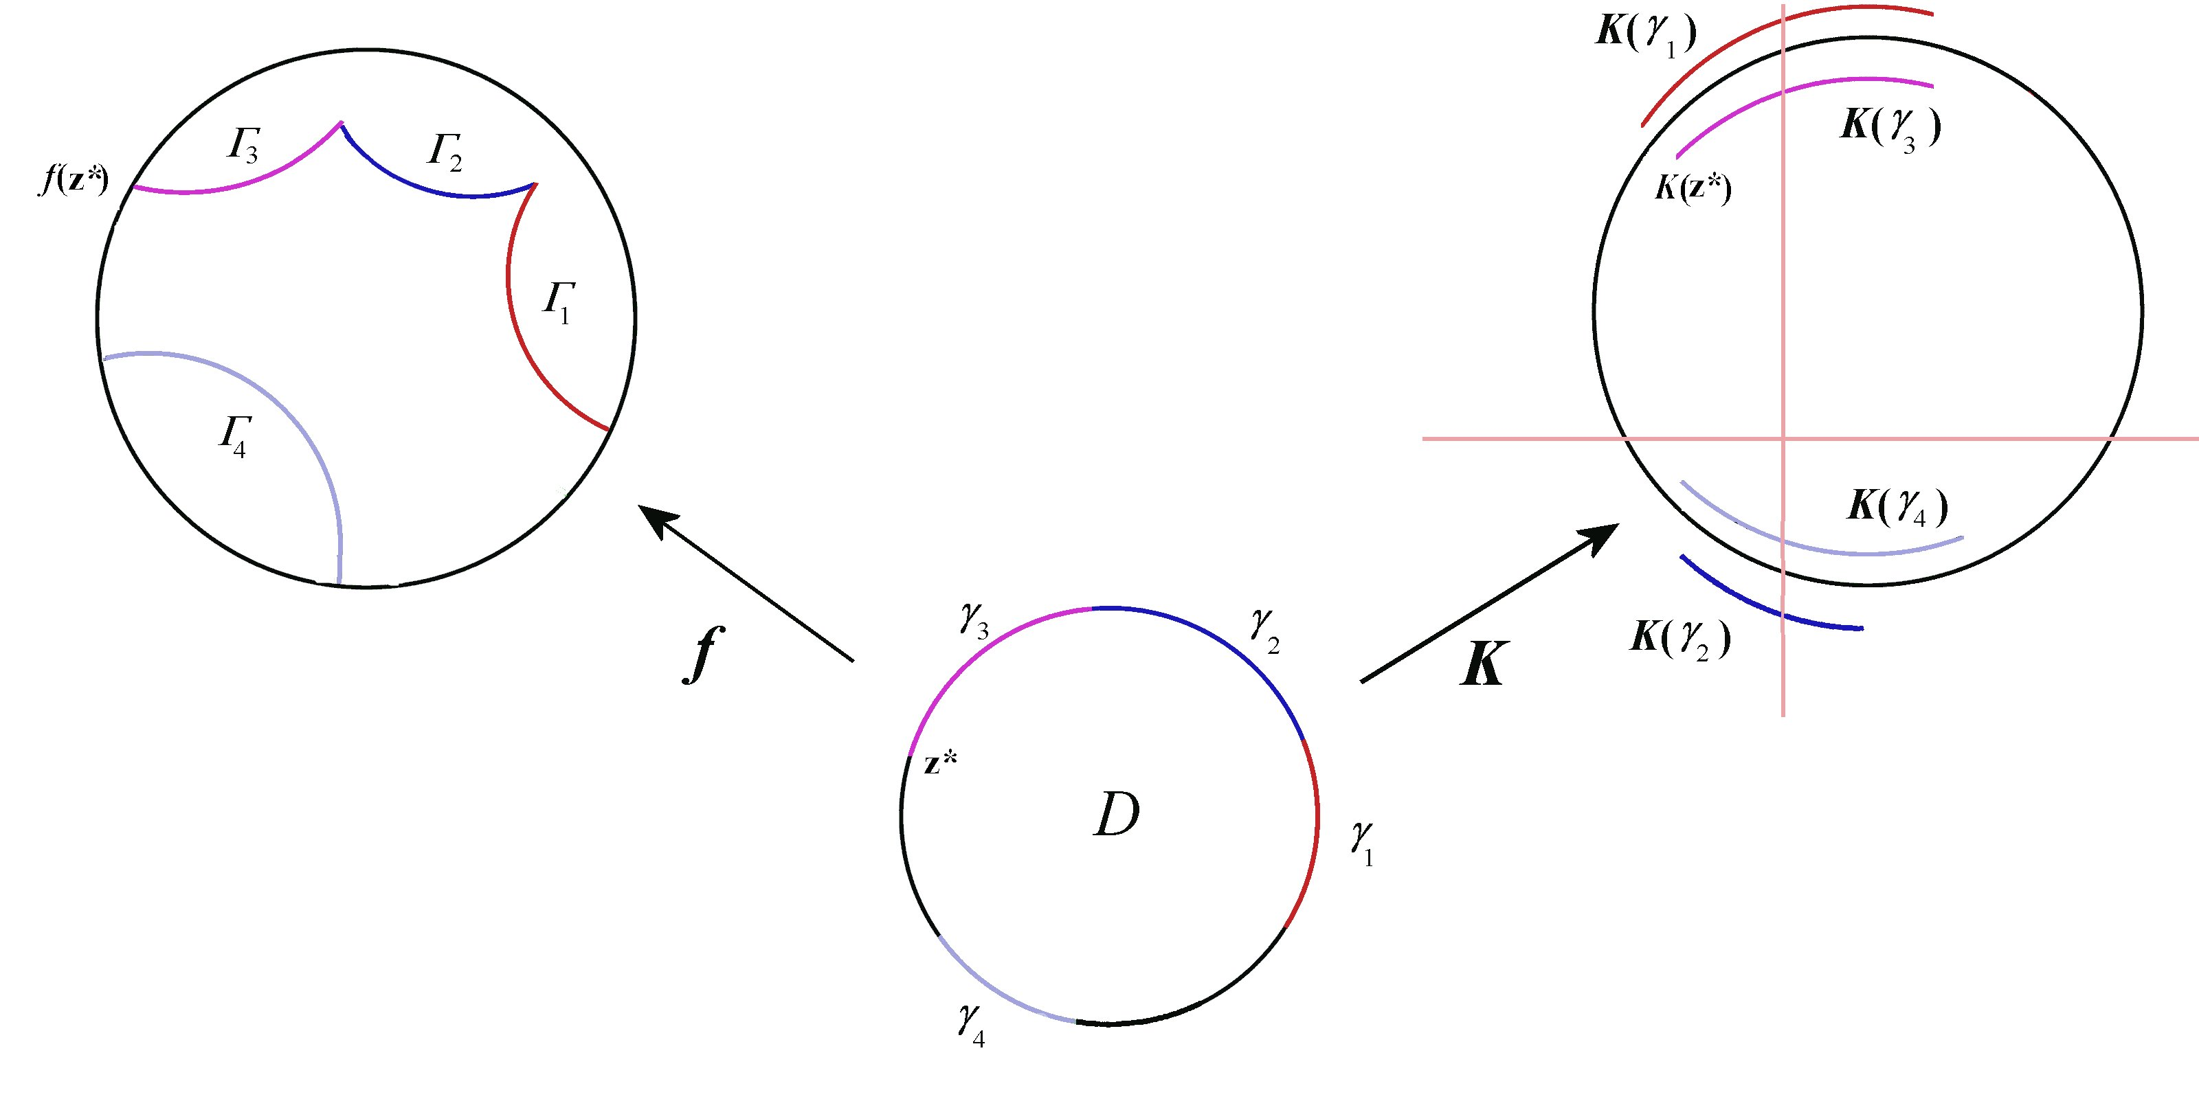
Reduction to H₂ – Step #2
Suppose is extremal and maps D to a region bounded by exactly four sides.

Slide 52

Reduction to H₂ – Step #2
Suppose is extremal and maps D to a region bounded by exactly four sides.

Slide 53
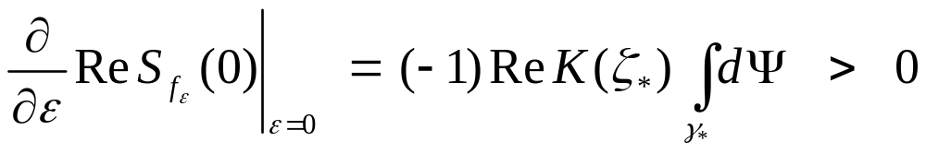
Reduction to H₂ – Step #2
Suppose is extremal and maps D to a region bounded by exactly four sides.
Then, pushing in the end of Γ₃ , near f (z*), using Var. #2, we have

Slide 54
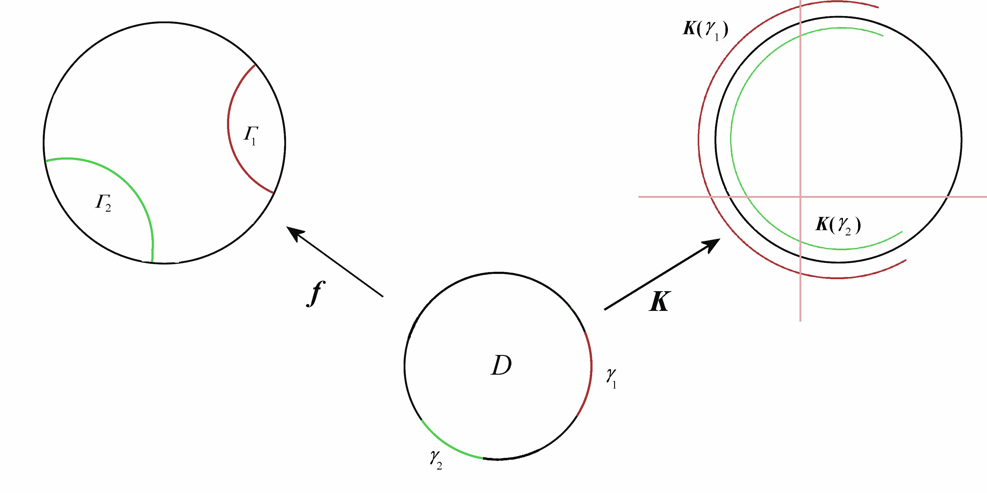
Reduction to H₂ – Step #2
Suppose is extremal and maps D to a region bounded by exactly two sides.

Slide 55
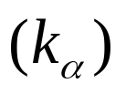
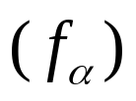
Computation in H₂
Functions whose ranges are convex domains bounded by one proper side
Functions whose ranges are convex domains bounded by two proper sides which intersect
Functions whose ranges are odd symmetric convex domains whose proper sides do not intersect

Slide 56
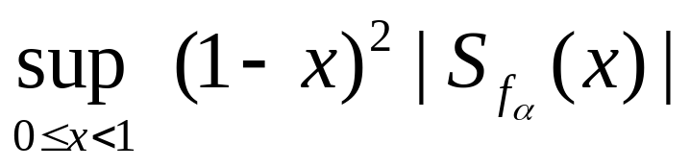
Computation in H₂
Using an extensive calculus argument which considers several cases (various interval ranges for |z|, arg z, and α) and uses properties of polynomials and K, one can show that this problem can be reduced to computing

Slide 57









Computation in H₂
Verified
  A. For each fixed that is maximized at r = 0
  B. The curve is unimodal, i.e., there exists a unique so that
  increases for and
  decreases for At

Slide 58


Graph of

