Slide 1

Verification of Inequalities
(i) Four practical mechanisms
The role of CAS in analysis
(ii) Applications
Kent Pearce
Texas Tech University
Presentation: January 2008
Notes:
Illustrate via of papers out of the last ten years scenarios where inequalities arose and and illustrate the mechanisms which we used to analytically verify that the inequalities held.

Slide 2
Question
Given a function f on an interval (a, b), what does it take to show that f is non-negative on (a, b)?
Proof by Picture
  Maple, Mathematica, Matlab, Mathcad,
  Excel, Graphing Calculators

Slide 3
(P)Lots of Dots

Slide 4
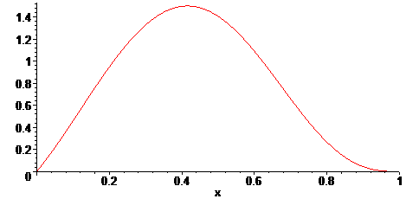
(P)Lots of Dots
Notes:
The displayed “graph” suggests that on the interval (0,1) that f > 0. The problem is that the display is misleading as to what exactly is being presented.

Slide 5
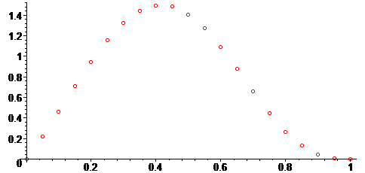
(P)Lots of Dots
Notes:
In reality, Maple or Mathematica or Silver Edition TI-84 is constructing a plot of dots (perhaps lots of them) and then connecting the dots linearly. Since the function is not linear or even piece-wise linear . . .

Slide 6
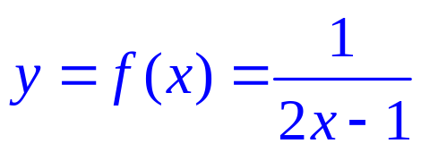
(P)Lots of Dots
Notes:
Rational function – singularity at x = 1/2. Graph consists of a pair of branches of a rectangular hyperbola.

Slide 7
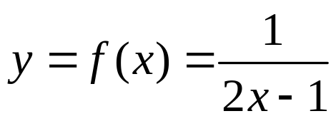
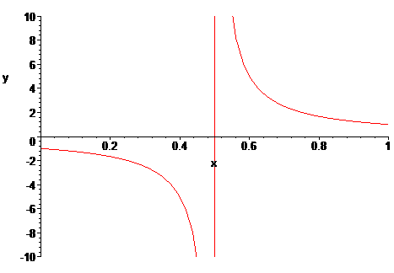
(P)Lots of Dots
Notes:
Maple is not drawing the asymptote. Maple is connecting the dots.

Slide 8
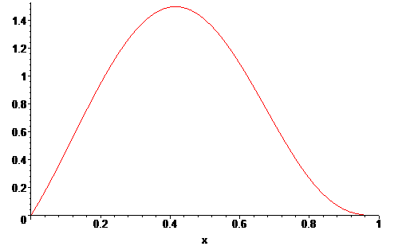
Blackbox Approximations
Polynomial

Slide 9

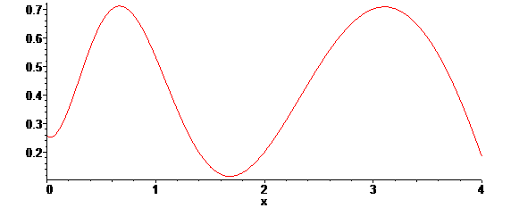
Blackbox Approximations
Transcendental / Special Functions

Slide 10
Practical Methods
A. Sturm Sequence Arguments
B. Linearity / Monotonicity Arguments
C. Special Function Estimates
D. Grid Estimates

Slide 11
Applications
"On a Coefficient Conjecture of Brannan," Complex Variables. Theory and Application. An International Journal 33 (1997) 51_61, with Roger W. Barnard and William Wheeler.
"A Sharp Bound on the Schwarzian Derivatives of Hyperbolically Convex Functions," Proceeding of the London Mathematical Society 93 (2006), 395_417, with Roger W. Barnard, Leah Cole and G. Brock Williams.
"The Verification of an Inequality," Proceedings of the International Conference on Geometric Function Theory, Special Functions and Applications (ICGFT) (accepted) with Roger W. Barnard.
"Iceberg-Type Problems in Two Dimensions," with Roger.W. Barnard and Alex.Yu. Solynin

Slide 12
Practical Methods
A. Sturm Sequence Arguments
B. Linearity / Monotonicity Arguments
C. Special Function Estimates
D. Grid Estimates

Slide 13
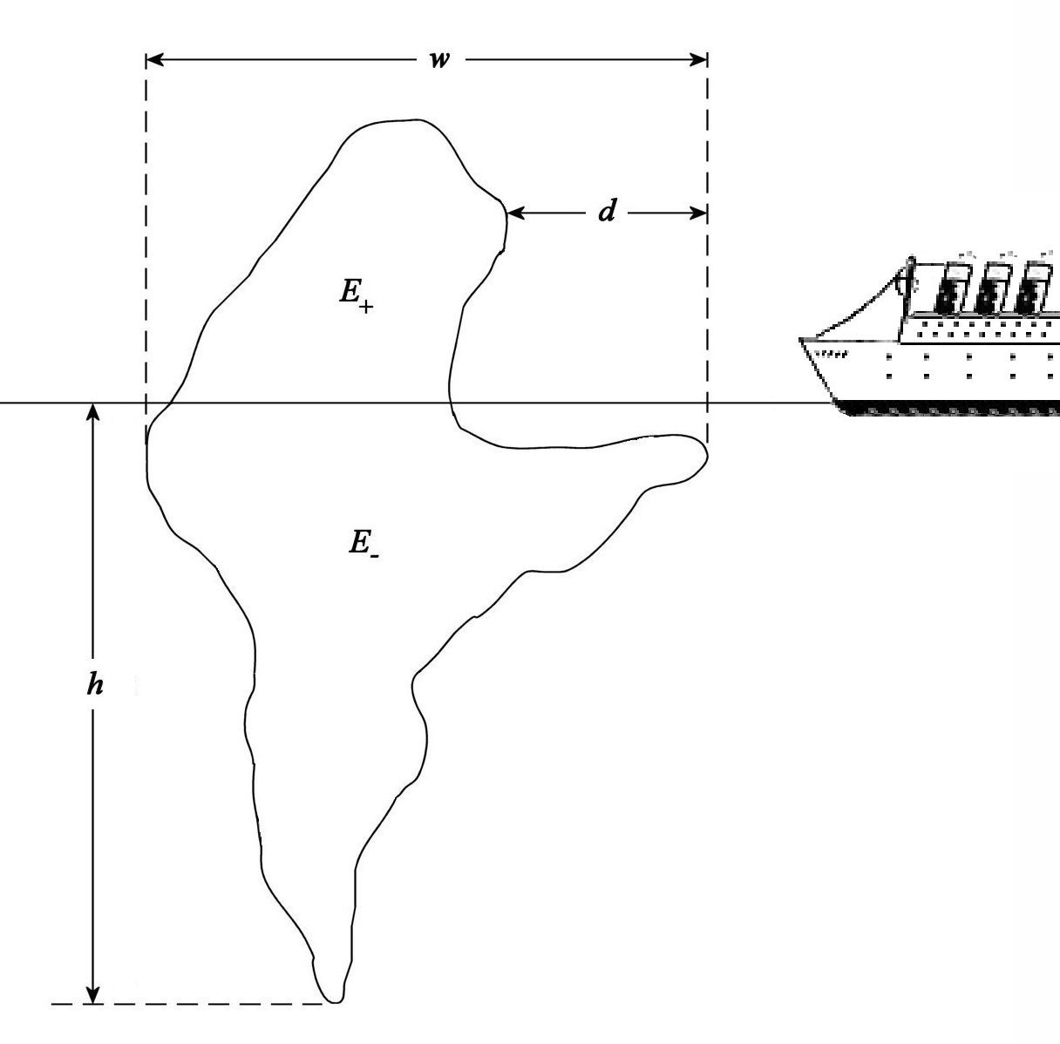
Iceberg-Type Problems

Slide 14
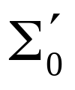

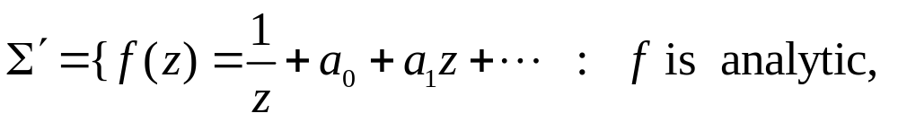


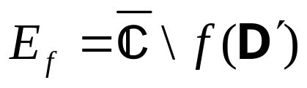
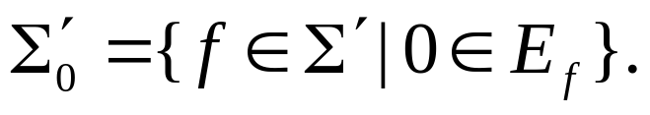
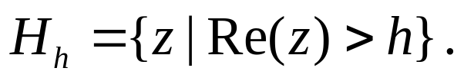
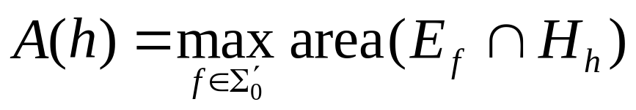
Iceberg-Type Problems
Dual Problem for Class
  Let and let
  For let
  and For 0 < h < 4, let
  Find

Slide 15
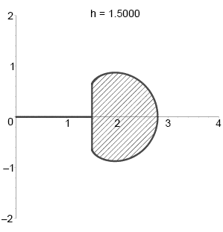
Iceberg-Type Problems
Extremal Configuration
  Symmetrization
  Polarization
  Variational Methods
  Boundary Conditions

Slide 16
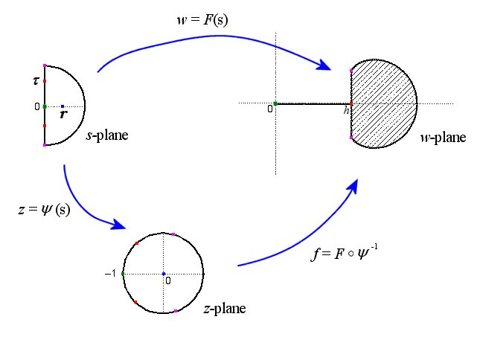
Iceberg-Type Problems

Slide 17
Iceberg-Type Problems
We obtained explicit formulas for A = A(r)
and h = h(r). However, the orginial problem was formulated to find A as a function of h, i.e. to find A = A(h).
To find an explicit formulation giving A = A(h), we needed to verify that h = h(r) was monotone.

Slide 18
Sturm Sequence Arguments
General theorem for counting the number of distinct roots of a polynomial f on an interval (a, b)
N. Jacobson, Basic Algebra. Vol. I., pp. 311-315,W. H. Freeman and Co., New York, 1974.
H. Weber, Lehrbuch der Algebra, Vol. I., pp. 301-313, Friedrich Vieweg und Sohn, Braunschweig, 1898

Slide 19
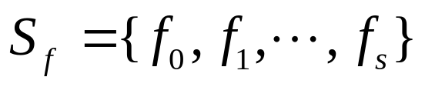

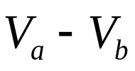

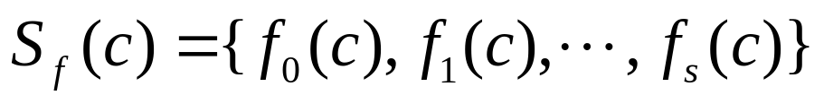
Sturm Sequence Arguments
Sturm’s Theorem. Let f be a non-constant polynomial with rational coefficients and let a < b be rational numbers. Let
be the standard sequence for f . Suppose that
Then, the number of distinct roots of f on (a, b) is where denotes the number of sign changes of

Slide 20

Sturm Sequence Arguments
Sturm’s Theorem (Generalization). Let f be a non-constant polynomial with rational coefficients and let a < b be rational numbers. Let
be the standard sequence for f . Then, the number of distinct roots of f on (a, b] is where denotes the number of sign changes of

Slide 21

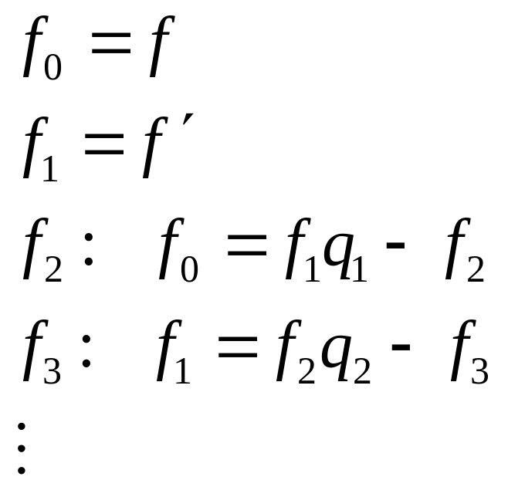
Sturm Sequence Arguments
For a given f, the standard sequence is constructed as:
Notes:
f _0= x^3 + 3x^2 + 6x -2
f_1 = 3x^2 + 6x + 6
f_2 = -2x + 4
f_3 = -1

Slide 22
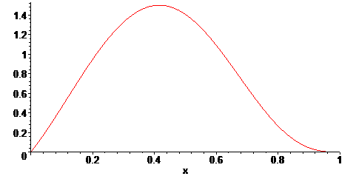
Sturm Sequence Arguments
Polynomial

Slide 23
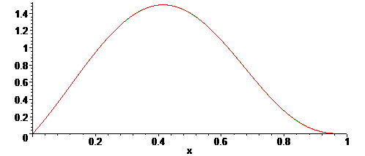
Sturm Sequence Arguments
Polynomial

Slide 24
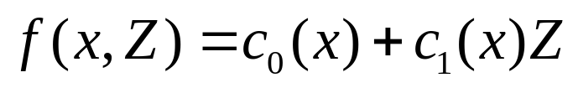

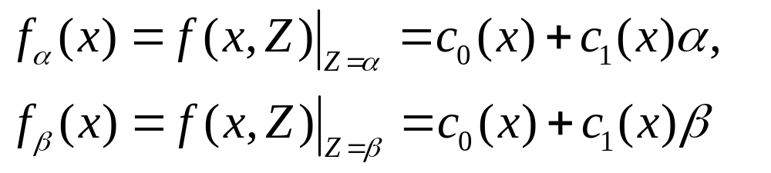
Linearity / Monotonicity
Consider
where
Let
Then,

Slide 25
Iceberg-Type Problems
We obtained explicit formulas for A = A(r)
and h = h(r). However, the orginial problem was formulated to find A as a function of h, i.e. to find A = A(h).
To find an explicit formulation giving A = A(h), we needed to verify that h = h(r) was monotone.

Slide 26
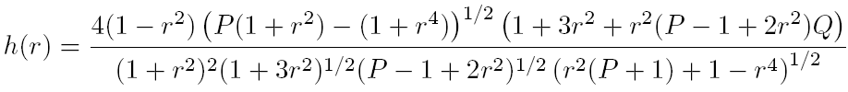

Iceberg-Type Problems
From the construction we explicitly found
where

Slide 27
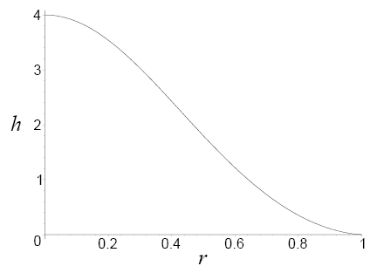
Iceberg-Type Problems

Slide 28

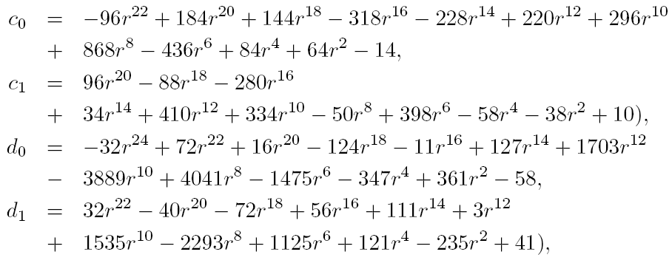
Iceberg-Type Problems
where

Slide 29
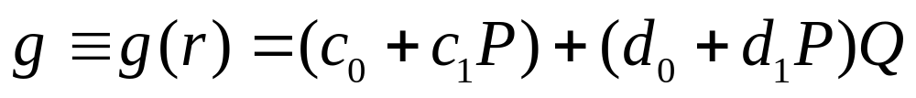
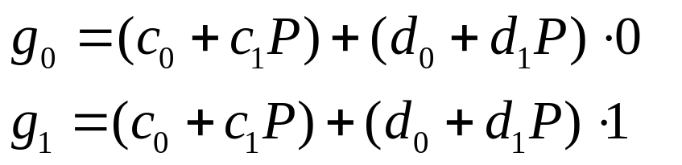
Iceberg-Type Problems
It remained to show
was non-negative. In a separate lemma, we showed 0 < Q < 1. Hence, using the linearity of
Q in g, we needed to show
were non-negative

Slide 30
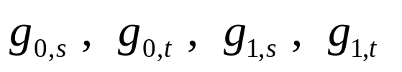
Iceberg-Type Problems
In a second lemma, we showed s < P < t where
Let
Each is a polynomial with rational coefficients for which a Sturm sequence argument show that it is non-negative.

Slide 31
Practical Methods
A. Sturm Sequence Arguments
B. Linearity / Monotonicity Arguments
C. Special Function Estimates
D. Grid Estimates

Slide 32

Notation & Definitions
Notes:
The unit disk D forms the Poincare model for the hyperbolic plane

Slide 33

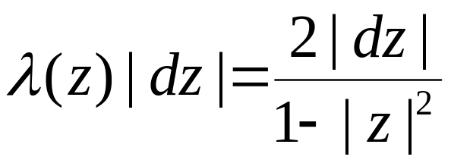
Notation & Definitions
Notes:
under the usual metric.

Slide 34
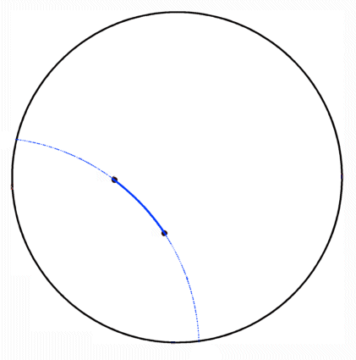
Notation & Definitions
Hyberbolic Geodesics
Notes:
In this model a hyperbolic geodesic is an arc connecting two points in D which lie on the arc of a circle which intersects the boundary of D orgothonally

Slide 35
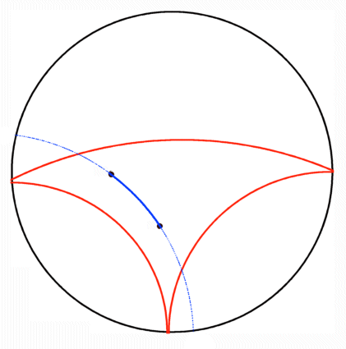
Notation & Definitions
Hyberbolic Geodesics
Hyberbolically Convex Set
Notes:
A subset of D is hyperbolically convex if each geodesic connecting points in the set again lies in the set

Slide 36
Notation & Definitions
Hyberbolic Geodesics
Hyberbolically Convex Set
Hyberbolically Convex Function
Notes:
A analytic function mapping D in to D is hyperbolically convex if its range is a hyperbolically convex subset of D

Slide 37
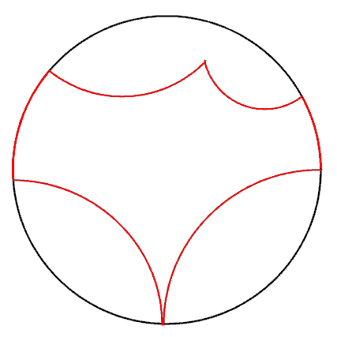
Notation & Definitions
Hyberbolic Geodesics
Hyberbolically Convex Set
Hyberbolically Convex Function
Hyberbolic Polygon
  o Proper Sides
Notes:
A hyperbolic polygon is a subset of D bounded by a finite number of geodesics in D and/or arc on the boundary of D.
We will call the bounding geodesics proper sides of the hyperbolic polygon.

Slide 38
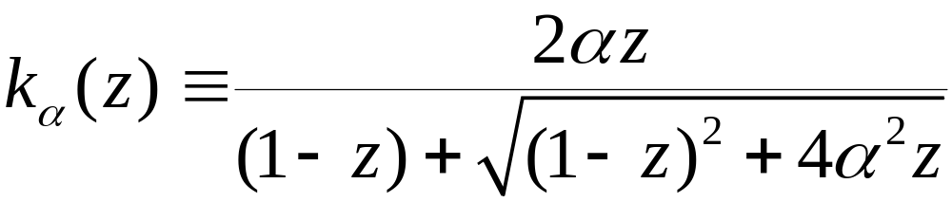
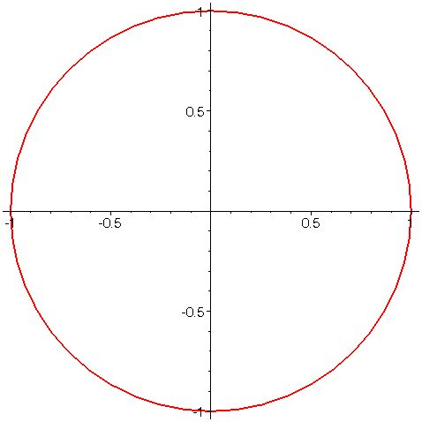
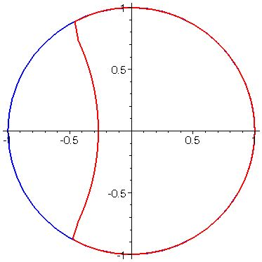

Examples
Notes:
The so called “Koebe” functions for these classes are the maps from D to the hyperbolic polygons bounded by exactly one proper side.
In the growth and distortion theorems established by previously mentioned authors, these functions frequently extremal for those problems.

Slide 39
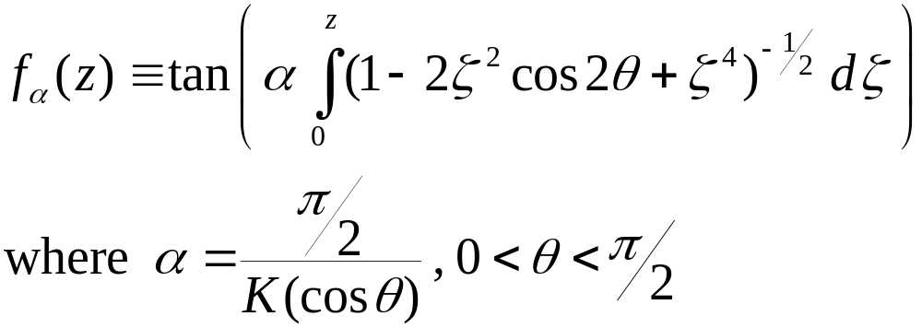
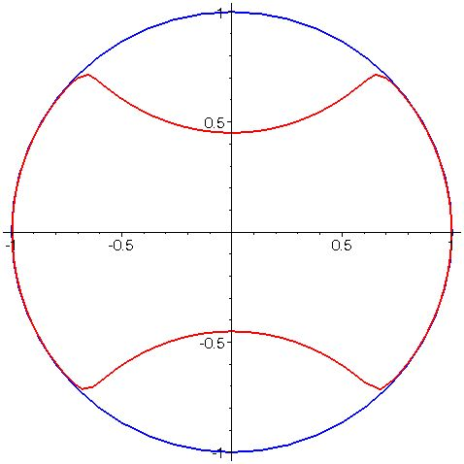

Examples
Notes:
The so called “Koebe” functions for these classes are the maps from D to the hyperbolic polygons bounded by exactly one proper side.
In the growth and distortion theorems established by previously mentioned authors, these functions frequently extremal for those problems.

Slide 40
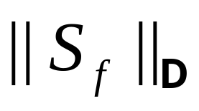

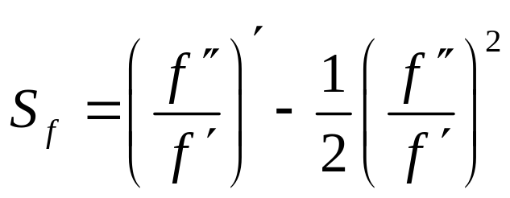
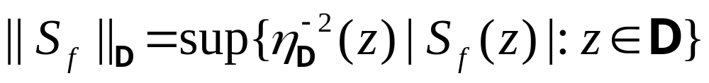
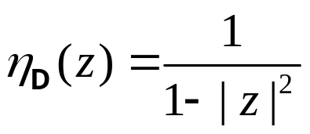
Schwarz Norm
For let
and
where
Notes:
Minda & Ma and Pommerenke posed in their papers problems for hyperbolically convex functions whose solutions did not directly follow from the techniques they developed in those papers. We have investigated three of these problems.
The first problem is, for fixed alpha and fixed z, to minimize over H_alpha the functional Re f(z)/z.

Slide 41



Extremal Problems for
Euclidean Convexity
  Nehari (1976):

Slide 42


Extremal Problems for
Euclidean Convexity
  Nehari (1976):
Spherical Convexity
  Mejía, Pommerenke (2000):

Slide 43

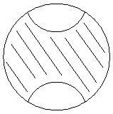
Extremal Problems for
Euclidean Convexity
  Nehari (1976):
Spherical Convexity
  Mejía, Pommerenke (2000):
Hyperbolic Convexity
  Mejía, Pommerenke Conjecture (2000):

Slide 44
Verification of M/P Conjecture
"A Sharp Bound on the Schwarzian Derivatives of Hyperbolically Convex Functions," Proceeding of the London Mathematical Society 93 (2006), 395_417, with Roger W. Barnard, Leah Cole and G. Brock Williams.
"The Verification of an Inequality," Proceedings of the International Conference on Geometric Function Theory, Special Functions and Applications (ICGFT) (accepted) with Roger W. Barnard.

Slide 45
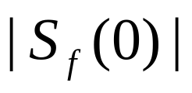
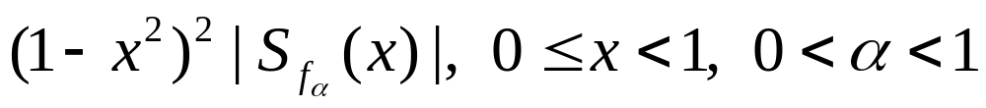
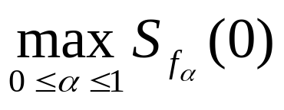
Verification of M/P Conjecture
Invariance under disk automorphisms
Reduction to hyperbolic polygonal maps
Reduction to
Julia Variation
Reduction to hyperbolic polygonal maps with at most two proper sides
Reduction to
Reduction to

Slide 46
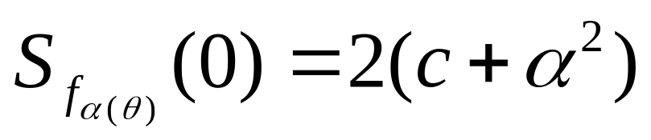
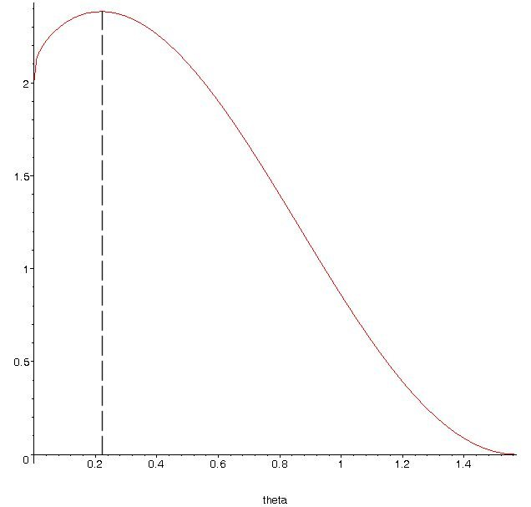

Graph of

Slide 47
Two-sided Polygonal Map
Notes:
The so called “Koebe” functions for these classes are the maps from D to the hyperbolic polygons bounded by exactly one proper side.
In the growth and distortion theorems established by previously mentioned authors, these functions frequently extremal for those problems.

Slide 48
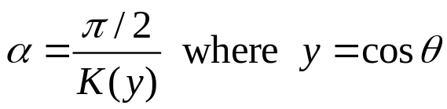


Special Function Estimates
Parameter

Slide 49

Special Function Estimates
Upper bound

Slide 50


Special Function Estimates
Upper bound
Partial Sums

Slide 51

Special Function Estimates

Slide 52


θ = 0.3π /2

Slide 53

θ = 0.5π /2

Slide 54
Verification of M/P Conjecture
Invariance under disk automorphisms
Reduction to hyperbolic polygonal maps
Reduction to
Julia Variation
Reduction to hyperbolic polygonal maps with at most two proper sides
Reduction to
Reduction to

Slide 55


Verification
where

Slide 56



Graph of

Slide 57
Verification
where

Slide 58





Verification
Straightforward to show that
In make a change of variable

Slide 59





Verification
Obtain a lower bound for by estimating
via an upper bound
Sturm sequence argument shows
is non-negative

Slide 60

Grid Estimates

Slide 61







Grid Estimates
Given
  A) grid step size h
  B) global bound M for maximum of
Theorem Let f be defined on [a, b]. Let
Let and suppose that N is chosen so that . Let L be the lattice . Let
If then f is non-negative on [a, b].

Slide 62

Grid Estimates
Maximum descent argument

Slide 63

Grid Estimates
Two-Dimensional Version

Slide 64

Grid Estimates
Maximum descent argument

Slide 65
Verification
where

Slide 66






Verification
The problem was that the coefficient was not globally positive, specifically, it was not positive for
We showed that by showing that
where
0 < t < 1/4.
Notes:
The polynomial r =r(w,m) for that partition was of degree 16 in w and degree 40 in m.

Slide 67




Verification
For the case, expand q(t) in powers of
Noting that are negative, we replaced by an upper bound ( of 1)
to obtain a lower bound
where
Notes:
The polynomial r =r(w,m) for that partition was of degree 16 in w and degree 40 in m.

Slide 68

Verification
Finally, we introduced a change of variable
to obtain
where the coefficients are polynomials (with rational coefficients) in w, y and
Notes:
The polynomial r =r(w,m) for that partition was of degree 16 in w and degree 40 in m.

Slide 69



Verification
Used Lemma 3.3 to show that the endpoints
and are non-negative. We partition the parameter space into subregions:
Notes:
The polynomial r =r(w,m) for that partition was of degree 16 in w and degree 40 in m.

Slide 70



Verification
Application of Lemma 3.3 to
After another change of variable, we needed to show that where
for 0 < w < 1, 0 < m < 1
Notes:
The polynomial r =r(w,m) for that partition was of degree 16 in w and degree 40 in m.

Slide 71

Verification

Slide 72




Verification
Quarter Square [0,1/2]x[0,1/2]
Grid 50 x 50

Slide 73


Verification
Application of Lemma 3.3 to non-negativity of
on the subregion D:
We showed that the discriminant of a related quadratic function was negative on D. That computation amounted to showing that a polynomial of degree 16 in m and degree 40 in w, was non-negative
Notes:
The polynomial r =r(w,m) for that partition was of degree 16 in w and degree 40 in m.

Slide 74
Conclusions
There are “proof by picture” hazards
  CAS numerical computations are rational number calculations
  CAS “special function” numerical calculations are inherently finite approximations
There is a role for CAS in analysis
There are various useful, practical strategies for rigorously establishing analytic inequalities

