Slide 1

Heap Spraying
Use main memory as a “cache” for secondary (disk) storage
Managed jointly by CPU hardware and the operating system (OS)
Programs share main memory
Each gets a private virtual address space holding its frequently used code and data
Protected from other programs
CPU and OS translate virtual addresses to physical addresses
VM “block” is called a page
VM translation “miss” is called a page fault
Notes:
<number>

Slide 2
Paging to/from Disk
Idea: hold only those data in physical memory that are actually accessed by a process
Maintain map for each process { virtual addresses } → { physical addresses } ∪ { disk addresses }
OS manages mapping, decides which virtual addresses map to physical (if allocated) and which to disk
Disk addresses include:
Executable .text, initialized data
Swap space (typically lazily allocated)
Memory-mapped (mmap’d) files (see example)
Demand paging: bring data in from disk lazily, on first access
Unbeknownst to application

Slide 3
Process Virtual Memory Image
Backed by
OS maintains structure of
each process’s address
space – which addresses are valid, what do they refer to, even those that aren’t in main memory currently
kernel virtual memory
Not paged, or swap file
%esp
stack
swap file
Memory mapped region for
shared libraries
code: shared .so file data: swap file (*)
run-time heap (via malloc)
swap file
uninitialized data (.bss)
swap file
initialized data (.data)
swap file (*)
program text (.text)
executable
0
Notes:
<number>

Slide 4
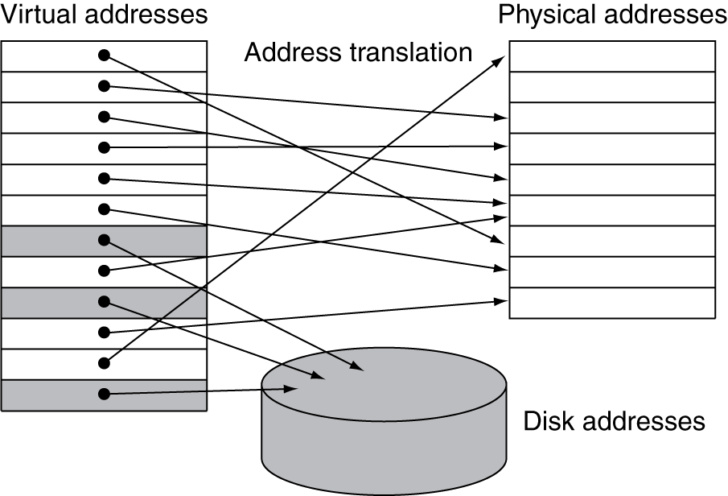
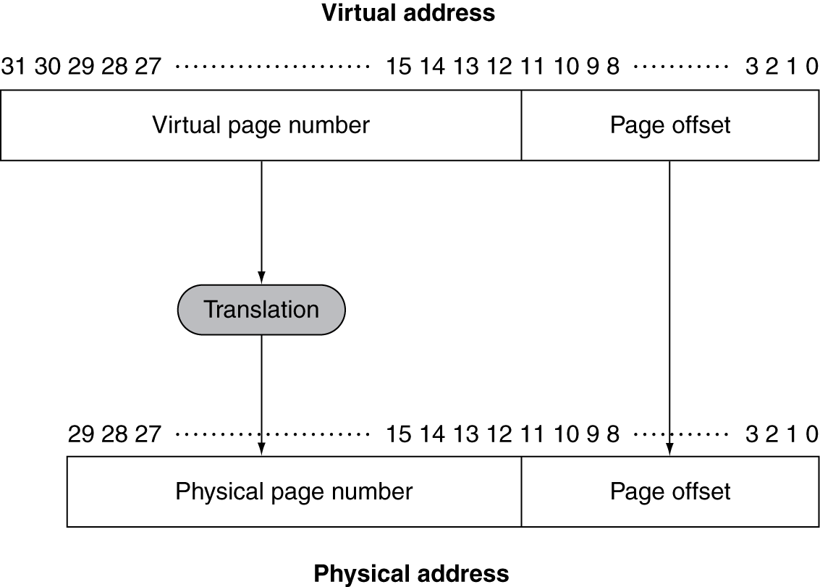
Address Translation
Fixed-size pages (e.g., 4KB)
Swap file
Notes:
<number>

Slide 5
Page Fault Penalty
On page fault, the page must be fetched from disk
Takes millions of clock cycles
Handled by OS code
Try to minimize page fault rate
Fully associative placement
Smart replacement algorithms
How bad is that?
Assume a 3 GHz clock rate. Then 1 million clock cycles would take 1/3000 seconds or 1/3 ms.
Subjectively, a single page fault would not be noticed… but page faults can add up.
We must try to minimize the number of page faults.
Notes:
<number>

Slide 6
Page Tables
Stores placement information
Array of page table entries, indexed by virtual page number
Page table register in CPU points to page table in physical memory
If page is present in memory
PTE stores the physical page number
Plus other status bits (referenced, dirty, …)
If page is not present
PTE can refer to location in swap space on disk
Notes:
<number>

Slide 7
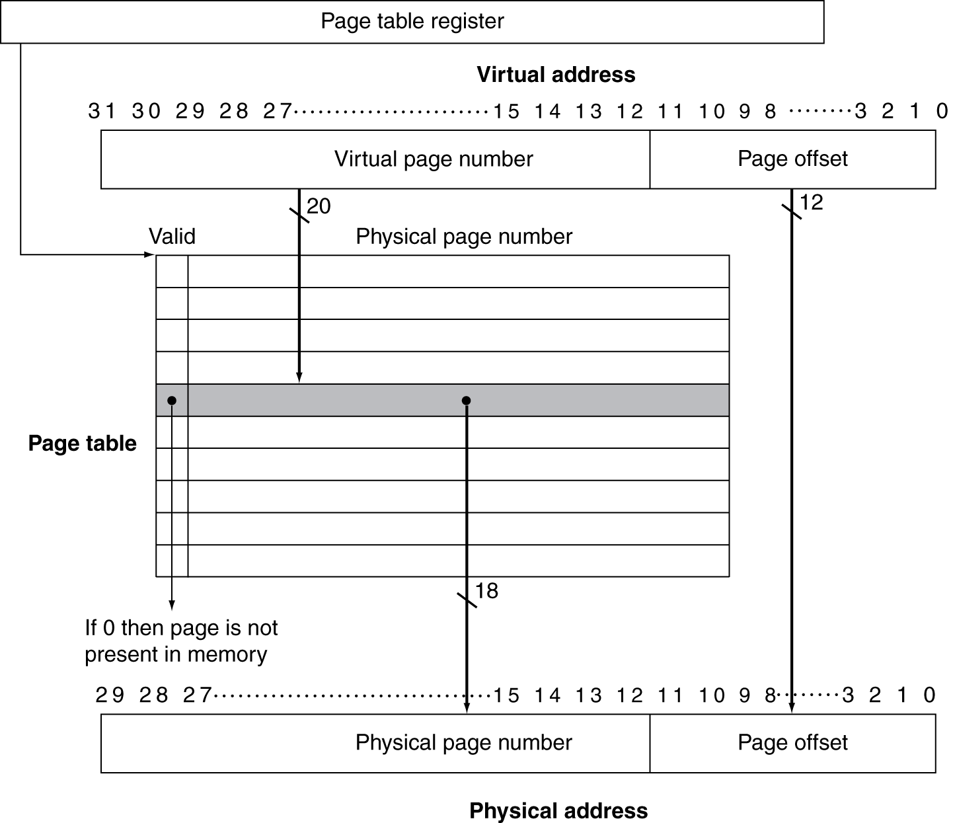
Translation Using a Page Table
1
2
3
5
4
Notes:
<number>

Slide 8
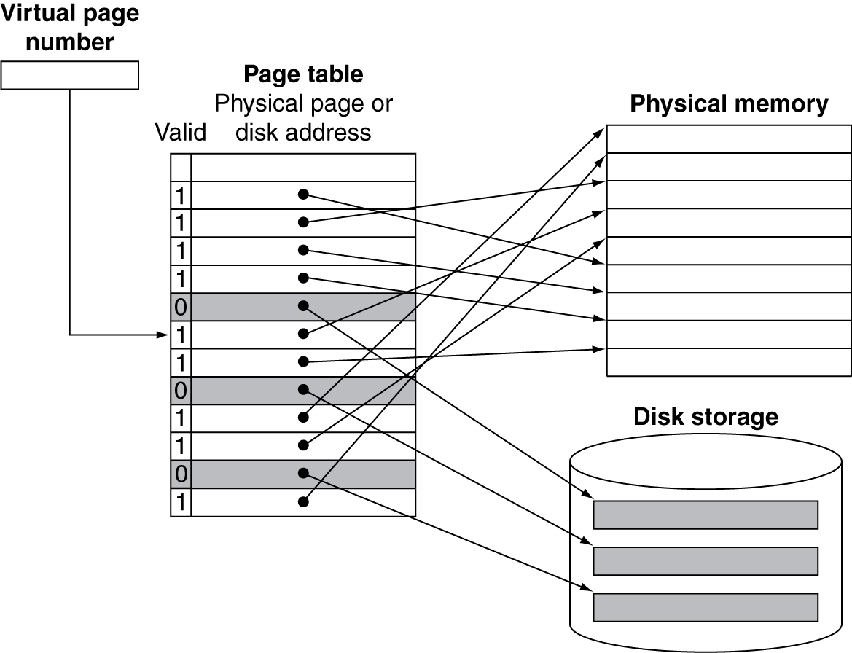
Mapping Pages to Storage
Notes:
<number>

Slide 9
Replacement and Writes
To reduce page fault rate, prefer least-recently used (LRU) replacement (or approximation)
Reference bit (aka use bit) in PTE set to 1 on access to page
Periodically cleared to 0 by OS
A page with reference bit = 0 has not been used recently
Disk writes take millions of cycles
Block at once, not individual locations
Write through is impractical
Use write-back
Dirty bit in PTE set when page is written
Notes:
<number>

Slide 10
Fast Translation Using a TLB
Address translation would appear to require extra memory references
One to access the PTE
Then the actual memory access
Can't afford to keep them all at the processor level.
But access to page tables has good locality
So use a fast cache of PTEs within the CPU
Called a Translation Look-aside Buffer (TLB)
Typical: 16–512 PTEs, 0.5–1 cycle for hit, 10–100 cycles for miss, 0.01%–1% miss rate
Misses could be handled by hardware or software
Notes:
<number>

Slide 11
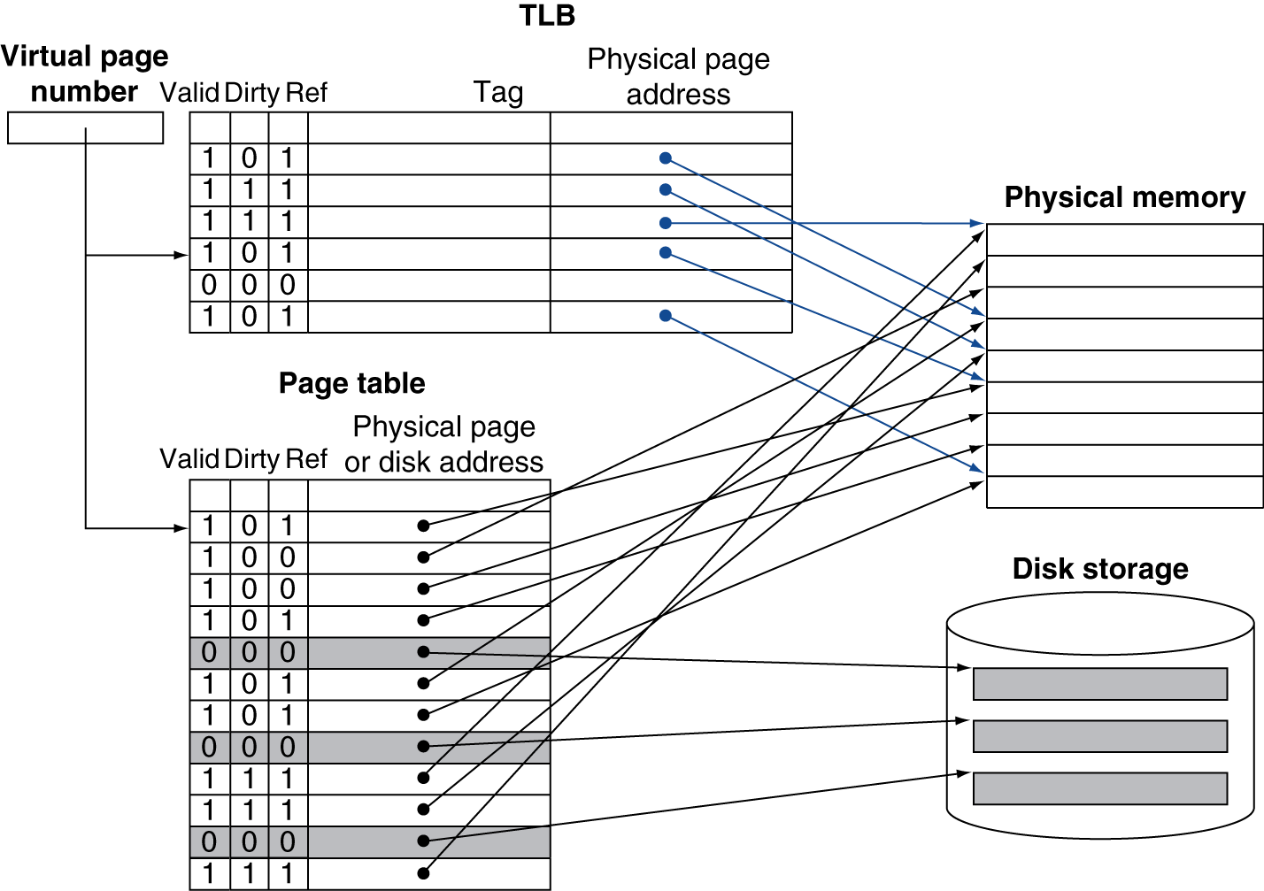
Fast Translation Using a TLB
Notes:
<number>

Slide 12
TLB Misses
If page is in memory
Load the PTE from memory and retry
Could be handled in hardware
Can get complex for more complicated page table structures
Or in software
Raise a special exception, with optimized handler
If page is not in memory (page fault)
OS handles fetching the page and updating the page table
Then restart the faulting instruction
Notes:
<number>

Slide 13
TLB Miss Handler
TLB miss indicates whether
Page present, but PTE not in TLB
Page not present
Must recognize TLB miss before destination register overwritten
Raise exception
Handler copies PTE from memory to TLB
Then restarts instruction
If page not present, page fault will occur
Notes:
<number>

Slide 14
Page Fault Handler
Use faulting virtual address to find PTE
Locate page on disk
Choose page to replace
If dirty, write to disk first
Read page into memory and update page table
Make process runnable again
Restart from faulting instruction
Notes:
<number>

Slide 15
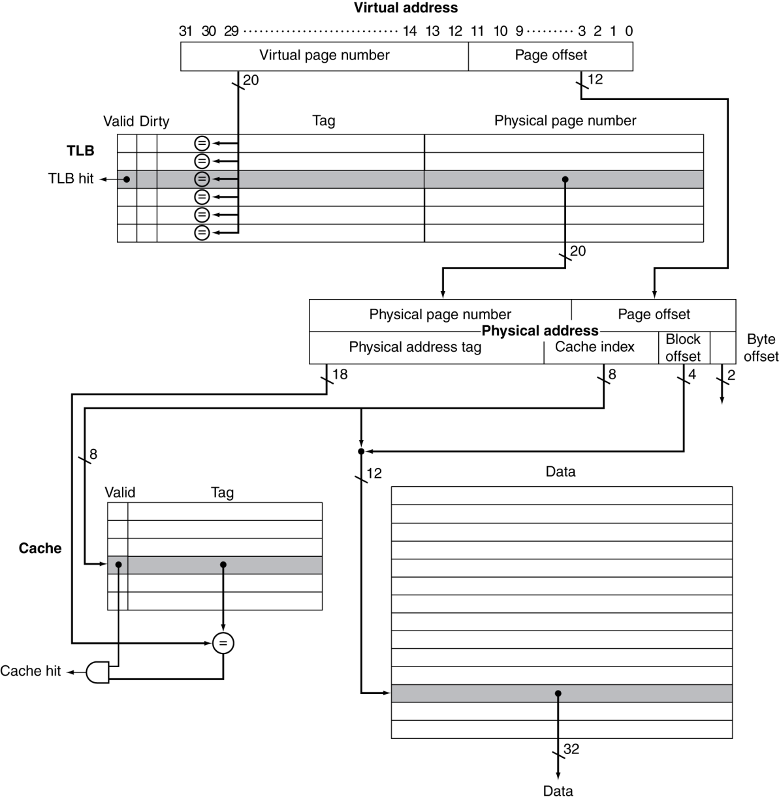
TLB and Cache Interaction
If cache tag uses physical address
Need to translate before cache lookup
Alternative: use virtual address tag
Complications due to aliasing
Different virtual addresses for shared physical address
Notes:
<number>

Slide 16
Memory Protection
Different tasks can share parts of their virtual address spaces
But need to protect against errant access
Requires OS assistance
Hardware support for OS protection
Privileged supervisor mode (aka kernel mode)
Privileged instructions
Page tables and other state information only accessible in supervisor mode
System call exception (e.g., syscall in MIPS)
Notes:
<number>

Slide 17
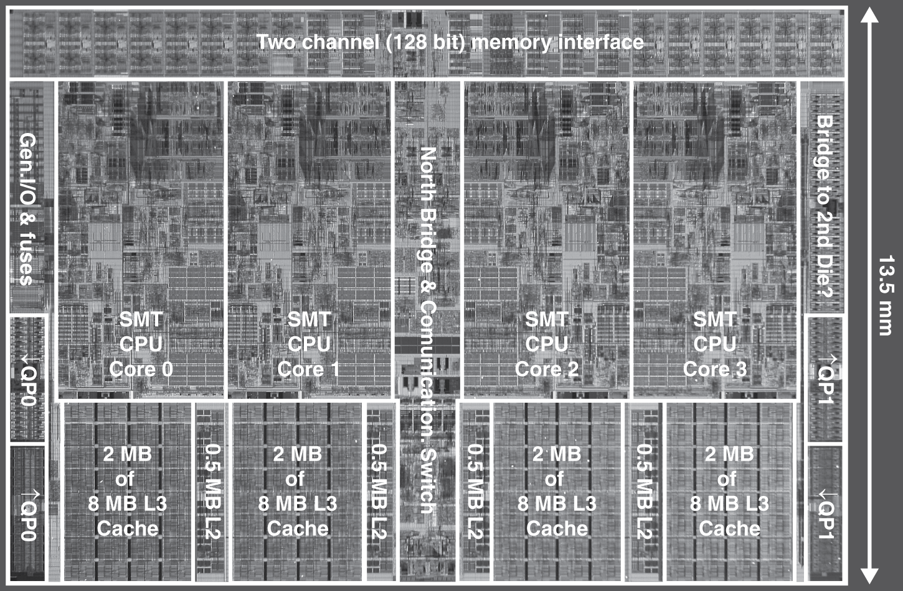
Multilevel On-Chip Caches
Intel Nehalem 4-core processor
Per core: 32KB L1 I-cache, 32KB L1 D-cache, 512KB L2 cache
Notes:
<number>

Slide 18
2-Level TLB Organization
 | Intel Nehalem | AMD Opteron X4
Virtual addr | 48 bits | 48 bits
Physical addr | 44 bits | 48 bits
Page size | 4KB, 2/4MB | 4KB, 2/4MB
L1 TLB (per core) | L1 I-TLB: 128 entries for small pages, 7 per thread (2×) for large pages L1 D-TLB: 64 entries for small pages, 32 for large pages Both 4-way, LRU replacement | L1 I-TLB: 48 entries L1 D-TLB: 48 entries Both fully associative, LRU replacement
L2 TLB (per core) | Single L2 TLB: 512 entries 4-way, LRU replacement | L2 I-TLB: 512 entries L2 D-TLB: 512 entries Both 4-way, round-robin LRU
TLB misses | Handled in hardware | Handled in hardware
Notes:
<number>

Slide 19
Nehalem Overview
Notes:
<number>

