Slide 1
Case Study: Charting the Future through Strategy
By: Mitchell Campbell, Jaden Patterson, Kenyon Rasheed, Kobe Ha

Slide 2
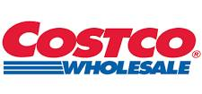
Costco Wholesale Corporation

Slide 3
Strategic Overview: Company Background
Founded: 1983; Headquarters: Issaquah, WA
876 warehouses (2024): 602 U.S., 107 Canada, 40 Mexico, 33 Japan, etc.
Business Model: Membership-based, low prices, high-quality via bulk purchasing and Kirkland Signature.

Slide 4

Revised Vision Statement
To lead globally in delivering unmatched value through quality, affordability, and sustainable practices.

Slide 5

Revised Mission Statement
To provide members with superior goods and services at the lowest prices, prioritizing employee welfare, sustainability, and global community impact.

Slide 6
Core Values
Member Satisfaction: Deliver quality and affordability.
Employee Care: Ensure fair wages and growth opportunities.
Sustainability: Commit to eco-friendly practices.
Operational Efficiency: Streamline operations for low costs.

Slide 7

Strategic Goals, Activities, and Resources
Goal 1: Strengthen E-Commerce
Objective: Increase online sales to 15% of revenue by 2030 (2024: 4.7%, $11.7B).
Activities: Develop AI-driven app with personalized recommendations; expand same-day delivery via Instacart.
Resources: $500M tech budget; Hyderabad Global Capability Centre for app development.

Slide 8

Strategic Goals, Activities, and Resources
Goal 2: Mitigate Economic Risks
Objective: Maintain 90%+ membership renewal rate (2024: 92.9%).
Activities: Offer smaller Kirkland Signature packs for urban/older households; pilot digital-only memberships.
Resources: $200M for product redesign; marketing team for outreach.

Slide 9

Strategic Goals, Activities, and Resources
Goal 3: Enhance Sustainability
Objective: Reduce Scope 3 emissions intensity by 20% by 2030.
Activities: Source eco-friendly Kirkland Signature products; install solar panels in 100 warehouses.
Resources: $300M for green tech; Green Century partnership for ESG audits.

Slide 10
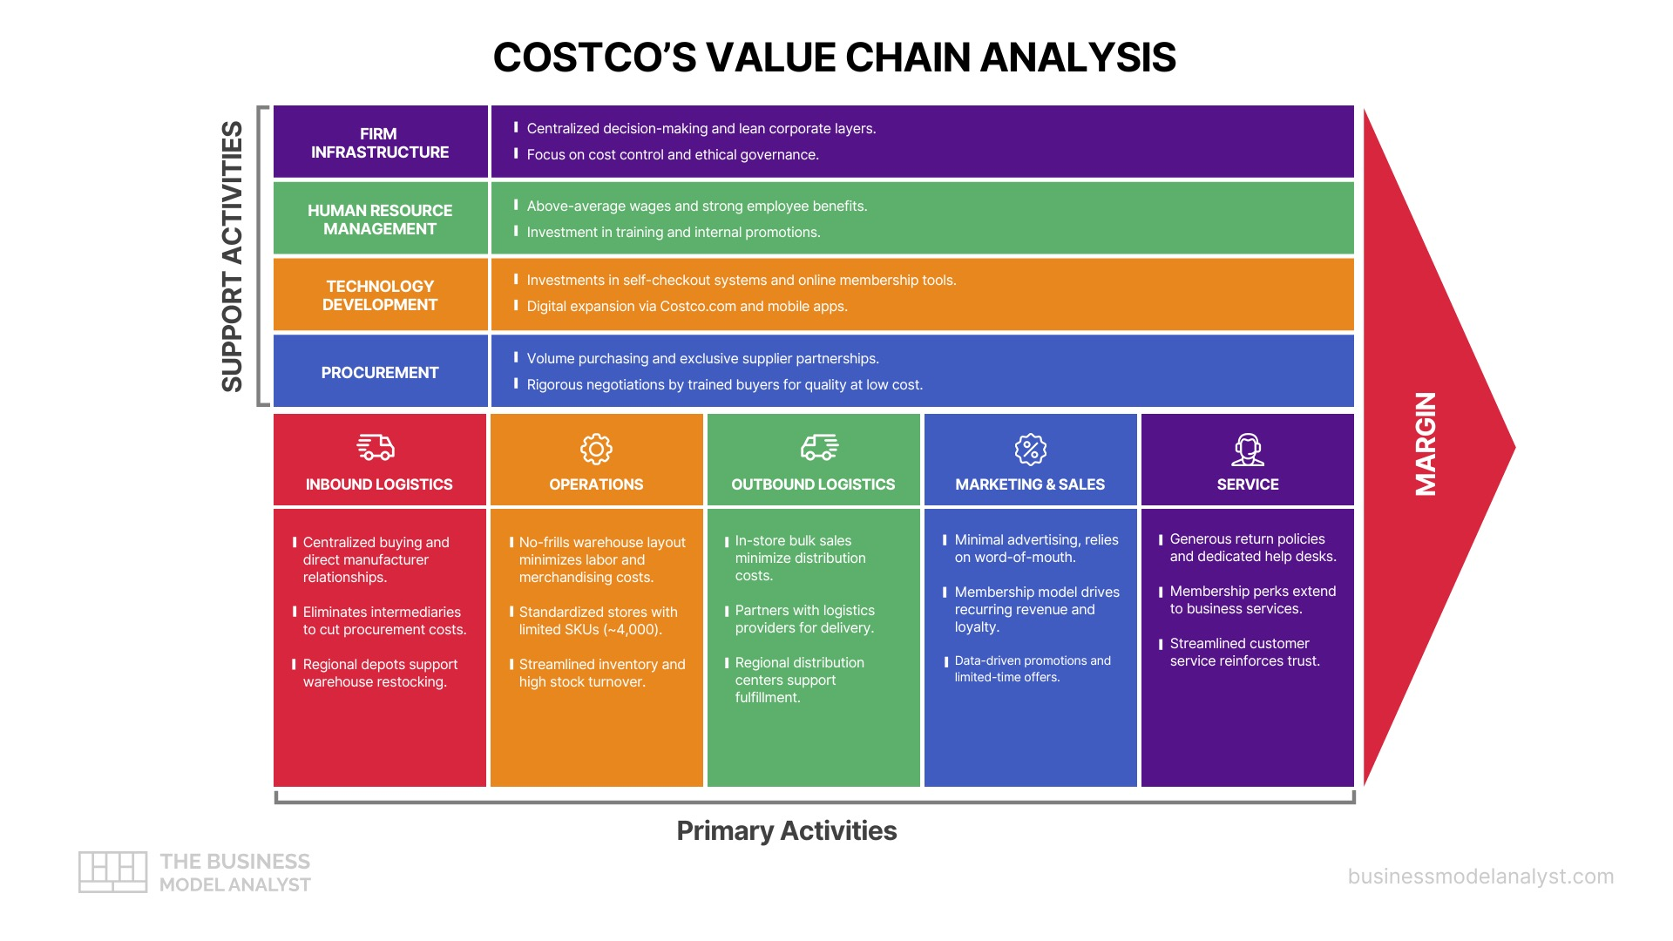

Slide 11
Organizational Structure & Culture
Organizational Structure:
  Costco uses a "centralized structure at the top" coordinating financial, human, and other resources.
  Senior leaders handle strategic planning, goal setting, budgeting, and talent acquisition.
  Operations are divided into core functions merchandising, membership, logistics, supply chain, accounting, finance etc.
Organizational Culture:
  Built on employee loyalty, integrity, and value to all its members.
  "Costco is recognized for treating employees as valuable assets. It offers above-average wages and strong benefits, which foster loyalty and reduce turnover" (Pereira, para. 11).
  Strong focus on ethical business practices and customer satisfaction.
Recommendations for Change:
  Create a digital innovation team to improve e-commerce and tech adoption.
  Enhance collaboration between business operations to reduce logistical errors between departments like accounting, IT, and merchandising.
  Expand leadership development programs to prepare mid-level managers for higher roles within the company.

Slide 12
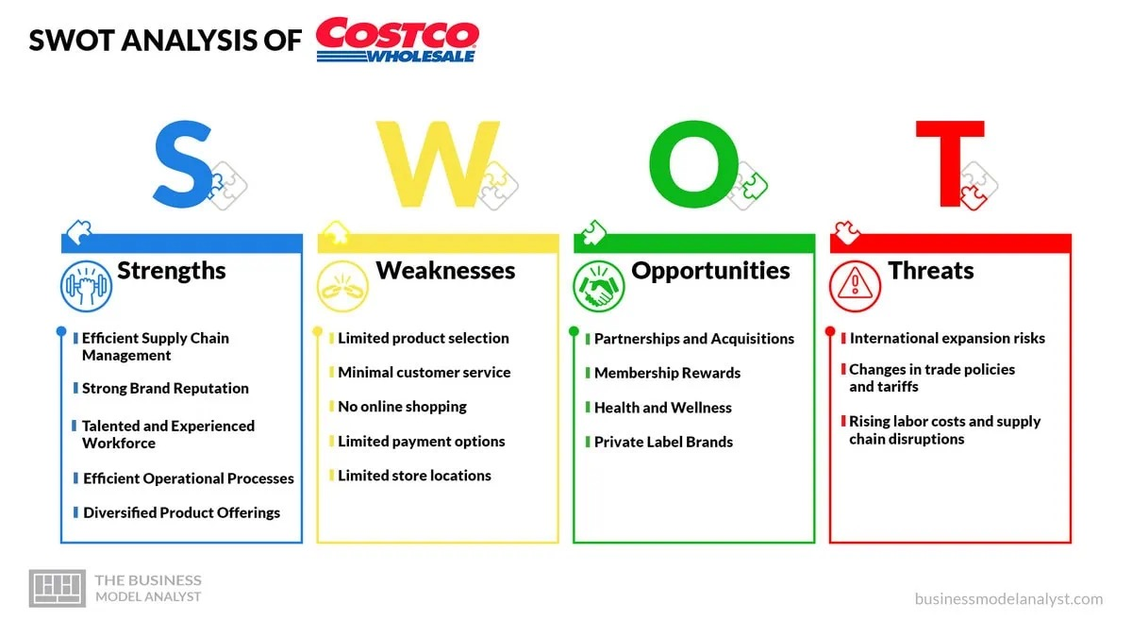

Slide 13
Internal Strengths Analysis
Core Competencies:
"The company is known for its ability to manage inventory and distribution effectively, which enables it to keep prices low while maintaining a high level of product quality" (Pereira, para. 7).
Kirkland Signature brand and strong vendor relationships allow for bulk purchasing and low pricing.
"The membership-based model enables Costco to maintain low overhead costs while offering products at discounted prices. It provides a significant source of revenue for the company while also fostering a sense of loyalty among its customers" (Pereira, para. 12).
Costco has a reputation for treating its employees well, offering competitive wages, benefits, and opportunities for advancement. This has helped motivate employees and is a huge contributor for the organization's success.
Costco's streamlined checkout process, which typically involves minimal wait times, has become a hallmark of its brand and a driver for customer loyalty.
Costco offers various products, including groceries, electronics, furniture, and clothing. This diversification attracts a broad customer base, from families to businesses, and maintain a competitive edge in the retail industry.

Slide 14
External Competition Analysis
Intense rivalry with Amazon, Walmart, Target, Aldi
  Amazon leads with a 50% U.S. e-commerce market share
International expansion challenges, facing culturally adept, tech-savvy local players as Costco enters markets like China
Inflationary pressures and demographic shifts (smaller households) erode the cost benefits of bulk purchases
Regulatory and sustainability pressures:
  Tariff fluctuations, labor regulations, and demands for sustainable practices escalate operational complexities
Porter’s Five Forces:
  Significant buying power and growing threats from substitute products and services in the retail sector

Slide 15
Financial Projection Analysis
For 2024: $249.6B in net sales, $4.83B in membership dues, and $11.7B in digital commerce, next year would want to have around 19% increase
Boost e-commerce to account for 15% of revenue by 2030 ($30-35B)
Large Investments:
  $500M in AI-powered digital growth, $300M in eco-friendly tech, and $200M in product redesign
Long-term:
  Maintain above 90% membership renewals, while managing growth expenses and margin protection

Slide 16
Projected Competitive Advantage
Scale buying power, lower costs and efficiencies from “no-frills” inventory and SKU strategy
Kirkland Signature:
  Premium products 20% cheaper than national brand equivalents
Membership:
  Recurring revenue that enables a high retention rate (stay around 92% renewal rate)
Digital & Sustainability:
  AI-powered personalization, same-day delivery
  Goal of 20% Scope 3 emissions reductions by 2030

Slide 17
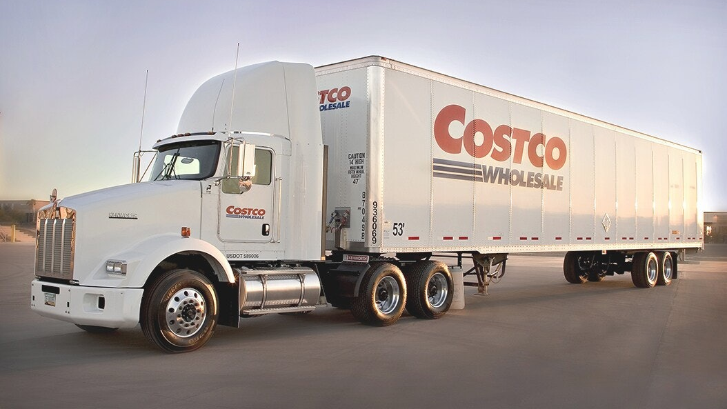
Costco's Global Strategies and Acquisitions
Expanding in the East
  Costco opened its second store in China which led to over 80,000 memberships being sold in the first week
  This indicates that there might be the start of Costco's globalization.
Acquisitions:
  Costco spent $1 billion dollars to acquire Innovel Solutions, this helped them with delivery logistics, warehousing, and more (Muse).
  Opened many doors for Costco to be able to distribute all across the US territories.

Slide 18
Strategy to Assess Progress Towards Goals
Strategic Goals | Key Performance Indicator (KPIs)
Strengthen E-Commerce | Increase online sales to 15% of revenue by 2030
Mitigate Economic Risk | Maintain 90%+ membership renewal rate
Improve Sustainability | Reduce Scope 3 emissions intensity by 20% by 2030.
Key Performance Indicators
As stated, since the first case study in this semester, Key Performance Indicators (KPIs) is a vital way to track progress towards a goal to see if you are on the right track.
Strategy Adjustments
Change strategies based of trajectory of reaching strategic goals
Gauge customer satisfaction by using ecofriendly options and surveys for changes

Slide 19
Works Cited
Costco 2024 Annual Report; Statista, 2024; Pew Research Center, 2022. (Slides 7, 15, & 16)
Muse, Tyler . “Costco Acquisitions & Mergers.” Www.historyoasis.com, www.historyoasis.com/post/costco-acquisitions-mergers.
Pereira, D. (2025, May 31). Costco Value Chain analysis. Business Model Analyst. https://businessmodelanalyst.com/costco-value-chain-analysis/?srsltid=AfmBOopR1NWMnv9EHAd5CmPwFZny9pBX5VCPnxi_rJnOQjrOd8NSVP4K (Slides 3, 4, & 16)
Pereira, D. (2024, December 20). Costco SWOT Analysis (2025). Business Model Analyst. https://businessmodelanalyst.com/costco-swot-analysis/?srsltid=AfmBOorvd3rbopxdHlYyvJSgwc5fCCVri1EBut6EseyEedFqnhp98bpt (Slides 5 & 6)

