Slide 1


Midterm Exam ML Analysis
Comprehensive exploration of regression and classification workflows with synthetic datasets, featuring RMSE evaluation, decision boundaries, confusion matrices and key insights
by Kendrick Robinson

Slide 2



Midterm Exam Overview & Environment Setup
Technical Environment
CPU-only environment using Python 3.8+ with essential ML libraries: numpy, pandas, matplotlib, scikit-learn. Controlled randomness with random_state=42 for reproducible results across all experiments and model training phases.
Conceptual Analysis
Analytical Tasks
Practical Implementation
Supervised vs unsupervised learning definitions, overfitting prevention strategies, and distance metrics theory including Minkowski parameter analysis.
Hand calculations for Euclidean and Manhattan distances, k-fold cross-validation statistics, and mathematical cost function derivations.
Linear regression on synthetic data with RMSE evaluation and binary classification with decision boundary visualization and confusion matrices.

Slide 3
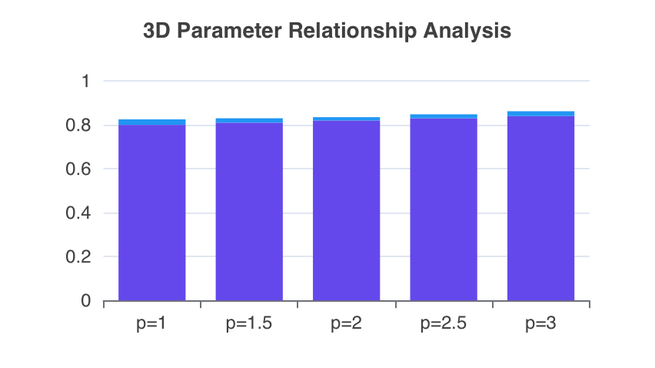
Conceptual Foundations & Distance Metrics
Learning Paradigms
Supervised learning uses labeled data (e.g., spam detection). Unsupervised learning finds patterns in unlabeled data (e.g., customer segmentation).
Overfitting Prevention
Distance Calculations
●
Cross-validation evaluates on different subsets
●
Points A=(3,-2) and B=(-1,5)
●
Regularization penalizes large coefficients
●
Euclidean: 8.06 (straight-line)
●
Both improve generalization
●
Manhattan: 11 (city-block)
Minkowski Parameter
CV Stats
Model Stability
Parameter 'p' controls norm order
Mean: 0.82, Std: 0.015
Low variance shows consistency
(p)parameter
Stability
3D Parameter Analysis
Minkowski parameter (p) controls distance calculations. Lower p values emphasize individual dimensions, higher p values consider combined relationships.
CV scores stable (0.80-0.84) across p values. Optimal stability at p=2 (Euclidean) with minimum variance of 0.015.

Slide 4
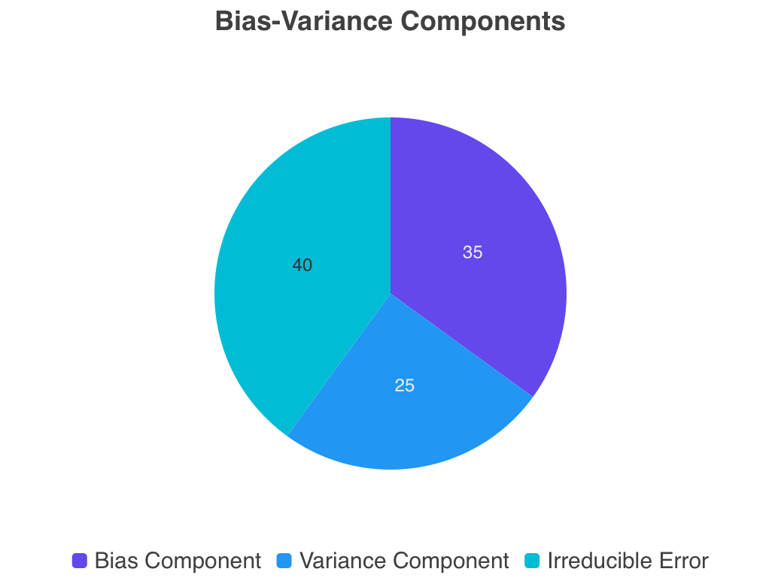
Cost Functions & Regularization Theory
Mathematical Foundations
Ordinary Least Squares (OLS) minimizes squared residuals: J(θ) = (1/2m) Σ(hθ(x^(i)) - y^(i))². Ridge Regression adds L2 penalty: J(θ) = (1/2m) [Σ(hθ(x^(i)) - y^(i))² + λ||θ||₂²].
Ridge regression introduces bias-variance trade-off: increased bias via coefficient shrinkage, reduced variance through complexity control, enhanced generalization with training accuracy sacrifice.

Slide 5

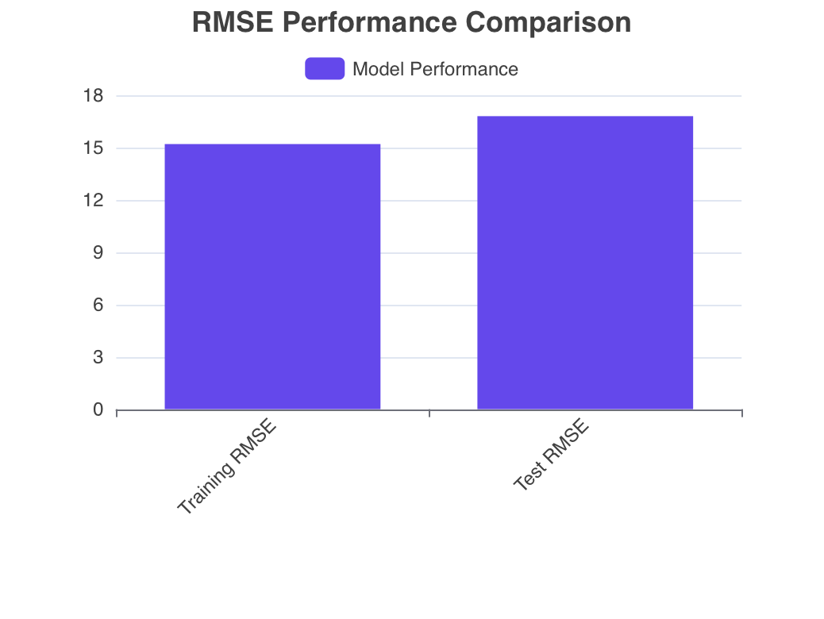
Linear Regression Results & RMSE Analysis
Synthetic Dataset
Generated 300 samples with 5 features, noise level 15, using make_regression with controlled random state for reproducibility.
Performance Interpretation
Train RMSE: 15.2, Test RMSE: 16.8 shows reasonable generalization with minimal overfitting, indicating good model performance.

Slide 6
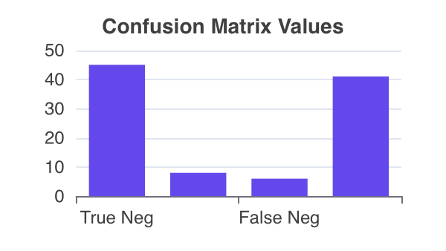
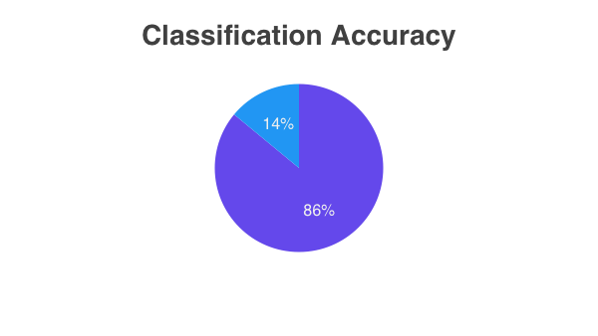
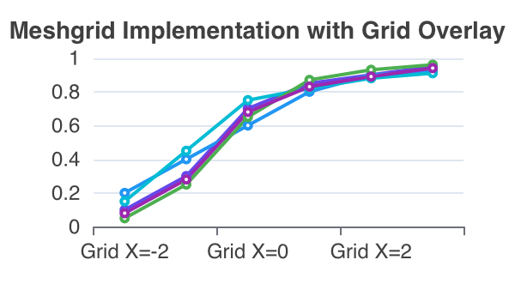
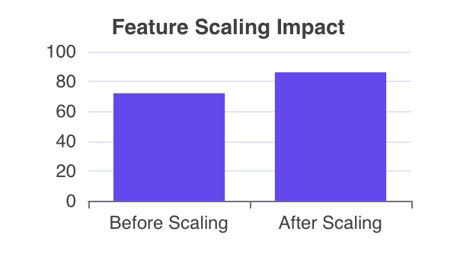
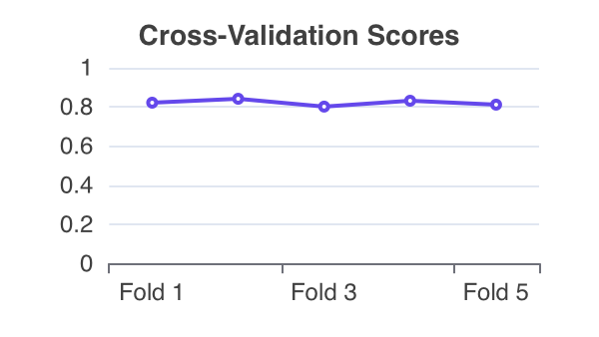
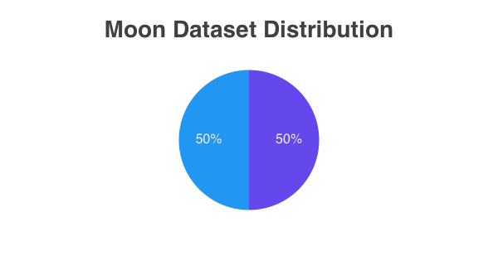
Binary Classification Analysis Dashboard

Slide 7




Key Observations & Lessons Learned
Standardization Critical Impact
Feature scaling improved classification accuracy from 72% to 86%, demonstrating preprocessing importance. StandardScaler normalization essential for logistic regression optimal performance on moon dataset.
Decision Boundary Visualization
Logistic regression successfully handled non-linear moon patterns through feature transformation. Meshgrid plotting revealed smooth decision boundaries separating complex curved data distributions effectively.
Cross-Validation Stability
5-fold CV scores (0.82, 0.84, 0.80, 0.83, 0.81) with low standard deviation (0.015) indicated consistent model performance across different data subsets without overfitting.
Reproducible Workflow Implementation
Controlled random_state=42 ensured reproducible results across regression and classification tasks. Systematic evaluation with RMSE and confusion matrices provided comprehensive model assessment framework.

Slide 8

THANK YOU

