Slide 1
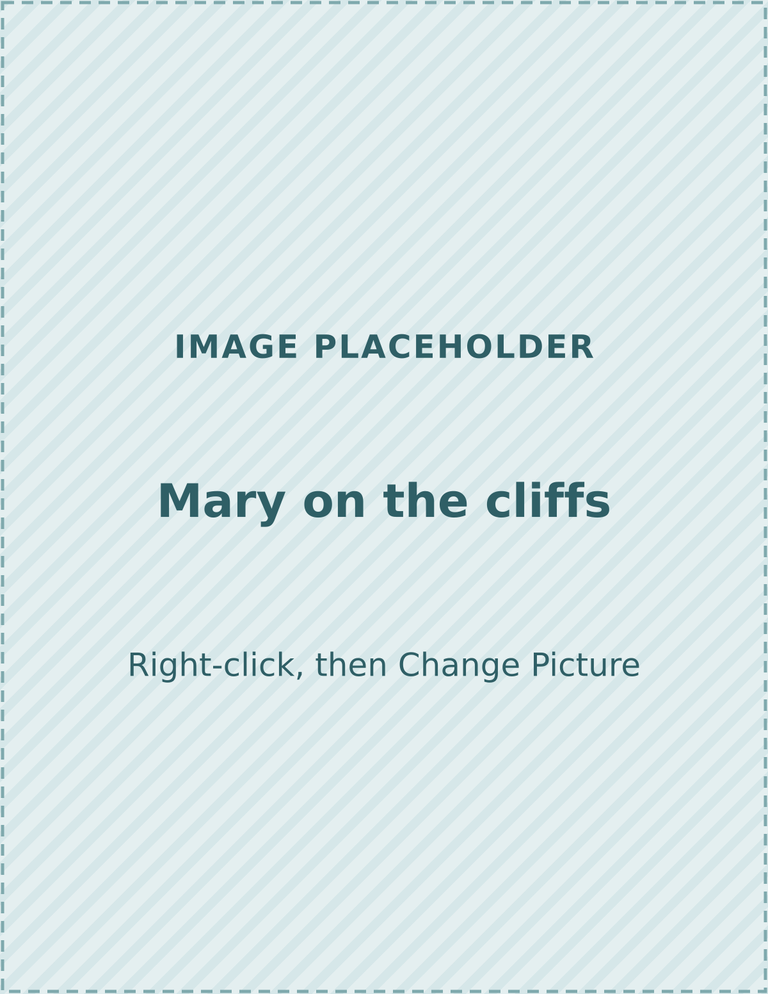
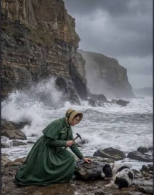
Fossil Detectives
GRADE 4 SCIENCE · 50-MINUTE LESSON
Mary Anning and the evidence in the rocks
Notes:
TITLE (1 min). Welcome the class. Say: 'Today you are fossil detectives. Detectives look for evidence, and so do scientists.' Do not explain the story yet; the hook comes next.
This lesson connects to NGSS 4-ESS1-1: identify evidence from patterns in rock formations and fossils in rock layers to support an explanation for changes in a landscape over time. Check it against your own standards.

Slide 2



Today's goal
BIG QUESTION
How can fossils and rock layers show us what a place was like long ago?
I can explain what a fossil is and how it forms.
I can use fossils and rock layers as evidence.
I can tell an observation from an inference.
Notes:
GOAL (2 min). Read the big question aloud. Then read the three 'I can' statements and ask students to listen for the words 'evidence' and 'inference'. We will come back to these at the end.

Slide 3
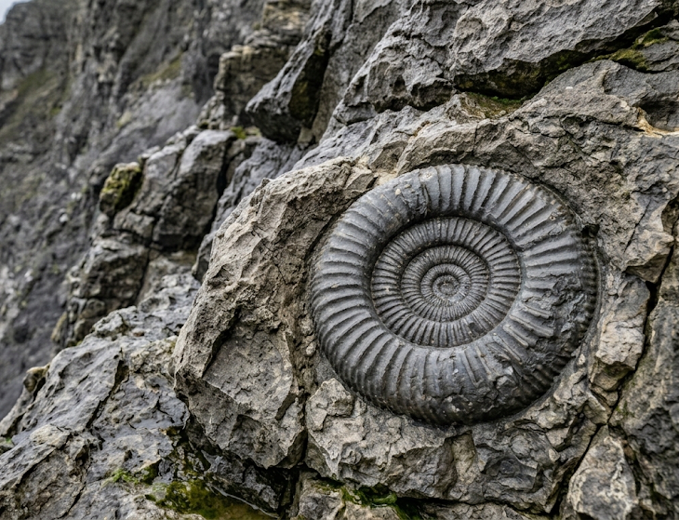
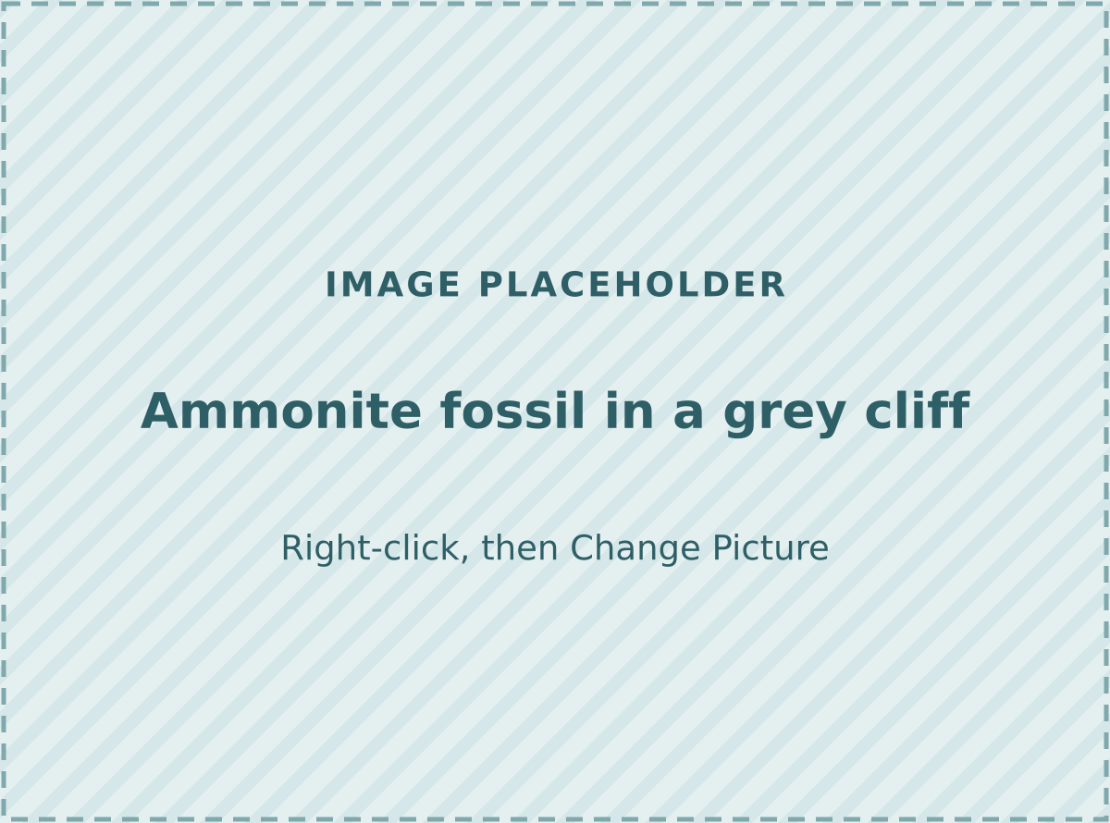
Mystery on the cliff
Scientists find a fossil sea shell high in a cliff, miles from the sea.
How did it get there?
THINK · PAIR · SHARE (2 minutes)
Notes:
HOOK (5 min). Show the picture. Read the question. Think, pair, share for two minutes: students turn to a partner and give one idea. Take three or four ideas on the board and DO NOT correct them yet.
Listen for: 'the sea used to be there', 'someone put it there', 'a flood'. We will test these ideas with evidence later.

Slide 4

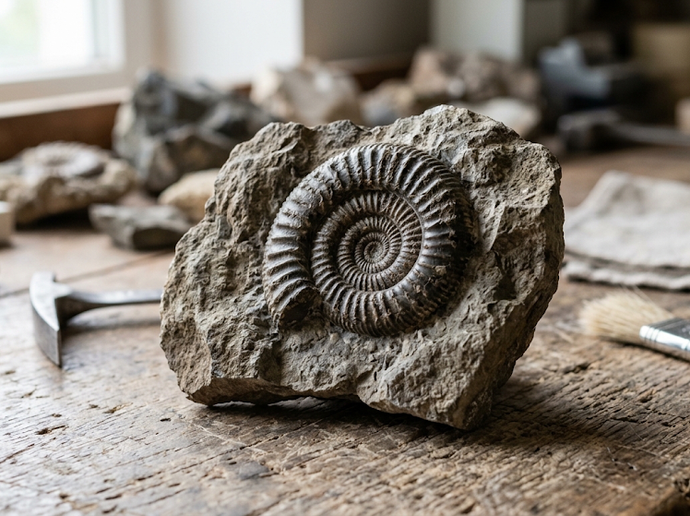
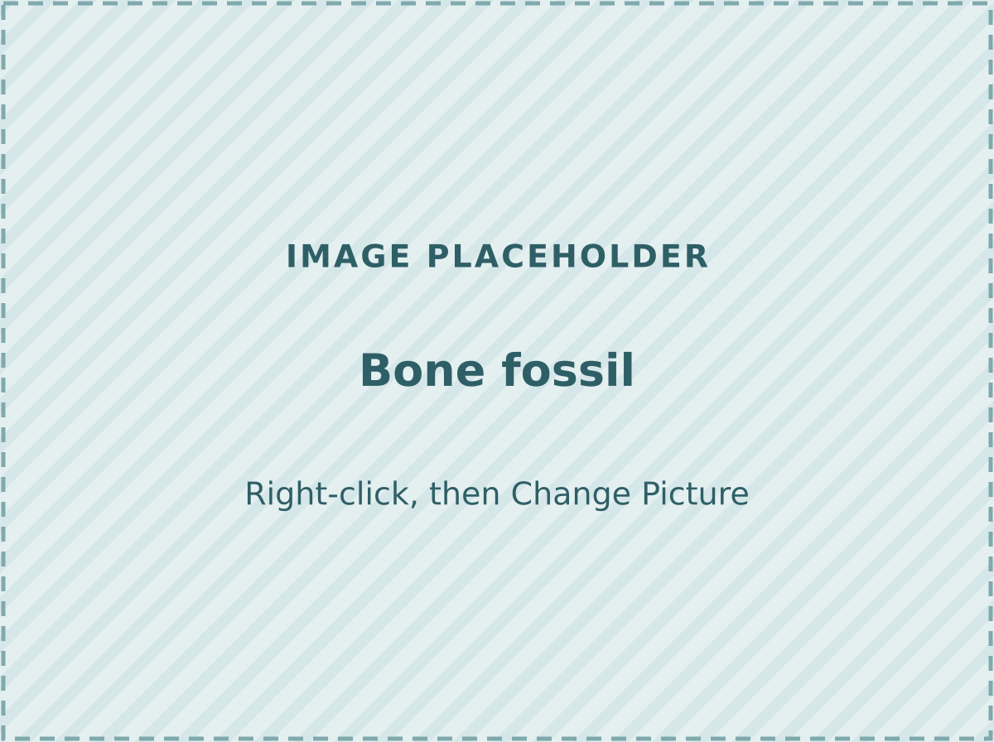
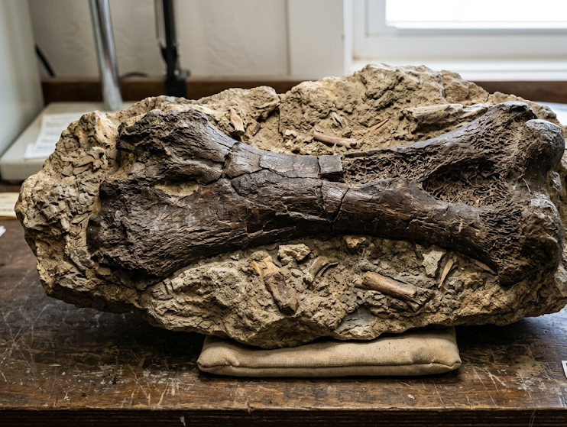
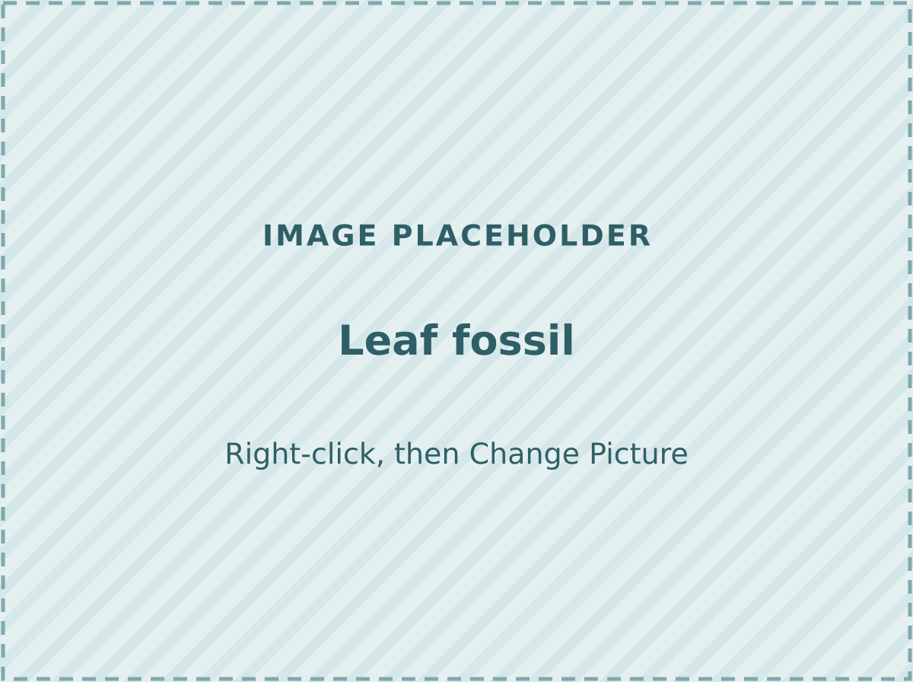
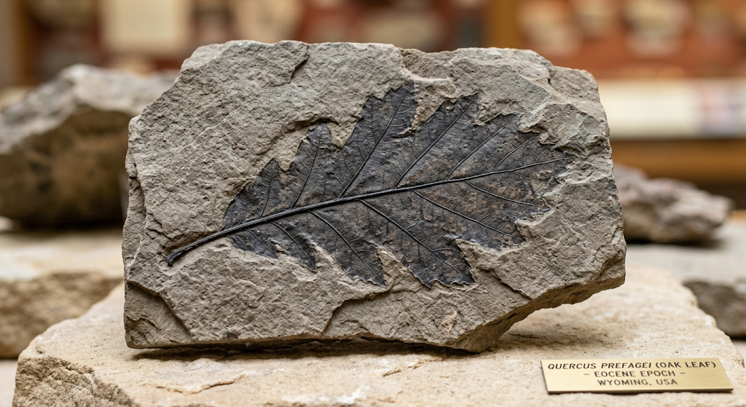
What is a fossil?
A fossil is the remains or an impression of a living thing that has been preserved in rock.
A shell
A bone
A leaf
Notes:
LEARN (3 min). Read the definition. Ask: 'What kinds of living things could become fossils?' Bones, shells, feathers and leaves can all become fossils. Footprints and other marks (impressions) count too.
Vocabulary to say aloud: fossil, impression, preserved.

Slide 5
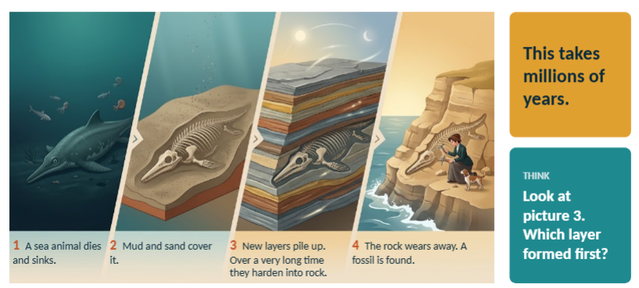
How does a fossil form?
Notes:
LEARN (3 min). Walk through the four steps slowly, left to right. Ask students to act out each step with their hands (sinking, burying, pressing, digging).
Key ideas: the animal is buried quickly; the layers pile up and press the lower layers into rock; it takes a very long time (millions of years); wind, water and waves wear the rock away so the fossil can be found.
Common misconception: fossils are not bones that 'turn to stone' overnight, and they are not found only in deserts.

Slide 6
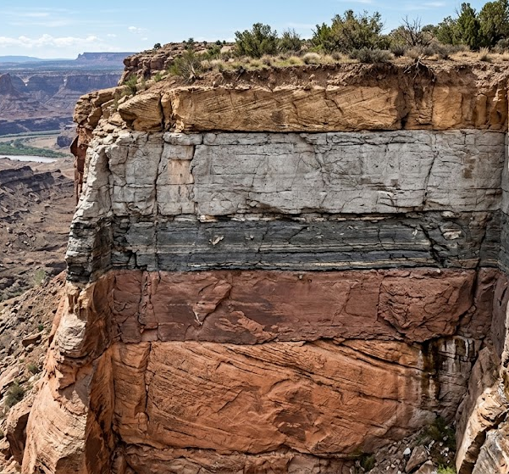
Rock layers are like a stack of pages
Youngest layer: formed last
In a stack of rock layers that has not been disturbed, the oldest layer is at the bottom.
The fossils in each layer help scientists work out the order the layers formed in.
Oldest layer: formed first
Notes:
LEARN (2 min). Use the picture of a book or a pile of paper: the page you put down first is at the bottom. Rock layers work the same way when they have not been disturbed.
Tell students: the oldest layer is at the bottom and the youngest is on top. Fossils help scientists work out the order the layers formed in.

Slide 7
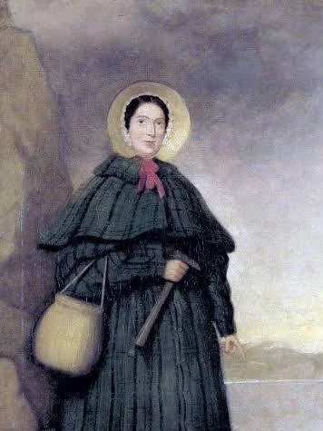

Meet Mary Anning
Born in 1799 in Lyme Regis, on the south coast of England.
Her family was poor. Her father collected fossils and sold them to visitors.
She taught herself geology and anatomy.
The cliffs near her home are full of fossils. Today they are part of the Jurassic Coast.
Mary Anning, painted in 1842. Public domain.
Notes:
STORY (3 min). Tell the story as a story, not a list. Mary was born on 21 May 1799. Her father collected fossils and sold them to visitors at the seaside, and the family was poor. Mary had little formal schooling, but she taught herself geology and anatomy.
Lyme Regis is on England's south coast. Its cliffs are part of the Jurassic Coast, a UNESCO World Heritage Site.

Slide 8
Mary's big discoveries
An ichthyosaur
Mary's brother Joseph found a skull. About a year later, Mary dug out the whole skeleton. It was about 5 meters long. Ichthyosaur means “fish lizard.”
A plesiosaur
Mary found one of the first complete plesiosaur skeletons ever discovered. Plesiosaurus means “near to reptile.”
A pterosaur
A flying reptile. It was the first pterosaur found outside Germany.
1811–12
1823
1828
Notes:
STORY (3 min). Three discoveries. Ichthyosaur means 'fish lizard'. Plesiosaurus means 'near to reptile'. A pterosaur is a flying reptile.
The ichthyosaur: Mary's brother Joseph found the skull in 1811 when Mary was 12; about a year later Mary carefully dug out the whole skeleton, about five meters long.
We say 'one of the first' for the plesiosaur because sources describe it in slightly different ways.

Slide 9
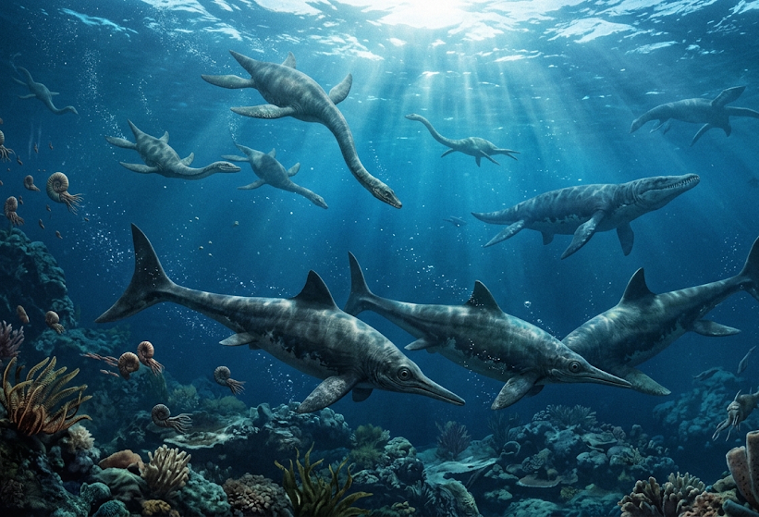
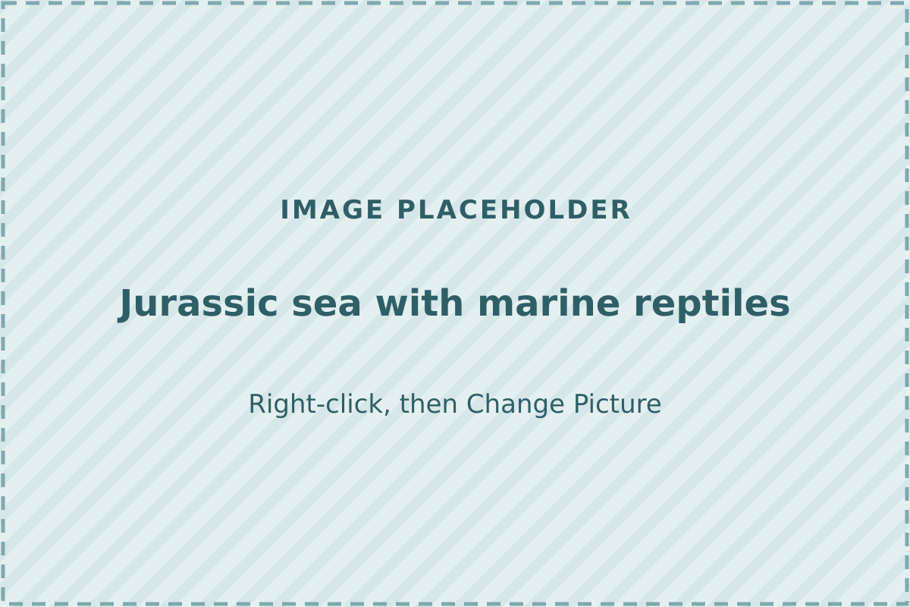
A sea full of reptiles
About 200 million years ago, a warm, shallow sea covered this part of England.
Ichthyosaurs and plesiosaurs were marine reptiles. They were not dinosaurs.
When they died, mud buried their bones. The mud later hardened into the cliffs.
Notes:
STORY (2 min). Connect back to the hook. About 200 million years ago (Early Jurassic), a warm, shallow sea covered this part of England. Ichthyosaurs and plesiosaurs were marine reptiles, not dinosaurs.
When they died, mud buried their bones. Over a very long time the mud hardened into the cliffs Mary searched.
Ask: 'If the cliffs used to be sea floor, what does that tell us about the land?'

Slide 10
Evidence from the cliff
OBSERVATION
We find sea-animal fossils in the cliff.
INFERENCE
This land was once under the sea.
An inference is an explanation that is backed up by evidence.
Notes:
PRACTICE (2 min). This is the key idea of the lesson. The observation is what we can see: sea-animal fossils in a cliff on land. The inference is the explanation: this land was once under the sea.
Ask: 'What makes an inference strong?' Evidence. Link to the hook: the shell high in the cliff.

Slide 11

Observe or infer?
Observation
What you can see, measure, or count.
Example
The shell is 12 centimeters wide.
Inference
An explanation based on evidence and what you already know.
Example
A sea animal lived here long ago.
Notes:
PRACTICE (2 min). Teach the difference with two examples. An observation uses your senses or tools: you can see it, measure it, or count it. An inference is an explanation using evidence and what you already know.
Hand out the O and I cards (or have students use thumbs: up for O, sideways for I).

Slide 12
Activity 1: Observe or infer?
Hold up O for observation or I for inference.
The rock has a spiral shell shape in it.
The shell is 12 centimeters wide.
1
2
A sea animal lived here a very long time ago.
The fossil is in the bottom layer of the cliff.
3
4
The bottom layer is the oldest layer.
This cliff was once under a warm sea.
5
6
Notes:
ACTIVITY 1 (6 min). Read each statement. Students hold up O (observation) or I (inference). After each, ask one student to explain.
ANSWERS: 1 O, 2 O, 3 I, 4 O, 5 I, 6 I.
Note on 5: 'the bottom layer is the oldest' is an inference because it uses the rule that, in undisturbed layers, older layers are on the bottom. Challenge: ask students which statement would need the most evidence.

Slide 13
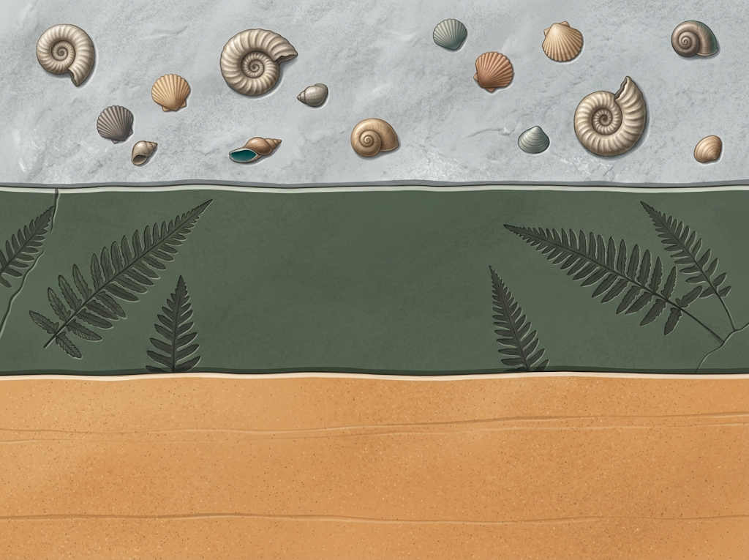
Activity 2: Read the rocks
Layer 3: Gray limestone with SHELL fossils
1. Which layer formed first?
2. What was this place like when Layer 2 formed?
3. What was it like when Layer 3 formed?
Use this frame:
I think ______ because ______.
Layer 2: Mudstone with FERN fossils
and no shells
Layer 1 :Sandstone with no fossils
Notes:
ACTIVITY 2 (8 min). Pairs study the cliff diagram and answer the three questions, using the sentence frame 'I think ___ because ___.'
ANSWERS: 1. Layer 1 (the bottom) formed first. 2. Layer 2 had fern fossils and no shells, so it was probably land (with plants) when it formed. 3. Layer 3 has shell fossils, so the place was probably under the sea when it formed. Whole story: the place changed from land to sea over time.
This matches the NGSS clarification example: shell fossils above plant fossils show a change from land to water.

Slide 14
Whose name is on the discovery?
DISCUSS
Why is it important to give credit to the people who find the evidence?
Mary was a woman from a poor family. She was not allowed to join the Geological Society.
Scientists wrote about her fossils, but they often did not name her.
Later the Society helped her with money, and wrote about her after she died in 1847.
Notes:
REFLECT (3 min). Keep this factual and age-appropriate. Mary was a woman from a poor family, and in her time women were not allowed to join the Geological Society. Scientists wrote about her fossils, and in some important papers they did not name her.
Later, the Society helped her with money (in 1846), and its journal published a tribute after she died in 1847.
Discussion: take two or three answers. Good answers mention fairness, honesty, and giving credit so others can check the evidence.

Slide 15
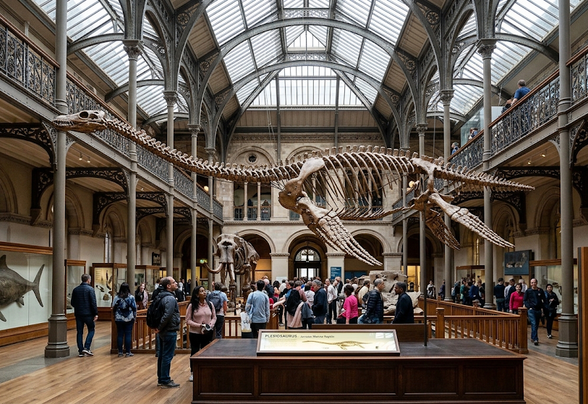
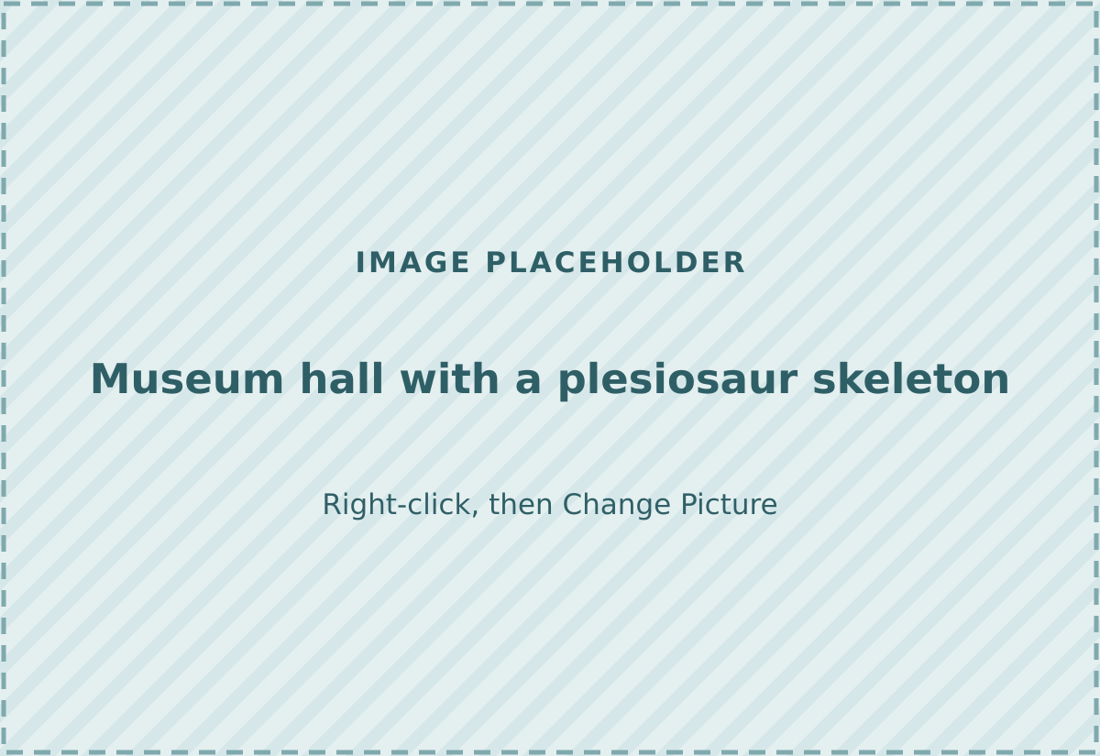
Mary's legacy
Many of her fossils are in the Natural History Museum in London.
In 2010 the Royal Society named her one of the ten most influential British women in the history of science.
Scientists still find fossils on the Jurassic Coast today.
Notes:
REFLECT (1 min). Mary's ichthyosaur, plesiosaur and pterosaur fossils are in the Natural History Museum in London. In 2010 the Royal Society named her one of the ten most influential British women in the history of science.
The Jurassic Coast became a UNESCO World Heritage Site in 2001, and fossil hunters still find marine reptile bones there.

Slide 16
Quick check (1 of 2)
1. What is a fossil?
A. A living animal found in the sea
B. The remains or an impression of a living thing, preserved in rock
C. A very old building
D. A kind of rock found only in cliffs
2. In a stack of undisturbed rock layers, where is the oldest layer?
A. At the top
B. In the middle
C. It depends on the color
D. At the bottom
Notes:
CHECK (3 min). Students answer on mini whiteboards or by showing fingers (1 to 4). ANSWERS: Question 1 is B, question 2 is D. Ask one student to explain why the others are wrong.

Slide 17
Quick check (2 of 2)
3. Shell fossils are found high in a cliff. What is the best inference?
A. Someone dropped them there
B. The shells fell from the sky
C. The cliff was once under the sea
D. The shells grew in the rock
4. Which of these is an observation?
A. The sea covered the cliff long ago
B. The fossil is curled like a spiral
C. The animal was a good swimmer
D. This layer is the oldest
Notes:
CHECK (3 min). ANSWERS: Question 3 is C, question 4 is B. If many students miss question 4, return to the observe or infer slide.

Slide 18
Exit ticket: claim, evidence, reasoning
A scientist finds shell fossils in a cliff far from the sea.
CLAIM
I think this place was once ______.
EVIDENCE
I observed ______.
REASONING
This supports my claim because ______.
Write 2 to 3 sentences. Use the words fossil, evidence, and observation.
Notes:
EXIT TICKET (4 min). Students write in their notebooks. Collect them to check understanding.
MODEL ANSWER: Claim: I think this place was once under the sea. Evidence: I observed shell fossils in the cliff. Reasoning: Shells come from sea animals, so the shells are evidence that the sea once covered this place.
Look for: a clear claim, an observation as evidence, and a reason that links them.

Slide 19
Word wall
fossil
the remains or an impression of a living thing, preserved in rock
sediment
very small pieces of rock, like sand and mud
layer
one level in a stack of rock
evidence
facts or observations that support an idea
observation
something you see, measure, or count
inference
an explanation based on evidence
paleontologist
a scientist who studies fossils
marine
living in or coming from the sea
Notes:
OPTIONAL (use as a closing review or leave on display). Ask students to pick two words and use them in one sentence about Mary Anning.

Slide 20
Lesson at a glance
Time | Part | Slides | What happens
5 min | Hook | 3 | Think, pair, share about the shell in the cliff
8 min | Fossils and rock layers | 4 to 6 | What a fossil is, how it forms, how layers stack
8 min | Mary Anning | 7 to 9 | Her story, her discoveries, the Jurassic sea
4 min | Evidence | 10 to 11 | Observation and inference
6 min | Activity 1 | 12 | Observe or infer? (O and I cards)
8 min | Activity 2 | 13 | Read the rocks (pairs, sentence frame)
4 min | Credit and legacy | 14 to 15 | Discussion: giving credit for evidence
7 min | Check and exit ticket | 16 to 18 | Quick check, then claim, evidence, reasoning
Standard: NGSS 4-ESS1-1: Identify evidence from patterns in rock formations and fossils in rock layers to support an explanation for changes in a landscape over time. Check it against your own standards.
Materials: paper O and I cards (or thumbs), mini whiteboards or notebooks, a stack of paper or a book to show layers.
Notes:
This page is for you. Slide numbers refer to this deck.

Slide 21
Answer key
Activity 1 | 1 O 2 O 3 I 4 O 5 I 6 I (statement 5 is an inference: it uses the rule that, in undisturbed layers, older layers are on the bottom)
Activity 2 | 1. Layer 1 (bottom) formed first. 2. Layer 2 had ferns and no shells, so it was probably land with plants. 3. Layer 3 has shells, so it was probably under the sea. The place changed from land to sea over time.
Quick check | 1 B 2 D 3 C 4 B
Exit ticket | Claim: this place was once under the sea. Evidence: I observed shell fossils in the cliff. Reasoning: shells come from sea animals, so they show the sea once covered this place.
Notes:
Answers for the activities, the quick check and the exit ticket. Model answers are samples; accept any answer that is backed up by evidence.

Slide 22
How this lesson was checked
Confirmed by more than one source
What changed during checking
Mary Anning: born 1799 in Lyme Regis, died 1847; taught herself geology and anatomy.
Her brother Joseph found the ichthyosaur skull in 1811; Mary dug out the skeleton about a year later (about 5 meters).
Plesiosaur in 1823; pterosaur in 1828 (first found outside Germany).
Lyme Regis cliffs are Early Jurassic, about 200 million years old.
She was not allowed to join the Geological Society, and was often not named in papers.
Fossil definition, rock-layer order, and the NGSS 4-ESS1-1 wording.
Detail | What the sources say, and what we did
Her father's age at death | Sources say 10 or 11. Left out.
Year women could join the Geological Society | Sources say 1904 or 1908. Left out.
"First" ichthyosaur and plesiosaur | Sources word these differently (first identified, first complete, first nearly complete). The lesson says "one of the first."
1811 or 1812 | Joseph found the skull in 1811. Mary dug out the skeleton about a year later.
To check yourself: look at each AI picture for mistakes (for example, wrong clothing for 1811, or dinosaurs in the sea), and confirm the lesson against your local standards.
Notes:
AI wrote the first drafts. Key facts were checked against the sources on the next page. Where sources disagreed, the lesson was softened or the detail was left out. This is the routine taught in the AI for Teachers program.

Slide 23
Sources
Natural History Museum, London: "Mary Anning: the unsung hero of fossil discovery"
Geological Society and STEM Learning: Mary Anning factsheet
Linda Hall Library: "Scientist of the Day: Mary Anning"
Biodiversity Heritage Library blog: "The Woman Naturalist: Mary Anning"
Royal Society of Biology: Mary Anning biography
Carnegie Museum of Natural History: "Mary Anning: For the Love of the Blue Lias"
Discovering Fossils: Lyme Regis geology (age of the Blue Lias)
Discover Wildlife: "Jurassic Coast" (World Heritage status)
NGSS 4-ESS1-1 performance expectation (via Smithsonian Learning Lab and AMNH NGSS card deck)
Education World: "Fossils and Rock Formations" (fossil definition)
Want to make lessons like this for your own classes?
AI for Teachers is ten one-hour, one-to-one sessions built around your own lessons, with a full session on quality assurance. Free 30-minute call to start.
teachers.executeai.it.com
Kenny Rooney · kennyjrooney@gmail.com
Notes:
The sources consulted. Check any claim you plan to teach beyond what is on the slides.

