Slide 1
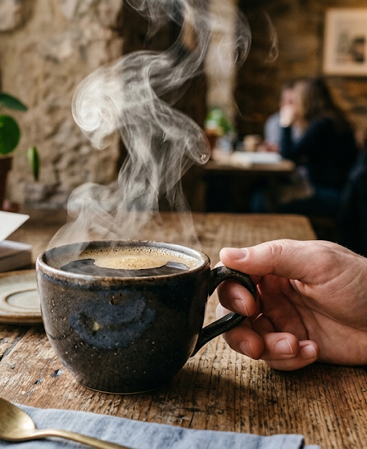
Coffee: Culture and History
A 60-minute conversation lesson for B1 to B2 learners
FREE SAMPLE · AI FOR TEACHERS
Notes:
Teacher: this lesson follows a 'content-fuelled conversation' pattern: short bites of content, each followed by language work and talk. Total time 60 minutes. Replace the grey placeholders with your own pictures (right-click, Change Picture). Optional: add a short video of your choice in bite 1.

Slide 2
Today's lesson
5 min | Warm up
8 min | Target vocabulary
10 min | Bite 1: A short history of coffee
8 min | Bite 2: Coffee around the world
7 min | Vocabulary practice
10 min | Bite 3: Coffeehouses and ideas, discussion
10 min | Create: pitch your café
2 min | Review and feedback
By the end you will be able to:
Use 12 words about coffee and tradition
Talk about your own coffee habits
Explain why places like cafés matter to a community
Pitch an idea and give reasons
Notes:
Read the plan aloud. Objectives: use 12 target words; talk about coffee habits and traditions; give and defend an opinion; pitch an idea.

Slide 3
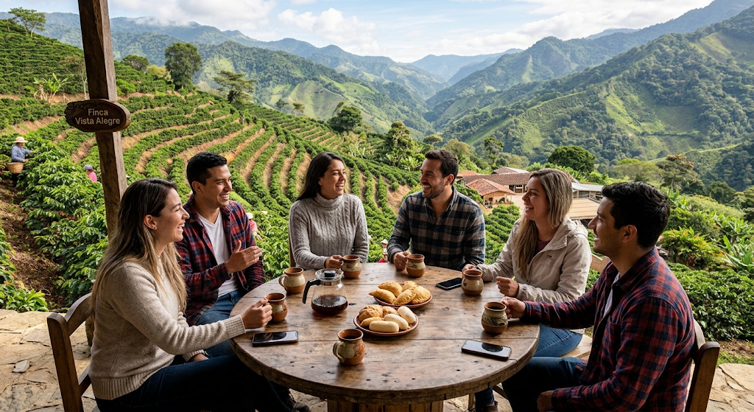
Warm up
5 MIN
In pairs:
1. How often do you drink coffee or tea? Where?
2. Do you drink it alone or with other people?
3. Is there a traditional drink in your country? When do people drink it?
4. What is your favourite café, and why?
Notes:
Pairs, 3 minutes, then 2 minutes of feedback. Listen for ideas to return to later. Do not correct yet; note two or three errors for the review slide at the end.

Slide 4
Target vocabulary
8 MIN
beans
the seeds of the coffee plant
roast
to heat beans until they are brown
brew
to make a drink with hot water
ceremony
a formal event with fixed steps
tradition
a custom passed down over many years
ban
to say officially that something is not allowed
gather
to come together in a group
merchant
a person who buys and sells goods
heritage
traditions and history from the past
habit
something you do regularly
popular
liked by many people
trade
the buying and selling of goods
Notes:
Elicit first: show the word, ask 'Who knows this?'. Then students match words to meanings in pairs (2 minutes) before you reveal. Drill pronunciation: ceremony, heritage, merchant. Words are used in all three bites.

Slide 5
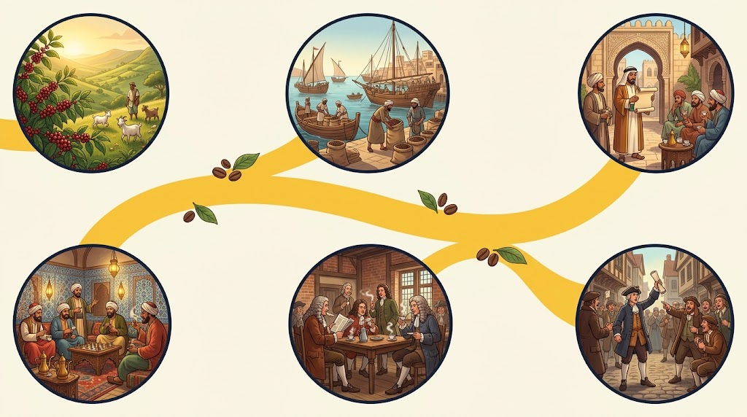
Bite 1: A short history of coffee
10 MIN
1
Ethiopia The coffee plant grows naturally in the highlands of Ethiopia. A popular legend says a goatherd noticed his goats were full of energy after eating its berries.
1
2
3
2
1400s Coffee drinking spreads in Yemen, and merchants trade the beans across the Red Sea and beyond.
3
1511 An official in Mecca tries to ban coffee. The ban does not last.
4
5
6
4
1500s Coffeehouses open in Istanbul. People gather to talk, play games and hear news.
5
1650s Coffeehouses open in England: first in Oxford, then London.
6
1675 King Charles II tries to close coffeehouses. After protests, he drops the plan.
Notes:
Optional video: add a 3 to 4 minute video of your choice in the video slot, and ask students to note three facts. Then students read the numbered timeline and do the questions on the next slide. A widely told legend says an Ethiopian goatherd, Kaldi, found the plant; stress that it is a legend. Check the 1511 detail: an official in Mecca tried to ban coffee, but the ban did not last.

Slide 6
Bite 1: Questions
A. Answer in pairs.
Where does the coffee plant come from?
What happened in Mecca in 1511?
English coffeehouses were often called 'penny universities'. Why do you think that was?
What did King Charles II try to do in 1675? What happened?
B. Talk about it.
Why would a government try to ban a drink?
Which of these facts surprised you most? Why?
Notes:
Answers: 1 Ethiopia. 2 An official tried to ban coffee, but the ban did not last. 3 Because, according to the usual account, for the price of a penny you could buy a coffee and join conversations about news and ideas. 4 He tried to close them but dropped the plan after protests. Use Q5 and Q6 for discussion in pairs.

Slide 7

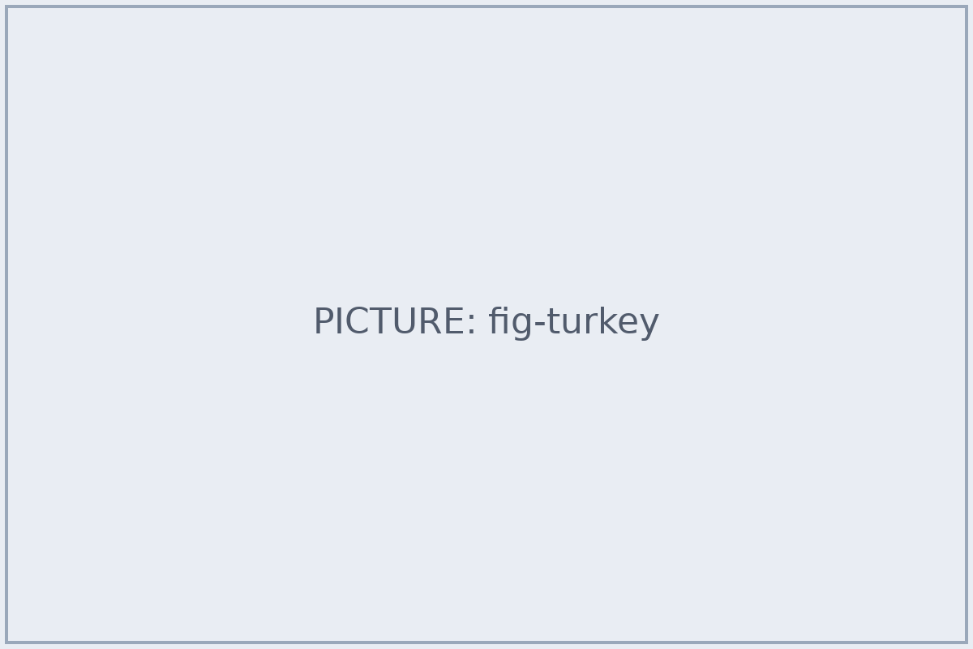

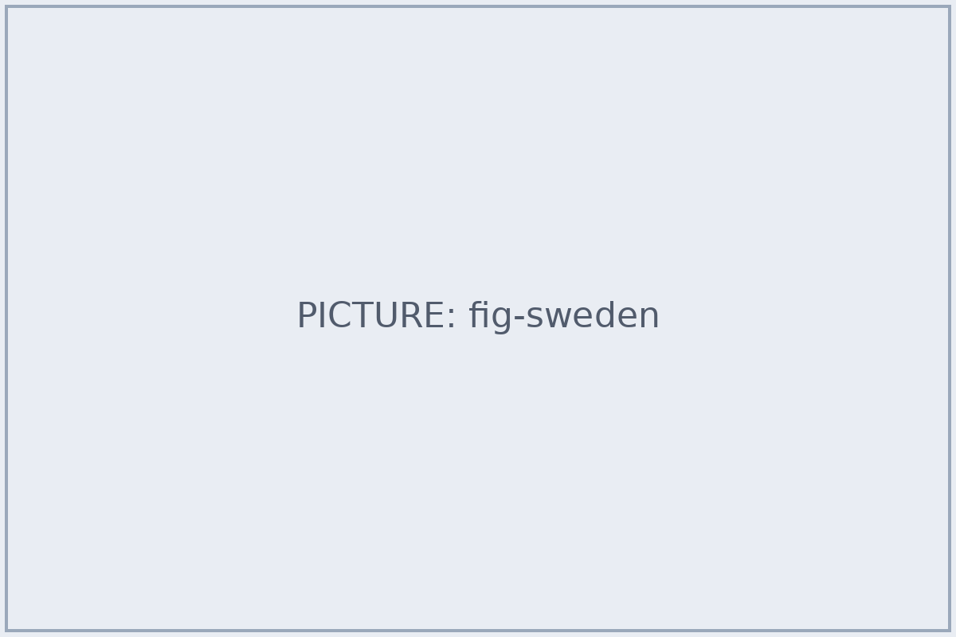
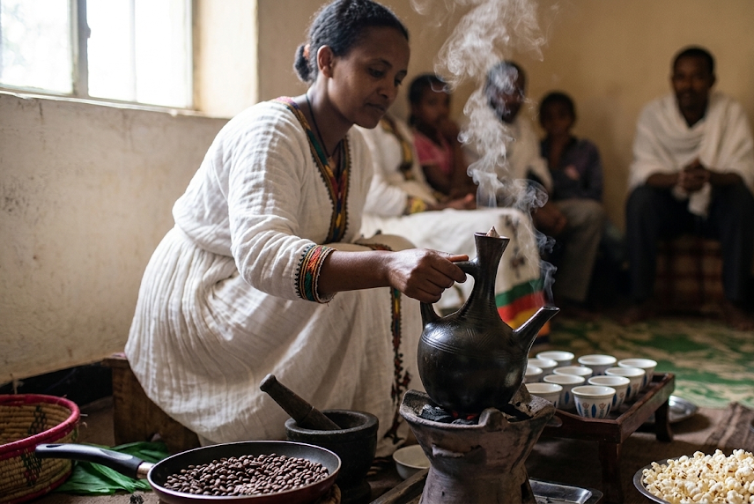
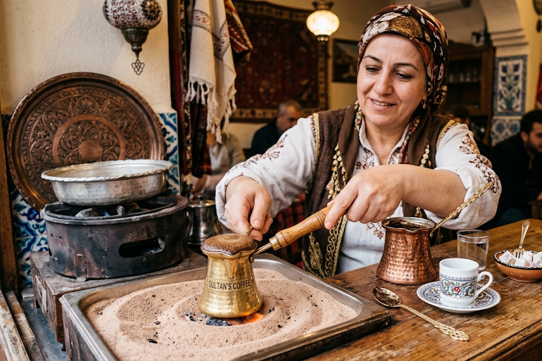
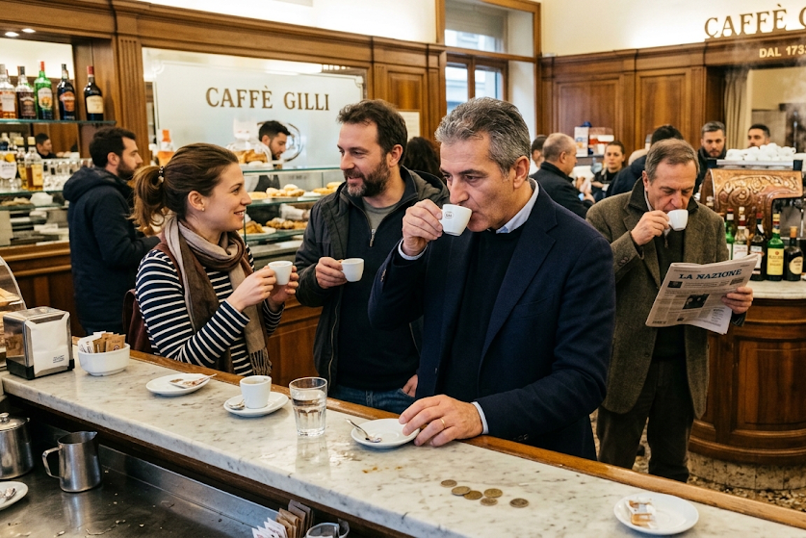
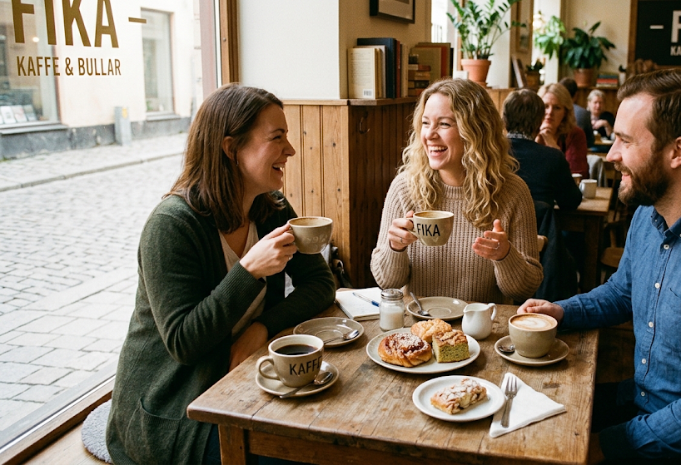
Bite 2: Coffee around the world
8 MIN
Ethiopia
The traditional coffee ceremony: beans are roasted, ground and brewed at home, usually in a clay pot called a jebena, and served in three rounds.
Türkiye
Very fine coffee is brewed in a small pot. Turkish coffee culture and tradition is on UNESCO's heritage list (2013).
Italy
Many people drink a quick espresso standing at the bar. Cappuccino is often a breakfast drink only.
Sweden
Fika: a break to drink coffee, usually with something sweet, and talk with friends or colleagues.
Which of these traditions is most like your own? Which is most different?
Notes:
Jigsaw option: four groups each take one card, prepare to explain it in 2 minutes, then regroup so each new group has an expert on each place. UNESCO added 'Turkish coffee culture and tradition' to its Representative List of the Intangible Cultural Heritage of Humanity in 2013. Note: these are common traditions, not rules; people everywhere vary.

Slide 8
Vocabulary practice
7 MIN
gather · roast · ban · heritage · habit · merchant · ceremony · brew
A. Complete the sentences. Use six of the words.
1. In Ethiopia, families ______ to share coffee in a ceremony.
2. Before you make coffee, you must ______ the beans.
3. In 1511 an official tried to ______ coffee in Mecca.
4. Turkish coffee is part of the national ______.
5. Drinking coffee after lunch is a daily ______ for me.
6. A ______ sold coffee beans to other countries.
B. Choose the best meaning.
1. brew
  to cut into pieces
  to cool down
  to make a drink with hot water
  to put in a bag
2. tradition
  a new fashion
  a custom passed down over many years
  a kind of shop
  a type of bean
3. gather
  to leave
  to argue
  to pay
  to come together
Notes:
Answers: A. 1 gather, 2 roast, 3 ban, 4 heritage, 5 habit, 6 merchant (not used: ceremony, brew). B. 1 C, 2 B, 3 D. Check in pairs before whole-class feedback.

Slide 9

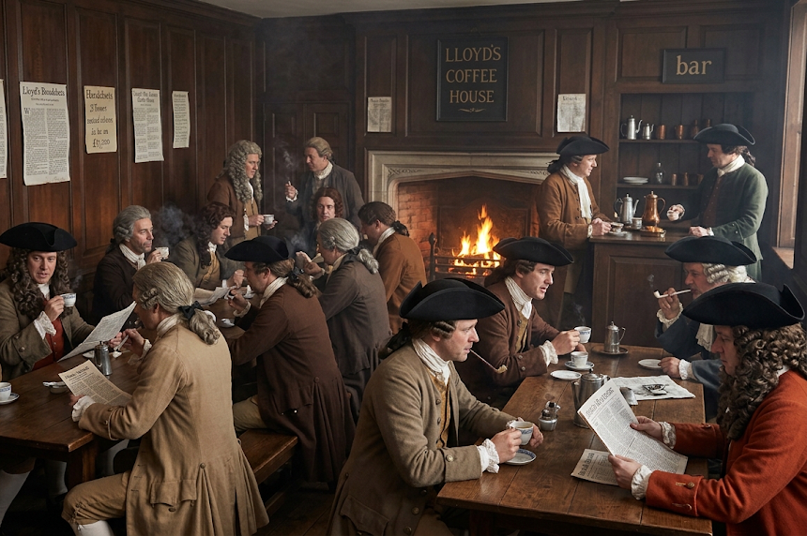
Bite 3: Coffeehouses and ideas
10 MIN
In 17th-century London, coffeehouses were busy places. For the price of a penny, people could buy a cup of coffee and join conversations about news, business and ideas. Many were nicknamed 'penny universities'.
Coffee was becoming a habit, but more importantly, the coffeehouse was becoming a place to gather. Some rulers disliked this, because people who gather also talk, and talk can change opinions.
Think
Is there a place like this today? A café, a park, a group chat, a website?
Notes:
Read the short text aloud or have students read silently (2 minutes), then discuss in pairs and move to the Bloom's questions on the next slide. The 'penny universities' name is a popular description rather than an official one; the usual account is that a penny bought entry and a cup of coffee. Where coffeehouses were a place for news and business, some businesses grew out of them; Lloyd's of London is often said to have begun in a coffeehouse, but check this before using it with students.

Slide 10
Discussion
Remember
Name three places or times in the history of coffee from today's lesson.
Understand
Explain in your own words why coffeehouses were important.
Apply
How would you describe your country's coffee or tea habits to a visitor?
Analyse
Why did coffee become a social drink, not just a drink?
Evaluate
Is a café a better place to work or to meet friends? Which rules would you make?
Create
Design the perfect café for your town. (We will do this next.)
Notes:
Work up the levels: pairs for 1 to 3, then change partners for 4 to 6. Do not rush: aim for reasons and examples, not one-word answers. Useful frames: 'In my opinion...', 'One reason is...', 'For example...', 'I see your point, but...'.

Slide 11
Create: pitch your café
10 MIN
Your group decides
Name and location
Who is it for?
One special drink or tradition
One rule (for example: no phones)
Why will people gather there?
Useful language
'Our café is called ... and it is for ...'
'We chose this place because ...'
'Our special drink is ... It is a tradition from ...'
'We have one rule: ... because ...'
Listeners: 'What would you do if ...?'
After the pitches, everyone votes for the café they would visit (not their own).
Notes:
Groups of 3 or 4. 5 minutes to plan, 4 minutes for pitches (about 1 minute each), 1 minute to vote. Encourage use of today's vocabulary: gather, tradition, heritage, habit, popular, brew, roast. For higher levels, add a rule: each group must include one tradition from another country.

Slide 12
Review and feedback
2 MIN
Find and fix the mistake.
1. I am drinking coffee every morning.
2. Coffee is popular in many country.
3. She gather with her friends every Sunday.
4. In 1511 they banned the coffee in Mecca.
5. I have visited Istanbul last year.
Before you go
Which new word will you use this week?
What was the most interesting fact today?
What would you like to talk about next time?
Notes:
Correct errors collected during the lesson, or use these. Answers: 1 I drink coffee every morning. 2 ...in many countries. 3 She gathers with her friends every Sunday. 4 ...banned coffee in Mecca. 5 I visited Istanbul last year. Ask: 'Which new word will you use this week?'

