Slide 1

Evolution of a RESTful Testing Framework
Kevin Shomper
k.shomper@nationwide.com
@kjshomper

Slide 2

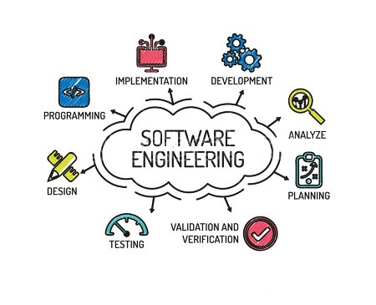

Bio – Kevin Shomper
9 years with USAF in systems acquisition and research (4)
1 year with SAIC (MOTS) (1)
5 years with Nationwide (developer, manager) (1)
7 years with Cendant (director, architect)
11 years with Nationwide (director, Application Owner)
1 year with Nationwide (sr. consultant) (1)
Notes:
35 Years in IT
Professional career started with systems acquisition and research with the USAF
Have participated in about every role (Ops, Dev, Analysis, Test, Architecture, PM)
Normal progression led to management roles, though always with a desire to stay connected to the real work (rolled up sleeves). Development matters, because that’s where the construction takes place. That’s where something tangible is created.
Being an software engineer at heart, I was excited to return to hands on work after 20+ years in management.

Slide 3
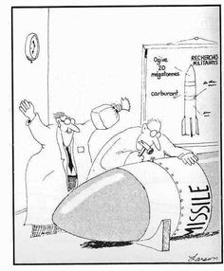
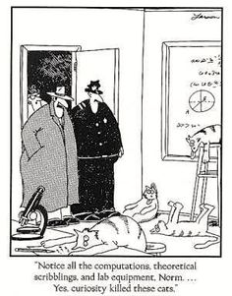
Notes:
Had to include these. First, because I like Far Side and Larson’s wit
Second, and more relevant to why we’re here: the title speaks to an EVOLUTION. If you’ve been in IT any length of time, you’ll realize things change and we must adapt.
Process changes:
- late 80’s early 90’s Doing research for the Air Force at Eglin AFB
- home to Armament Systems Division
- First Gulf War, needed an air dropped bomb that could penetrate deep
- contracting takes time
- altered processes, worked with materials at hand, and questioned constraints
Technology changes:
Stay curious recognizing today’s innovation is tomorrow’s obsolescence.
- the rate of technical decay is increasing in proportion to speed technical invention
- technologies used to survive 10+ years
- now the cool new thing you’re working hard to assimilate will be yesterday’s news
Change is easier to move through if humor is present.
REITERATE TITLE FOR TRANSITION

Slide 4

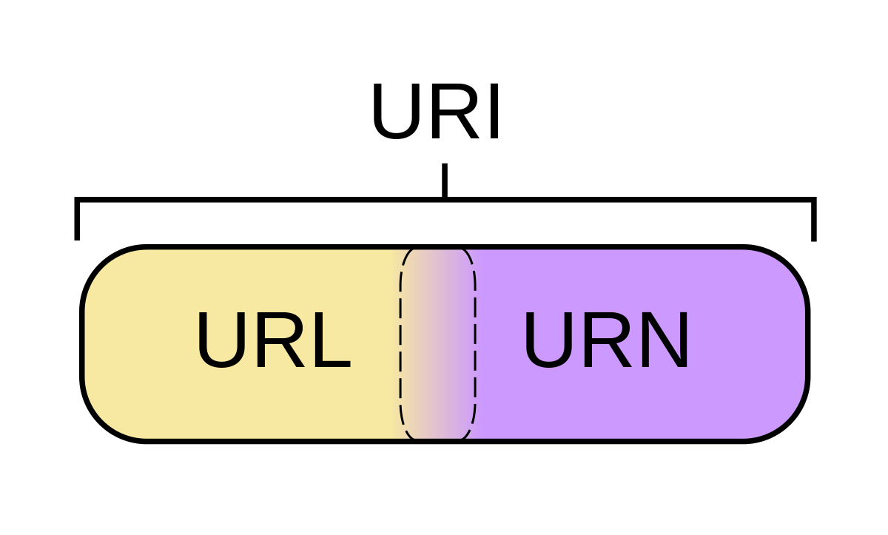

Definitions
RESTful API
HTTP
Resources
JSON
I’m assuming API is defined by an OAS
Open API Specification defines the interaction model for a set of resources
Developer documentation
Notes:
Many things have been described as APIs: hardware interfaces, language libraries, interprocess communication. FOR THE NEXT HOUR WHEN I SAY API think of the request/response activity you perform with some block box endpoint to affect it at arms length.
Look at CODE – CRE-REPO.SH
Not a good idea to just start coding an API and figure it out as you go along. First, you want your API to make sense to the potential consumes of it (think outside in)
Second, once API start to be consumed, you don’t want a lot of breaking change, design first is important, as parties outside your organization can be affected.

Slide 5
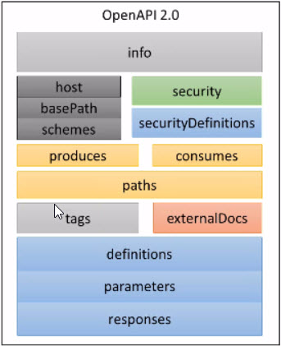
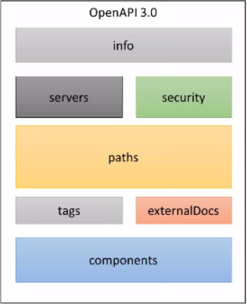
Testable Parts of OAS Specs
- Authentication
-- API Keys
-- Auth Header
MIME types
Paths/resources
Schema definitions
Parameter and/or object definitions
-etc.
Notes:
OAS 3.0 release in August 2017. Not yet widely supported by tooling.
Speak to the important parts that need to be tested

Slide 6
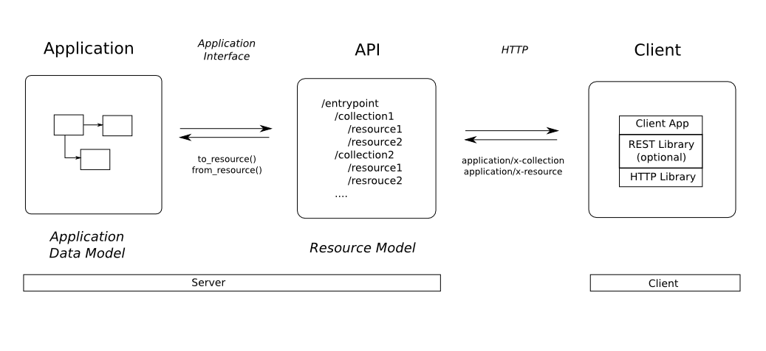
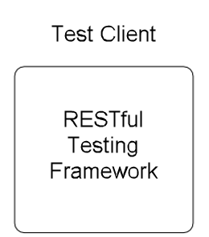
}
60+
Validating the resources and their interactions
Notes:
So we’re putting our test client in the place of the “normal” client and exercising a series of request/response pairs
How hard could that be?
As we saw the are multiple sections of the OAS to validate and that’s if everything goes well.
The HTTP specification defines upwards of 60 possible responses. 10 just for the Success responses.

Slide 7
In Depth Look at an API
http://developer.nationwide.com
Note:
Often multiple resources for each API
Parameters or payloads for actions taken
Usually 6+ possible response codes
Almost always payloads (response body) returned
Notes:
Browse the Commercial Lines Billing API just to demo complexity
Speak to findings after review

Slide 8
Development
Application:
- Service X
- Service Y
- Service Z
/base-path-A
/resource-1
/{id-a}
/sub-resc
/resource-2
API Testing
Resource View
Notes:
So here’s where we began our evolution.
Nationwide chose to use an API Gateway as a proxy for the underlying applications. As such, we separate the concept of application (provider) developer, an API developer, and a Client developer.
This created a focus for the API developer to make sure the work they’re doing in implementing the OAS in the Gateway was IAW the spec

Slide 9
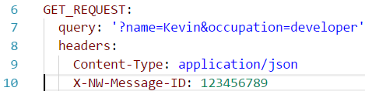
Initial Design
{ test:‘response_code’, method:,:get, resource:,‘/get’, data:‘GET’, validation:200 }
Minimal set of data needed is:
Type of test we’re running: response code test
The HTTP method: GET
The API resource we’re exercising: /get
Any support data we’ll need GET_REQUEST
Expected results (validation): 200
Note: the server and base path as well as other configuration items were held in a file called api_config.yml
Notes:
Top line is a sample test step.
Has five mandatory parts the test type, method, resource, data, and expected result
What action (Verb) we’re taking against a given /resource (path) with a particular payload or parameters and what we expect to get as a response.
Quick note on all config data in .yml file.

Slide 10
Initial Design (cont)
Test types were: response_key, header, substring, and nested_key
Worked well for single API simple validation; however the test type was overloaded:
The output was coupled to the test type
Header output headers for review
Response_key output all values that matched the response key
Some test types required additional keys
E.g. the header test had an extra key (equals) to support validation
Exercising multiple tests would require multiple invocations of the REST call
The test step was an evaluated Ruby string

Slide 11
Development
Test/CI
Application:
- Service X
- Service Y
- Service Z
/base-path-A
/resource-1
/{id-a}
/sub-resc
/resource-2
API Testing
Resource View ● Certification
Decouple call/test ● Regression
need reset for repeatability

Slide 12
Second Design
Still focused on a single API specification
Added support for chaining tests and negative tests with additional test types:
response_capture, custom_capture, api_key, and oauth
Provided ability to maintain state in the test application between API calls
Added user realms (associate, member, unidentified, etc.)
Limitations:
Only one value captured with each call
Negative tests validated response code only
User and API configuration coupled to test script

Slide 13
Development
Test/CI
Application:
- Service X
- Service Y
- Service Z
/base-path-A
/resource-1
/{id-a}
/sub-resc
/resource-2
API Testing
Resource View ● Certification
Decouple call/test ● Regression
Stub/Mock support
support across 2+ base paths
dependencies
/base-path-B
/resource-1
/{id-a}
/sub-resc
/resource-2

Slide 14
Third Design
Recognized need to separate the REST API call from the tests (asserts):
Restructuring of test scenario file to .yml
Test descriptions
Multiple tests (asserts) possible addresses idempotency issues
Not just chaining, but dependencies. If A fails don’t run B and report failed test.
Tests extensible (regex, optional capture)
APIs enhanced to provided stubbing/mocking support. Test tool supports with optional headers.
Modeled adjustment to configuration files for 2+ user realms or base paths

Slide 15
Development
Test/CI
Production
Application 1:
- Service X
- Service Y
- Service Z
/base-path-A
/resource-1
/{id-a}
/sub-resc
/resource-2
API Testing
Resource View ● Certification ● Monitoring
Decouple call/test ● Regression
need reset for repeatability
support across 2+ base paths
Dependencies
● Client check ● App Suite View
/base-path-B
/resource-1
/{id-a}
/sub-resc
/resource-2
Application 2:
- Service X
- Service Y
- Service Z
/base-path-B
/resource-1
/{id-a}
/sub-resc
/resource-2

Slide 16
Current Work
Integration with New Relic APM
Configuration files – separating system under test with test environment setup
Exercising of 2+ scenario files, i.e. easier test suite selection.
?

Slide 17
Thank You - Questions ?
Don’t forget the session survey
k.shomper@nationwide.com
@kjshomper

