Slide 1
Nutrient Monitoring
Learning Module #8

Slide 2
Agenda
Time | Length | Activity
1:00 | 40 min | USGS Article Reading
1:40 | 55 min | Protocols for Nutrient Monitoring
2:35 | 10 min | Creating a Data Sheet
2:45 | 15 Min | BREAK
3:00 | 1 hour, 15 min | Nutrient Monitoring in our Campus Stream
4:15 | 15 Min | Closing activity

Slide 3
USGS Article Reading
Instructions:
Read the article. Feel free to underline key points and/or circle any terms you don’t know!

Slide 4
USGS Article Reading
Instructions:
Read the article. Feel free to underline key points and/or circle any terms you don’t know!
Answer the questions pertaining to the article on the worksheet.

Slide 5
USGS Article Reading: Discussion
1. What does eutrophication mean?
2. List at least two examples of nutrients?
3. How do excess nutrients typically enter aquatic ecosystems?
4. What are some problems that eutrophication can cause in aquatic systems?
5. Would you classify nutrients as point source or nonpoint source pollution? Explain your answer.

Slide 6
Protocols for Nutrient Monitoring
Today, we will be learning how to analyze stream water for nutrients (nitrogen and phosphorus).
To do this, we will use a Hach Colorimeter.

Slide 7
Colorimeters – how they work!
https://www.youtube.com/watch?v=noUSORH5JWo

Slide 8
Protocols for Nutrient Monitoring
You will need:
Hach Colorimeter for Nitrate and associated supplies (sample cells, powder pillows, cleaning cloth)
Protocols for Nitrate
Hach Colorimeter for Orthophosphate and associated supplies (sample cells, powder pillow, cleaning cloth)
Protocols for Orthophosphate
Pencil/Rite-in-Rain
Gloves
Safety Glasses
Sample water
Waste Jug
Deionized water (for rinsing/cleaning)
Make sure to wear GLOVES and SAFTEY GLASSES at all times!

Slide 9
Nitrate Procedures
First, let’s walk through the procedures!

Slide 10
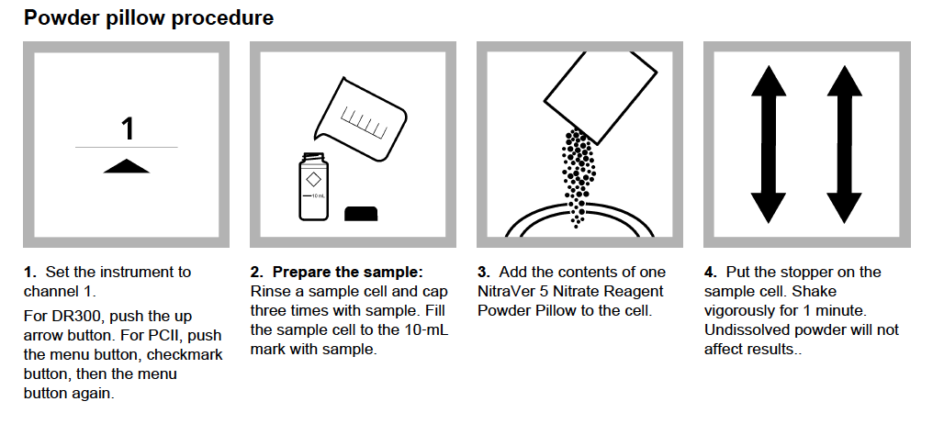
Nitrate Procedures

Slide 11
Nitrate Procedures
Q: Why do you think we rinse the sample cell and cap three time with the sample?

Slide 12
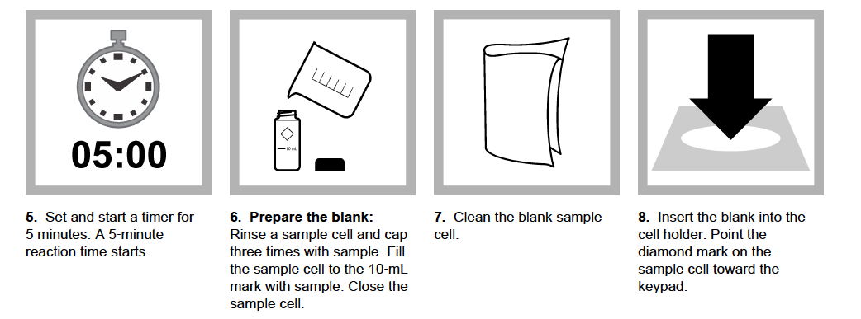
Nitrate Procedures

Slide 13
Nitrate Procedures
Q: Why do you think a 5 min. wait period is required after the contents of the powder pillow are entered into the sample?

Slide 14
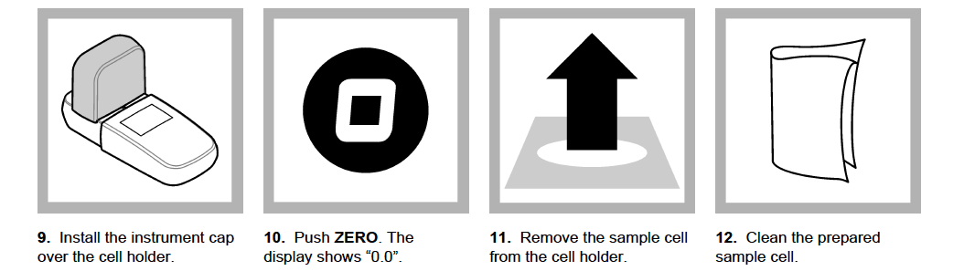
Nitrate Procedures

Slide 15
Nitrate Procedures
Q: What do you think the purpose of the “blank” is?

Slide 16
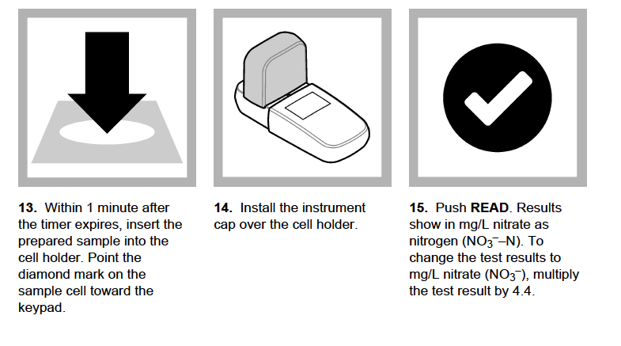
Nitrate Procedures
Tip: make sure to write your result down!

Slide 17
Nitrate Procedures
Now, let’s try it together!

Slide 18
Nitrate Procedures

Slide 19
Nitrate Procedures

Slide 20
Nitrate Procedures

Slide 21
Nitrate Procedures
Tip: make sure to write your result down!

Slide 22
Orthophosphate Procedures
Now, let’s move on to orthophosphate. The procedure is very similar as the nitrate, except for a few small differences.
Read through the procedure and see if you can spot the differences!

Slide 23
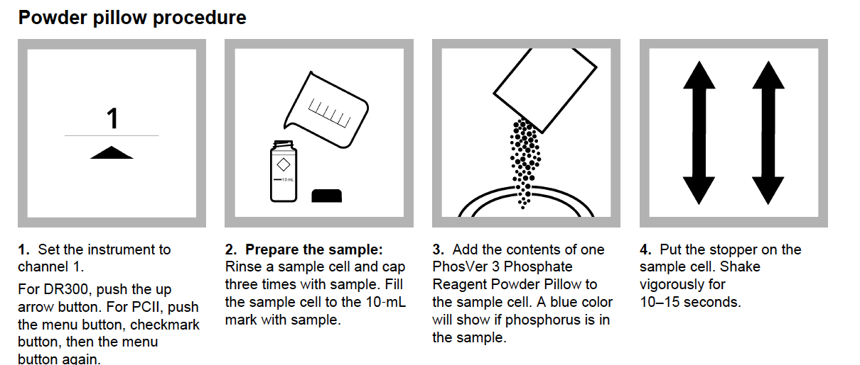
Orthophosphate Procedures

Slide 24
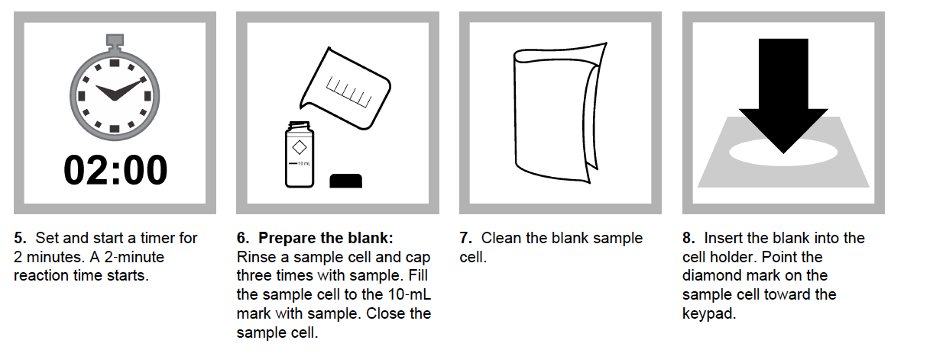
Orthophosphate Procedures

Slide 25
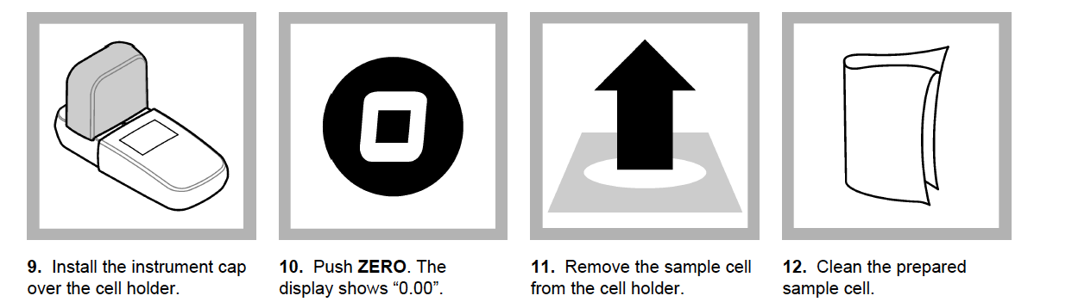
Orthophosphate Procedures

Slide 26
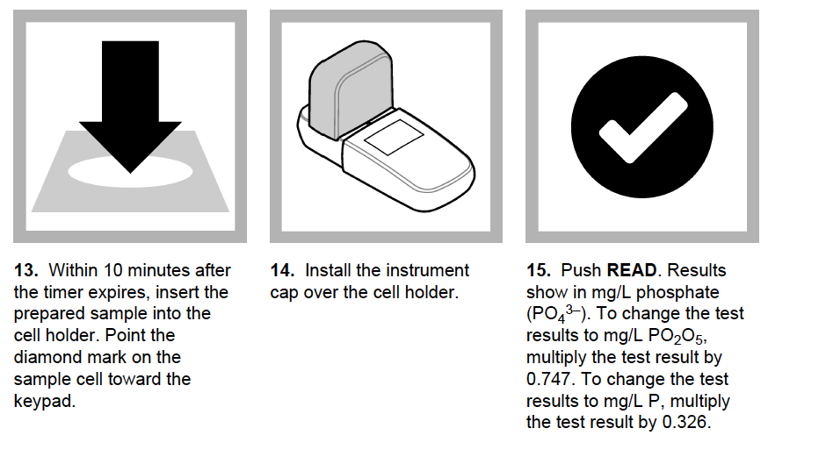
Orthophosphate Procedures
Tip: make sure to write your result down!

Slide 27
Creating a data sheet

Slide 28
Creating a data sheet
Helpful information to include:
Stream name
Date
Time
Samplers names
Blank spaces for data (example: Nitrate Test 1:___________________
Nitrate Test 2: __________________)

Slide 29
Take
a
break!
Water Dawgs

Slide 30
Nutrient Monitoring of our Campus Stream
You will need:
Hach Colorimeter for Nitrate and associated supplies (sample cells, powder pillows, cleaning cloth)
Protocols for Nitrate
Hach Colorimeter for Orthophosphate and associated supplies (sample cells, powder pillow, cleaning cloth)
Protocols for Orthophosphate
Pencil/Rite-in-Rain
Gloves
Safety Glasses
Waste Jug
Deionized water (for rinsing/cleaning)
Waterboots
Backpack
Make sure to wear GLOVES and SAFTEY GLASSES at all times!

Slide 31
Nutrient Monitoring of our Campus Stream
SAFETY
FIRST

Slide 32
Closing Activity
Instructions:
Write your response to the questions on the lesson worksheet.

Slide 33
Closing Activity
Question 1: How can excess nutrients enter stream ecosystems stream ecosystems?
Question 2: Why can too many nutrients in aquatic ecosystems be a problem?

