Slide 1
Biodiversity
Learning Module #15

Slide 2
Agenda
Time | Length | Activity
9:00 | 20 min | Opening Activity
9:20 | 1 hour, 15 min | Bean Biodiversity
10:35 | 10 min | BREAK
10:45 | 25 min | Stream Biodiversity
11:10 | 10 min | BREAK
11:20 | 55 min | Estimating Stream Biodiversity
12:15 | 15 min | Closing Activity

Slide 3
Opening Activity
For the opening activity, answer both questions on your lesson worksheet.

Slide 4
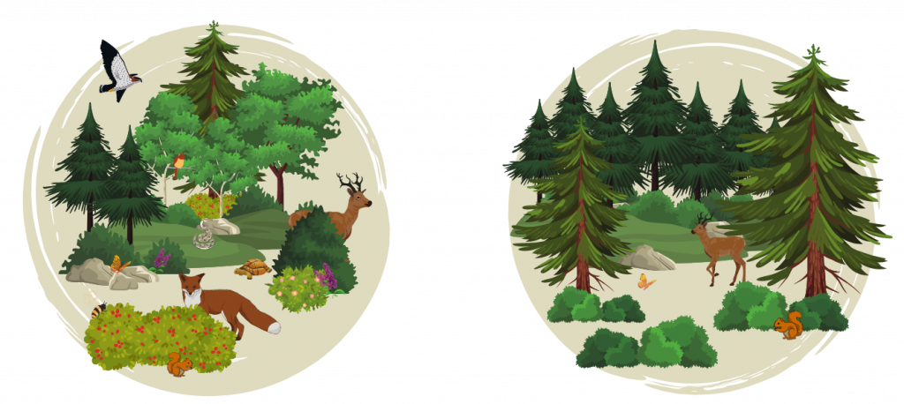
Opening Activity
Question 1: What do you know about the word “biodiversity”? Explain what you think it means and/or give an example.
Question 2: Which of the two images below do you think has higher biodiversity? Explain your reasoning.
Image from Tualatin SWCD
https://tualatinswcd.org/
what-is-biodiversity-and-why-does-it-matter-for-you/
Image 1
Image 2

Slide 5
Bean Biodiversity
Read opening paragraphs silently.
As you are reading:
Underline the definitions of richness and abundance.
Circle any words you are unfamiliar with!

Slide 6
Bean Biodiversity
Example Community
Taxa | # of Each
Grasshoppers | 25
Ladybugs | 25
Ticks | 20
Ants | 20
Bees | 10

Slide 7
Bean Biodiversity
Example Community
Taxa | # of Each
Grasshoppers | 25
Ladybugs | 25
Ticks | 20
Ants | 20
Bees | 10
1) What is the total # of insects in the community?
2) What is the richness of the community?
3) What is the relative abundance of ladybugs?
4) What is the relative abundance of bees?

Slide 8
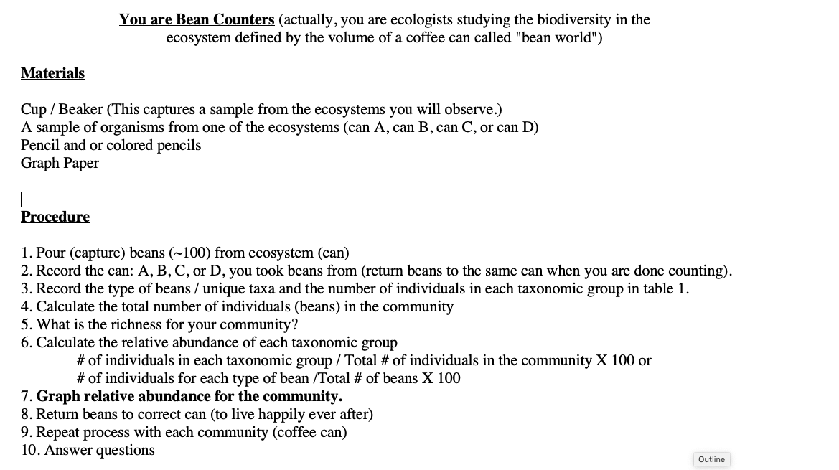
Bean Biodiversity
Note: you can use your calculator at any time you need today!

Slide 9
Bean Biodiversity
Which community has the greatest richness?
Which bean taxa has the greatest relative abundance in each community?
Which bean taxa is most likely to become extinct? Why? (okay, we all know the beans are safe in the coffee can - pretend they are subject to the forces of natural selection and the negative consequences of human activities)
Which community has the greatest biodiversity? Use the terms “richness” and “abundance” to support your answer.
Urbanization is the process by which humans occupy and modify ecosystems. How do you think that urbanization affects habitat quality and quantity? How do you think urbanization affects biodiversity?

Slide 10
Take
a
break!

Slide 11
Stream Biodiversity

Slide 12
Stream Biodiversity
What is biodiversity?

Slide 13
Stream Biodiversity
What is biodiversity? The variety of life that occurs within an ecosystem

Slide 14
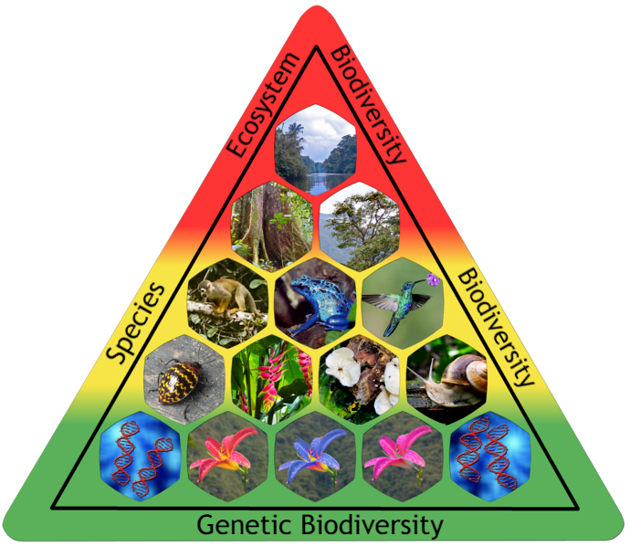
Stream Biodiversity
What is biodiversity? The variety of life that occurs within an ecosystem
Today, we are talking mostly about species biodiversity –
but ecosystem biodiversity and genetic biodiversity are other important components of biodiversity!
Photo credit:
Fährtenleser, CC BY-SA 4.0 <https://creativecommons.org/licenses/by-sa/4.0>,
via Wikimedia Commons
Notes:
Genetic diversity is all the different genes contained in all individual
plants, animals, fungi, and microorganisms. It occurs within a species as
well as between species.
• Species diversity is all the differences within and between populations
of species, as well as between different species.
• Ecosystem diversity is all the different habitats, biological communities,
and ecological processes, as well as variation within individual ecosystems

Slide 15
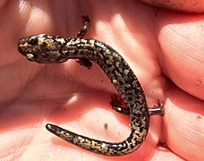
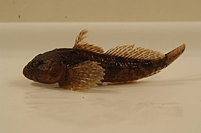
Stream Biodiversity
Weller’s Salamander
The southeastern United States is a hotspot for stream biodiversity!
The southeastern U.S. has
-33% of the world’s crayfish species
-40% of the world’s freshwater mussel species
Of the 831 freshwater fishes in U.S. and Canada, 550 (79%) are found in the Southeast.
The Southeast also has very diverse assemblages of salamanders, turtles, mayflies, and caddisflies!!
Photo credit:
vastateparksstaff, CC BY 2.0 <https://creativecommons.org/licenses/by/2.0>,
via Wikimedia Commons
Mottled sculpin
Photo credit:
USFWS, Public domain, via Wikimedia Commons

Slide 16
Stream Biodiversity
How do ecologists measure species diversity?

Slide 17
Stream Biodiversity
How do ecologists measure species diversity?
There are multiple ways to measure species diversity:
Species richness (# of species)
Species abundance or evenness (how evenly distributed are the relative abundances of each species)
A combination of richness and evenness (Shannon Index; Simpson’s Index)

Slide 18
Stream Biodiversity
Why is aquatic/stream biodiversity important?

Slide 19
Stream Biodiversity
Why is aquatic/stream biodiversity important?
Take five minutes to brainstorm ideas with a partner or group. Write your ideas down on your lesson worksheet.

Slide 20
Stream Biodiversity
Why is aquatic/stream biodiversity important?
Species biodiversity = functional diversity = healthy stream ecosystem – and we depend on healthy aquatic ecosystems for survival
Maintain food web balance
Aquatic wildlife are important sources of food, energy, jobs, atmospheric oxygen, buffers against new diseases.
Biodiversity is a part of culture/identity/happiness
It’s our responsibility (?)

Slide 21
Stream Biodiversity
What are threats to aquatic/stream biodiversity?
Notes:
--Habitat loss and destruction, usually as a direct result of human activity and population growth, is a
major force in the loss of species, populations, and ecosystems.
--Alterations in ecosystem composition, such as the loss or decline of a species, can lead to a loss of
biodiversity. For example, efforts to eliminate coyotes in the canyons of southern California are linked to
decreases in song bird populations in the area. As coyote populations were reduced, the populations of
their prey, primarily raccoons, increased. Since raccoons eat bird eggs, fewer coyotes led to more
raccoons eating more eggs, resulting in fewer song birds.
• The introduction of exotic (non-native) species can disrupt entire
ecosystems and impact populations of native plants or animals. These invaders
can adversely affect native species by eating them, infecting them, competing
with them, or mating with them.
• The over-exploitation (over-hunting, over-fishing, or over-collecting) of a
species or population can lead to its demise.
• Human-generated pollution and contamination can affect all levels of
biodiversity.
• Global climate change can alter environmental conditions. Species and
populations may be lost if they are unable to adapt to new conditions or
relocate.

Slide 22
Stream Biodiversity
What are threats to aquatic/stream biodiversity?
Take five minutes to brainstorm ideas with a partner or group. Write your ideas down on your lesson worksheet.
Notes:
--Habitat loss and destruction, usually as a direct result of human activity and population growth, is a
major force in the loss of species, populations, and ecosystems.
--Alterations in ecosystem composition, such as the loss or decline of a species, can lead to a loss of
biodiversity. For example, efforts to eliminate coyotes in the canyons of southern California are linked to
decreases in song bird populations in the area. As coyote populations were reduced, the populations of
their prey, primarily raccoons, increased. Since raccoons eat bird eggs, fewer coyotes led to more
raccoons eating more eggs, resulting in fewer song birds.
• The introduction of exotic (non-native) species can disrupt entire
ecosystems and impact populations of native plants or animals. These invaders
can adversely affect native species by eating them, infecting them, competing
with them, or mating with them.
• The over-exploitation (over-hunting, over-fishing, or over-collecting) of a
species or population can lead to its demise.
• Human-generated pollution and contamination can affect all levels of
biodiversity.
• Global climate change can alter environmental conditions. Species and
populations may be lost if they are unable to adapt to new conditions or
relocate.

Slide 23
Stream Biodiversity
What are threats to aquatic/stream biodiversity?
Habitat loss and destruction
Alterations to ecosystem composition (i.e., loss or decline or a species)
Sometimes: introduction of non-native species
Over-fishing or over-collecting
Pollution or contamination
Climate change
Notes:
--Habitat loss and destruction, usually as a direct result of human activity and population growth, is a
major force in the loss of species, populations, and ecosystems.
--Alterations in ecosystem composition, such as the loss or decline of a species, can lead to a loss of
biodiversity. For example, efforts to eliminate coyotes in the canyons of southern California are linked to
decreases in song bird populations in the area. As coyote populations were reduced, the populations of
their prey, primarily raccoons, increased. Since raccoons eat bird eggs, fewer coyotes led to more
raccoons eating more eggs, resulting in fewer song birds.
• The introduction of exotic (non-native) species can disrupt entire
ecosystems and impact populations of native plants or animals. These invaders
can adversely affect native species by eating them, infecting them, competing
with them, or mating with them.
• The over-exploitation (over-hunting, over-fishing, or over-collecting) of a
species or population can lead to its demise.
• Human-generated pollution and contamination can affect all levels of
biodiversity.
• Global climate change can alter environmental conditions. Species and
populations may be lost if they are unable to adapt to new conditions or
relocate.

Slide 24
Stream Biodiversity
What are threats to aquatic/stream biodiversity?
Habitat loss and destruction
Alterations to ecosystem composition (i.e., loss or decline or a species)
Sometimes: introduction of non-native species
Over-fishing or over-collecting
Pollution or contamination
Climate change
Native species: a species that originated and developed in its surrounding habitat and has adapted to living in that particular environment.
Non-native species: a species that originated somewhere other than its current location and has been introduced to the area where it now lives.
Invasive species : a species of plant or animal that outcompetes other species, which may cause damage to an ecosystem – can be native or non-native!
Notes:
--Habitat loss and destruction, usually as a direct result of human activity and population growth, is a
major force in the loss of species, populations, and ecosystems.
--Alterations in ecosystem composition, such as the loss or decline of a species, can lead to a loss of
biodiversity. For example, efforts to eliminate coyotes in the canyons of southern California are linked to
decreases in song bird populations in the area. As coyote populations were reduced, the populations of
their prey, primarily raccoons, increased. Since raccoons eat bird eggs, fewer coyotes led to more
raccoons eating more eggs, resulting in fewer song birds.
• The introduction of exotic (non-native) species can disrupt entire
ecosystems and impact populations of native plants or animals. These invaders
can adversely affect native species by eating them, infecting them, competing
with them, or mating with them.
• The over-exploitation (over-hunting, over-fishing, or over-collecting) of a
species or population can lead to its demise.
• Human-generated pollution and contamination can affect all levels of
biodiversity.
• Global climate change can alter environmental conditions. Species and
populations may be lost if they are unable to adapt to new conditions or
relocate.

Slide 25
Take
a
break!

Slide 26
Estimating Stream Biodiversity
Go to the following website: virtualbiologylab.org
Under “Ecology Models”, click “Biodiversity Ecology”
Scroll down
Under “Model 2 – Estimating Stream Diversity”, click “Launch Model”
NOTE: You can use your calculators in this activity, if needed!

Slide 27
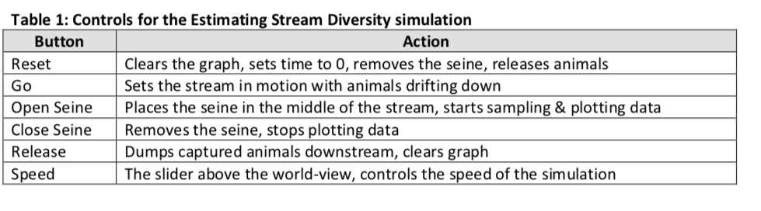
Estimating Stream Biodiversity

Slide 28
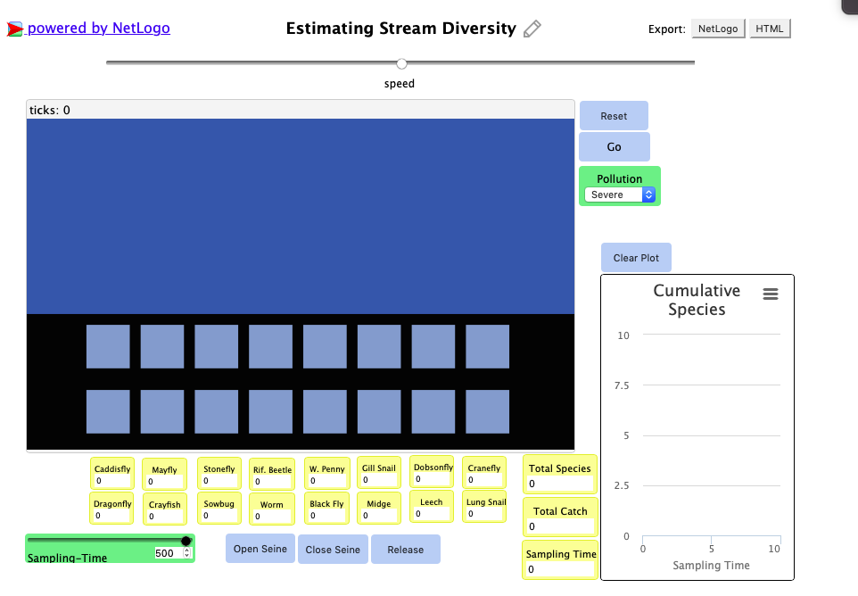
Estimating Stream Biodiversity
These are the two controls you will be varying throughout the activity.

Slide 29
Estimating Stream Biodiversity
Let’s go over the questions as a class!

Slide 30
Closing Activity
Instructions:
Write your responses to the questions on the lesson worksheet.

Slide 31
Closing Activity
Question 1: What is the species richness of the assemblage?
Question 2: What is the relative abundance of Spotfin chub? (Note: can use calculator!)
Question 3: How might pollution coming into the stream for a local factory affect the species richness of this fish assemblage?
Question 4: What is one reason we should care about maintaining the biodiversity of this fish assemblage?
Here are sample data for a fish assemblage in a stream in North Carolina:
Fish species | Count
Mottled sculpin | 22
Brook trout | 10
Tennessee shiner | 8
Spotfin chub | 4
Rock bass | 4
Central stoneroller | 1
Mirror shiner | 1
Total count = 50

