Slide 1
Chemical Monitoring, Part A
Learning Module #5

Slide 2
Agenda
Time | Length | Activity
9:00 | 30 min | The Last Dragons
9:30 | 1 hour | How do chemical properties of water relate to stream health?
10:30 | 15 min | BREAK
10:45 | 30 min | Guided notes
11:15 | 15 Min | BREAK
11:30 | 45 min | Monitoring chemical properties of our campus stream
12:15 | 15 Min | Closing Activity

Slide 3
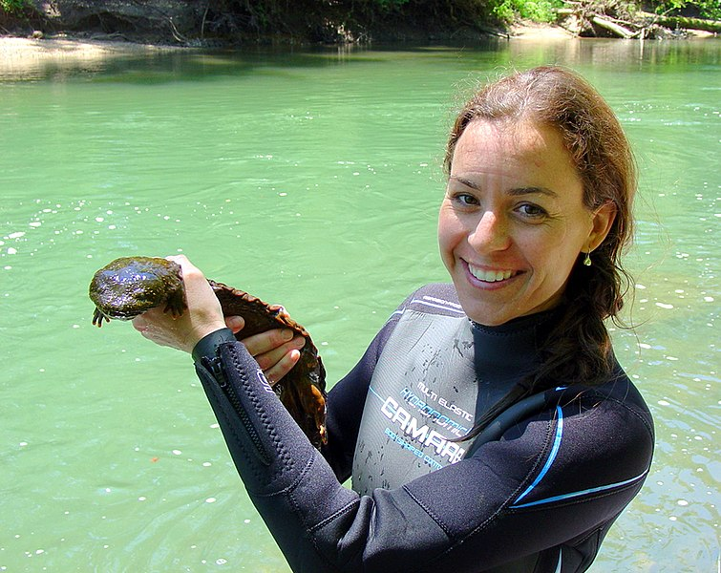
Opening Activity
Image from:
USFWS Midwest Region from United States, CC BY 2.0
<https://creativecommons.org/licenses/by/2.0>, via Wikimedia Commons

Slide 4
Opening Activity
The Last Dragons:
https://vimeo.com/108512185

Slide 5
The Last Dragons: Discussion
Why are hellbenders becoming endangered?

Slide 6
The Last Dragons: Discussion
Why are hellbenders becoming endangered?
Why is siltation/turbidity a problem for hellbenders?

Slide 7
The Last Dragons: Discussion
Why are hellbenders becoming endangered?
Why is siltation/turbidity a problem for hellbenders?
What causes siltation/turbidity in a stream?

Slide 8
The Last Dragons: Discussion
Why are hellbenders becoming endangered?
Why is siltation/turbidity a problem for hellbenders?
What causes siltation/turbidity in a stream?
Where are hellbenders still found?

Slide 9
The Last Dragons: Discussion
Why are hellbenders becoming endangered?
Why is siltation/turbidity a problem for hellbenders?
What causes siltation/turbidity in a stream?
Where are hellbenders still found?
Do you think hellbenders may have ever lived in Athens? Why/why not?

Slide 10
The Last Dragons: Discussion
Why are hellbenders becoming endangered?
Why is siltation/turbidity a problem for hellbenders?
What causes siltation/turbidity in a stream?
Where are hellbenders still found?
Do you think hellbenders may have ever lived in Athens? Why/why not?
Any other thoughts?

Slide 11
How do chemical properties of water relate to stream health?
Instructions
For this activity, you will be working with a partner/small group to graph relationships between chemical water quality parameters and other variables. You/your team will also be answering question associated with each graph.
Please use a separate sheet of graphing paper for each graph. Answer the questions in the space provided.
One you graph the points, connect you points with a line.
Don’t forget to label the x and y-axes!

Slide 12
Graph 1
Maximum temperature and abundance (number) of salamanders

Slide 13

Graph 1

Slide 14
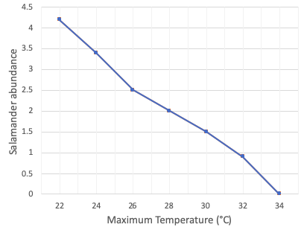
Graph 1
Question 1: Describe the relationship between maximum temperature and number of salamanders.
Question 2: Based on the graph, what do you think will happen to salamanders as temperatures become warmer due to climate change?

Slide 15
Graph 2
Temperature and dissolved oxygen

Slide 16
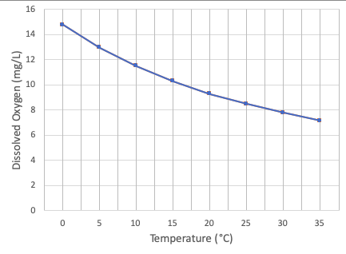
Graph 2
Question 3: Describe the relationship between water temperature and dissolved oxygen.
Question 4: Why might oxygen be important to organisms living in a stream? What might happen if dissolved oxygen gets too low?

Slide 17
Graph 3
pH and abundance (number) of rainbow trout

Slide 18
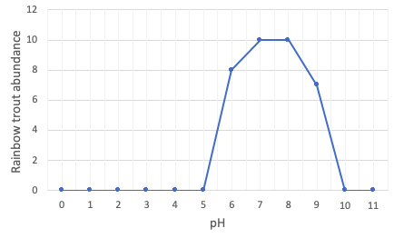
Graph 3
Question 5: Describe the relationship between pH and number of rainbow trout.
Question 6: What range of pH can rainbow trout tolerate?

Slide 19
Graph 4
Percent impervious surface and conductivity

Slide 20
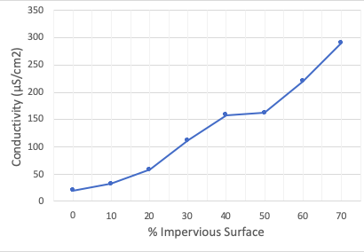
Graph 4
Question 7: What do you think “conductivity” in a stream means? Take your best guess!
Question 8: Describe the relationship between impervious surface and conductivity.

Slide 21
Take
a
break!

Slide 22
Guided Notes
Instructions:
Listen and ask questions!
Write down anything you see that is bold, brown, and underlined

Slide 23
Temperature
Definition: how hot or cold the water is
Measured in:
Importance:
Georgia Standards: Less than 32.2°C (90°F)

Slide 24
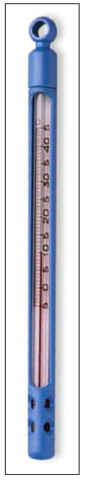
Temperature
Definition: how hot or cold the water is
Measured in: °C
Importance:
Affects feeding, respiration (breathing), and metabolism of aquatic
Most aquatic life is adapted to a narrow range of temperatures
Temperature/Dissolved Oxygen relationship
Georgia Standards: Less than 32.2°C (90°F)
Image: Georgia Adopt-A-Stream

Slide 25
Dissolved oxygen
Definition: how much oxygen is dissolved in water
Measured in:
Importance:
Georgia standards: Average of 5 mg/L; minimum 4 mg/L
Dissolved Oxygen (mg/L)
0
4.0
6.5
9.5
14+
No fish
can live
Few fish
can live
Most fish can live
All fish
can live

Slide 26
Dissolved oxygen
Definition: how much oxygen is dissolved in water
Measured in: mg/L or ppm (parts per million)
Importance:
All aquatic organisms need it for respiration (breathing)
Georgia standards: Average of 5 mg/L; minimum 4 mg/L
Dissolved Oxygen (mg/L)
0
4.0
6.5
9.5
14+
No fish
can live
Few fish
can live
Most fish can live
All fish
can live

Slide 27
Temperature and Dissolved Oxygen (DO)
______ related to temperature
As temperatures go up, DO goes ___
As temperatures go down, DO goes ___
DO may decrease due to:
Rising temperatures
An overload of decaying organic matter
Slow moving, deep water

Slide 28
Temperature and Dissolved Oxygen (DO)
Inversely related to temperature
As temperatures go up, DO goes down
As temperatures go down, DO goes up
DO may decrease due to:
Rising temperatures
An overload of decaying organic matter
Slow moving, deep water

Slide 29
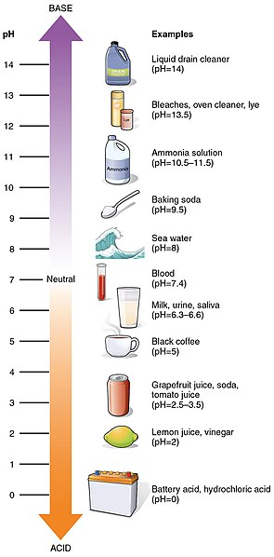
pH
Definition: a measure of hydrogen ions (H+)
Measured in:
Importance:
Georgia standards: 6-8.5
Photo credit:
OpenStax College, CC BY 3.0 <https://creativecommons.org/licenses/by/3.0>, via Wikimedia Commons
Notes:
Fun facts:
Some south Georgia waters may have pH as low as 3.5
•In coastal waters, pH increases (becomes more basic) with increasing salinity and is still within state standards.

Slide 30
pH
Definition: a measure of hydrogen ions (H+)
Measured in: unitless; measured on scale from 0-14
Importance:
Aquatic organisms are sensitive to fluctuations in pH
Georgia standards: 6-8.5
pH tolerance ranges of
aquatic organisms
Plants
Snails, Clams,
Mussels
Perch
Frogs
Carp, catfish,
Some insects
Photo credit:
OpenStax College, CC BY 3.0 <https://creativecommons.org/licenses/by/3.0>, via Wikimedia Commons
Bacteria
Trout,
Salamanders
Notes:
Fun facts:
Some south Georgia waters may have pH as low as 3.5
•In coastal waters, pH increases (becomes more basic) with increasing salinity and is still within state standards.

Slide 31
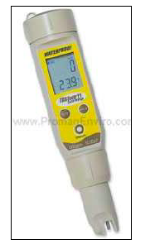
Conductivity
Definition: a measure of water’s ability to pass electrical current; Indicate presence of ions in water
Measured in:
Importance:
Georgia standards: No regulated levels in Georgia; ranges from 50-1500 µS/cm
Image: Georgia Adopt-A-Stream
Notes:
Fun facts:
Some south Georgia waters may have pH as low as 3.5
•In coastal waters, pH increases (becomes more basic) with increasing salinity and is still within state standards.

Slide 32
Conductivity
Definition: a measure of water’s ability to pass electrical current; Indicate presence of ions in water
Measured in: µS/cm
Importance:
Higher conductivity can be an indicator pollutants in the water (nutrients, sewage, urban runoff)
Georgia standards: No regulated levels in Georgia; ranges from 50-1500 µS/cm
Image: Georgia Adopt-A-Stream
Notes:
Fun facts:
Some south Georgia waters may have pH as low as 3.5
•In coastal waters, pH increases (becomes more basic) with increasing salinity and is still within state standards.

Slide 33
Take
a
break!

Slide 34
Monitoring the chemical properties of our campus stream
Notes:
We will be focusing our water quality monitoring efforts on a campus stream. Before we begin learning different ways to conduct water quality monitoring, we want to learn a little bit about the watersheds and about the history of the campus streams.
Does anyone know what streams are on University of Georgia’s campus?

Slide 35
Monitoring the chemical properties of our campus stream
Instructions:
Each student (or pair) will be in charge of data from one of five water quality parameters for our campus stream:
Visual
Temperature
pH
DO
Conductivity

Slide 36
Monitoring the chemical properties of our campus stream
Instructions:
Create a poster for your water quality parameter. Each poster should have:
Title the poster (make sure to include the water quality parameter)
Define the parameter
Explain why the parameter important to stream health
Graph trends over time of the parameter
We will then present the posters to the class. During your presentation, make sure you describe any trends over time of your water quality parameter!
Notes:
Then, define terms as a class

Slide 37
Monitoring the chemical properties of our campus stream
Share out with class!

Slide 38
Closing Activity
Instructions:
Write your response to the questions on the lesson worksheet.

Slide 39
Closing Activity
At high water temperatures, would you expect to measure high or low dissolved oxygen?
Why is dissolved oxygen important to aquatic life?
How would you expect conductivity to change with increasing urbanization?

Slide 41
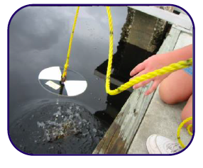
Water Clarity
Definition: a measure of clearness of the water. It is affected by the amount of algae growth and suspended particles.
Measured in: m; use Secchi disk (lakes only)
Importance, Low water clarity can:
limits amount of sunlight available for photosynthesis
Damage gills of fish and macroinvertebrates
Suffocate fish and oysters
Georgia standards: No regulated levels in Georgia
Image: Georgia Adopt-A-Stream
Notes:
Fun facts:
Some south Georgia waters may have pH as low as 3.5
•In coastal waters, pH increases (becomes more basic) with increasing salinity and is still within state standards.

