Slide 1

Stream Bioassessments, Part C
Learning Module #18

Slide 2
Agenda
Time | Length | Activity
1:00 | 15 min | Opening Activity
1:15 | 1 hour, 30 min | Non-Urban Stream Bioassessment
2:45 | 10 min | BREAK
2:55 | 20 min | Compare and Contrast Bioassessments
3:15 | 1 hour | Macroinvertebrate Family Level IDs
4:15 | 15 min | Closing Activity

Slide 3
Opening Activity
For the opening activity, we are going to watch a short video that gives us an in depth look at caddisflies and how they survive in streams!

Slide 4
Opening Activity
Video: Sticky. Stretchy. Waterproof. The Amazing Underwater Tape of the Caddisfly
https://www.youtube.com/watch?v=Z3BHrzDHoYo&t=14s

Slide 5
Opening Activity: Discussion Questions
Did we collect any caddisflies that looked like the ones we saw in the video? Why do you think this is?

Slide 6
Opening Activity: Discussion Questions
Did we collect any caddisflies that looked like the ones we saw in the video? Why do you think this is?
Was there anything that surprised you in this video?

Slide 7
Opening Activity: Discussion Questions
Did we collect any caddisflies that looked like the ones we saw in the video? Why do you think this is?
Was there anything that surprised you in this video?
What other observations or questions do you have after watching this video?

Slide 8
Non-Urban Stream Bioassessment
So far, we have performed a stream bioassessment on our campus stream.
This afternoon, we are going to perform a stream bioassessment on a non-urban stream. This will allow you to compare and contrast macroinvertebrates that you might observe in urban vs. non-urban streams and give you another chance to practice your macroinvertebrate identification and bioassessment skills!

Slide 9
Non-Urban Stream Bioassessment
You will need:
Preserved Macroinvertebrate Collection
Forceps
Collecting tray
Pencils
Rite in Rains/Data sheet
Clear plastic cups or similar (for sorting)
Macro ID Binders
Ethanol
Macro ID Book(s)
Macroinvertebrate Bioassessment Form (Page 2 only)

Slide 10
Non-Urban Stream Bioassessment
Work with your partner/group to identify your macroinvertebrates. Use any ID guides that are helpful to you! (You will have about 1 hour for identifications). Record your group’s data in your Rite-in-Rain data sheet!
When your group is finished identifying their macroinvertebrates, your group should bring their data sheet to the instructor so that the instructor can compile macroinvertebrate collection data from all groups.
Once data has been compiled, use the Non-Urban Macroinvertebrate Collection Data to fill out the Macroinvertebrate Bioassessment Form (Page 2 ONLY).

Slide 11
Data sheet set-up (example)
Researchers:
Stream name:
Date:
Time:
Description | ID | Tally/Count
Long and skinny, has rock case | Caddisfly | IIII
Has three ”tails” - brown in color | Mayfly | IIIII II
Looks like a penny | Water penny | II

Slide 12
Take
a
break!

Slide 13
Compare and Contrast
Working with a partner, take 10 minutes to create a Venn Diagram comparing and contrasting our Campus Stream Bioassessment with the Non-Urban Stream Bioassessment on your lesson worksheet.
Things you might include in your Venn Diagram:
Macroinvertebrates that were only in one or the other, and ones they both contained.
Quantity (number) of macroinvertebrates
Bioassessment scores
Anything else you noticed!
Campus Stream
Non-Urban Stream

Slide 14
Compare and Contrast
Campus Stream
Non-Urban Stream
Let’s share out what you discussed!

Slide 15
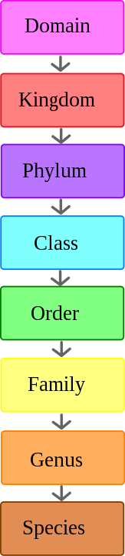
Macroinvertebrate Family Level IDs
So far, we have used a macroinvertebrate bioassessment that use macroinvertebrate identifications at the classification level of order.
However, other types of bioassessments use macroinvertebrate identifications at the classification level of family.
Image credit: By Daniel Herbert - Own work This W3C-unspecified vector image was created with Inkscape .,
Public Domain, https://commons.wikimedia.org/w/index.php?curid=2160738

Slide 16
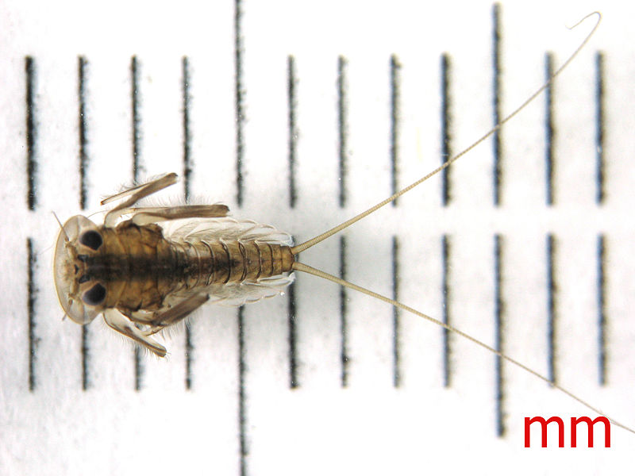
Macroinvertebrate Family Level IDs
So far, we have used a macroinvertebrate bioassessment that use macroinvertebrate identifications at the classification level of order.
However, other types of bioassessments use macroinvertebrate identifications at the classification level of family.
Animalia
Arthropoda
Insecta
Ephemeroptera
Heptageniidae
Image credit: Mopebiologia, CC BY-SA 4.0
<https://creativecommons.org/licenses/by-sa/4.0>, via Wikimedia Commons
Example with Mayflies (Ephemeroptera):
Image credit: By Daniel Herbert - Own work This W3C-unspecified vector image was created with Inkscape .,
Public Domain, https://commons.wikimedia.org/w/index.php?curid=2160738

Slide 17
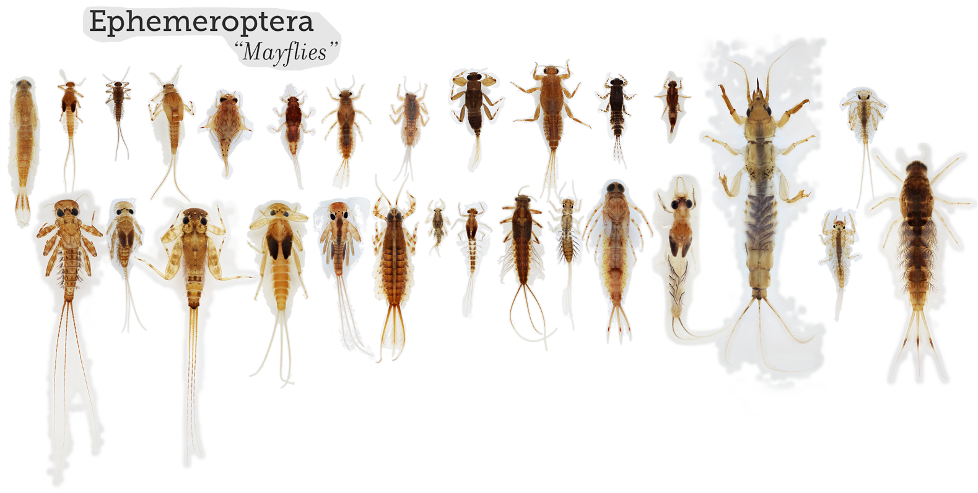
Macroinvertebrate Family Level IDs
Within each “order” of macroinvertebrates, there are many “families”
Image: Macroinvertebrates.org

Slide 18
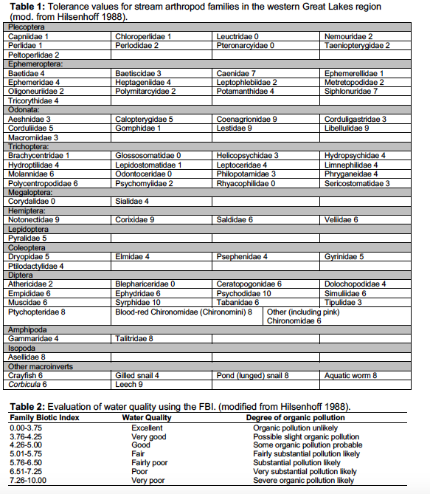
Macroinvertebrate Family Level IDs
Example of bioassessment that uses family level IDs:
Family Biotic Index
Notes:
This was developed by Hilsenhoff (1988) and requires that identification to the family level. Family-level pictorial keys will be available, and we will try to help with this. Calculate the FBI using the techniques described below:
a. Multiply the number of individuals in each family by the tolerance value for that family (Table 1).
b. Sum those products, and then divide by the total number of individuals counted.
c. Refer to Table 2 (below) to rate water quality using this index.

Slide 19
Macroinvertebrate Family Level IDs
Pros of using family-level IDs and bioassessments:
Macroinvertebrate families within each order vary in their tolerances to poor water quality. Thus, family-level IDs and bioassessments can provide a more accurate bioassessment than those that only ID to order.
Cons of using family-level IDS and bioassessments:
Requires more materials (microscopes)
Requires more expertise and training

Slide 20
Macroinvertebrate Family Level IDs
Today, you are going to practice identifying a macroinvertebrate of your choice to the family level!
Some macroinvertebrate morphology terms you may need to know (your instructor will also pass this out)

Slide 21
Macroinvertebrate Family Level IDs
Directions:
Pick a macroinvertebrate of your choice from the collection.
Use a dissecting microscope or magnifying glass and forceps, make observations about your macroinvertebrate. What are its distinguishing characteristics?
Then, use ID resources to identify your macroinvertebrate to the family level (we will help!)
When you think you have correctly identified your macroinvertebrate to family, raise your hand to have the instructor check your work.
Learn more about your macroinvertebrate family using the tools in macroinvertebrates.org.
If you have leftover time, try to ID your macroinvertebrate to genus OR pick a new macroinvertebrate to ID to family.
ID resources:
Macroinvertebrates.org (this will be the most useful resource!)
A Guide to Common Freshwater Invertebrates of North America
An Introduction to Common Insects of North America
Aquatic Entomology: The Fisherman’s and Ecologist’s Illustrated Guide to Insects and Their Relatives

Slide 22
Macroinvertebrates.org

Slide 23
Closing Activity
Use macroinvertbrates.org to show the class:
The order of your macroinvertebrate
The family of your macroinvertebrate
What characteristics of your macroinvertebrate you used to help you distinguish its family-level identification
Any other cool facts about your macroinvertebrate (i.e., from family overview, pollution tolerance, feeding habits, or moving habits)

