Slide 1
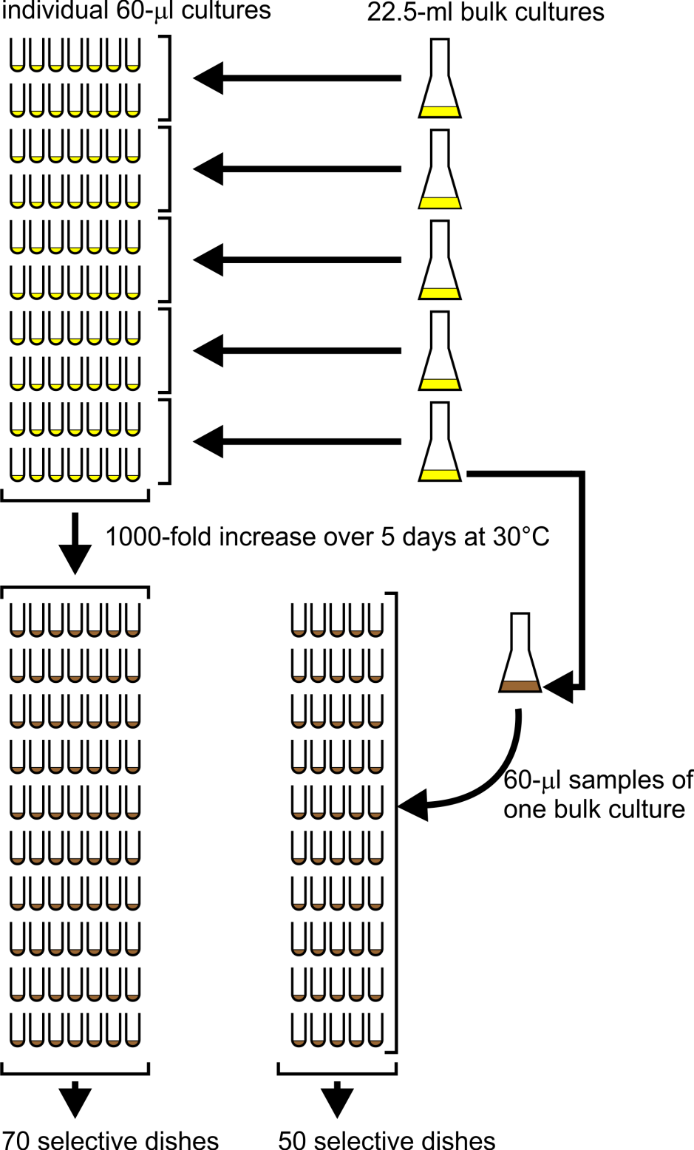
Session 1
According to the pre-exposure hypothesis, canavanine-resistance mutations occur randomly during growth in non-selective medium
Session 2
According to the post-exposure hypothesis, canavanine-resistance mutations don’t occur until the yeast are exposed to canavanine on selective agar medium
Notes:
This slide summarizes what you’ve done to carry out the yeast fluctuation test. The experiment started with a parent yeast strain, YFT1, that is sensitive to canavanine.
Just before Session 1, the instructor inoculated five 22.5-ml bulk cultures with YFT1 cells at a concentration of 10⁵ cells/ml. The nutrient medium in these cultures was non-selective, meaning it didn’t contain any canavanine; all yeast cells were therefore able to grow in this medium, whether or not they were canavanine-resistant mutants. Portions of the inoculated bulk cultures were distributed to the students for use in the next step; the remainders of the bulk cultures were poured into 5 125-ml culture flasks.
During Session 1, the class distributed 60-μl portions of the bulk cultures into 70 sterile culture tubes; these were the individual cultures. Each 60-μl individual culture contained only 6000 yeast cells (0.06 ml x 10⁵ cells/ml), few if any of which were canavanine-resistant mutants. Each bulk culture (~21 ml remaining, with 2.1 million yeast cells) was equivalent to ~350 individual cultures all mixed together.
Between Sessions 1 and 2, both the 70 individual cultures and the 5 bulk cultures were shaken at 30°C. During that incubation, the cell concentration in both the bulk cultures and the 60-μl individual cultures increased 1000-fold from 10⁵ cells/ml to 10⁸ cells/ml. The medium turned from clear (the starting cell concentration of 10⁵ cells/ml was much too low to give any visible turbidity) to turbid; that’s symbolized in the diagram from the change from yellow to brown. According to the pre-exposure hypothesis, but not the post-exposure hypothesis, canavanine-resistance mutations occured randomly during this growth in non-selective medium.
During Session 2, students distributed 60-μl samples of one of the 5 bulk cultures into 50 additional culture tubes. These are called the bulk-culture samples.
Still during Session 2, students spread the cells in all 120 culture tubes (70 individual culture tubes, 50 bulk-culture sample tubes) onto selective petri dishes. The agar medium in these selective dishes contains canavanine, so that only the rare canavanine-resistant mutants will be able to grow and form colonies. According to the post-exposure hypothesis, canavanine-resistance mutations don’t occur until the cells first encounter canavanine on the selective agar medium in the petri dishes. The petri dishes will be incubated at 30°C for at least 5 days.
During Session 3 (not shown in the diagram), students will count both red and white mutant (canavanine-resistant) colonies. Only the red mutants will be analyzed in this lab. It’s the distribution of red colony counts in the dishes that will provide the key evidence discriminating between the two contending ideas: the pre- and post-exposure hypotheses. Let’s see if the class can figure out how the colony count data should differ according to the two competing hypotheses.

Slide 2
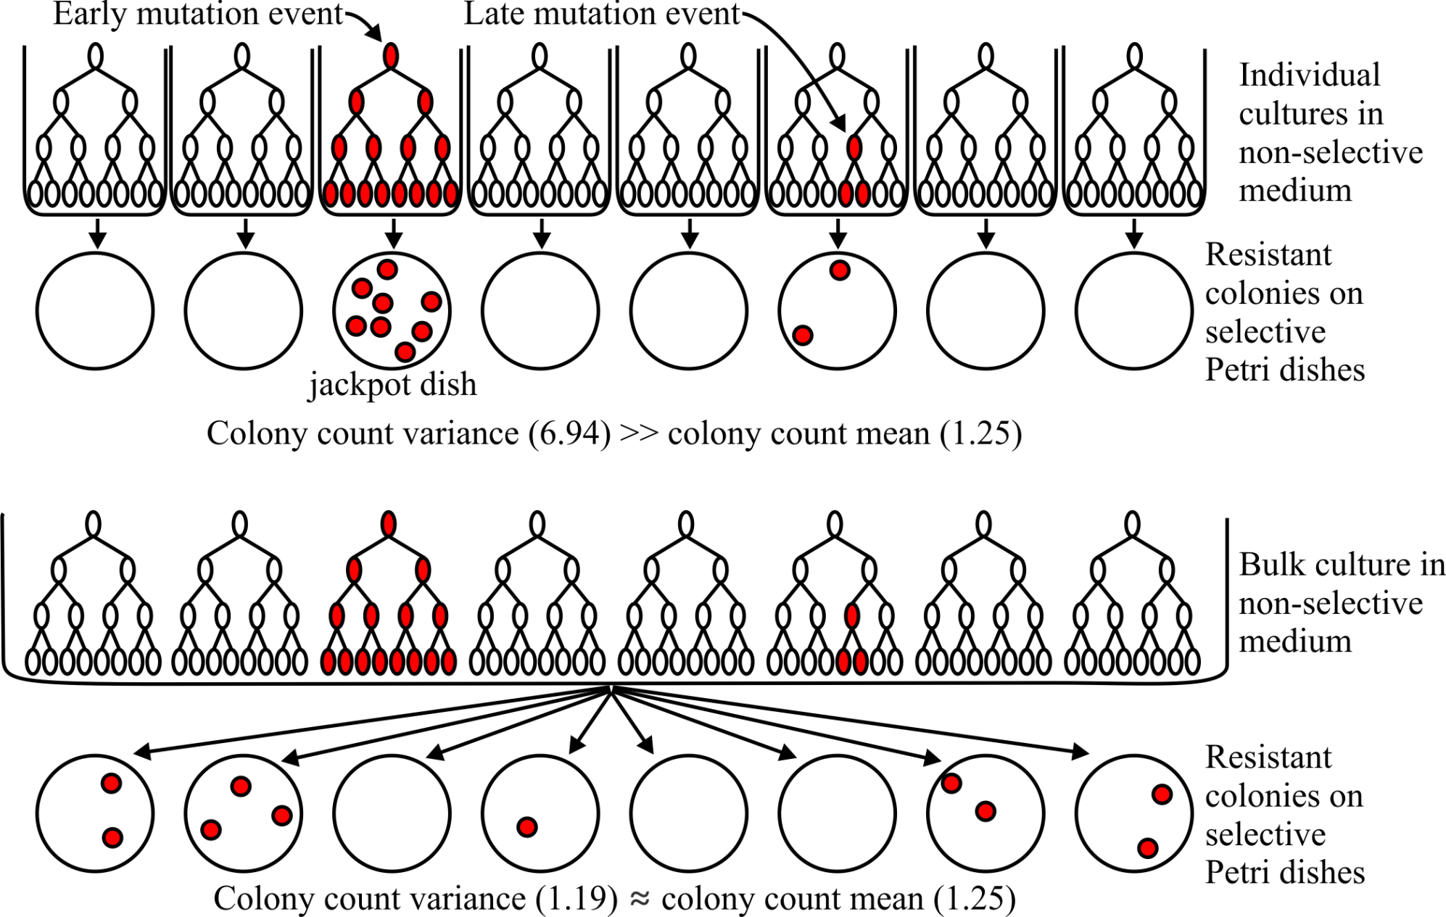
Individual culture dishes
Pre-exposure hypothesis:
Mutations arise before cells encounter canavanine
Notes:
According to the pre-exposure hypothesis, mutation events occur randomly during the 5 days of growth in non-selective medium. Each individual mutation event gives rise to a clone of mutants, the size of that clone reflecting how early in the growth that particular mutation event occurs. Early mutation events gave rise to exponentially larger clones of identical mutants than late mutation events; when such cultures are spread on selective agar medium in Petri dishes, and the dishes are incubated to allow each mutant cell to grow into a visible mutant colony, there will be large numbers of mutant colonies. Such a dish will be a “jackpot.” At the same time, as long as the mean number of mutation events per culture is modest (say less than 1 mutation event per culture), there will be other individual cultures in which no resistance mutation events occur at all. Those cultures will give rise to selective agar dishes with no colonies at all. The number of descendants in the various mutant clones will thus vary greatly, depending on how early during non-selective growth the mutation event happens to occur.
To summarize: According to the pre-exposure hypothesis, we expect a lot of scatter in the colony counts. Many dishes will have no mutations or just a few, while a few dishes (the jackpots) will have a lot. The colony counts are not clustered about their mean.

Slide 3
Bulk culture sample dishes
Pre-exposure hypothesis
Mutations arise before cells encounter canavanine
How does colony count distribution differ from the colony count distribution in the individual culture dishes?
Notes:
A bulk culture is equivalent to ~350 individual cultures. There is just as much variance in the size of mutant clones in the bulk cultures as in the individual cultures. However, all mutants in a bulk culture are mixed together in a single vessel, giving a certain concentration of mutant cells per ml. When 60-μl samples of a single bulk culture are spread on selective dishes, the scatter in mutant colony counts should be only what’s expected from random sampling error. The mutant colony counts should cluster about their mean.

Slide 4
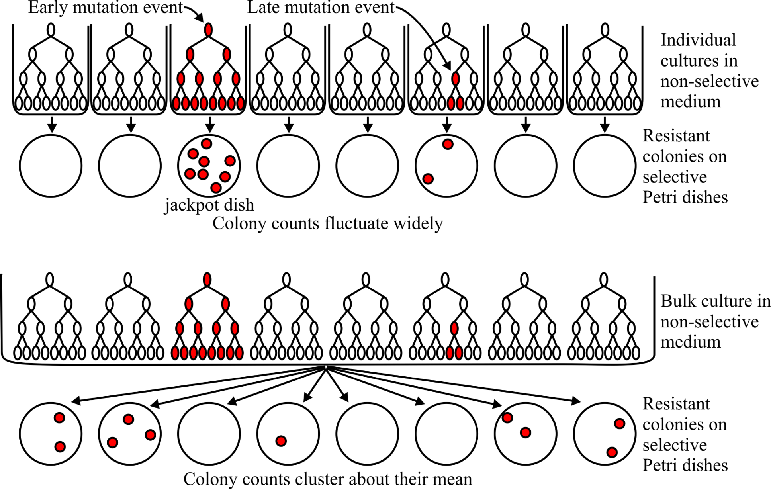
Review: Individual cultures versus bulk culture samples according to pre-exposure hypothesis
Notes:
Here again are the contrasting expectations for the individual culture dishes and the bulk culture sample dishes according to the pre-exposure hypothesis:
The colony counts for the individual culture dishes will be widely scattered, with many dishes having no colonies and a few dishes (jackpots) having many. The colony counts will not be clustered about their mean.
The colony counts for the bulk culture sample dishes will be clustered about their mean.

Slide 5
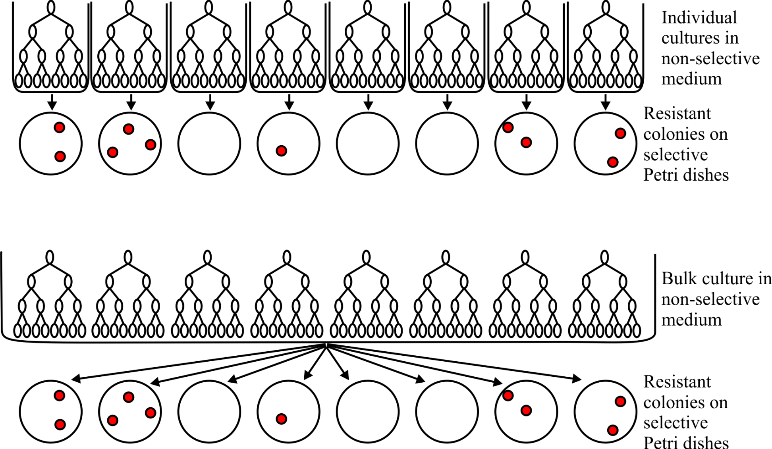
Individual cultures versus bulk culture samples
Post-exposure hypothesis
Mutations arise after cells encounter canavanine
Notes:
According to the post-exposure hypothesis, no canavanine resistance mutation events occur during the 5 days of growth in non-selective medium. Resistance mutations only occur once the cells are spread on the selective agar medium containing canavanine. The prior history of the cells—whether they come from an individual culture or the bulk culture—is irrelevant to their chances of mutating to canavanine resistance. So the distribution of colony counts on bulk culture sample dishes should be the same as the distribution on individual culture dishes.
What is that expected distribution? In the post-exposure scenario, each cell struggles to survive canavanine independently of all other cells, whether on the same or different dishes. The probability of successfully mutating to canavanine resistance (and thereby founding a visible colony) is therefore the same for all cells. That probability must be very small to account for the fact that the number of mutant colonies is much less than the number of cells spread on the dish (about 6 million). The colony counts on all dishes, whether from individual cultures or bulk culture samples, will be clustered about their mean.

Slide 6
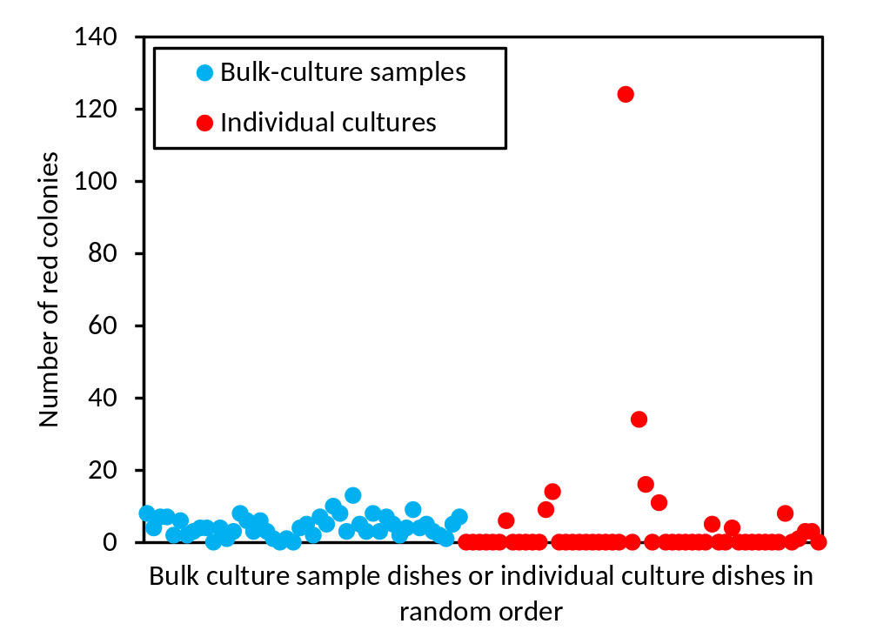
2013 red mutant colony counts
Which hypothesis, pre-exposure or post-exposure, do these data favor?

