Slide 1
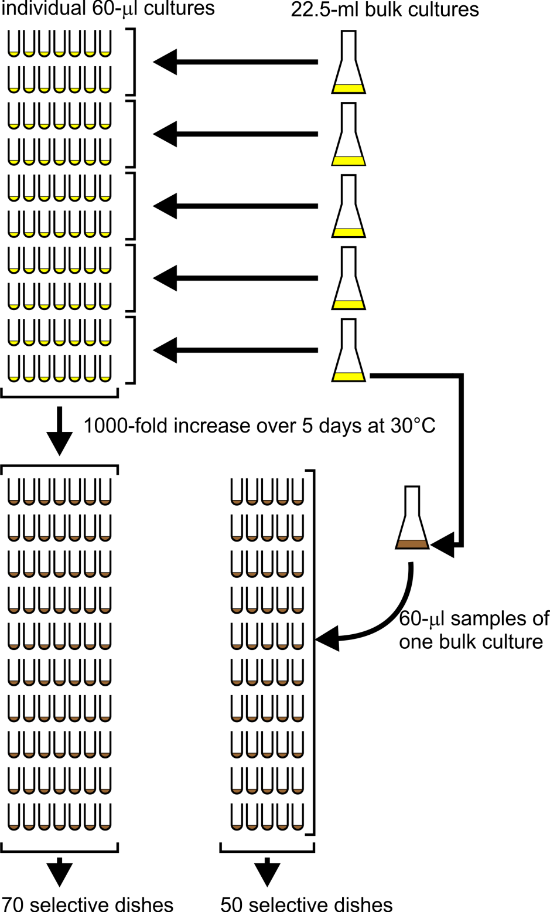
Session 1
According to the pre-exposure hypothesis, canavanine-resistance mutations occur randomly during growth in non-selective medium
Session 2
According to the post-exposure hypothesis, canavanine-resistance mutations don’t occur until the yeast are exposed to canavanine on selective agar medium
Notes:
This slide summarizes what you did to carry out the yeast fluctuation test. You started with a parent yeast strain, YFT1, that is sensitive to canavanine.
Just before Session 1, the instructor inoculated five 22.5-ml bulk cultures with YFT1 cells at a concentration of 10⁵ cells/ml. The nutrient medium in these cultures was non-selective, meaning it didn’t contain any canavanine; all yeast cells were therefore be able to grow in this medium, whether or not they were canavanine-resistant mutants. Portions of the inoculated bulk cultures were distributed to the students for use in the next step; the remainders of the bulk cultures were poured into 5 125-ml culture flasks.
During Session 1, the class distributed 60-μl portions of the bulk cultures into 70 sterile culture tubes; these were the individual cultures. Each 60-μl individual culture contained only 6000 yeast cells (0.06 ml x 10⁵ cells/ml), few if any of which were canavanine-resistant mutants. Each bulk culture (~21 ml remaining, with 2.1 million yeast cells) was equivalent to ~350 individual cultures all mixed together.
Between Sessions 1 and 2, both the 70 individual cultures and the 5 bulk cultures were shaken at 30°C. During that incubation, the cell concentration in both the bulk cultures and the 60-μl individual cultures increased 1000-fold from 10⁵ cells/ml to 10⁸ cells/ml. The medium turned from clear (the starting cell concentration of 10⁵ cells/ml is much too low to give any visible turbidity) to turbid; that’s symbolized in the diagram from the change from yellow to brown. According to the pre-exposure hypothesis, but not the post-exposure hypothesis, canavanine-resistance mutations occurrd randomly during this growth in non-selective medium.
During Session 2, students distributed 60-μl samples of one of the 5 bulk cultures into 50 additional culture tubes. These were called the bulk-culture samples.
Still during Session 2, students spread the cells in all 120 culture tubes (70 individual culture tubes, 50 bulk-culture sample tubes) onto selective Petri dishes. The agar medium in these selective dishes contained canavanine, so that only the rare canavanine-resistant mutants were able to grow and form colonies. According to the post-exposure hypothesis, canavanine-resistance mutations couldnn’t occur until the cells first encountered canavanine on the selective agar medium in the Petri dishes. The Petri dishes were incubated at 30°C for at least 5 days.
During Session 3 (not shown in the diagram), students counted both red and white mutant (canavanine-resistant) colonies. Only the red mutants will be analyzed in this lab. It’s the distribution of red colony counts in the dishes that provide the key evidence discriminating between the two contending ideas: the pre- and post-exposure hypotheses.

Slide 2
Your colony counts
SAMPLE: Substitute chart of actual results
Which hypothesis, pre-exposure or post-exposure, do these data favor?
Notes:
You should now be able to answer this question in light of class discussion and after reading YeastFluctuationSession1&2.ppt.

Slide 3
To further test these hypotheses, you are sequencing the mutant “red” gene in 24 red canavanine-resistant colonies.
8 colonies were sampled from each of two “jackpot” dishes that had many colonies (colonies R1-R8 & B1-B8).
As controls, a single colony was sampled from each of 8 dishes that had only a few colonies (colonies G1-G8).
Notes:
This, of course, could never have been done in the days of Luria and Delbrück. You won’t get your sequencing data until Session 5. Meanwhile, however, let’s try to anticipate the results expected according to the pre-exposure versus post-exposure hypotheses.

Slide 4
Examples of control sequences from “green” dishes
89-bp “red” gene
Many distinct mutations in the “red” gene give rise to red canavanine-resistant colonies. Only rarely are two independently occurring red-gene mutations identical to each other.
Notes:
These red mutant colonies all come from different individual culture dishes (the “green” dishes). As such, they serve as controls. Whichever hypothesis—pre-exposure or post-exposure—is correct, mutant colonies on different dishes must stem from independent red-gene mutations. Since many distinct red-gene mutations can give rise to red canavanine-resistant colonies, only rarely will two control colonies have identical red-gene mutations.
The observed “green” colony sequences, such as those in this slide, fully confirm this expectation.

Slide 5
But what about colonies B1-B8, which come from the same dish? Should they also have different mutations? How about colonies R1-R8, which also come from the same dish?
89-bp “red” gene
(these aren’t your sequences)
The answer depends on which hypothesis, pre-exposure or post-exposure, is correct.

