Slide 1
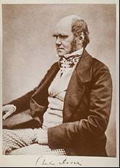
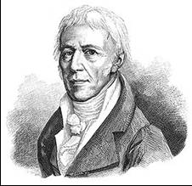
Darwin vs Lamarck
Do mutations arise in response to adaptive need for those mutations? Or do they arise “randomly,” without regard to any advantage they may confer?
Notes:
Microorganism populations adapt rapidly to lethal challenges such as viruses or antibiotics. Before challenge, the cells in the population are sensitive to the lethal agent. But upon exposure to the challenge, resistant mutants rapidly overgrow to replace non-mutant cells in the population. Do these resistance mutations arise “randomly” (i.e., without regard to whatever challenge they might happen to meet), and are then subsequently selected by the challenge? Or are they “directed” by the challenge, in the sense of arising only as a specific response to that challenge?

Slide 2
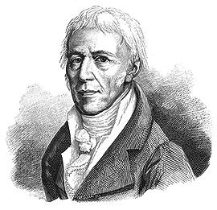
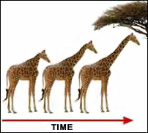
Jean-Baptiste Lamarck 1744-1829
Early evolutionary thinker
Use and disuse; organisms adapt to their environment by
inheritance of favorable acquired characteristics
Notes:
Some early 20th century microbiologists saw the conflict between random versus directed accounts of resistance mutations as a microbiological version of the earlier conflict between Darwinian versus Lamarckian accounts of evolution.
Lamarck was a French naturalist who preceded Darwin. He proposed that organisms evolve over many generations by acquiring characteristics favored by their environment. As giraffes stretched their necks to reach high foliage, they passed slightly longer necks on to their offspring. (He also believed that organisms had a drive to evolve into more complex forms.)
Lamarck’s theory—that characteristics acquired by an organism in its struggle to survive can be inherited by the organism’s offspring—can be extended to microorganisms. Instead of large-scale characteristics—for example, the longer neck length achieved in the struggle to find enough food in the case of giraffes—microbes might acquire small-scale characteristics in their small-scale struggle to survive, and pass those tiny characteristics on to their daughter cells as they divide. Resistance to a lethal agent, such as a virus or antibiotic, would be a good example of such a tiny characteristic. A microbe struggling to survive a lethal agent might acquire resistance to the agent, and then pass on that acquired resistance on to its daughter cells.

Slide 3
As many more individuals of each species are born than can possibly survive; and as, consequently, there is a frequently recurring struggle for existence, it follows that any being, if it vary however slightly in any manner profitable to itself, under the complex and sometimes varying conditions of life, will have a better chance of surviving, and thus be naturally selected. From the strong principle of inheritance, any selected variety will tend to propagate its new and modified form.
from the Introduction to Origin of Species
Charles Darwin 1809-1854
Notes:
Darwin respected Lamarck as an evolutionary thinker, but his theory of evolution by natural selection does not require the inheritance of acquired characteristics or directed mutations. Darwin himself wavered on whether acquired characteristics could be inherited (he didn’t know of a mechanism for heredity or mutation). But his theory removed the need for Lamarckian adaptation.
Darwin’s idea, like Lamarck’s, can be extended to microorganisms. In particular, natural selection might account for heritable resistance to a lethal agent without having to appeal to inheritance of acquired characteristics. In this scenario, microorganisms exhibit random heritable variations, among which are a few that happen to confer resistance to a given lethal agent. Those resistance-conferring variations are rare in a population that’s not exposed to the lethal agent. But in a population that is exposed to the lethal agent, the non-resistant majority are killed, while the tiny resistant minority survive and proliferate until they take over the entire population. This gives the illusion that the population as a whole “adapts” to the lethal agent.

Slide 4
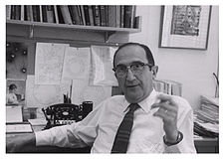
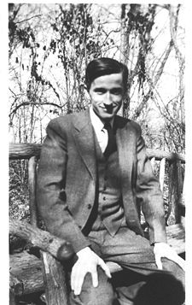
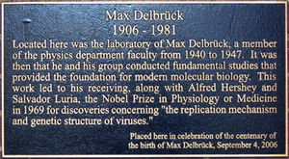
Salvador Luria 1929-1991
Max Delbrück 1906-1981
Notes:
Luria and Delbruck were refugee scientists who left Europe just before WWII and joined labs in the United States. Along with Alfred Hershey, they would later share the Nobel Prize for their contributions to genetics. They were among the founders of molecular biology.

Slide 5
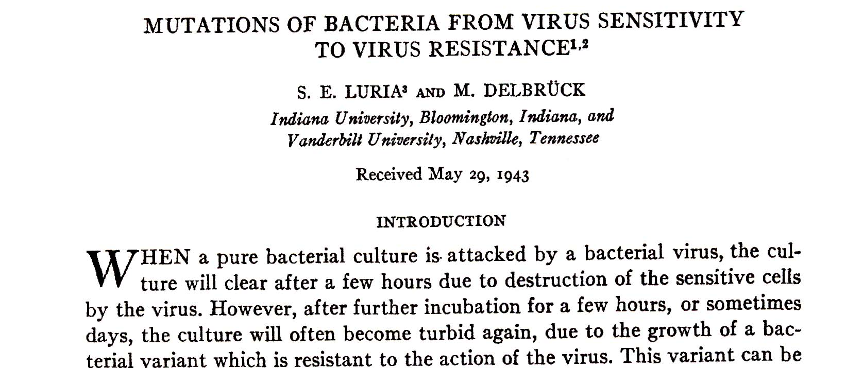
Do resistance mutations arise “randomly,” before exposure to the lethal agent (the pre-exposure hypothesis); or only after exposure to the lethal agent (post-exposure hypothesis)?
Pre-exposure resistance mutations are “Darwinian” in that they can’t be directed by the lethal agent. Post-exposure resistance mutations might be “Lamarckian.”
Notes:
This is their original paper on the fluctuation test as applied to Darwin vs Lamarck. They sought to determine if resistance mutations arise before exposure to the lethal agent (in which case the mutations must be “Darwininan,” in that they can’t be directed by the lethal agent); or only after exposure to the lethal agent (in which case the mutations might be “Lamarckian,” in that they might be directed by the lethal agent). We will call these opposing hypotheses the pre-exposure versus the post-exposure hypotheses, respectively.
In this module, you’ll be implementing the Luria-Delbrück experiment with yeast, using canavanine as the lethal agent.

Slide 6

Canavanine
Notes:
Canavanine is an antibiotic that kills wild-type (non-mutant) yeast cells. When a population of parent yeast cells that are initially sensitive to canavanine is challenged by exposure to canavanine, canavanine-resistant mutant yeast cells promptly take over the yeast population.

Slide 7
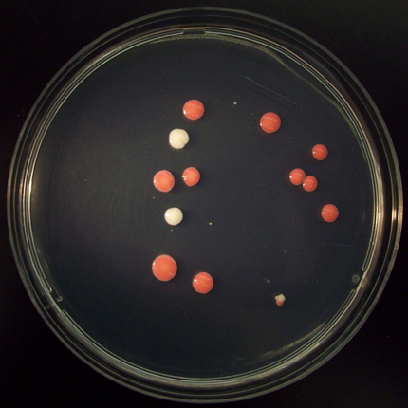
Notes:
In this lab, non-selective medium will not contain canavanine, and thus will allow all yeast cells to grow equally, whether or not they are canavanine-resistant mutants. In contrast, selective agar medium will contain a lethal concentration of canavanine, and thus will allow only canavanine-resistant mutants to grow into colonies.
Two types of mutation give rise to canavanine-resistant yeast cells. Mutations in the “red” gene give rise red colonies, while mutations in the “white” gene give rise to white colonies. You’ll focus on the red mutants. (The identities of the “red” and “white” genes may emerge later in the module.)

Slide 8
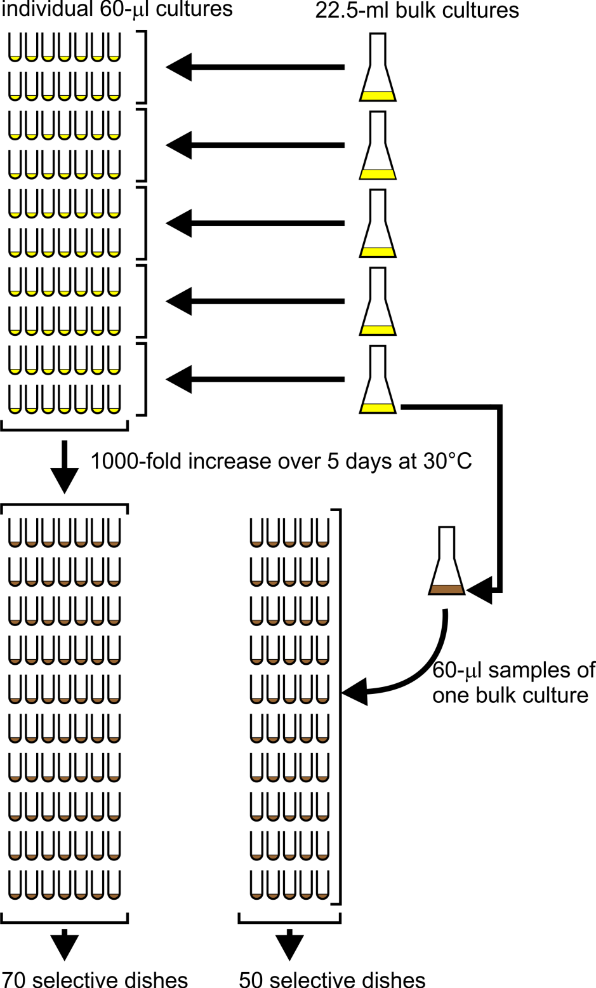
Session 1
According to the pre-exposure hypothesis, canavanine-resistance mutations occur randomly during growth in non-selective medium
Session 2
According to the post-exposure hypothesis, canavanine-resistance mutations don’t occur until the yeast are exposed to canavanine on selective agar medium
Notes:
This slide summarizes what you’ll do to carry out the yeast fluctuation test. You’ll start with a parent yeast strain, YFT1, that is sensitive to canavanine.
Just before Session 1, the instructor will inoculate five 22.5-ml bulk cultures with YFT1 cells at a concentration of 10⁵ cells/ml. The nutrient medium in these cultures will be non-selective, meaning it won’t contain any canavanine; all yeast cells will therefore be able to grow in this medium, whether or not they are canavanine-resistant mutants. Portions of the inoculated bulk cultures will be distributed to the students for use in the next step; the remainders of the bulk cultures will be poured into 5 125-ml culture flasks (see next slide). Sterile technique will be maintained throughout these steps.
During Session 1, the class will use sterile technique to distribute 60-μl portions of the bulk cultures into 70 sterile culture tubes; these are the individual cultures. Each 60-μl individual culture will contain only 6000 yeast cells (0.06 ml x 10⁵ cells/ml), few if any of which will be canavanine-resistant mutants. Each bulk culture (~21 ml remaining, with 2.1 million yeast cells) is equivalent to ~350 individual cultures all mixed together.
Between Sessions 1 and 2, both the 70 individual cultures and the 5 bulk cultures will be shaken at 30°C. During that incubation, the cell concentration in both the bulk cultures and the 60-μl individual cultures will increase 1000-fold from 10⁵ cells/ml to 10⁸ cells/ml. The medium will turn from clear (the starting cell concentration of 10⁵ cells/ml is much too low to give any visible turbidity) to turbid; that’s symbolized in the diagram from the change from yellow to brown. According to the pre-exposure hypothesis, but not the post-exposure hypothesis, canavanine-resistance mutations occur randomly during this growth in non-selective medium.
During Session 2, students will use sterile technique to distribute 60-μl samples of one of the 5 bulk cultures into 50 additional culture tubes. These are called the bulk-culture samples.
Still during Session 2, and still maintaining sterile technique, students will spread the cells in all 120 culture tubes (70 individual culture tubes, 50 bulk-culture sample tubes) onto selective petri dishes. The agar medium in these selective dishes will contain canavanine, so that only the rare canavanine-resistant mutants will be able to grow and form colonies. According to the post-exposure hypothesis, canavanine-resistance mutations don’t occur until the cells first encounter canavanine on the selective agar medium in the petri dishes. The petri dishes will be incubated at 30°C for at least 5 days.
During Session 3 (not shown in the diagram), students will count both red and white mutant (canavanine-resistant) colonies. Only the red mutants will be analyzed in this lab. It’s the distribution of red colony counts in the dishes that will provide the key evidence discriminating between the two contending ideas: the pre- and post-exposure hypotheses. How this inference emerges from the colony count data will become apparent during the module.

Slide 9
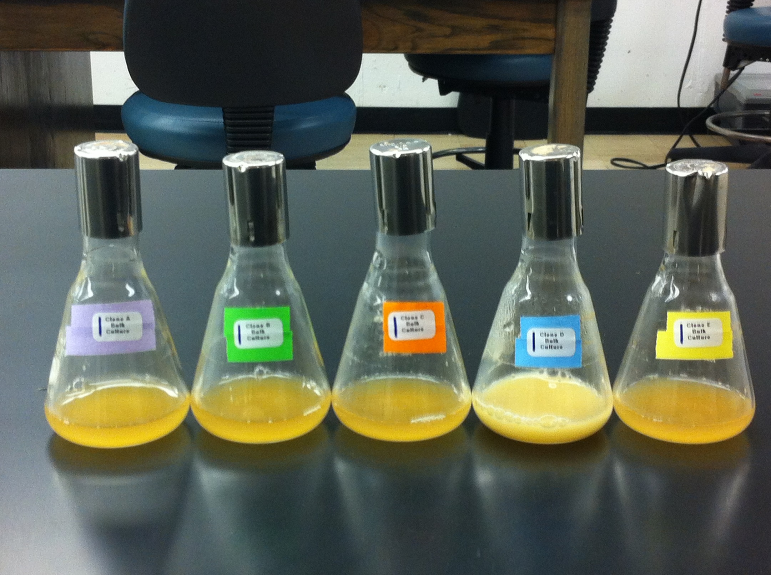
Notes:
Here’s a picture of five bulk cultures after 5 days in the shaker-incubator. Note that all the cultures are turbid rather than clear. One of the cultures (the 4th one from the left) has been contaminated with bacteria, as evidenced by its lighter color and higher turbidity. You will use an uncontaminated bulk culture as the source of the 50 60-µl bulk-culture samples. As long as you use an uncontaminated bulk culture as the source of bulk-culture samples, the bacterial contamination won’t compromise the fluctuation test.

