Slide 1
Estimated Influenza Disease Burden, by Season
United States, 2010-11 through 2019-20 Influenza Seasons
 | Symptomatic Illnesses |  | Medical Visits |  | Hospitalizations |  | Deaths
Season | Estimate | 95% Cr I | Estimate | 95% Cr I | Estimate | 95% Cr I | Estimate | 95% Cr I
2010-2011 | 21,000,000 | (20,000,000 – 25,000,000) | 10,000,000 | (9,300,000 – 12,000,000) | 290,000 | (270,000 – 350,000) | 37,000 | (32,000 – 51,000)
2011-2012 | 9,300,000 | (8,700,000 – 12,000,000) | 4,300,000 | (4,000,000 – 5,600,000) | 140,000 | (130,000 – 190,000) | 12,000 | (11,000 – 23,000)
2012-2013 | 34,000,000 | (32,000,000 – 38,000,000) | 16,000,000 | (15,000,000 – 18,000,000) | 570,000 | (530,000 – 680,000) | 43,000 | (37,000 – 57,000)
2013-2014 | 30,000,000 | (28,000,000 – 33,000,000) | 13,000,000 | (12,000,000 – 15,000,000) | 350,000 | (320,000 – 390,000) | 38,000 | (33,000 – 50,000)
2014-2015 | 30,000,000 | (29,000,000 – 33,000,000) | 14,000,000 | (13,000,000 – 16,000,000) | 590,000 | (540,000 – 680,000) | 51,000 | (44,000 – 64,000)
2015-2016 | 24,000,000 | (20,000,000 – 33,000,000) | 11,000,000 | (9,000,000 – 15,000,000) | 280,000 | (220,000 – 480,000) | 23,000 | (17,000 – 35,000)
2016-2017 | 29,000,000 | (25,000,000 – 45,000,000) | 14,000,000 | (11,000,000 – 23,000,000) | 500,000 | (380,000 – 860,000) | 38,000 | (29,000 – 61,000)
2017-2018 | 41,000,000 | (35,000,000 – 53,000,000) | 19,000,000 | (16,000,000 – 24,500,000) | 710,000 | (566,000 – 1,100,000) | 52,000 | (34,000 – 95,500)
2018-2019 | 29,000,000 | (25,000,000 – 40,000,000) | 13,000,000 | (11,500,000 – 18,500,000) | 380,000 | (300,000 – 660,000) | 28,000 | (19,000 – 97,000)
Preliminary estimates * | Estimate | 95% UI | Estimate | 95% UI | Estimate | 95% UI | Estimate | 95% UI
2019-2020 * | 35,000,000 | (30,000,000- 49,000,000) | 16,000,000* | (14,000,000 – 22,000,000) | 380,000* | (312,000 – 630,000) | 20,000* | (18,000- 80,000)
* Estimates from the 2019-2020 season are preliminary and may change as data are finalized.
https://www.cdc.gov/flu/about/burden/index.html

Slide 2
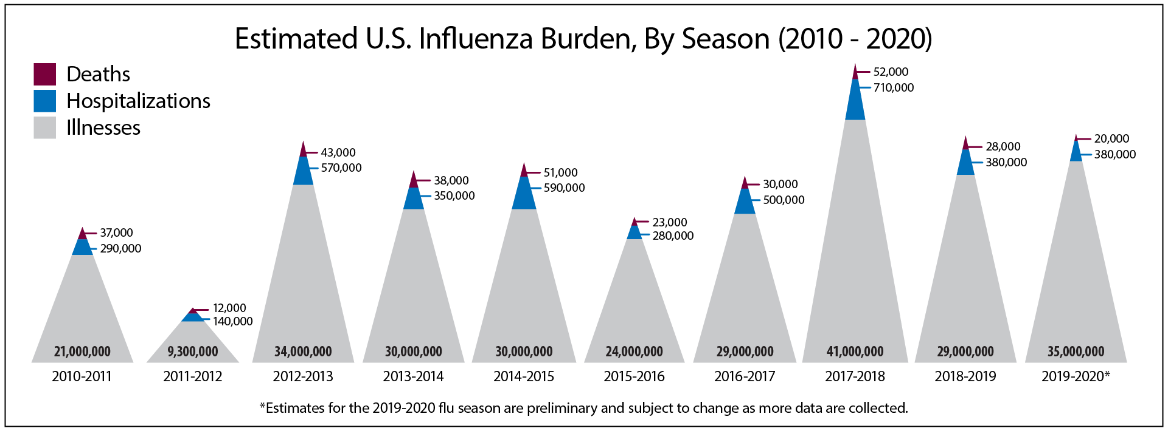
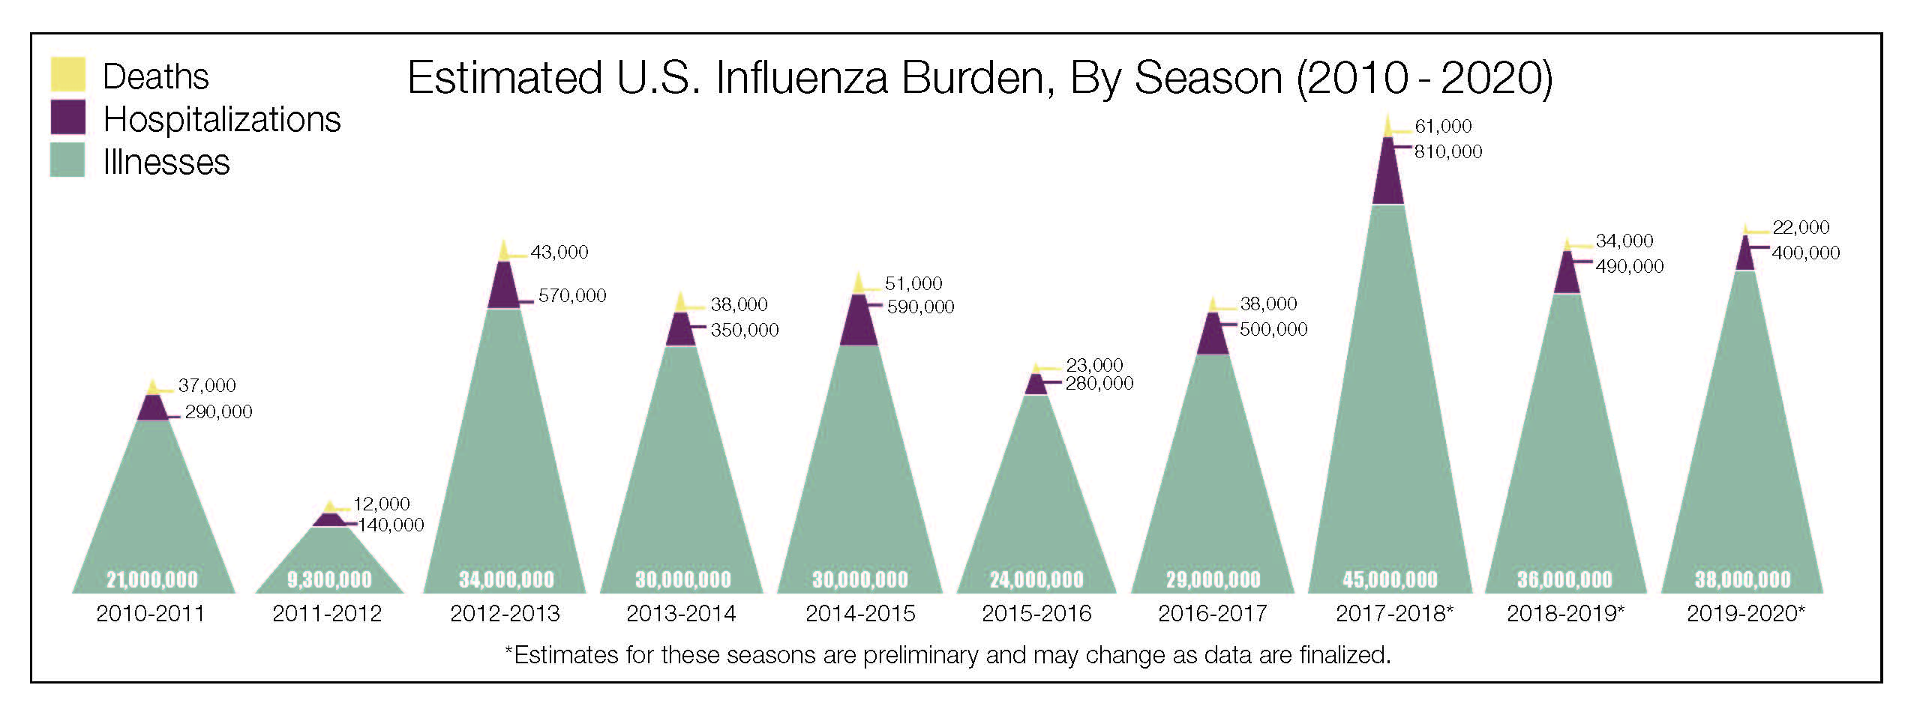
Estimated Influenza Disease Burden, by Season
United States, 2010-11 through 2019-20 Influenza Seasons
https://www.cdc.gov/flu/about/burden/index.html

Slide 3
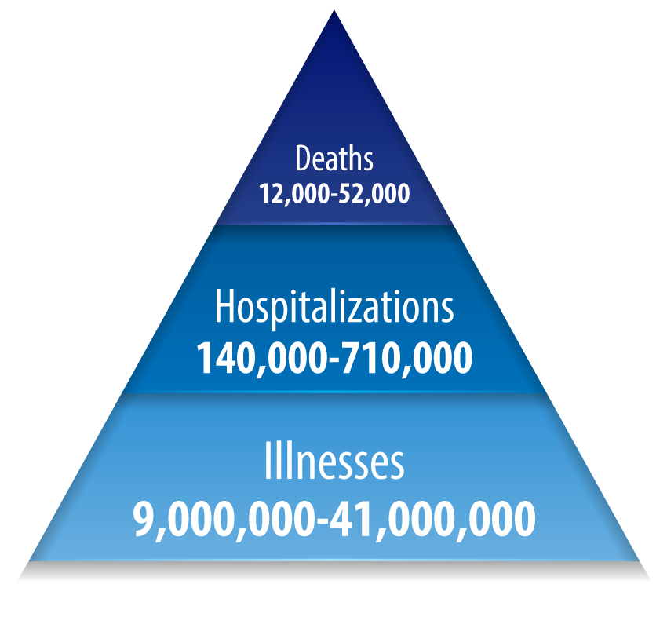
Estimated Range of Annual Burden of Flu
United States, 2010-11 through 2019-20 Influenza Seasons
The burden of influenza disease in the United States can vary widely and is determined by a number of factors including the characteristics of circulating viruses, the timing of the season, how well the vaccine is working to protect against illness, and how many people got vaccinated. While the impact of flu varies, it places a substantial burden on the health of people in the United States each year.
CDC estimates that from 2010- 2020, influenza has resulted in between 9 million – 41 million illnesses, between 140,000 – 710,000 hospitalizations and between 12,000 – 52,000 deaths annually.
https://www.cdc.gov/flu/about/burden/index.html

