Slide 1


AUTOMATED ATTENDANCE SYSTEM USING ANDROID DEVICE

Slide 2
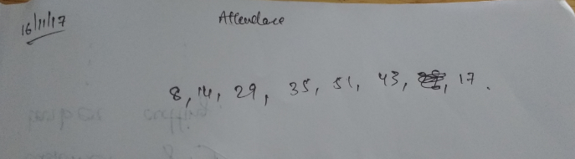
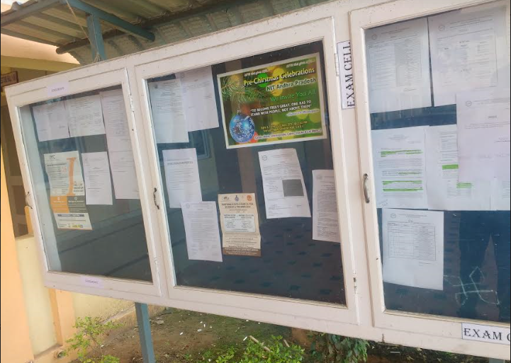
PROBLEM STATEMENT

Slide 3
Jaya Shankar Reddy Kommuru 411529
Vishnu Nagineni 411551
Prathyush V 411576

Slide 4


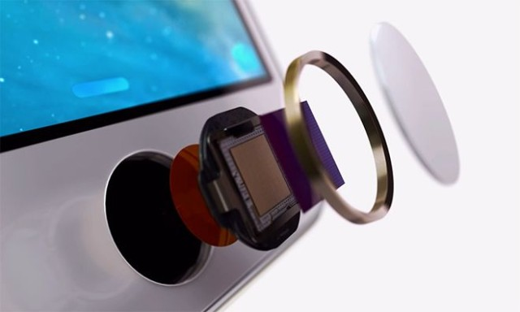
1. ATTENDANCE MODULE
2.RECEVING OTP AND NOTIFICATIONS MODULES

Slide 5
MODULE 1 : ATTENDANCE UPLOAD
TWO CHALLENGES :
1. Student should be present in the class.
2. Unique identity for each student.

Slide 6

LONGITUDES
https://cmkt-image-prd.global.ssl.fastly.net/0.1.0/ps/1446298/1160/772/m1/fpnw/wm0/2508-.jpg?1468330992&s=a34bc18f038618af2568f498117364a0
latitudes

Slide 7

ALTITUDE OF ROOM 2
ALTITUDE OF ROOM 1

Slide 8
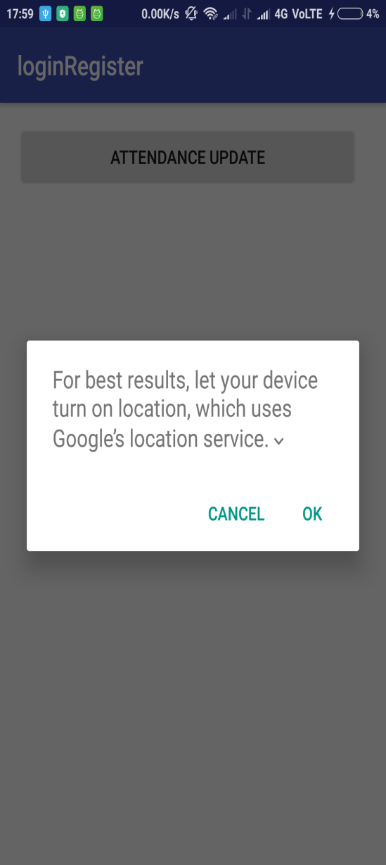
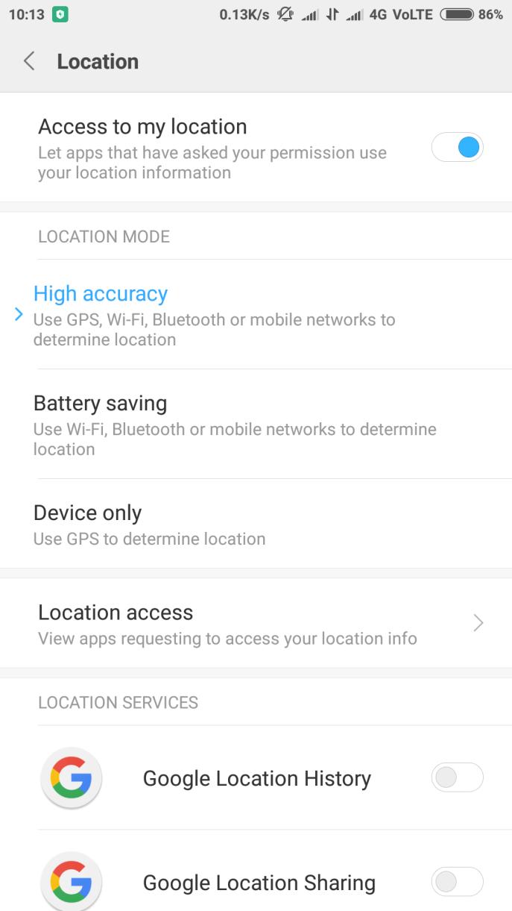
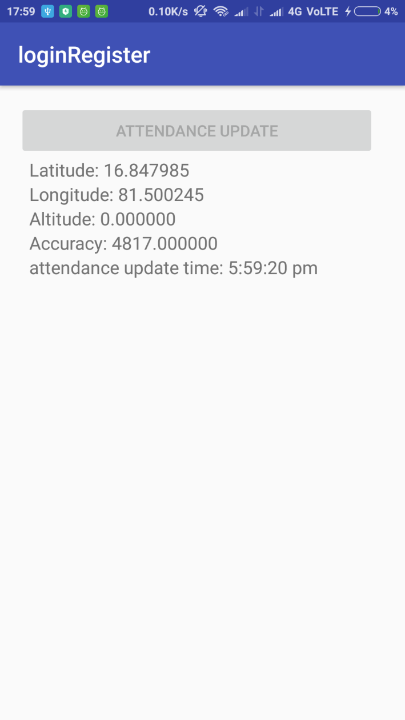

Slide 9
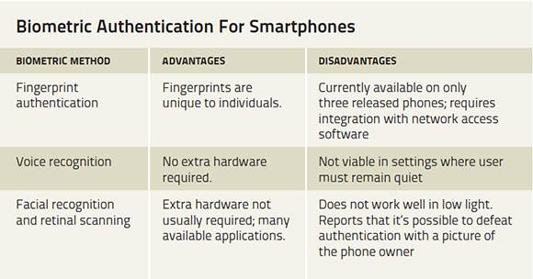

Slide 10
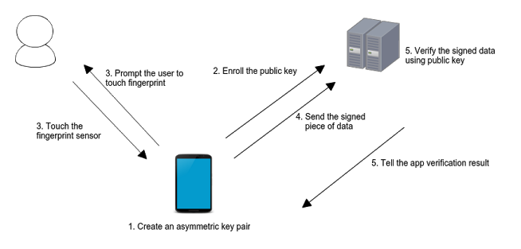
ARCHITECTURE

Slide 11
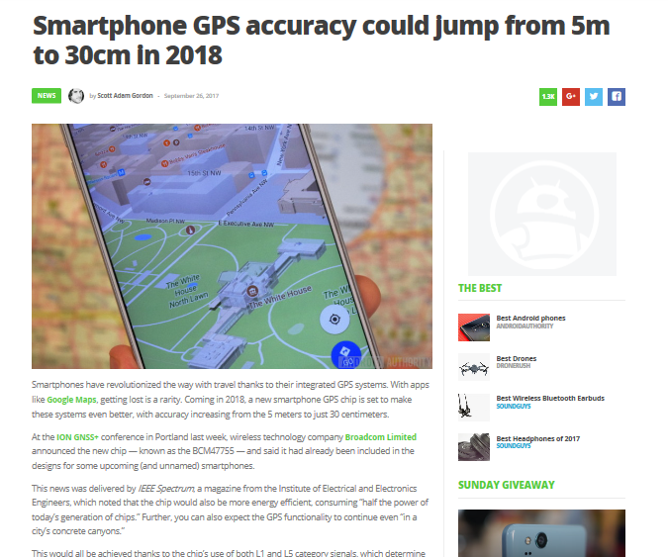

Slide 12
RECEIVING OTP AND NOTIFICATIONS
Store the mobile numbers in the database.
Identify each user of the app using fcm_token.

Slide 13
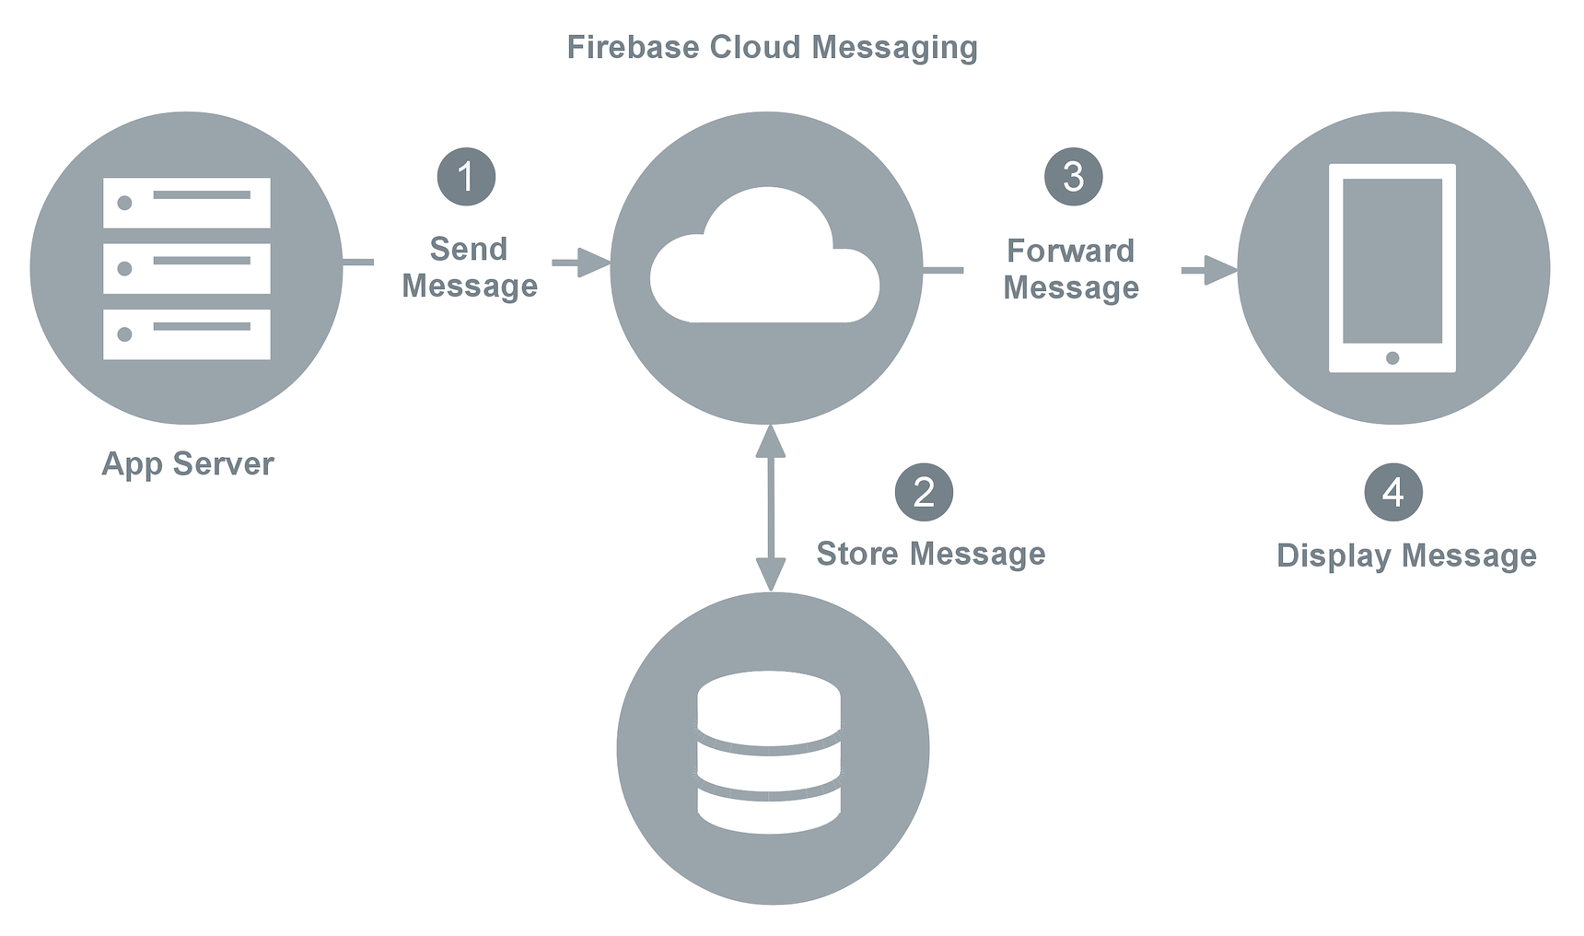
ARCHITECTURE OF NOTIFICATIONS MODULE

Slide 15
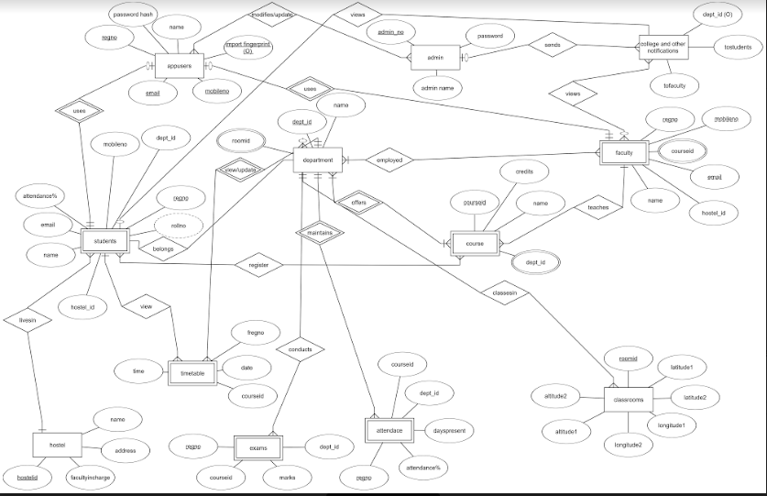

Slide 16
HARDWARE AND SOFTWARE REQUIREMENTS
HARDWARE :
Fingerprint sensor
GPS sensor
2. SOFTWARE:
Android 6.0 or above
PHP,MYSQL,AndroidSDK,Java,XML,Volley Library, Firebase Cloud,phpmyadmin
HTML
Web Server.

Slide 17
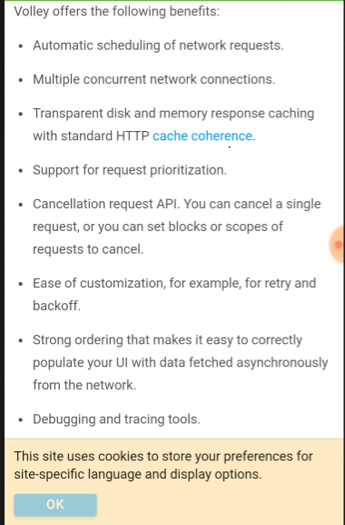
COMPARISON WITH EXISTING SYSTEM
Uses VOLLEY library.
Uses phone’s
fingerprint sensor.
Least cost solution as
of till date.
Uses free hosting, firebase
cloud functions.

Slide 18
Limitations:
Android 6.0 and above for fingerprint identification.
Uses more battery because of FINE_ACCESS_LOCATION parameter of google services.

Slide 19
FUTURE WORK
Optimise the battery usage.
Include all academic activities like registration of incoming students, view results, etc.
Make this app official for NIT AP.

