Slide 1

SMART ODISHA HACKATHON 2018
THEME: HEALTHCARE
“HEALTH CARE APPLICATION”

Slide 2
OUTLINE
Problem Statement
Solution
Workflow
Features
UML Use Case Diagram
Architecture
Why this idea?
Challenges

Slide 3
PROBLEM STATEMENT
Information regarding free health services provided by the government is taking huge time to reach out to the huge scale of the public causing unawareness.
Sometimes, these services do not meet the health requirements of a particular location’s public.
These result in public spending huge money on private health services and underutilization of government’s services and medicines causing loss to both the government and the public.
The above two problems are caused basically due to the Information asymmetry between the government and public. An efficient solution is required to symmetrise the communication.

Slide 4
SOLUTION
An easy to use mobile application acting as a bridge.
Users (public) of the application will be frequently updated with information on various health services being provided by the government.
Users can also request for a particular health service they require the most.
Geofencing using GPS of the mobile phones is utilised to gain maximum benefits.
The requests from the users can be used by the government to decide which kind of health service is required at which location.
Users can view the details of the health centres near to them.

Slide 5
FEATURES OF THE APPLICATION
Notifying the user instantaneously about the services and allowing the user to add reminders for services.
Allows the user to add preferences, apply filters, put on a request so that they receive what they desire.
The geofencing concept is used to find the nearest centres to the user and update him/her whenever the user is traveling closer to an ongoing (running) health centre. For this, the app continuously tracks the user location.
Provides directions to the desired centre to the user. (Google Map Integration).
Users can give feedback about a health centre. Admin can view the statistics and can report them to the higher authorities.
Additional: A voice-enabled Chabot can be integrated for better user experience.

Slide 6
WORKFLOW
Admin gets the information about various health centres and keeps updating them to the database that is being used by the app as backend.
Users download the app on their mobiles and grant permission to access their location. Once they register, they are provided with a unique UID.
They enter all their details along with their preferences (the type of health service required, timings, locations, etc) which can be changed at any time. They can also request for a particular health service.
Users view the details of the ongoing and upcoming health services. They filter these services according to their requirement and are provided with the nearest health centres that match their requirement.
They add a reminder for a particular health service. On the service day, they are reminded and provided with the Google directions to the centre.

Slide 7
WORKFLOW
Users attending a centre are recorded with their UIDs. All such details are again stored in the database. These details and requests put by them can be used in future to decide which kind of service is required more at which location. (Statistics)
Users give feedback about the service they are provided with.
The App continuously tracks it’s user and notifies him/her whenever he/she travels nearer to a running health centre.
The App continuously updates the user with the latest health services and schemes that are being initiated by the government.
The Users contact admin if they are facing any problem using the app.

Slide 8
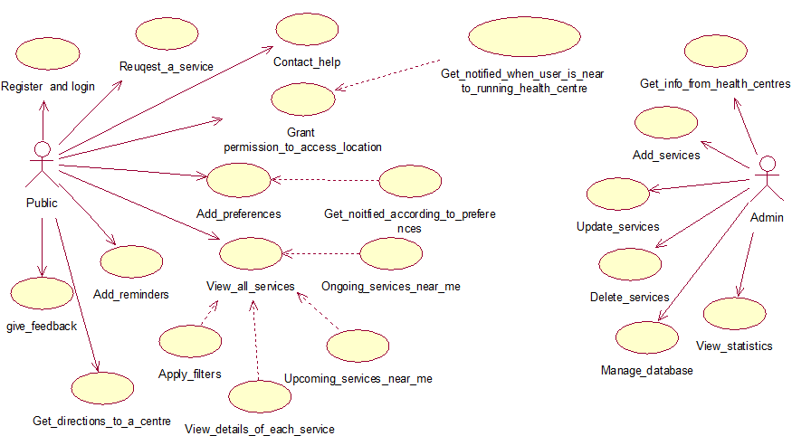
USE CASE DIAGRAM

Slide 9
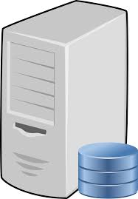
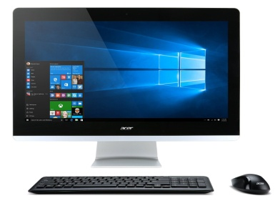
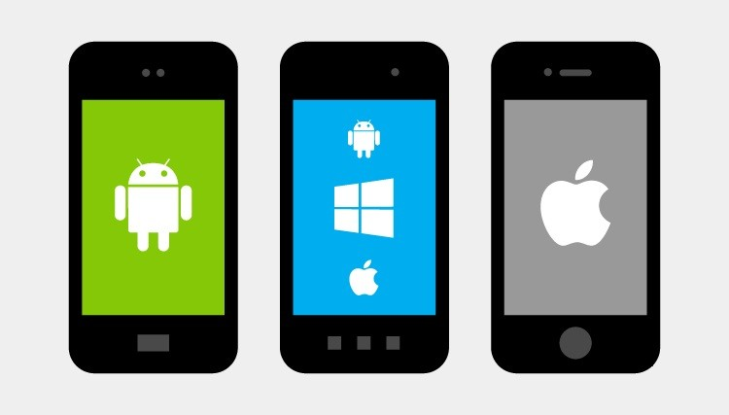
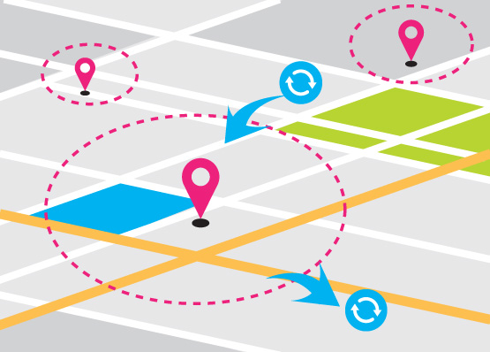
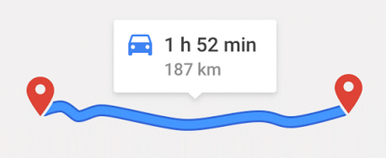
Database_mysql_server
Upload health centres’ location and details
Internet
PHP
Requests
API
Statistics
PHP
Get health centres location, info and notifications
Users
Admin
ARCHITECTURE
Geofencing to view nearest service centres
Directions to health centre
Health Assistance Application App Code
GPS

Slide 10
WHY THIS IDEA?
The “Health Assistant Application” application provides the public with all the required information regarding health services provided by the government. Information reaches to the users instantaneously. Analysing requests from users helps to provide service suitable to the health problems of a location. Bridges the gap absolutely symmetrising the information.
The government’s initiative to provide free health services to reduce the deaths due to non-communicable diseases can be efficiently implemented using this app. The government’s services and medicines will never be underutilised from now on.
GPS service used by app provides nearest available health centres to the public, also, the directions to reach the centre. This makes life easier for the public.
The feedback service and statistics of the public utilizing the service centres can be used to gauge the scale of the service that is required at a particular centre.

Slide 11
CHALLENGES
Security, reliability, robustness, and scalability of the app are desired.
The user should be trusting the app as it tracks him/her all day long. And the battery usage by GPS is more. So, the app is to be optimised as much as possible.
Not all people have a Smartphone to install the app and reap its benefits. The non-smart phones may not have GPS. This type of users will be less but are equally important. For such users, messages need to be sent to their mobile number to keep them updated on health services. To allow them to put requests, they can contact or message to a toll-free number. And this data needs to be updated to the database. A simple alternative can be found to automate this process.
The registration process should identify the users uniquely using Aadhar card number and OTP (One Time Password).

