Slide 1
Measurement Description
3 terminal transistor: Gate, Drain, Source
For measurements, please assume the following:
Gate connected to PMU1-channel1
Drain connected to PMU1-channel2
Source connected to PMU2-channel1
Measure-Stress-Measure sequence repeated for given list of cumulative stress times

Slide 2
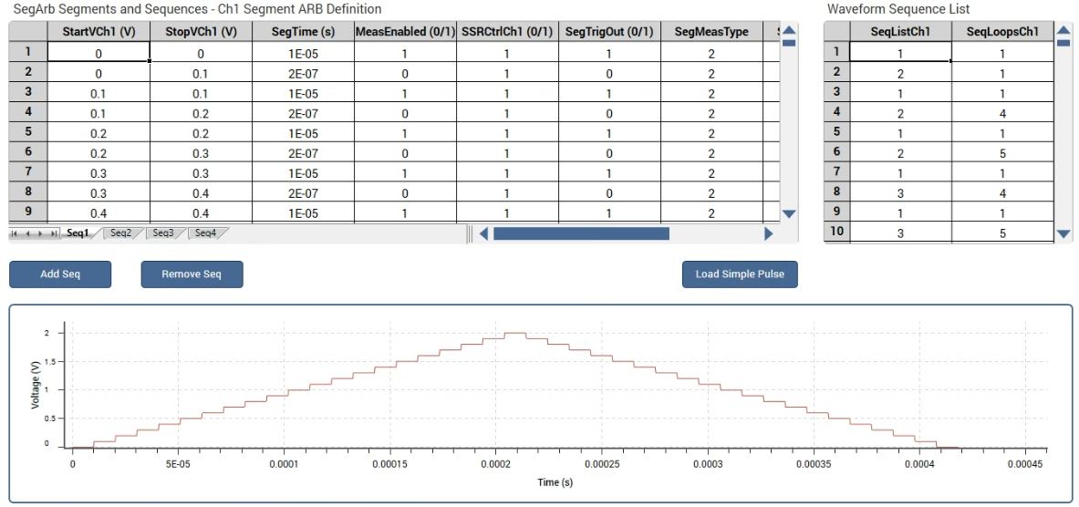
Measure
Bidirectional staircase ramp for Gate, Drain at vdrain V and Source at zero
Parametrized by trf=2e-7, tplateu=1e-5, vdrain=0.1, vgate_start=0, vgate_stop=2, vgate_step=0.1
Spot-mean measurement only at plateus

Slide 3
Stress
Mode: ‘DC’ → constant voltage vstress V at Gate, Drain and Source at 0 V
Mode: ‘AC’ → square pulses parametrized by trf, thigh, duty-cycle, vstdby, vstress (same as above) → no of cycles calculated from the stress time, thigh and duty-cycle

