Slide 1
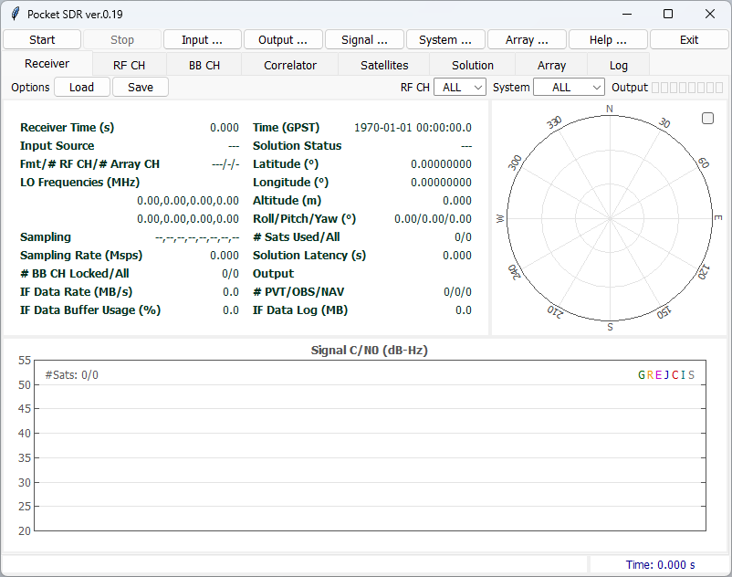
pocket_sdr.py help
ver. 0.19 2026-07-24
Initial Window
Page Tabs:
Tabs to switch current page
Command Buttons
Start
Stop
Input...
Output...
Signal...
System...
Array...
Help
Exit
: Start the receiver
: Stop the receiver
: Show Input Options dialog
: Show Output Options dialog
: Show Signal Options dialog
: Show System Options dialog
: Show Array Options dialog
: Show Help dialog
: Exit the receiver
Load or Save Receiver Options: The options format complies with Windows ini.
Status Bar:
Status info or error message for the receiver
Receiver Time:
Elapsed time since the receiver started (s)

Slide 2
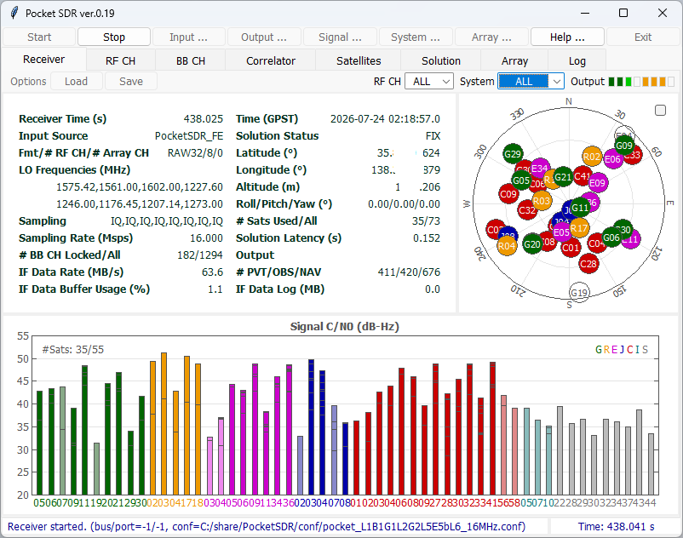
Receiver Page
Receiver Time:
Elapsed time since the receiver started
Input Source:
IF data source (RF_Frontend or IF_Data)
Fmt/# RF CH/# Array CH:
IF data format ^{*3} and number of CHs
LO Frequencies (MHz):
Local oscillator frequencies for each RF CH (MHz)
Sampling:
IF data sampling type for each RF CH
(I or IQ)
Sampling Rate (Msps):
IF data sampling rate
# BB CH Locked/All:
Number of BB CHs tracked and all
IF Data Rate (MB/s):
IF data transfer rate
IF Data Buffer Usage (%):
Receiver internal IF data buffer usage rate
Time (GPST):
PVT Solution time in GPST
Solution Status:
PVT Solution status (- or FIX)
Latitude, Longitude and Altitude:
PVT Solution latitude/ longitude (deg) and ellipsoidal height (m)
Roll/Pitch/Yaw (deg):
Attitude solution by antenna array
# Sats Used / All:
Number of used satellites for PVT and all satellites with OBS data
Solution Latency (s):
PVT Solution latency
# PVT/# OBS/NAV Data:
Total count of PVT solutions, OBS and NAV data
IF Data Log (MB):
Recorded size of IF Data log
Output Status Indicators
for stream 1-8 (PVT solution, OBS/NAV data, receiver log or IF data log)
Receiver Status Panel
RF CH and System Selection for Skyplot and C/N0 Plot
Orange: waiting for connection
Green: data OK
Light-Green: data active
Red: error
White: no output
Satellite Positions in Skyplot ^{*1 *2}
* 1 GNSS System Color:
Green: GPS
Orange: GLONASS
Magenta: Galileo
Blue: QZSS
Red: BeiDou
Blue-Green: NavIC
Grey: SBAS
White or light-color:
unused satellites for solution
Number of used satellites and all satellites with OBS data
Signal C/N0 (dB-Hz) Plot for Each Satellite and Signals (stacked) ^{*1 *2}
*2 Satellite ID complies with RINEX convention
*3 INT8 (int8 I-sampling), INT8X2 (interleaved-int8 IQ-sampling), RAW8, RAW16, RAW32 (Pocket SDR FE), CS8 or CS16 (SoapySDR devices)

Slide 3
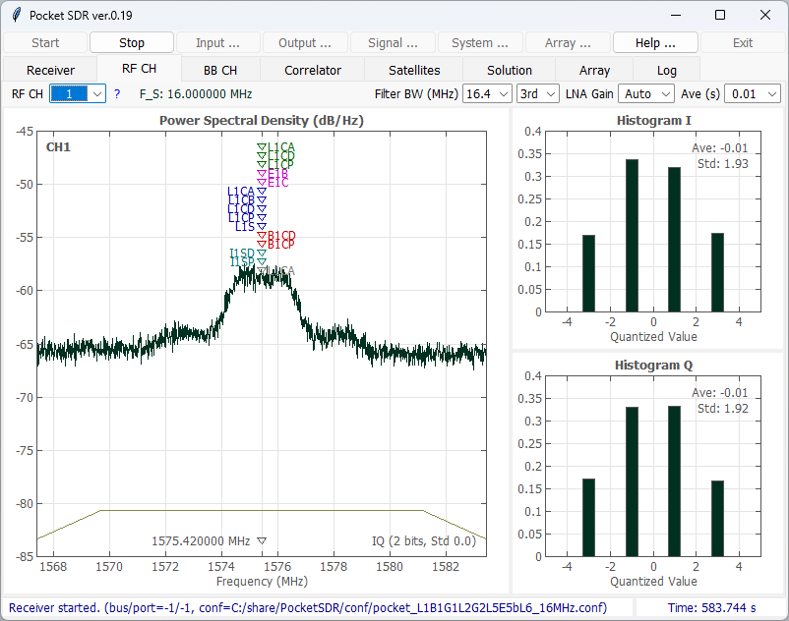
RF CH Page
Link to GNSS Signal Band Table
Sampling Rate
IF Filter Bandwidth and order Selection ^{*1 *2}
LNA Gain Selection ^{*1}
RF CH
Selection:
ALL, 1, 2, ..., 16, 1-4 or 5-8 ^{*3}
Averaging Time Selection for Power Spectral Density and Histogram
Carrer-Frequency Marks for each GNSS Signal
Average and Standard Deviation of Sample Values
Power Spectral Density Plot (Spectral Analyzer) for each RF CH
IF Filter
Bandwidth
Histogram for IF Data Sample Values (I-sample and Q-sample)
Local Oscillator
Frequency
Sampling Type (I or IQ) and number of sample bits, Standard-deviation of Sample Value
*1 Only valid for RF_Frontend Input, *2 Only valid for IQ-sampling
*3 RF CH 9, 10, ..., 16 are beamforming CHs by antenna array

Slide 4
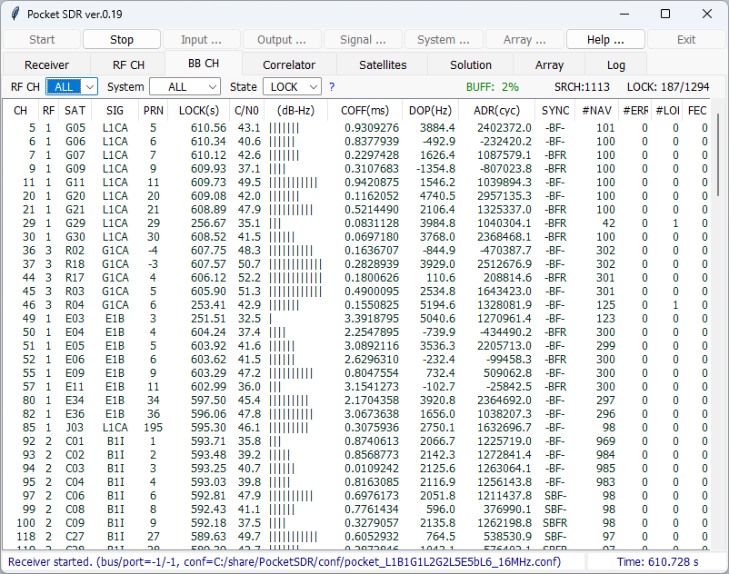
BB CH Page
RF CH
Selection:
ALL, 1, 2, ..., 16
GNSS System Selection:
ALL, GPS, GLONASS, ...
BB CH State Selection:
LOCK or ALL
Link to GNSS Signal Table
Internal IF Data
Buffer Usage Rate in %
BB CH No Searching Signal
Number of Locked and All BB CHs
Status for each BB CH:
CH
RF
SAT
SIG
PRN
LOCK
C/N0
(dB-Hz)
COFF
DOP
ADR
SYNC
#NAV
#ERR
#LOL
FEC
: BB CH no
: Assigned RF CH no for BB CH
: Satellite ID
: Signal ID
: PRN number or FCN for
GLONASS FDMA signal
: Continuous lock time (s)
: Signal C/N0 (dB-Hz)
: Signal C/N0 Bar (20-50 dB-Hz)
: Code offset (ms)
: Doppler frequency (Hz)
: Accumulated Doppler range
(cycle)
: Synchronization status
: Decoded subframe or message
count
: NAV data error count
: Loss-of-lock count
: Number of error bits corrected
by FEC (-1: correction unable)
Synchronization Status:
S : Secondary code sync
B : NAV symbol (bit) sync
F : Subframe or message sync
R : Polarity of subframe or
message sync (R: reversed)

Slide 5
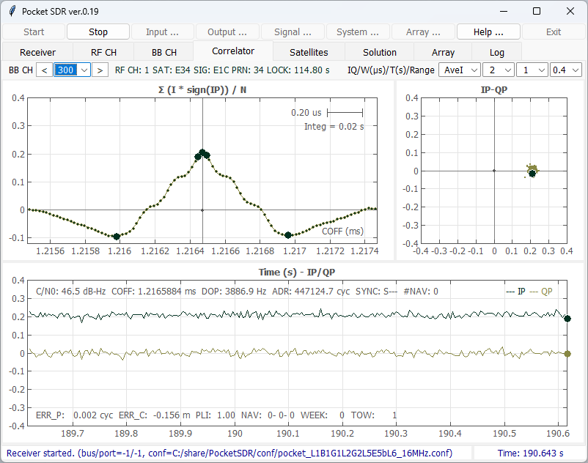
Correlator Page
RF CH, Satellite ID, Signal ID PRN No. and Lock Time of BB CH
Correlation Plot Type Selection
X-axis Range Selection for Correlation Plot
Time Span Selection for Correlation History or Constellation Plot
BB CH
Selection ^{*1}:
1, 2, 3, ...
Y-axis Range Selection
Correlation
Plot
Constellation
Plot
X-axis: code offset (ms)
Y-axis: correlations
(I * sign(IP), sqrt(I² + Q²) or sqrt(sum(I² + Q²))) ^{*2}
Large dots:
correlator positions for
VE, E, P, L and VL ^{*3}
X-axis: IP-correlation
Y-axis: QP-correlation
Large dot:
current correlation
C/N0, code offset, Doppler Frequency, accumulated Doppler range, synchronization status, decoded subframe or message count
Correlation
History Plot
X-axis: receiver time (s)
Y-axis: IP or QP-correlation
*1 BB CH can be selected by clicking BB CH Status row in BB CH Page
*2 Integration time is based on non-coherent integration time for DLL
*3 VE and VL are only shown in case of BOC-modulation and Bump-Jump enabled

Slide 6
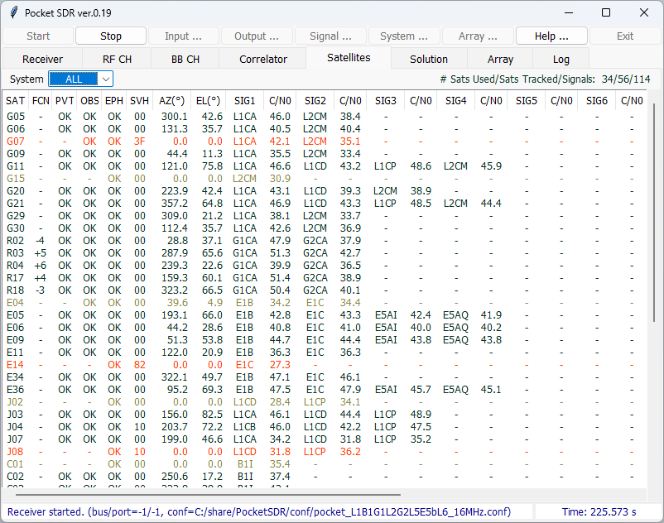
Satellites Page
System Selection
Number of satellites used for PVT solution, number of satellites tracked, number of all tracked signals
Status for each Satellite:
SAT
FCN
PVT
OBS
EPH
SVH
AZ
EL
SIG1
C/N0
SIG2
C/N0
SIG3
C/N0
...
: Satellite ID
: Frequency channel no (FCN) for
GLONASS FDMA signals
: Satellite used in PVT solution or
not
: Satellite L1 OBS data availability
: Satellite ephemeris availability
: Satellite health flag in
ephemeris (HEX)
: Azimuth angle (deg)
: Elevation angle (deg)
: Signal 1 ID
: C/N0 of signal 1 (dB-Hz)
: Signal 2 ID
: C/N0 for signal 2 (dB-Hz)
: Signal 3 ID
: C/N0 for signal 3 (dB-Hz)
...
Red: unhealthy satellite
Grey: unused satellite for PVT solution

Slide 7
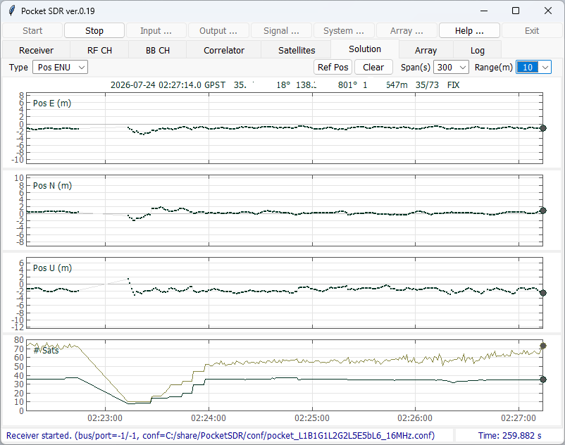
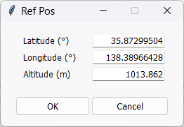
Solution Page
PVT Solution Plot Selection:
Pos ENU or Pos Horiz
Show Ref Pos
Dialog Button
PVT Solution Clear Button
Time Span and Y-axis Range Selections
Current Solution and Number of Used/All Satellites
PVT Solution Plot:
Pos E, N, U: position errors east-west, north-south, up-down ^{*1},
# Sats: Number of used/all satellites
or
Position error horizontal ^{*1} (east-west and north-west, horizontal scatter plot)
Ref Pos Dialog
*1 The reference position is automatically selected from the first epoch solution.
It can be modified by using Ref Pos Dialog

Slide 8
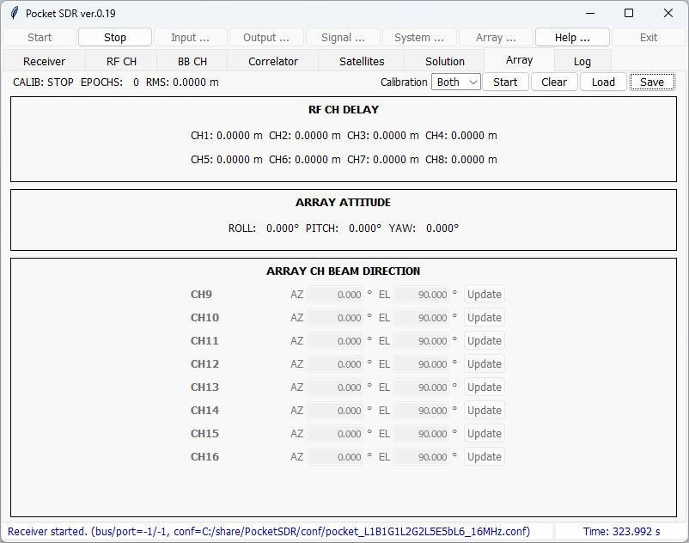
Array Page
Array Calibration Status:
STOP or RUN, Total epochs for calibration and RMS residuals
Array Calibration Targets:
Both: Dealy and Attiude
Delay: Delay only
Att: Attitude only
Array Calibration Operation Buttons:
Start or Stop, Clear, Load and Save
RF CH DELAY: RF CH delay calibration results referenced to RF CH1
ARRAY ATTITUDE:
Array attitude calibration results (ROLL, PITCH, YAW angles)
ARRAY CH BEAM DIRECTION:
Beam direction control for each Array CH. Set AZ (azimuth) and EL (elevation) angles and push Update Button.

Slide 9
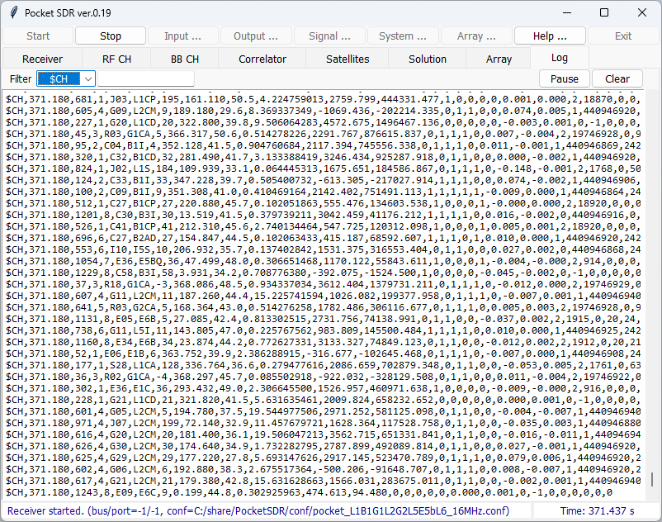
Log Page
Additional Receiver Log Filter:
filter string, like G01 or L1CA, separated by spaces, | indicates OR condition
(e.g., G10|G02|G03)
Receiver Log Pause Button
Receiver Log Clear Button
Receiver Log Type Selection:
Blank: all log
Receiver Logs ^{*1 *2}
*1 Refer p.16 for the receiver log formats
*2 To copy the logs to Clip-board, push Pause button, select the logs and push Ctrl-C of the keyboard

Slide 10
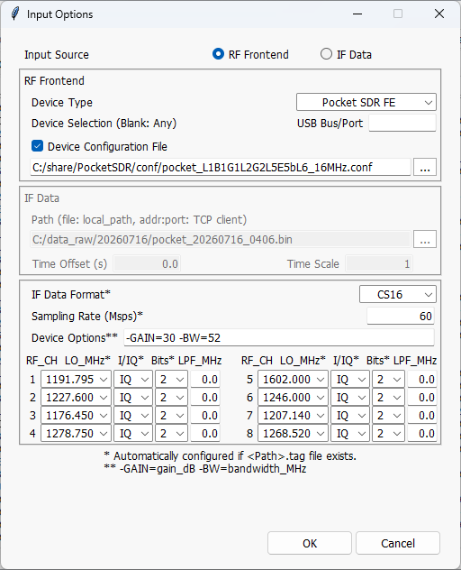
Input Options Dialog
RF Frontend Type Selection:
Pocket SDR FE: Pocket SDR FE 2CH, 4CH, 8CH
USRP (uhd): USRP via Soapy SDR
LimeSDR (lime): LimeSDR via Soapy
LimeSDR (limesuiteng): LimeSDR via newer driver with Soapy
BladeRF (bladrf): bladeRF via Soapy
RTL-SDR (rtlsdr): RTL-SDR via Soapy
Plute-SDR (plutosdr): PlutoSDR via Soapy
Airspy (airspy): Airspy via Soapy
Input Source Selection:
RF Frontend or IF Data
Device Configuration File:
RF Frontend configuration settings for Pocket SDR FE (MAX2771 register) to be loaded at the receiver started. Check Device Configuration File and fill the file path. If unchecked, the current configuration for the device is used. Ignored for other devices.
USB Bus/Port:
To select Pocket SDR FE in case of multiple devices connected.
If blank, the device is automatically selected.
Time Offset and Scale:
Start time offset and time scale to playback the IF Data.
IF Data File ^{*1}:
IF data file path, if IF Data selected as the input source. The IF data can be captured by pocket_dump or as IF data log of the receiver with tag files.
IF Data File Property ^{*1}:
IF Data Format, Sampling Rate, LO frequency, Sampling Type (I or IQ), Number of sample bits for each RF CH. If the tag file exist for the IF data file, these are automatically configured according to the tag file.
Sampling Rate and Device Options for Soapy SDR Devices: -GAIN=gain (LNA gain),
-BW=bw (Filter Bandwidth),
Options are separated by spaces.
Input LPF Settings:
Set two-sided bandwidth (MHz) of LPF for each RF CH. 0 indicates disabled.
*1 Refer to p.15 for the IF data file formats

Slide 11
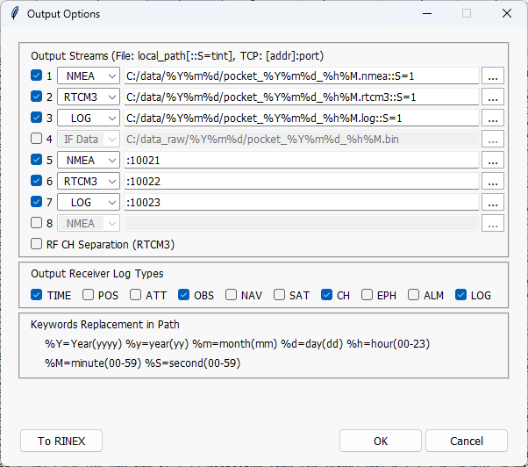
Output Options Dialog
Output Stream 1, 2, 3, ..., 8 ON/OFF, Type and Path
NMEA: PVT Solution ^{*1}
(NMEA 0183 GNRMC, GNGGA, GNGSA, GxGSV)
RTCM3: OBS and NAV Data ^{*1 *2}
(RTCM 3.4 MSM: MT1077, 1087, 1097, 1117, 1127, 1137 and 1107, with extension and EPH: MT1019, 1020, 1045, 1046, 1044, 1042 and 1041)
LOG: Receiver Log ^{*1 *3} (Receiver Log)
IF Data: IF Data Log ^{*1 *4},
(It is only valid for RF Frontend selected as the input source)
RF CH separation ON/OFF for RTCM3
Receiver Log Type Selections ^{*3}
Execute RINEX Converter for RTM3 OBS and NAV data
*1 The output path should be one of the followings.
(1) <local path>: A local file path <local path>. It can contain time keywords replaced by the log start time. Optionally, it can include the file swapping order “::S=<tint>” by the specified interval <tint> (H).
(2) :<port>: TCP server with the port number <port>. The TCP server waits for and accepts the external TCP connection at the port and output data
(3) <addr>:<port>: TCP client with the address <addr> and the port number <port>. The TCP client connects the external TCP server and output data
*2 The output RTCM 3.4 MSM (with extensions) and EPH can be converted to RINEX OBS and NAV by CONVBIN utility included in the Pocket SDR package
*3 Refer to p.16 for the receiver log format. The receiver log can be plotted by the Log Viewer pocket_plot.py in the Pocket SDR package
*4 Refer p.15 for the IF data log format. The output format is automatically selected according to the RF Frontend (RAW8, RAW16, RAW32, CS8 or CS16). The tag file is also generated.

Slide 12
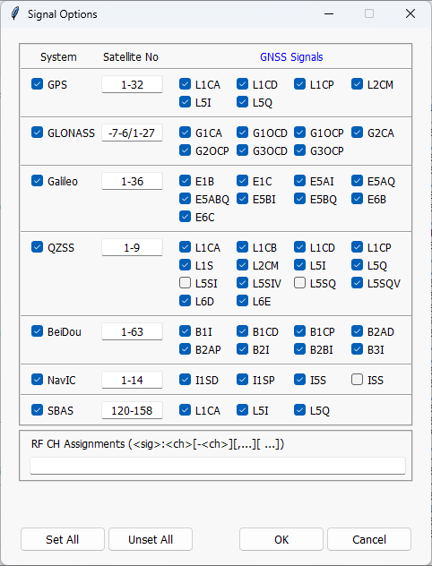
Signal Options Dialog
Pocket SDR Signal ID Table
System | Signal | Signal ID
GPS | L1C/A | L1CA
 | L1C-D | L1CD
 | L1C-P | L1CP
 | L2C-M | L2CM
 | L5-I | L5I
 | L5-Q | L5Q
GLONASS | L1C/A | G1CA
 | L1OCd | G1OCD
 | L1OCp | G1OCP
 | L2C/A | G2CA
 | L2OCp | G2OCP
 | L3OCd | G3OCD
 | L3OCp | G3OCP
Galileo | E1-B | E1B
 | E1-C | E1C
 | E5a-I | E5AI
 | E5a-Q | E5AQ
 | E5AltBOC | E5ABQ
 | E5b-I | E5BI
 | E5b-Q | E5BQ
 | E6-B | E6B
 | E6-C | E6C
QZSS | L1C/A | L1CA
 | L1C/B | L1CB
 | L1C-D | L1CD
 | L1C-P | L1CP
 | L1S | L1S
 | L2C-M | L2CM
 | L5-I | L5I
 | L5Q | L5Q
 | L5S-I | L5SI
 |  | L5SIV^{*2}
 | L5S-Q | L5SQ
 |  | L5SQV^{*2}
 | L6D | L6D
 | L6E | L6E
System | Signal | Signal ID
BeiDou | B1I | B1I
 | B1C-D | B1CD
 | B1C-P | B1CP
 | B2a-D | B2AD
 | B2a-P | B2AP
 | B2I | B2I
 | B2b-I | B2BI
 | B3I | B3I
NavIC | L1-SPS-D | I1SD
 | L1-SPS-P | I1SP
 | L5-SPS | I5S
 | S-SPS | ISS^{*3}
SBAS | L1C/A | L1CA
 | L5-I | L5I
 | L5-Q | L5Q
Link to Detailed GNSS Signal Table
GNSS System and Signal Selections:
System: GNSS System,
Satellite No: Satellite number or number range (n-m) separated by , ^{*1}
GNSS Signals: Signal IDs to be tracked
RF CH Assignment Options:
RF CH is automatically assigned for signals. To assign signals to specific RF CH(s) manually, use the option as the format <sig>:<ch_list> separated by spaces, where, <sig> is signal ID and <ch_list> is RF CH number list like 1,3,5-7. Additionally, SRCH:<ch_list> can be used to specify signal search CH(s) to shorten the acquisition time.
Set or unset all systems and signals
*1 For GPS, Galileo, BeiDou, NavIC and SBAS, these satellite numbers are the same as the signal PRN numbers. For GLONASS, use the frequency channel number (FCN) for FDMA signals and satellite slot number for CDMA signals instead separated by /. For QZSS, which has complicated satellite numbering, use SV IDs (1-5, 8, 9) or non-standard code numbers (6, 10) instead as the satellite numbers.
*2 QZSS L5S verification mode signals
*3 Pocket SDR FE currently does not support S-band signals

Slide 13
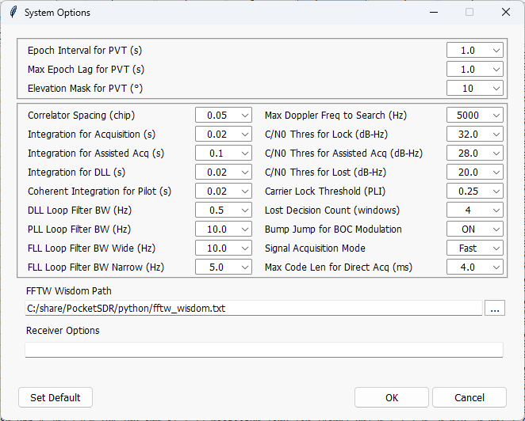
System Options Dialog
PVT Options Selection:
Epoch Interval (s), Max Epoch Lag (s) and Elevation angle Mask (deg)
Signal Acquisition Mode Selection:
Full: All PRN signals are searched. Fast: Only signals of visible satellites are searched for fast acquisition. The visibility is estimated with CPU time, last or current FIX position, almanac or ephemeris of each satellites. The Doppler also is decided by last or current refence oscillator freq. offset. So, if FE changed, use Full-Search.
Signal Acquisition and Tracking Options Selection:
Correlation Spacing (chip), Non-coherent Integration Time for Acquisition (s), Non-coherent Integration Time for Assisited Acquisition (s), Non-coherent Integration Time for DLL (s), Coherent Integration Time for Pilot Signal (s), Loop filter bandwidth for DLL, PLL, FLL (wide-band) and FLL (narrow-band) (Hz), Max Doppler Frequency search range (Hz), C/N0 thresholds for signal-lock, Assisted acquisition or signal-lost decision (dB-Hz), Carrier Lock Threshold as PLI (phase lock indicator), Lost Decision Count, Bump-Jump for BOC modulation enabled or disabled, Max code length for direct acquisition (ms).
FFTW Wisdom Path:
FFTW wisdom file path to shorten the signal acquisition time. The file can be generated by the utility fftw_wisdom in the Pocket SDR package.
Receiver Specific Options
Set all options default

Slide 14
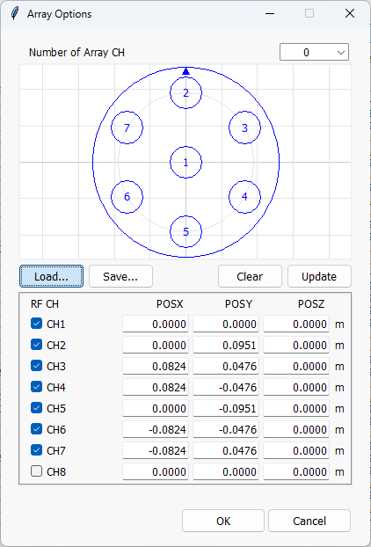
Array Options Dialog
Number of Array CH enabled.
Array Element Horizontal Plot
(Antenna Geometry)
Antenna Geometry Clear and Update Buttons
Antenna Geometry Load and Save Buttons
Enable/Disable and Positions X, Y, Z (m) in body-frame for each Antenna Element.

Slide 15
IF Data File Formats
I_{i}
: i-CH I-sample, : i-CH Q-sample
Q_{i}
* Q-polarity inverted due to MAX2771 convention
8 bits / sample
INT8 (int8)
I₁ (int8)
I₁ (int8)
I₁ (int8)
I₁ (int8)
...
INT8X2
(interleaved int8)
16 bits / sample
I₁ (int8)
Q₁ (int8) *
I₁ (int8)
Q₁ (int8) *
...
RAW8
(FE 2CH raw)
8 bits / sample
Q₂*
I₂
Q₁ *
I₁
Q₂ *
I₂
Q₁ *
I₁
Q₂ *
I₂
Q₁ *
I₁
Q₂ *
I₂
Q₁ *
I₁
...
I₂
I₁
I₂
I₁
I₂
I₁
I₂
I₁
RAW16
(FE 4CH raw)
16 bits / sample
Q₂ *
I₂
Q₁ *
I₁
Q₄ *
I₄
Q₃ *
I₃
Q₂ *
I₂
Q₁ *
I₁
Q₄ *
I₄
Q₃ *
I₃
...
I₂
I₁
I₄
I₃
I₂
I₁
I₄
I₃
RAW32
(FE 8CH raw)
32 bits / sample
Q₂ *
I₂
Q₁ *
I₁
Q₄ *
I₄
Q₃ *
I₃
Q₆ *
I₆
Q₅ *
I₅
Q₈ *
I₈
Q₇ *
I₇
...
I₂
I₁
I₄
I₃
I₆
I₅
I₈
I₇
MSB
LSB
16 bits / sample
CS8
(SoapySDR Device)
I₁ (int8)
Q₁ (int8)
I₁ (int8)
Q₁ (int8)
...
32 bits / sample
CS16
(SoapySDR Device)
I₁ (int16_low)
I₁ (int16_high)
Q₁ (int16_low)
Q₁ (int16_high)
...
2 bits IQ-sampling (RAW8/16/32)
2 bits I-sampling (RAW8/16/32)
IF Data Tag File (<path>.tag)
bits | 00 | 01 | 10 | 11
I | +1 | +3 | -1 | -3
Q * | -1 | -3 | +1 | +3
bits | **00 | **01 | **10 | **11
I | +1 | +3 | -1 | -3
PROG = Pocket SDR
TIME = 2024/11/01 20:48:00.776 (Start Time GPST)
FMT = RAW16 (Format)
F_S = 24 (Sampling Freq. MHz)
F_LO = 1568,1237.8,1176.45,1278.75 (LO Freq. MHz)
IQ = 2,2,2,2 (Sampling, 1:I, 2:IQ)
BITS = 2,2,2,2 (Sampling Bits)
3 bits I-sampling (RAW8/16/32)
bits | 0000 | 1000 | 0001 | 1001 | 0010 | 1010 | 0011 | 1011
I | +1 | +3 | +5 | +7 | -1 | -3 | -5 | -7

Slide 16
Receiver Logs
$TIME,time,year,mon,day,hour,min,sec,tsys (time info)
$OBS,time,year,month,day,hour,min,sec,sat,code,cn0,pr,cp,dop,lli,fcn (OBS data)
$NAV,time,sat,sig,nerr,size,data (raw NAV data)
$POS,time,year,month,day,hour,min,sec,lat,lon,hgt,Q,ns,stdn,stde,stdu,dtr (position solution)
$SAT,time,year,month,day,hour,min,sec,sat,pvt,obs,cn0,az,el,res (satellite info)
$EPH,time,sat,sig,IODE,IODC,SVA,SVH,Toe,Toc,Ttr,A,e,i0,OMEGA0,omega,M0,delta-n,OMEGAdot,Idot,Crc,Crs,Cuc,Cus,Cic,Cis,Toes,Fit,Af0,Af1,Af2,
TGD,code,flag (GPS/Galileo/QZSS/BeiDou/NavIC decoded ephemeris)
$EPH,time,sat,sig,tb,fcn,SVH,SVA,age,Toe,Tof,pos-x,pos-y,pos-z,vel-x,vel-y,vel-z,acc-x,acc-y,acc-z,tau-n,gamma-n,delta-tau-n (GLONASS
decoded ephemeris)
$ALM,time,sat,sig,svh,week,A,e,i0,OMG0,omg,M0,OMGd,toas,f0,f1 (GPS,Galileo,QZSS,BeiDou decoded alamanac)
$ALM,time,sat,sig,svh,taun,lambda,di,eps,omg,tlambda,dT,dTd,frq (GLONASS decoded alamanac)
$CH,time,ch,rfch,sat,sig,prn,lock,cn0,coff,dop,adr,ssync,bsync,fsync,rev,srev,err_phas,err_code,tow_v,tow,week,type,nnav,nerr,nlol,nfec
(receiver channel info)
$LOG,time,message (error, warning, general info message)
$TIME
time receiver time (s)
year year (2000-2099)
mon month (1-12)
day day (1-31)
hour hour (0-23)
min minute (0-59)
sec second (0.000-59.999)
tsys time system (GPST or UTC)
$OBS
time receiver time (s)
year,month,day
obs data day (GPST)
hour,min,sec
obs data time (GPST)
sat satellite ID
code RINEX obs code
cn0 C/N0 (dB-Hz)
pr pseudorange (m)
cp carrier phase (cyc)
dop Doppler frequency (Hz)
lli loss-of-lock indicator
fcn frequency channel number
for GLONASS FDMA signals
$NAV
time receiver time (s)
sat satellite ID
sig signal ID
nerr number of corrected error
bits
size raw NAV data size (bits)
data raw NAV data HEX dump
$POS
time receiver time (s)
year,month,day solution day (GPST)
hour,min,sec solution time (GPST)
lat solution latitude
(deg,+:north,-:south)
lon solution longitude
(deg,+:east,-:west)
hgt solution ellipsoidal height
(m)
Q quality flag (=5: single)
ns number of valid satellites
stdn solution standard-dev north
(m)
stde solution standard-dev east
(m)
stdu solution standard-dev up (m)
dtr receiver clock bias (s)
$SAT
time receiver time (s)
year,month,day solution day (GPST)
hour,min,sec solution time (GPST)
sat satellite ID
pvt PVT status (0:not used,1:used)
obs L1 obs data status
(0:unavailable,1:available)
cn0 L1 signal C/N0 (dB-Hz)
az azimuth angle (deg)
el elavation angle (deg)
res L1 pseudorange residual (m)
$EPH
time receiver time (s)
sat satellite ID
sig signal ID
... decoded ephemeris parameters
$ALM
time receiver time (s)
sat satellite ID
sig signal ID
... decoded almanac parameters
$LOG
time receiver time (s)
message error, warning or general info message
$CH
time receiver time (s)
ch receiver channel number
rfch RF channel number
sat satellite ID
sig signal ID
prn PRN number
lock lock time (s)
cn0 C/N0 (dB-Hz)
coff code offset (ms)
dop Doppler frequency (Hz)
adr accumlated Doppler range (cyc)
ssync secondary code sync flag(0:async,1:sync)
bsync symbol/bit sync flag (0:async,1:sync)
fsync frame sync flag (0:async,1:sync)
rev primary code polarity (0:normal,1:reversed)
srev secondary code polarity (0:normal,1:reversed)
err_phas phase error (cyc)
err_code code error (10^-6 s)
tow_v tow valid flag (0:invalid,1:valid,
2:ambiguity unresolved)
tow time of week (ms)
week week number (week)
type navigation subframe or message type
nnav navigation subframe/message count
nerr error subframe/message count
nlol loss-of-lock count
nfec number of error corrected (bits)

