Slide 1
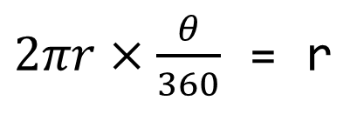

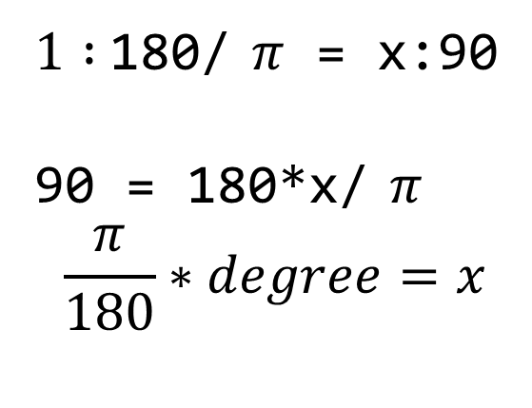
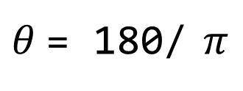
import numpy as np
t = np.arange(0,12,0.01)
# print(len(t))
y = np.sin(t)
r
𝜃 = 57.295779513082320876798154814105
$$θ$$
r
$1 :$180/ $π$ = x:90
90 = 180*x/ $π$
$$\frac{π}{180}∗degree=x$$
$2πr×\frac{θ}{360}$ = r
$θ$= 180/ $π$

Slide 2
plt.figure(figsize=(10,6))
plt.subplot(221)
plt.subplot(222)
plt.subplot(223)
plt.subplot(224)
#plt.subplot(212)
plt.show()
1
2
3
4

Slide 3
10
plt.figure(figsize=(10,6))
plt.subplot(221)
plt.subplot(222)
plt.subplot(211)
plt.show()
1
2
3
1
2
3

Slide 4
10
plt.figure(figsize=(10,6))
plt.subplot(411)
plt.subplot(423)
plt.subplot(424)
plt.subplot(413)
plt.subplot(414)
plt.show()

Slide 5
gu_name = []
for name in station_addreess:
tmp = name.split()
tmp_gu = [gu for gu in tmp if gu[-1] == '구'][0]
gu_name.append(tmp_gu)
crime_anal_police['구별'] = gu_name
crime_anal_police.head()
name = '대한민국 서울특별시 중구 을지로동 수표로 27'
tmp = ['대한민국','서울특별시','중구','을지로동','수표로','27']
gu = '중구'
['중구'][0]
'중구'
gu_name = ['중구',...]

Slide 6
def MinMaxScaler( data ):
min = data.min
max = data.max
for i in range(len(data)):
data[i] = (data[i]-min)/(max-min)
max = 3850
min = 1063
(2366- 1063)/(3850- 1063)

Slide 7
for n in pop.index:
if pop['광역시도'][n][-3:] not in ['광역시', '특별시', '자치시']:
if pop['시도'][n][:-1]=='고성' and pop['광역시도'][n]=='강원도':
si_name[n] = '고성(강원)'
elif pop['시도'][n][:-1]=='고성' and pop['광역시도'][n]=='경상남도':
si_name[n] = '고성(경남)'
else:
si_name[n] = pop['시도'][n][:-1]
'장안구'
for keys, values in tmp_gu_dict.items():
if pop['시도'][n] in values:
if len(pop['시도'][n])==2:
si_name[n] = keys + ' ' + pop['시도'][n]
elif pop['시도'][n] in ['마산합포구','마산회원구']:
si_name[n] = keys + ' ' + pop['시도'][n][2:-1]
else:
si_name[n] = keys + ' ' + pop['시도'][n][:-1]
수원 장안

Slide 8
for n in pop.index:
...
elif pop['광역시도'][n] == '세종특별자치시':
si_name[n] = '세종'
else:
if len(pop['시도'][n])==2:
si_name[n] = pop['광역시도'][n][:2] + ' ' + pop['시도'][n]
else:
si_name[n] = pop['광역시도'][n][:2] + ' ' + pop['시도'][n][:-1]

Slide 9
'42,512
(41.59)'
'42,512','41.59)'
import re
def get_num(tmp='102,566'):
return float(re.split('\(', tmp)[0].replace(',',''))
[0]
sido_names_values
[1]
['서울특별시',
'부산광역시',
'대구광역시',
'인천광역시',
'광주광역시',
'대전광역시',
'울산광역시',
'세종특별자치시',
'경기도',
'강원도',
'충청북도',
'충청남도',
'전라북도',
'전라남도',
'경상북도',
'경상남도',
'제주특별자치도']
102566.0

Slide 10
election_result_raw = {'광역시도' : [],
'시군' : [],
'pop' : [],
'moon' : [],
'hong' : [],
'ahn' : [] }
def append_data(df, sido_name='부산광역시', data):
for each in df[0].values[1:]:
data['광역시도'].append(sido_name)
data['시군'].append(each[0])
data['pop'].append(get_num(each[2]))
data['moon'].append(get_num(each[3]))
data['hong'].append(get_num(each[4]))
data['ahn'].append(get_num(each[5]))
election_result_raw
'광역시도'
'서울특별시'
'서울특별시'
....
'부산광역시'
'시군'
'종로구'
'중구'
...
'중구'
'pop'
'moon'
102566.0
109836.0
...
28604.0
'hong'
42512.0
34062.0
..
9918.0
'ahn'

Slide 11
def move_sido(name='서울특별시'):
element = driver.find_element_by_id("cityCode")
element.send_keys(name)
make_xpath = """//*[@id="searchBtn"]"""
wait.until(EC.element_to_be_clickable((By.XPATH,make_xpath)))
driver.find_element_by_xpath(make_xpath).click()

Slide 12
from bs4 import BeautifulSoup
for each_sido in sido_names_values:
move_sido(each_sido='부산광역시')
html = driver.page_source
soup = BeautifulSoup(html, 'html.parser')
table = soup.find('table')
df = pd.read_html(str(table))
append_data(df, each_sido, election_result_raw)

Slide 13
sido_candi = election_result['광역시도']
sido_candi = [name[:2] if name[:2]
in ['서울','부산','대구','광주','인천','대전','울산']
else '' for name in sido_candi]
['서울', '서울', '서울', '서울', '서울', '서울', '서울', '서울', '서울', '서울', '서울', '서울',
'서울', '서울', '서울', '서울', '서울', '서울', '서울', '서울', '서울', '서울', '서울', '서울',
'서울', '부산', '부산', '부산', '부산', '부산', '부산', '부산', '부산', '부산', '부산', '부산',
'부산', '부산', '부산', '부산', '부산', '대구', '대구', '대구', '대구', '대구', '대구', '대구',
'대구', '인천', '인천', '인천', '인천', '인천', '인천', '인천', '인천', '인천', '인천', '광주',
'광주', '광주', '광주', '광주', '대전', '대전', '대전', '대전', '대전', '울산', '울산', '울산',
'울산', '울산', '', '', '', '', '', '', '', '', '', '', '', '', '', '', '', '', '', '', '',
'', '', '', '', '', '', '', '', '', '', '', '', '', '', '', '', '', '', '', '', '', '', '',
'', '', '', '', '', '', '', '', '', '', '', '', '', '', '', '', '', '', '', '', '', '', '',
'', '', '', '', '', '', '', '', '', '', '', '', '', '', '', '', '', '', '', '', '', '', '',
'', '', '', '', '', '', '', '', '', '', '', '', '', '', '', '', '', '', '', '', '', '', '',
'', '', '', '', '', '', '', '', '', '', '', '', '', '', '', '', '', '', '', '', '', '', '',
'', '', '', '', '', '', '', '', '', '', '', '', '', '', '', '', '', '', '', '', '', '', '',
'', '', '', '', '', '', '', '', '', '', '', '', '', '', '', '', '', '', '']

Slide 14
def cut_char_sigu(name):
return name if len(name)==2 else name[:-1]
import re
sigun_candi = ['']*len(election_result)
for n in election_result.index:
each = election_result['시군'][n]
if each[:2] in ['수원', '성남','안양','안산','고양',
'용인','청주','천안','전주','포항','창원']:
sigun_candi[n] = re.split('시', each)[0]+' '+ cut_char_sigu(re.split('시', each)[1])
else:
sigun_candi[n] = cut_char_sigu(each)
sigun_candi
'안산시상록구'
=> '안산','상록구'
=> '안산 상록'

Slide 15
['서울',
'서울',
'서울',
'서울',
'서울',
...
''
['종로',
'중구',
'용산',
'성동',
'광진',
...
'수원 장안'
'서울 종로'
'서울 중구'
'서울 용산'
'서울 성동'
'서울 광진'
' 수원 장안'
'수원 장안'
'예천'
ID_candi = [sido_candi[n]+' '+sigun_candi[n] for n in range(0,len(sigun_candi))]
ID_candi = [name[1:] if name[0]==' ' else name for name in ID_candi]
ID_candi = [name[:2] if name[:2]=='세종' else name for name in ID_candi]
ID_candi

Slide 16
election_result[['rate_moon','rate_hong','rate_ahn']] = \
election_result[['moon','hong','ahn']].div(election_result['pop'], axis=0)
election_result[['rate_moon','rate_hong','rate_ahn']] *= 100
election_result.head()

Slide 17
광역시도 시군 pop moon hong ahn ID rate_moon rate_hong rate_ahn
85 경기도 부천시 543777.0 239697.0 100544.0 128297.0 부천 44.080018 18.489932 23.593679
...
250 경기도 부천시 543777.0 239697.0 100544.0 128297.0 부천 44.080018 18.489932 23.593679
ahn_tmp = election_result.loc[85, 'ahn']/3
hong_tmp = election_result.loc[85, 'hong']/3
moon_tmp = election_result.loc[85, 'moon']/3
pop_tmp = election_result.loc[85, 'pop']/3
rate_moon_tmp = election_result.loc[85, 'rate_moon']
rate_hong_tmp = election_result.loc[85, 'rate_hong']
rate_ahn_tmp = election_result.loc[85, 'rate_ahn']
election_result.loc[250] = [ahn_tmp, hong_tmp, moon_tmp, pop_tmp,
'경기도', '부천시', '부천 소사',
rate_moon_tmp, rate_hong_tmp, rate_ahn_tmp]
election_result.loc[251] = [ahn_tmp, hong_tmp, moon_tmp, pop_tmp,
'경기도', '부천시', '부천 오정',
rate_moon_tmp, rate_hong_tmp, rate_ahn_tmp]
election_result.loc[252] = [ahn_tmp, hong_tmp, moon_tmp, pop_tmp,
'경기도', '부천시', '부천 원미',
rate_moon_tmp, rate_hong_tmp, rate_ahn_tmp]

Slide 18
plt.plot()
0,7,철원
1/4
0
철원
4/4
y
5
10
x
7

Slide 19
def drawKorea(targetData, blockedMap, cmapname):
gamma = 0.75
whitelabelmin = 20.
datalabel = targetData
tmp_max = max([ np.abs(min(blockedMap[targetData])),
np.abs(max(blockedMap[targetData])) ])
vmin, vmax = -tmp_max, tmp_max
mapdata = blockedMap.pivot_table(index='y', columns='x', values=targetData)
masked_mapdata = np.ma.masked_where(np.isnan(mapdata), mapdata)
plt.figure(figsize=(9, 11))
plt.pcolor(masked_mapdata, vmin=vmin, vmax=vmax, cmap=cmapname,
edgecolor='#aaaaaa', linewidth=0.5)
drawKorea('moon_vs_hong', final_elect_data, 'RdBu')

Slide 20
2. 딥러닝을 위한 수학
2.1 MSE(Mean Squared Error)
2.2 SGD (Stochastic Gradient Descent)
2.3 역전파 구현
2.4 선형회귀 구현
2.5 시그모이드 함수
2.6 로지스틱 회귀 구현

Slide 21
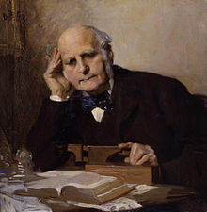
Regression
2.1 MSE(Mean Squared Error)
Regression - 회귀
"Regression toward the mean"
Sir Francis Galton
(1822 ~ 1911)

Slide 22
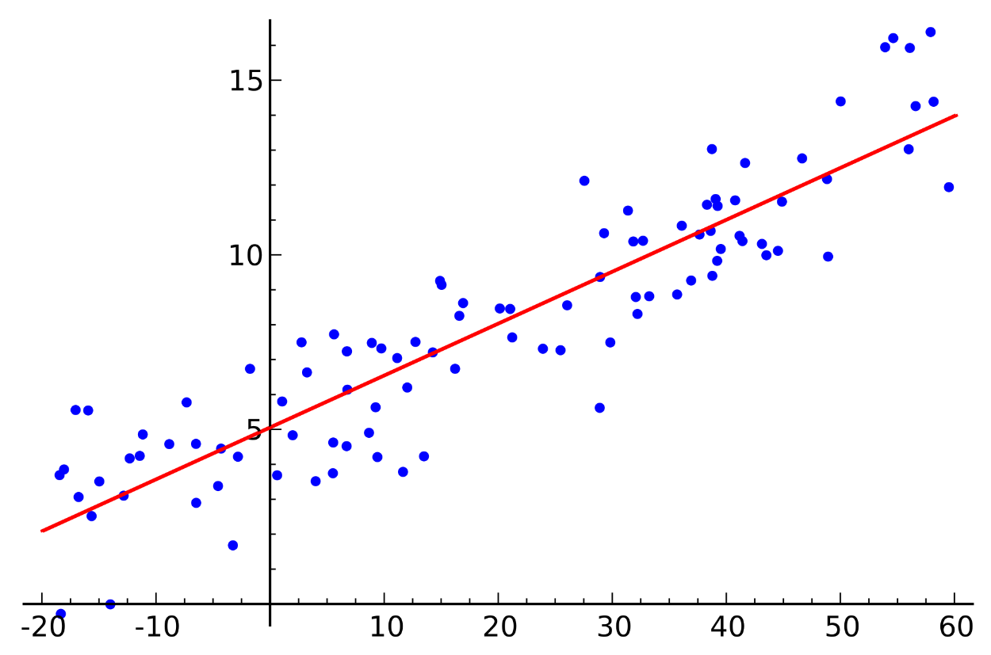
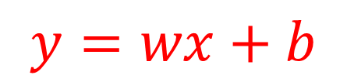
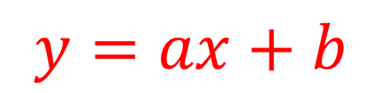
Regression
2.1 MSE(Mean Squared Error)
Linear Regression - 선형 회귀
$$y=ax+b$$
$$y=wx+b$$
https://en.wikipedia.org/wiki/Linear_regression

Slide 23

Cost function
2.1 MSE(Mean Squared Error)
hypothesis ?
Training Set
$$\hat{y}= wx + b$$
Learning Algorithm
y
집의
크기
hypothesis
예상
가격
x

Slide 24
케라스로 구현한 선형 회귀
2.1 MSE(Mean Squared Error)
from keras.models import Sequential
from keras.layers import Dense
from keras import optimizers
import numpy as np
import matplotlib.pyplot as plt
X=np.array([1,2,3,4,5])
Y=np.array([1,2,3,4,5])
model=Sequential()
model.add(Dense(1, input_dim=1, activation='linear'))
sgd=optimizers.SGD(lr=0.01)
model.compile(optimizer=sgd ,loss='mse',metrics=['accuracy'])
model.fit(X,Y, batch_size=1, epochs=10, shuffle=False)
plt.plot(X, Y, 'bo')
plt.plot(X, model.predict(X), 'r-')
plt.show()

Slide 25
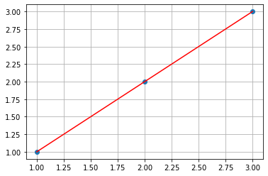
matplotlib 를 이용한 그래프 그리기
2.1 MSE(Mean Squared Error)
import numpy as np # numeriacal computing
import matplotlib.pyplot as plt # plotting core
x = np.array([1,2,3])
y = np.array([1,2,3])
plt.plot(x,y, 'o' )
plt.plot(x,y, 'r-' )
plt.grid(True)
plt.show()

Slide 26



Cost function
2.1 MSE(Mean Squared Error)
$$\hat{y}=wx+b$$
$$y$$
3
3
3
2
2
2
1
1
1
0
$$x$$
0
0
0
1
2
3
0
1
2
3
0
1
2
3
w = 0
b = 1.5
w = 0.5
b = 0
w = 0.5
b = 1

Slide 27
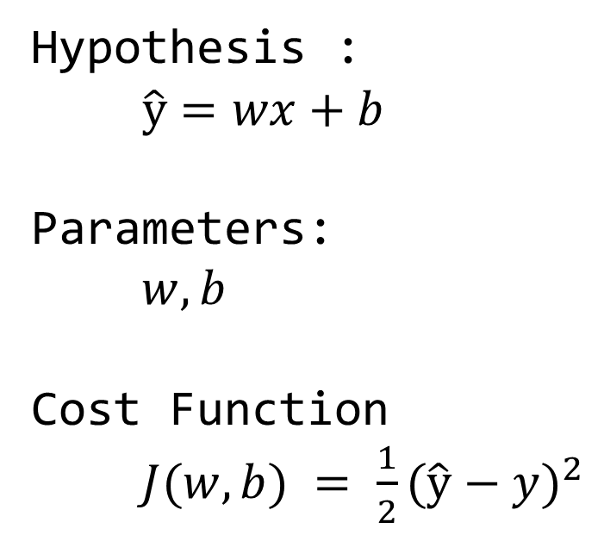
Cost function
2.1 MSE(Mean Squared Error)
Hypothesis :
$$\hat{y}=wx+b$$
Parameters:
$w, b$
Cost Function
$J(w,b) = {\frac{1}{2}(\hat{y}−y)}^{2}$

Slide 28

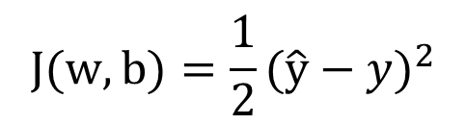
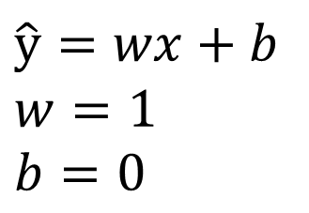
Cost function
2.1 MSE(Mean Squared Error)
$$\hat{y}=wx+b$$
$$w=1$$
$$b=0$$
$$J(w,b)={\frac{1}{2}\text{(}\hat{y}−y)}^{2}$$
3
3
2
2
y
$$J$$
1
1
0
0
0
1
2
3
0
1
2
3
x
w

Slide 29
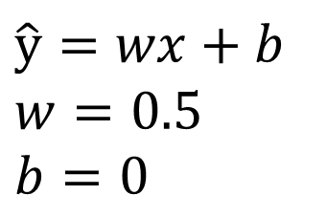
Cost function
2.1 MSE(Mean Squared Error)
$$\hat{y}=wx+b$$
$$w=0.5$$
$$b=0$$
$$J(w,b)={\frac{1}{2}\text{(}\hat{y}−y)}^{2}$$
3
3
2
2
y
$$J$$
1
1
0
0
0
1
2
3
0
1
2
3
x
w

Slide 30
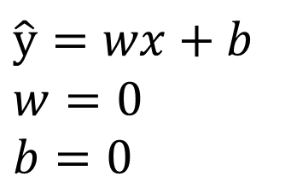
Cost function
2.1 MSE(Mean Squared Error)
$$\hat{y}=wx+b$$
$$w=0$$
$$b=0$$
$$J(w,b)={\frac{1}{2}\text{(}\hat{y}−y)}^{2}$$
3
3
2
2
y
$$J$$
1
1
0
0
0
1
2
3
0
1
2
3
x
w

Slide 31
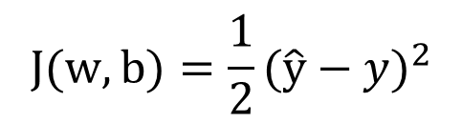
Cost function
2.1 MSE(Mean Squared Error)
$$\hat{y}=wx+b$$
$$w=0$$
$$b=0$$
$$J(w,b)={\frac{1}{2}\text{(}\hat{y}−y)}^{2}$$
3
3
2
2
y
$$J$$
1
1
0
0
0
1
2
3
0
1
2
3
x
w

Slide 32
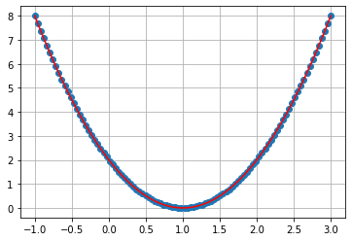
Cost function
2.1 MSE(Mean Squared Error)
J
w

Slide 33
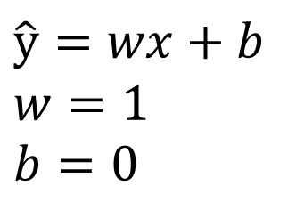
Cost function
2.1 MSE(Mean Squared Error)
$$\hat{y}=wx+b$$
$$w=1$$
$$b=0$$
$$J(w,b)={\frac{1}{2}\text{(}\hat{y}−y)}^{2}$$
3
3
2
2
y
$$J$$
1
1
0
0
0
1
2
3
0
1
2
3
x
b

Slide 34

Cost function
2.1 MSE(Mean Squared Error)
$$\hat{y}=wx+b$$
$$w=1$$
$$b=0.5$$
$$J(w,b)={\frac{1}{2}\text{(}\hat{y}−y)}^{2}$$
3
3
2
2
y
$$J$$
1
1
0
0
0
1
2
3
0
1
2
3
x
b

Slide 35

Cost function
2.1 MSE(Mean Squared Error)
$$\hat{y}=wx+b$$
$$w=1$$
$$b=1$$
$$J(w,b)={\frac{1}{2}\text{(}\hat{y}−y)}^{2}$$
3
3
2
2
y
$$J$$
1
1
0
0
0
1
2
3
0
1
2
3
x
b

Slide 36

Cost function
2.1 MSE(Mean Squared Error)
$$\hat{y}=wx+b$$
$$w=1$$
$$b=2$$
$$J(w,b)={\frac{1}{2}\text{(}\hat{y}−y)}^{2}$$
3
3
2
2
y
$$J$$
1
1
0
0
0
1
2
3
0
1
2
3
x
b

Slide 37

Cost function
2.1 MSE(Mean Squared Error)
$$\hat{y}=wx+b$$
$$w=1$$
$$b=2$$
$$J(w,b)={\frac{1}{2}\text{(}\hat{y}−y)}^{2}$$
3
3
2
2
y
$$J$$
1
1
0
0
0
1
2
3
0
1
2
3
x
b

Slide 38
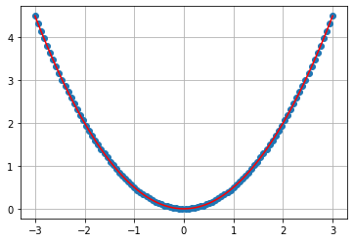
Cost function
2.1 MSE(Mean Squared Error)
J
b

Slide 39
2. 딥러닝을 위한 수학
2.1 MSE(Mean Squared Error)
2.2 SGD (Stochastic Gradient Descent)
2.3 역전파 구현
2.4 선형회귀 구현
2.5 시그모이드 함수
2.6 로지스틱 회귀 구현

Slide 40
Gradient descent algorithm
2.2 SGD (Stochastic Gradient Descent)
Gradient descent algorithm
비용 함수 최소화
경사 하강은 많은 최소화 문제에 사용된다.
주어진 비용 함수, 비용 (W, b)에 대해 비용을 최소화하기 위해 W, b를 찾는다.
일반적인 함수 : 비용 (w1, w2,…)에 적용 가능

Slide 41
Gradient descent algorithm
2.2 SGD (Stochastic Gradient Descent)
작동 방식
초기 추측으로 시작
0,0 (또는 다른 값)에서 시작
W와 b를 약간 변경하여 cost(W, b)의 비용을 줄이려고 노력
매개 변수를 변경할 때마다 가능한 가장 낮은 cost(W, b)을 감소시키는 기울기를 선택
반복
최소한의 지역으로 수렴 할 때까지 수행

Slide 42
Gradient descent algorithm
2.2 SGD (Stochastic Gradient Descent)
Gradient descent algorithm
w = w - G
Initial Weight
Gradient
Increment Step
J
Minimum cost
w

Slide 43
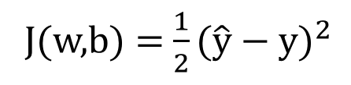
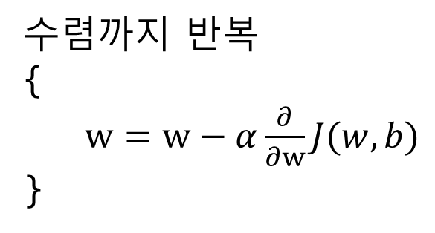
Gradient descent algorithm
2.2 SGD (Stochastic Gradient Descent)
수렴까지 반복
{
$w=w−α\frac{∂}{∂w}J(w,b)$
}
learning
rate
derivative
J
J(w,b) = ${\frac{1}{2}\text{(}\hat{y} \text{− }\text{y}\text{)}}^{2}$
w
$\frac{∂}{∂w}J(w,b)$는 ${\frac{1}{2}\text{(}\hat{y} \text{− }\text{y}\text{)}}^{2}$ 을 w에 대해서 편미분 하면 된다.

Slide 44
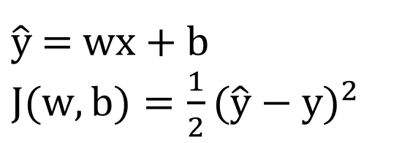
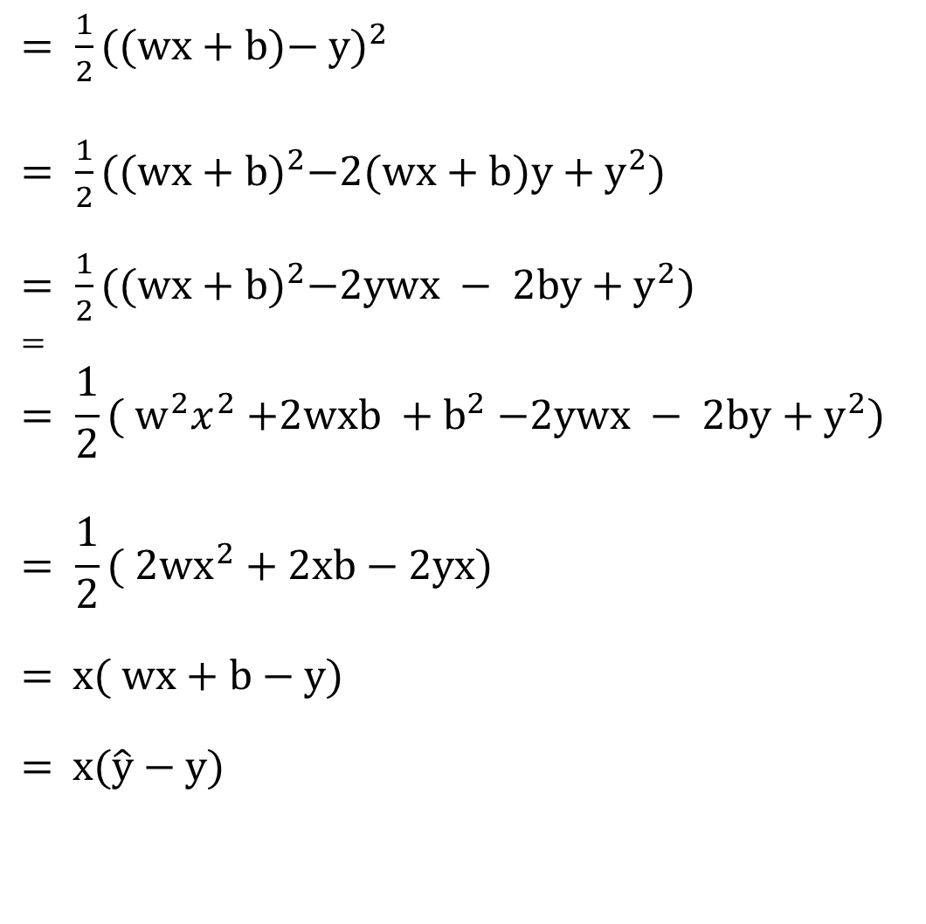
Gradient descent algorithm
2.2 SGD (Stochastic Gradient Descent)
$= {\frac{1}{2}\text{(}(wx+b)\text{− }\text{y}\text{)}}^{2 }$
$= {\frac{1}{2}\text{(}{(wx+b)}^{2}\text{−}2(wx+b)\text{y}+y^{2}\text{)}}^{ }$
$= {\frac{1}{2}\text{(}{(wx+b)}^{2}\text{−}2ywx − 2b\text{y}+y^{2}\text{)}}^{ }$
=
$$= {\frac{1}{2}\text{(} w^{2}x^{2}{+2wxb +b}^{2}\text{−}2ywx − 2b\text{y}+y^{2}\text{)}}^{ }$$
$$= {\frac{1}{2}\text{( }2wx^{2}+2xb \text{−} 2yx\text{)}}^{ }$$
$= { x\text{( }wx+b \text{−} y\text{)}}^{ }$x
$= { x\text{(}\hat{y} \text{− }y\text{)}}^{ }$y" = −(y − y ̂)
$\hat{y}$ = wx + b
$J(w,b)={\frac{1}{2}\text{(}\hat{y} \text{− }\text{y}\text{)}}^{2 }$

Slide 45
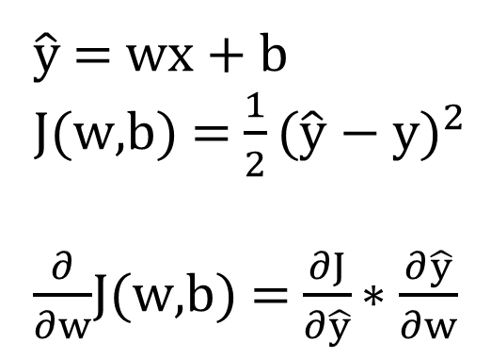
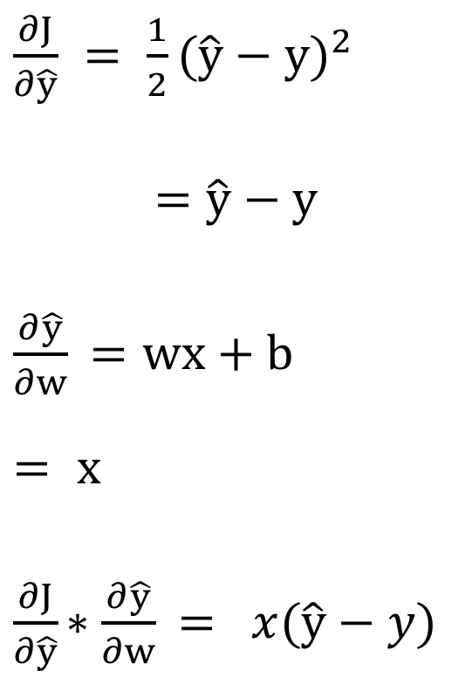
Gradient descent algorithm
2.2 SGD (Stochastic Gradient Descent)
$\frac{∂J}{∂\hat{y}} = {\frac{1}{2}\text{(}\hat{y} \text{− }\text{y}\text{)}}^{2 }$
$$=\hat{y}\text{ − }\text{y}$$
$\frac{∂\hat{y}}{∂w}$ $=\text{wx}\text{ + }\text{b}$
$$= x$$
$\frac{∂J}{∂\hat{y}}$ $∗\frac{∂\hat{y}}{∂w}$ $= ^{ }x(\hat{y}−y)\text{x}$
Chain Rule 사용
$\hat{y}$ = wx + b
J(w,b) = ${\frac{1}{2}\text{(}\hat{y} \text{− }\text{y}\text{)}}^{2 }$
$\frac{∂}{∂w}$J(w,b) = $\frac{∂J}{∂\hat{y}}$ $∗\frac{∂\hat{y}}{∂w}$

Slide 46
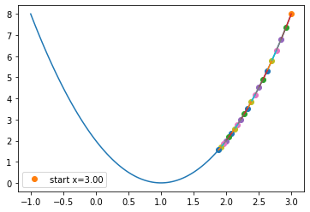
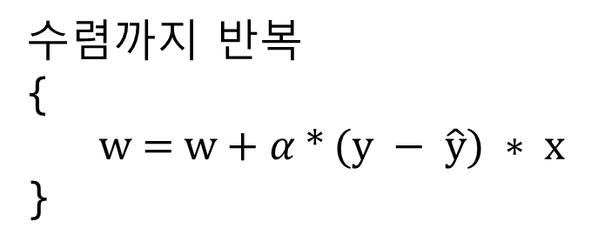

Gradient descent algorithm
2.2 SGD (Stochastic Gradient Descent)
수렴까지 반복
{
w = w + $α$ * $(y − \hat{y}) ∗ x\text{x}$
}
J
$$α$$
가 0.01인 경우
w

Slide 47
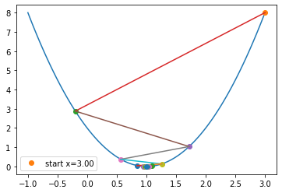
Gradient descent algorithm
2.2 SGD (Stochastic Gradient Descent)
수렴까지 반복
{
w = w + $α$ * $(y − \hat{y}) ∗ x\text{x}$
}
J
$$α$$
가 𝟎.4인 경우
w

Slide 48
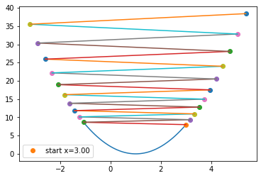
Gradient descent algorithm
2.2 SGD (Stochastic Gradient Descent)
수렴까지 반복
{
w = w + $α$ * $(y − \hat{y}) ∗ x\text{x}$
}
J
$$α$$
가 0.51인 경우
w

Slide 49
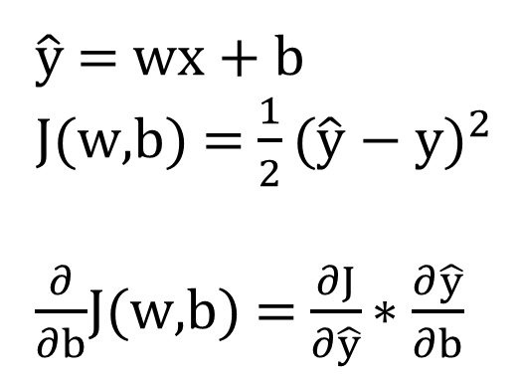
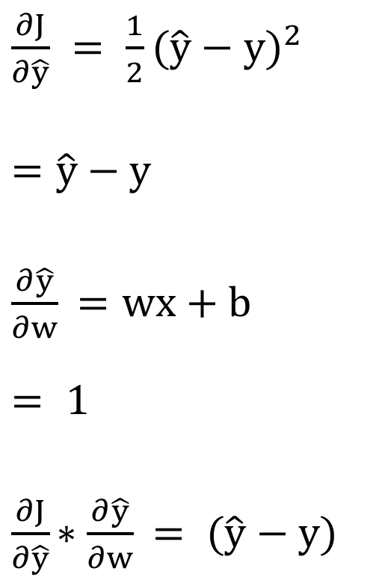
Gradient descent algorithm
2.2 SGD (Stochastic Gradient Descent)
$\frac{∂J}{∂\hat{y}} = {\frac{1}{2}\text{(}\hat{y} \text{− }\text{y}\text{)}}^{2 }$
$$=\hat{y}\text{ − }\text{y}$$
$\frac{∂\hat{y}}{∂w}$ $=\text{wx}\text{ + }\text{b}$
$$= 1$$
$\frac{∂J}{∂\hat{y}}$ $∗\frac{∂\hat{y}}{∂w}$ $={ \text{(}\hat{y}\text{ − }y\text{)}}^{ }\text{x}$
Chain Rule 사용
$\hat{y}$ = wx + b
J(w,b) = ${\frac{1}{2}\text{(}\hat{y} \text{− }\text{y}\text{)}}^{2 }$
$\frac{∂}{∂b}$J(w,b) = $\frac{∂J}{∂\hat{y}}$ $∗\frac{∂\hat{y}}{∂b}$

Slide 50
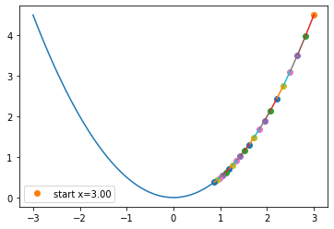

Gradient descent algorithm
2.2 SGD (Stochastic Gradient Descent)
수렴까지 반복
{
w = w + $α$ * $(y − \hat{y}) \text{x}$
}
J
$$α$$
가 𝟎.𝟎𝟑인 경우
b

Slide 51
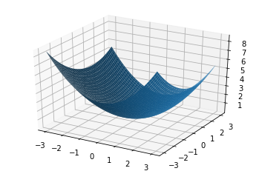
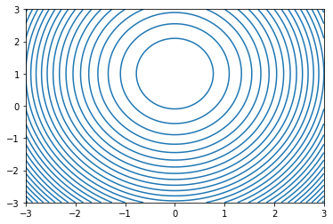
Gradient descent algorithm
2.2 SGD (Stochastic Gradient Descent)
J
J
b
w
w
j
w
b
b

Slide 52
2. 딥러닝을 위한 수학
2.1 MSE(Mean Squared Error)
2.2 SGD (Stochastic Gradient Descent)
2.3 역전파 구현
2.4 선형회귀 구현
2.5 시그모이드 함수
2.6 로지스틱 회귀 구현

Slide 53
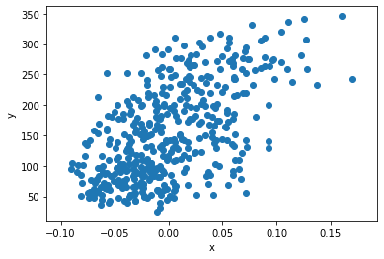
Data Set 이용
2.3 역전파 구현
data set 준비(sklearn 이용)
from sklearn.datasets import load_diabetes
diabetes = load_diabetes()
import matplotlib.pyplot as plt
x = diabetes.data[:, 2]
y = diabetes.target
plt.scatter(x, y)
plt.xlabel('x')
plt.ylabel('y')
plt.show()

Slide 54
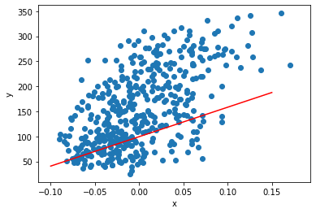
역전파 구현 I
2.3 역전파 구현
역전파 구현
1. batch=1
2. 점의 전체 개수만큼 1번 순회 (epoch=1)
: SGD=>원소 하나마다 w,b 갱신
w = 1.0
b = 1.0
for x_i, y_i in zip(x, y):
y_hat = x_i * w + b
err = y_i - y_hat
w_rate = x_i
w = w + w_rate * err
b = b + 1 * err
plt.scatter(x, y)
pt1 = (-0.1, -0.1 * w + b)
pt2 = (0.15, 0.15 * w + b)
plt.plot([pt1[0], pt2[0]], [pt1[1], pt2[1]], 'r-')
plt.xlabel('x')
plt.ylabel('y')
plt.show()

Slide 55
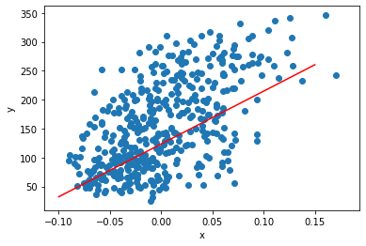
역전파 구현 II
2.3 역전파 구현
역전파 구현
1. batch=1
2. epoch=100번 만큼 외부 루프에서 순회
3. 점의 전체 개수만큼 1번 순회
: SGD=>원소 하나마다 w,b 갱신
for i in range(1, 100):
for x_i, y_i in zip(x, y):
y_hat = x_i * w + b
err = y_i - y_hat
w_rate = x_i
w = w + w_rate * err
b = b + 1 * err
plt.scatter(x, y)
pt1 = (-0.1, -0.1 * w + b)
pt2 = (0.15, 0.15 * w + b)
plt.plot([pt1[0], pt2[0]], [pt1[1], pt2[1]], 'r-')
plt.xlabel('x')
plt.ylabel('y')
plt.show()

Slide 56
2. 딥러닝을 위한 수학
2.1 MSE(Mean Squared Error)
2.2 SGD (Stochastic Gradient Descent)
2.3 역전파 구현
2.4 선형회귀 구현
2.5 시그모이드 함수
2.6 로지스틱 회귀 구현

Slide 57
Neuron class
2.4 선형회귀 구현
Neuron class 만들기
class Neuron:
def __init__(self):
# 초기화 작업을 수행합니다.
...
# 필요한 함수를 추가합니다.
...
1. __init__() 함수 만들기
def __init__(self):
self.w = 1.0
self.b = 1.0

Slide 58





Neuron class
2.4 선형회귀 구현
2. 정방향 계산 만들기
def forpass(self, x):
y_hat = x * self.w + self.b # 직선 방정식을 계산합니다
return y_hat
$$w$$
Neuron
$$x$$
*
$$\hat{y}$$
+
정방향 계산
$$b$$
$$\hat{y}=wx+b$$

Slide 59
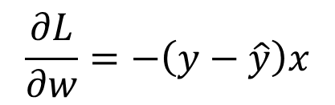








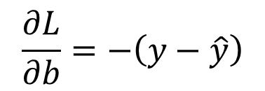
Neuron class
2.4 선형회귀 구현
3. 역방향 계산 만들기
def backprop(self, x, err):
w_grad = x * err # 가중치에 대한 그래디언트를 계산합니다
b_grad = 1 * err # 절편에 대한 그래디언트를 계산합니다
return w_grad, b_grad
$$\frac{∂L}{∂w}=−\left(y−\hat{y}\right)x$$
$$w$$
가중치 업데이트($\frac{∂L}{∂w}=−\left(y−\hat{y}\right)x$)
Neuron
역방향 계산($−(\hat{y}−y)$)
$$x$$
*
$$\hat{y}$$
$$\frac{∂L}{∂b}=−\left(y−\hat{y}\right)$$
+
정방향 계산($\hat{y}=wx+b$)
$$b$$
절편 업데이트($\frac{∂L}{∂b}=−\left(y−\hat{y}\right)$)

Slide 60
Neuron class
2.4 선형회귀 구현
4. 훈련을 위한 fit() 함수 구현
def fit(self, x, y, epochs=100):
for i in range(epochs): # 에포크만큼 반복합니다
for x_i, y_i in zip(x, y): # 모든 샘플에 대해 반복합니다
y_hat = self.forpass(x_i) # 정방향 계산
err = y_i - y_hat # 오차 계산
w_grad, b_grad = self.backprop(x_i, err) # 역방향 계산
self.w += w_grad # 가중치 업데이트
self.b += b_grad # 절편 업데이트
5. 모델 훈련하기
neuron = Neuron()
neuron.fit(x, y)

Slide 61
Neuron class
2.4 선형회귀 구현
6. 학습이 완료된 모델의 가중치와 절편 확인
plt.scatter(x, y)
pt1 = (-0.1, -0.1 * neuron.w + neuron.b)
pt2 = (0.15, 0.15 * neuron.w + neuron.b)
plt.plot([pt1[0], pt2[0]], [pt1[1], pt2[1]],'r')
plt.xlabel('x')
plt.ylabel('y')
plt.show()

