Slide 1
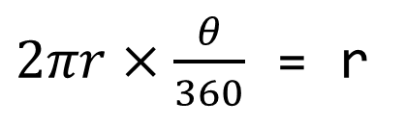

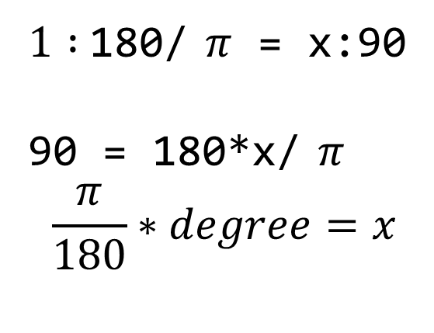
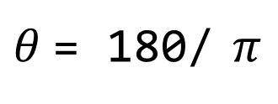
import numpy as np
t = np.arange(0,12,0.01)
# print(len(t))
y = np.sin(t)
r
𝜃 = 57.295779513082320876798154814105
$$θ$$
r
$1 :$180/ $π$ = x:90
90 = 180*x/ $π$
$$\frac{π}{180}∗degree=x$$
$2πr×\frac{θ}{360}$ = r
$θ$= 180/ $π$

Slide 2
plt.figure(figsize=(10,6))
plt.subplot(221)
plt.subplot(222)
plt.subplot(223)
plt.subplot(224)
#plt.subplot(212)
plt.show()
1
2
3
4

Slide 3
10
plt.figure(figsize=(10,6))
plt.subplot(221)
plt.subplot(222)
plt.subplot(211)
plt.show()
1
2
3
1
2
3

Slide 4
10
plt.figure(figsize=(10,6))
plt.subplot(411)
plt.subplot(423)
plt.subplot(424)
plt.subplot(413)
plt.subplot(414)
plt.show()

Slide 5
gu_name = []
for name in station_addreess:
tmp = name.split()
tmp_gu = [gu for gu in tmp if gu[-1] == '구'][0]
gu_name.append(tmp_gu)
crime_anal_police['구별'] = gu_name
crime_anal_police.head()
name = '대한민국 서울특별시 중구 을지로동 수표로 27'
tmp = ['대한민국','서울특별시','중구','을지로동','수표로','27']
gu = '중구'
['중구'][0]
'중구'
gu_name = ['중구',...]

Slide 6
def MinMaxScaler( data ):
min = data.min
max = data.max
for i in range(len(data)):
data[i] = (data[i]-min)/(max-min)
max = 3850
min = 1063
(2366- 1063)/(3850- 1063)

